Slide 1
Chapter 19
Criminal Activities of Gangs
and Other Dangerous Groups

Slide 2
Introduction
Actual events reflecting reality of gangs, hate crime, and ritualistic crimes in the United States
  Minneapolis
  Jasper, Texas
  Wisconsin
  Rancho Santa Fe, California
  Tavares, Florida

Slide 3
Threat of Gangs: An Overview
INTEREST AND CONCERN
  Existed for most of the country’s history
  Belonging to a gang is not illegal
  Many activities that gangs engage in are illegal
  Gangs now exist in almost every community

Slide 4
Gangs Defined
COMMON DEFINITION
  Group of individuals
  Recognized name and symbol
  Form an allegiance for a common purpose
  Engage in continuous unlawful activity
  Many states have their own definitions

Slide 5
Extent of Gangs
SCOPE OF GANGS
  Number of gangs and gang members has remained relatively stable
  Serious concern for law enforcement
  Gang violence has become increasingly lethal
  Gang migration
    Not restricted to metropolitan areas

Slide 6
Why People Join Gangs
REASONS
  Provide protection to youth from violent peers
  Sense of acceptance
  Way to obtain money, power, and drugs
  Come from a gang-involved family
  Lack of parental attachment

Slide 7
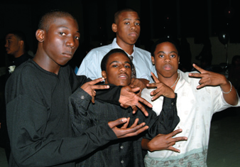
Types of Gangs
CATEGORIES AND THEIR PRESENCE
  Outlaw motorcycle gangs (OMGs)
  Gangs members in the military
  Female gang members
  Street gangs
  Prison gangs
Notes:
Learning Objective:
List the types of gangs identified by the National Gang Intelligence Center.
The National Gang Intelligence Center has identified three general types of gangs: street gangs, prison gangs and outlaw motorcycle gangs (OMGs).
---
Gang members flash their signs.
Carter, T. / PhotoEdit

Slide 8
Gang Culture, Membership, and Organization
AFFILIATION
  Symbols
    Clothing
    Hand signals
  Turf and graffiti
  Tattoos

Slide 9
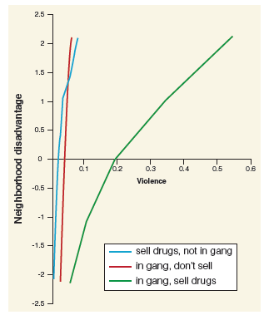
Gang Activities
ADDITIONAL ACTIVITIES
  Engage in antisocial or criminal behavior
  Wide variety of illegal activities
  Gangs and crime
  Gangs and drugs
  Gangs and violence
Notes:
Learning Objective:
Identify the types of crimes gangs typically engage in.
In addition to drug dealing, gang members often engage in vandalism, arson, auto theft, shoplifting, shootings, stabbings, intimidation and other forms of violence.
---
Figure 19.2 Simple slope of gang membership and drug selling on violence by neighborhood disadvantage.
Source: Bellair, P. E., & McNulty, T. L. (2009, December). Gang membership, drug selling, and violence in neighborhood context. Justice Quarterly, 26(4), 661.
© Academy of Criminal Justice Sciences, reprinted by permission of Taylor & Francis Ltd, www.tandfonline.com on behalf of Academy of Criminal Justice Sciences.

Slide 10
Recognizing a Gang Problem
ACKNOWLEDGMENT
  Graffiti
  Obvious colors of clothing
  Tattoos
  Initiations
  Hand signals or handshakes
  Uncommon terms or phrases
Notes:
Learning Objective:
Outline the first step in dealing with a gang problem.
The first step in dealing with a gang problem is to recognize it.

Slide 11
Identifying Gang Members
CRITERIA
  Names
  Symbols (clothing and tattoos)
  Communication styles
  Graffiti
  Sign language
Notes:
Learning Objective:
Understand the criteria or characteristics used to identify gang members.
Gang members may be identified by their names, symbols (clothing and tattoos) and communication styles, including graffiti and sign language.

Slide 12
Records to Keep
FILES TO KEEP ON RECORD
  Gangs
  Gang members
  Monikers
  Photographs
  Vehicles and illegal activities
  Be able to cross-reference the records
Notes:
Learning Objective:
Describe the types of records to keep on gangs.
Maintain records on gangs, gang members, monikers, photographs, vehicles and illegal activities. Cross-reference the records.

Slide 13
Investigating Illegal Gang Activity
CHALLENGES
  Multitude of suspects
  Unreliability of witnesses
  Fear of witnesses
  Reading and responding to graffiti
    Documenting graffiti
Notes:
Learning Objective:
Explain the special challenges that may be involved in investigating illegal activities of gangs.
Special challenges in investigating the illegal activities of gangs include the multitude of suspects, the potential mobility of the members,
and the unreliability or fear of witnesses.

Slide 14
Approaches to the Gang Problem
STRATEGIES
  Three-pronged strategy
    Prevention
    Intervention
    Suppression
  Civil gang injunctions (CGIs) and ordinances
    Legal tools used with urban gangs
Notes:
Learning Objective:
Summarize what strategies have been used to combat a gang problem.
A three-pronged approach to address the gang problem uses a balance of prevention, intervention and suppression strategies.

Slide 15
Collaborative Efforts: Gang Task Forces
COLLABORATION
  Enhances efforts to cope with the gang problem
  Partnerships with the community
  Parents and schools
  OJJDP’s Comprehensive Gang Model

Slide 16
Prosecuting Gang-Related Crimes
TACTICS
  Defense strategies
    Diminished capacity
    Self-defense
  Prosecution
    Apply federal charges
    No parole offered
Notes:
Learning Objective:
Explain what two defense strategies are commonly used by gang members’ lawyers in court.
The two most often used defense strategies are pleas of diminished capacity and self-defense.

Slide 17
Federal Efforts to Combat the Gang Problem
RESOURCES
  National Gang Intelligence Center (NGIC)
  National Gang Targeting, Enforcement, and Coordination Center (GangTECC)
  National Youth Gang Center (NYGC)
  GANGINFO

Slide 18
Bias and Hate Crime: An Overview
COMPLEX SUBJECT
  Divided into two categories
    Rational and irrational
  Bias or hate crime
    Due to someone’s actual or perceived
    membership in a particular group

Slide 19
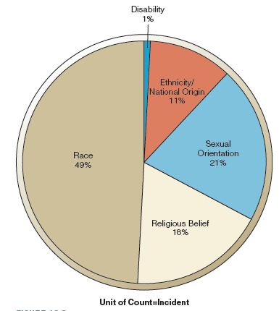
Motivation for Hate Crime
REASONS
  Motivated by bigotry
  Hatred against a specific group of people
  Race is usually the primary motivation
  African Americans are most often the victims
Notes:
Learning Objective:
Recognize what the primary motivation for bias or hate crimes is and who is most frequently targeted.
Bias or hate crimes are motivated by bigotry and hatred against a specific group of people. Race is usually the primary motivation for hate crimes, and African Americans are most often the victims.
---
Figure 19.3
Source: Adapted from Federal Bureau of Investigation. (2013). Hate crime statistics, 2013. Washington, DC: Author. Retrieved May 30, 2015, from http://www.fbi.gov/about-us/cjis/ucr/hate-crime/2013/topic-pages/incidents-and-offenses/incidentsandoffenses_final.

Slide 20
Hate Groups
MAIN GROUPS
  Skinheads
  Christian identity groups
  Ku Klux Klan (KKK)
  Black separatists
  White supremacists
  Neo-Nazis

Slide 21
The Police Response
OVERVIEW
  Respond promptly
  Reduce the victims’ fears
  Determine the exact type of prejudice involved
  Determine if hate or bias motivated
  Always provide follow-up information

Slide 22
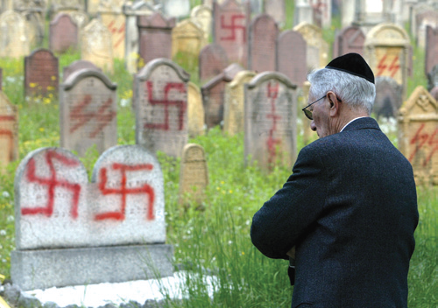
Efforts to Combat Bias and Hate Crimes
ENDEAVORS
  Celebrating diversity
  Legislation
    Enhanced penalties
    Criminal penalties for vandalism
    of religious institutions
    Collection of data
Notes:
Graves scribbled with swastikas and other anti-Semitic graffiti in a Jewish cemetery. One of the results of increased awareness of hate crimes is the creation of laws that exact higher penalties from convicted hate-crime offenders.
© Kessler, V./Reuters/CORBIS

Slide 23
Ritualistic Crime: An Overview
CULT GROUPS
  Refers to those who practice such beliefs
  System of religious beliefs and rituals
  Less negative term is new religious movement (NRM)
  NRMs normally have a charismatic leader
  Leaders use fear and mysticism

Slide 24
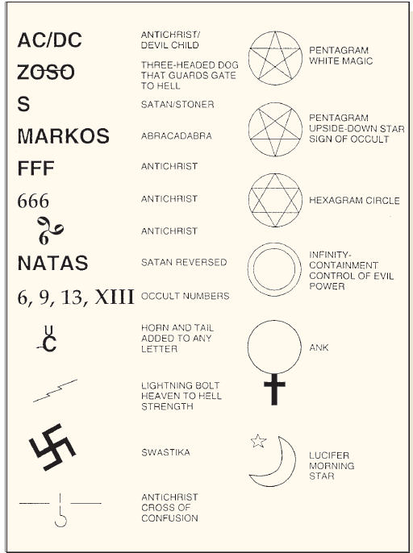
Terminology and Symbols of Cults
COMMON TERMS
  Antichrist and Beelzebub
  Coven and hand of glory
  Incantation and magick
  Occult and ritual
  Sabbat
Notes:
Figure 19.5 Common satanic and occult symbols.

Slide 25
Nature of Ritualistic Crimes
OVERVIEW
  Unlawful act committed within the context of a ceremony
  Three levels of activity
    Dabbling
    Serious involvement
    Criminal involvement
Notes:
Learning Objective:
Define what a ritualistic crime is and identify what to investigate.
A ritualistic crime is an unlawful act committed within the context of a ceremony. Investigate the crime, not the belief system.

Slide 26
Who Commits Ritualistic Crime?
PROFILE
  Creative
  Imaginative
  Curious
  Daring
  Intelligent and well educated
  Frequently underachievers

Slide 27

Investigating Ritualistic Crimes
OVERVIEW
  Signs of cult-related activity
  Indicators of ritualistic crimes
  Investigating animal deaths
  Investigating homicides
  Investigating satanic serial killings
  Investigating youth suicides
Notes:
Learning Objective:
List the indicators of ritualistic crimes.
Indicators that criminal activity may be cult related include symbols, candles, makeshift altars, bones, cult-related books, swords, daggers and chalices.
---
Scott Dyleski, 16 at the time of this photo, appears behind a protective glass barrier in Judge David Flinn’s courtroom in Martinez, California, Thursday, October 27, 2005. Dyleski was convicted of first-degree murder as an adult in the death of Pamela Vitale, the wife of prominent defense attorney and television commentator Daniel Horowitz. The 16-year-old suspect was reported to have been involved in some kind of self-styled Satanism, including the reading of Anton LeVey’s Satanic Bible and use of occult symbols at the crime scene. Vitale was killed on October 15, 2005, having been hit 39 times with a piece of crown molding and stabbed in the abdomen. A Lorraine Cross (a cross with two horizontal lines, the lower one larger than the upper one, which is associated with Satanism and suggests fire and brimstone) was carved into her back.
Dyleski was a juvenile at the time of the murder and, as such, was not eligible for the death penalty. Shortly after his 18th birthday on October 30, 2006, he was transferred from the juvenile facility where he was being held to a state prison, where he will serve his sentence of life without parole.
© AP Images/Larson, B.

Slide 28
Special Challenges in
Ritualistic Crime Investigations
DIFFICULTIES
  Separating the belief system from the illegal acts
  Sensationalism
  Abnormal personalities
  Less than credible testimony to some
  Appearance not normal
Notes:
Learning Objective:
Identify what special challenges are involved in investigating ritualistic crimes.
Special challenges involved in investigating ritualistic or cult-related crimes include separating the belief system from the illegal acts, the sensationalism that frequently accompanies such crimes and the “abnormal” personalities of some victims and suspects.

Slide 29
Summary
Belonging to a gang is not illegal in this country
Activities of gang members frequently are illegal
Investigating bias or hate crimes and ritualistic crimes is challenging
Ritualistic crimes are often associated with the occult
Investigate the crime—not the belief system

