Slide 1
Chapter 20
Terrorism and Homeland Security

Slide 2
Introduction
The Justice Department’s top priority is to support law enforcement and intelligence agencies in the fight against terrorism
After 9/11, our country entered a new era of policing
For cops, crime fighting and counterterrorism go hand in hand

Slide 3
Terrorism: An Overview
TERRORISM DEFINED
  Systematic physical violence
  Actual or threatened
  Against noncombatants
  Create a climate of fear
  Cause some religious, political, or social change
Notes:
Learning Objective:
Identify what most definitions of terrorism have in common.
Most definitions of terrorism have common elements, including involving acts dangerous to human life that violate federal or state law and are intended to intimidate or coerce a civilian population, or to influence the policy or affect the conduct of a government.

Slide 4
Terrorism: An Overview (continued)
MOTIVATIONS FOR TERRORISM
  Dissatisfaction
    Religious, political, or social system, or policy
  Inability to effect change through acceptable, nonviolent means
Notes:
Learning Objective:
Understand the motivations for terrorist attacks.
Most terrorist acts result from dissatisfaction with a religious, political, or social system or policy and frustration resulting from an inability to change it through acceptable, nonviolent means.

Slide 5
Classification of Terrorist Acts
DOMESTIC TERRORISM
  Based and operating entirely within the United States
  Without foreign direction
  Committed against persons or property
  To intimidate or coerce a government
  Civilian population or any segment thereof

Slide 6
International Terrorism
ISLAMIC TERRORIST GROUPS
  Hezbollah
  HAMAS
  Palestinian Islamic Jihad (PIJ)
  The al-Aqsa Martyrs’ Brigades
  al-Qaeda
  ISIL/ISIS
Notes:
Learning Objective:
List the groups commonly identified as Islamic terrorist organizations.
Islamic terrorist groups include Hizballah, HAMAS, Palestinian Islamic Jihad (PIJ), the al-Aqsa Martyrs Brigades, core al-Qa’ida groups and their affiliates,
and ISIL.

Slide 7
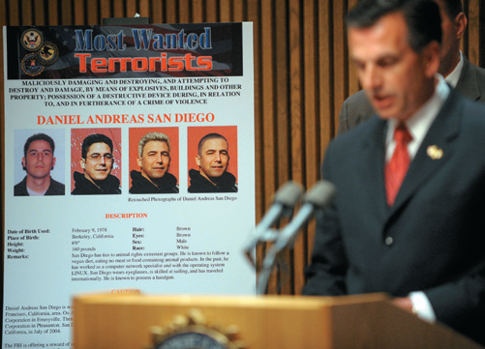
Domestic Terrorist Groups in the United States
LEFT AND RIGHT
  White and Black supremacists
  Militia groups
  Other right-wing extremists
  Left-wing extremists
  Pro-life extremists
  Animal rights and environmental extremists
  HVEs
Notes:
Learning Objective:
Recognize the domestic terrorist groups that exist in the United States.
Domestic terrorist groups within the United States
include White supremacists, Black supremacists, militia groups, other right-wing extremists, leftwing extremists, pro-life extremists, animal rights
extremists, and environmental extremists. HVEs are also sometimes categorized as domestic terrorists.
---
Daniel Andreas San Diego is wanted for his alleged involvement in two bombings in the San Francisco, California, area. On August 28, 2003, two bombs exploded approximately one hour apart on the campus of a biotechnology corporation in Emeryville. Then, on September 26, 2003, one bomb strapped with nails exploded at a nutritional products corporation in Pleasanton. San Diego was indicted in the United States District Court, Northern District of California, in July of 2004.
Ngan, M./Getty Images

Slide 8
Terrorists as Criminals
NONTRADITIONAL
  Different motivations
  Different objectives
  Much deadlier weapons
  Seek to cause wide-scale damage
  Inflict fear

Slide 9
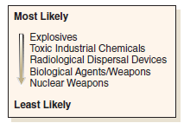
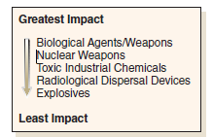
Methods Used by Terrorists
OVERVIEW
  Weapons of mass destruction
    Biological, chemical, or
    nuclear agents
  Explosives and bombs
  Armed attack
  Arson
  Technology
Notes:
Figure 20.2 Terrorist threats from most likely to least likely.
Source: Reuland, M., & Davis, H. J. (2004, September). Protecting your community from terrorism: Strategies for local law enforcement, Vol. 3. Preparing for and responding to bioterrorism. Washington, DC: Community Oriented Policing Services Office and the Police Executive Research Forum, p. 7.
---
Figure 20.3 Level of impact by weapon used.
Source: Reuland, M., & Davis, H. J. (2004, September). Protecting your community from terrorism: Strategies for local law enforcement, Vol. 3. Preparing for and responding to bioterrorism. Washington, DC: Community Oriented Policing Services Office and the Police Executive Research Forum, p. 8. Reprinted by permission of the Police Executive Research Forum.

Slide 10
Methods Used by Terrorists
EXPLOSIVES AND BOMBS
  Suspicious packages
  Vehicle bombs
  Suicide bombers
  Police Executive Research Forum (PERF)
    Patrol-level response

Slide 11
Methods Used by Terrorists
WEAPONS OF MASS DESTRUCTION (WMDs)
  Biological agents
  Chemical agents
  Nuclear terrorism
  Detecting radiation and other bioterrorism agents
  WMD team

Slide 12
Methods Used by Terrorists
TECHNOLOGICAL TERRORISM
  Attacks on our technology
  Attacks by technology
  Energy drives our technology
  Cyberterrorism

Slide 13
Funding Terrorism
FINANCING
  Narcoterrorism
  Wealthy sympathizers
  MONEY LAUNDERING
  Hawala
  No tax record or paper trail

Slide 14
Federal Response to Terrorism
OVERVIEW
  Department of Homeland Security
  FBI
    Lead agency responding to acts of domestic terrorism
  FEMA
    Lead agency for consequence management (after an attack)
Notes:
Learning Objective:
Name the federal office that was established as a result of the 9/11 terrorist attacks on the United States.
The Department of Homeland Security was established as a result of 9/11, reorganizing the departments of the federal government.
Learning Objective:
Identify the two lead agencies in combating terrorism and how they are involved.
At the federal level, the FBI is the lead agency for responding to acts of domestic terrorism. The Federal Emergency Management Agency (FEMA) is the lead agency for consequence management (after an attack).

Slide 15
Federal Response to Terrorism
USA PATRIOT ACT
  Uses the tools already available
  Facilitates information sharing
  Updates the law
  Reflects new technologies and new threats
  Increases the penalties for those who commit or support terrorist crimes
Notes:
Learning Objective:
Explain how the USA PATRIOT Act enhances counterterrorism efforts by the United States.
The USA PATRIOT Act:
Allows investigators to use the tools already available to investigate organized crime and drug trafficking.
The USA PATRIOT Act significantly improved the nation’s counterterrorism efforts by:
Allowing investigators to use the tools already
available to investigate organized crime and
drug trafficking.
Facilitating information sharing and cooperation
among government agencies so they can better
“connect the dots.”
Updating the law to reflect new technologies
and new threats.
Increasing the penalties for those who commit
or support terrorist crimes.

Slide 16
Federal Response to Terrorism
NATIONAL INFRASTRUCTURE PROTECTION PLAN
  Comprehensive risk management framework
  FUSION CENTERS
  Collaborative effort
  Two or more agencies
  Exchange of critical information

Slide 17
Hometown Security and Homeland Security
FIVE KEY PRINCIPLES
  All terrorism is local
  Prevention is paramount
  Hometown security is homeland security
  Coordinate strategies nationally, not federally
  Bottom-up engineering is important
    State, tribal, and local public safety communities

Slide 18
Investigating Possible Terrorist Activities
TYPICAL STAGES IN A TERRORIST ATTACK
  Three-tiered model of al-Qaeda attacks by sleeper cells
    Attacking in conjunction with the group’s leaders
    Attacking on their own
    Individuals attacking with support from small cells

Slide 19
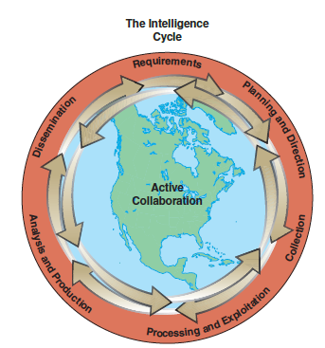
Information Gathering and Intelligence Sharing
INTELLIGENCE CYCLE
  Intelligence requirements
  Planning and direction
  Collecting raw information
  Processing and exploiting
  Analysis and production
  Dissemination
Notes:
Figure 20.6 The intelligence cycle.
Source: http://www.fbi.gov/about-us/intelligence/intelligence-cycle/

Slide 20
Crucial Collaborations and Partnerships
KEYS
  Number-one priority is communication
  Collaboration among local, state, and federal law enforcement agencies
  Key to combating terrorism lies with the local police
  Regional Information Sharing Systems (RISS) program

Slide 21
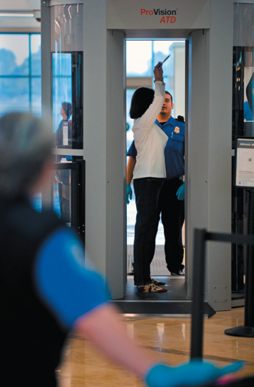
Initiatives to Assist in the
Fight against Terrorism
INITIATIVES
  Community Protection Act
    Off-duty and retired police officers
    Right to carry concealed firearms
  Increased border security
  National Memorial Institute for the Prevention of Terrorism
Notes:
Airports around the globe are installing full-body scanners in an attempt to improve passenger screening capabilities and airline security.
ZUMA Press, Inc / Alamy

Slide 22
Initiatives to Assist in the
Fight against Terrorism
INITIATIVES
  National Center for Food Protection and Defense
  National Incident Management System (NIMS)
    Standardized incident response
  Joint Terrorism Task Forces

Slide 23
Role of the Media in the War on Terrorism
SYMBIOTIC RELATIONSHIP
  Terrorism is futile without publicity
  Media generates much publicity
  Contagion effect
    Coverage of terrorism inspires more terrorism
    Contagious

Slide 24
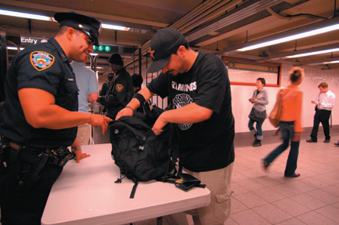
Concerns Related to the War on Terrorism
OVERVIEW
  Civil liberties
  Discrimination
  Victims of hate crimes
  Guiding principle of DHS
    Protect civil rights and
    civil liberties
Notes:
Learning Objective:
Describe two major concerns related to the war on terrorism.
Two pressing concerns related to the “war on terrorism” are that civil liberties may be jeopardized and that people of Middle Eastern descent may be discriminated against or become victims of hate crimes.
---
Under heightened security due to a terrorist threat, an NYPD police officer checks bags at Union Square subway station in New York.
Roberts, F./ Alamy

Slide 25
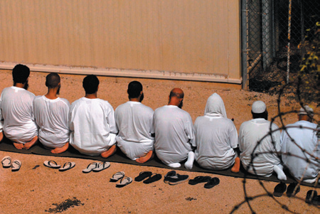
Concerns Related to the War on Terrorism
CONCERN FOR CIVIL RIGHTS
  Enhance security
  Maintain freedom
  RETALIATION OR
  DISCRIMINATION
  Lack of cultural awareness
  Language barriers
Notes:
Enemy combatants held as detainees observe morning prayer before sunrise inside Camp Delta November 19, 2009, in Guantanamo, Cuba. The detainees were captured in the wars in Iraq and Afghanistan.
DOD Photo / Alamy

Slide 26
Community Policing and Homeland Security
GUIDELINES
  Establish a liaison with DHS
  Formulate a policy statement
  Educate community members
  Emphasize the importance of reporting information
  Do not make assumptions about guilt

Slide 27
Summary
Threat of terrorism has become a reality in America
FBI classifies terrorist acts as either domestic or international
DHS was established as a result of 9/11
USA PATRIOT Act significantly improves the nation’s counterterrorism efforts
A difficult challenge is finding balance between enhancing security and the need to maintain freedom

