Slide 1
Chapter 21
Preparing for and Presenting Cases in Court

Slide 2
Introduction
A final report on the case must be written
Establishing the elements of the crime and proving the corpus delicti
Even the most experienced investigator may worry about having to testify
The most important rule to eradicate fear of testifying in court is to always tell the truth
Notes:
Learning Objective:
Identify what the most important rule is to eradicate fear of testifying in court.
The most important rule to eradicate fear of testifying in court is to always tell the truth.

Slide 3
The Final Report
CONTENTS
  The complaint
  The preliminary investigation report
  All follow-up, supplemental and progress reports
  Statements, admissions and confessions
Notes:
Learning Objective:
Do you know what to include in the final report?
The final report contains (1) the complaint; (2) the preliminary investigation report; (3) all follow-up, supplemental and progress reports; (4) statements, admissions and confessions; (5) laboratory reports; (6) photographs, sketches and drawings; and (7) a summary of all negative (exculpatory) evidence. The quality of the content and writing of the report influences its credibility.

Slide 4
The Final Report (Continued)
CONTENTS
  Laboratory reports
  Photographs, sketches and drawings
  Summary of all negative (exculpatory) evidence
  Quality of the content and writing of the report influences its credibility

Slide 5
The Final Report (Continued)
THE COMPLAINT
  Copy of the original complaint received
  THE PRELIMINARY INVESTIGATION REPORT
  Provides essential information
  Provides immediate and subsequent actions taken

Slide 6
The Final Report (Continued)
FOLLOW-UP REPORTS
  Chronological order
  Can be in the form of progress notes
  STATEMENTS, ADMISSIONS AND CONFESSIONS
  Statements of all witnesses interviewed
  All polygraphs or other examinations used

Slide 7
The Final Report (Continued)
LABORATORY REPORTS
  Assemble in one segment of the final report
  PHOTOGRAPHS, SKETCHES AND DRAWINGS
  Show conditions when officers arrived
  The available evidence

Slide 8
The Final Report (Continued)
SUMMARY OF NEGATIVE EVIDENCE
  All negative or exculpatory evidence
  Write the report clearly and accurately
  Logical sequence
  Convenient format

Slide 9
The Role of the Prosecutor
OVERVIEW
  Gatekeeper of the court system
  Determines which cases are prosecuted
  Central position in the criminal justice system
  Broad discretion
  Most powerful official in the court system
Notes:
Learning Objective:
Explain the relative importance of the prosecutor in the court system.
The prosecutor is the most powerful official in the court system.

Slide 10
The Role of the Prosecutor (continued)
REASONS FOR NOT GOING TO TRIAL
  Complaint is invalid
  Prosecutor declines after reviewing the case
  Complainant refuses to prosecute
  Offender dies
  Offender is in prison or out of the country and cannot be returned
  No evidence or leads exist
Notes:
Learning Objective:
Understand the reasons why some cases are not prosecuted.
Some cases are not prosecuted because:
The complaint is invalid.
The prosecutor declines after reviewing the case.
The complainant refuses to prosecute.
The offender dies.
The offender is in prison or out of the country and cannot be returned.
No evidence or leads exist.

Slide 11
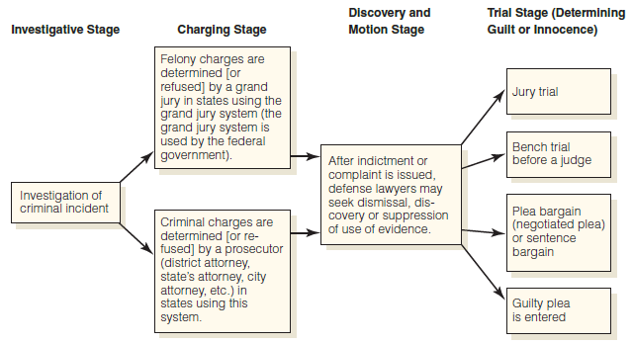
Preparing a Case for Prosecution
OVERVIEW
  Review evidence
  Evaluate evidence
  Review all reports
  Prepare witnesses
  Write final report
  Pretrial conference
Notes:
Learning Objective:
Outline the necessary steps to take to prepare a case for court.
To prepare a case for court,
Review and evaluate all evidence, including
exculpatory, and the chain of custody.
Review all reports on the case, including
transcripts of any depositions you have given.
Prepare witnesses.
Hold a pretrial conference with the prosecutor.
---
Figure 21.1 The use of evidence in the stages of the criminal justice process.
Source: From Gardner, T. J., & Anderson, T. M. (2010). Criminal evidence: principles and cases, 7th ed. Belmont, CA: Wadsworth Publishing Company, a part of Cengage Learning, Inc.

Slide 12
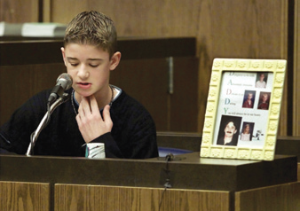
Preparing a Case for Prosecution (continued)
REVIEW AND EVALUATE EVIDENCE
  Concentrate on proving the elements of the crime
  Establish the offender’s identity
  REVIEW REPORTS
  Review written reports of everything
  Review your deposition
Notes:
Learning Objective:
Summarize what to concentrate on when reviewing a case.
Concentrate on proving the elements of the crime and establishing the offender’s identity.
---
An important step in preparing a case for prosecution is to reinterview witnesses to refresh their memories. Officers should read the witnesses’ previous statements to them and ask if this is the evidence they will present in court. This review helps alleviate fears witnesses have about testifying in court.
Victims and witnesses may also have the opportunity to speak to the court during the sentencing phase of a trial, should a conviction occur. Statements made during this stage are often emotionally charged and intended to provide the court with insight about the impact of the crime on the victim(s) or witness(es). Preparation is also important in making the most of these “statement of opinion” opportunities.
Brendan Costin, shown here speaking at the sentencing trial of Thomas Junta, the man found guilty of beating Brendan’s father to death at the boy’s hockey practice, is noticeably choked up as he states, “I can still remember being hysterical, trying to wake him up as the blood streamed down his face. Rushed to the hospital in the ambulance, my father had stopped breathing and had no pulse and his heart stopped beating. After two days in the hospital I realized I had just witnessed my dad literally getting beaten to death.”
The 6-foot-1, 270-pound Junta was convicted of involuntary manslaughter for beating 160-pound Michael Costin to death at a Reading, Massachusetts, ice rink in 2000, after Junta got angry over rough play on the ice. Junta testified that he struck Costin only in self-defense. Others said Junta was red-faced with rage. After hearing both sides, the judge determined there were aggravating circumstances surrounding Costin’s death, including the fact that the beating took place in front of children.
© Bourg, J./Reuters/Corbis

Slide 13
Preparing a Case for Prosecution (continued)
PREPARE WITNESSES
  Re-interview
  Refresh memories
  PRETRIAL CONFERENCE
  Review all the evidence
  Strengths and weaknesses
  Probable line of questioning
Notes:
Learning Objective:
Discuss what occurs during the pretrial conference.
The pretrial conference involves:
Reviewing all the evidence.
Discussing the strengths and weaknesses of the case.
Discussing the probable line of questioning by the prosecutor and the defense.

Slide 14
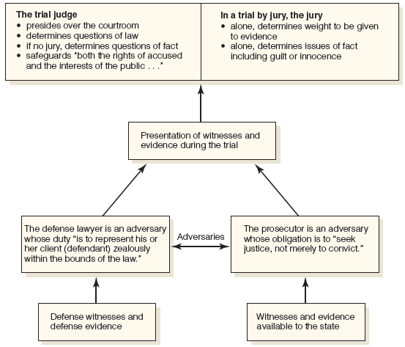
Preparing a Case for Prosecution (continued)
FINAL PREPARATIONS
  Review your notes and your final report
  Know what is expected and the rules of the court
  Dress appropriately
  Be on time
Notes:
Figure 21.2 The American adversary system.
Source: From Gardner, T. J., & Anderson, T. M. (2010). Criminal evidence: principles and cases, 7th ed. Belmont, CA: Wadsworth Publishing Company, a part of Cengage Learning, Inc.

Slide 15
The Trial
ADVERSARY SYSTEM
  Judge or magistrate
  Jurors
  Legal counsel
  Defendants
  Witnesses

Slide 16
Sequence of a Criminal Trial
USUAL SEQUENCE
  Jury selection
  Opening statements by prosecution and the defense
  Presentation of the prosecution’s case
  Presentation of the defense’s case
  Rebuttal and surrebuttal testimony
Notes:
Learning Objective:
Diagram the usual sequence of a criminal trial.
The usual sequence in a criminal trial is:
Jury selection
Opening statements by the prosecution and the defense
Presentation of the prosecution’s case; cross-examination by the defense
Presentation of the defense’s case; cross-examination by the prosecution
Rebuttal and surrebuttal testimony
Closing statements by the prosecution and the defense
Instructions to the jury
Jury deliberation to reach a verdict
Reading of the verdict
Acquittal or passing of sentence

Slide 17
Sequence of a Criminal Trial (Continued)
USUAL SEQUENCE
  Closing statements by prosecution and the defense
  Instructions to the jury
  Jury deliberation to reach a verdict
  Reading of the verdict
  Acquittal or passing of sentence

Slide 18
While Waiting to Testify
GUIDELINES
  Do not discuss the case in hallway
  De minimus communication
    Simple hello
    Giving directions
  Do not appear aloof or unfriendly

Slide 19
Testifying under Direct Examination
OVERVIEW
  “Win” is to have established credibility
  Inadmissible statements
    Opinions and conclusions
    Hearsay
    Privileged communication
    Statements about character and reputation
Notes:
Learning Objective:
Explain what the “win” is for an investigator who testifies in court.
The “win” for an investigator who testifies is to have established credibility.
Learning Objective:
Describe the kinds of statements that are inadmissible in court.
Opinions and conclusions (unless the witness is qualified as an expert)
Hearsay
Privileged communication
Statements about character and reputation, including the defendant’s criminal record

Slide 20
Testifying under Direct Examination (Continued)
OVERVIEW
  Speak clearly, firmly and with expression
  Answer questions directly
  Do not volunteer information
  Pause briefly before answering
  Refer to your notes if you do not recall exact details
Notes:
Learning Objective:
List the guidelines for effective testimony.
To testify most effectively:
Speak clearly, firmly and with expression.
Answer questions directly. Do not volunteer information.
Pause briefly before answering.
Refer to your notes if you do not recall exact details.
Admit calmly when you do not know an answer.
Admit any mistakes you make in testifying.
Avoid police jargon, sarcasm and humor.
Tell the complete truth as you know it.
Learning Objective:
Determine when to use notes while testifying.
Refer to your notes if you are uncertain of specific facts, but do not rely on them excessively.

Slide 21
Testifying under Direct Examination (Continued)
OVERVIEW
  Admit calmly when you do not know an answer
  Admit any mistakes you make in testifying
  Avoid police jargon, sarcasm and humor
  Tell the complete truth as you know it

Slide 22
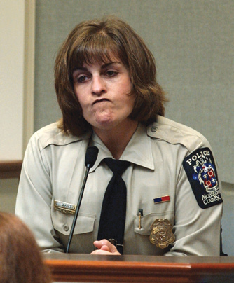
Testifying under Direct Examination (Continued)
NONVERBAL FACTORS
  Dress
  Eye contact
  Posture
  Gestures and mannerisms
  Rate of speech
  Tone of voice
  Facial expressions
Notes:
Learning Objective:
Recognize what nonverbal elements can influence courtroom testimony positively and negatively.
Important nonverbal elements include dress, eye contact, posture, gestures, mannerisms, rate of speech, tone of voice and facial expressions.
---
Testifying in court is part of working in law enforcement. Officers must never underestimate the power of nonverbal communication when they testify. Although what is being said (the “facts” to which the officer is testifying) is certainly important, the way these facts are presented can speak just as loudly, if not more loudly, to the judge and jury. Important nonverbal elements include dress, eye contact, posture, gestures, mannerisms, rate of speech, and tone of voice. These factors can provide far more insight and depth into an officer’s statement of fact and experience, particularly as pertains to a brutal or otherwise horrific crime scene, than can mere words recorded onto the court transcript.
Consider the expression of Montgomery County police officer Cynthia Martin, the first officer on the scene of the shooting of sniper shooting victim Sarah Ramos, as she testifies during the trial of Washington area sniper suspect John Allen Muhammad.
© Snider-Pool, A./Getty Images News/Getty Images

Slide 23
Testifying under Direct Examination (Continued)
STRATEGIES FOR EXCELLING AS A WITNESS
  Set yourself up
  Provoke defense to allow you to explain yourself
  Be unconditional and do not stall
  EXPERT TESTIMONY
  Special training, education or experience

Slide 24
Testifying under Cross-Examination
OVERVIEW
  Display an even temperament
  Be likeable and polite
  Maintain eye contact
  Never volunteer any information
  Anticipate defense attorney tactics
Notes:
Learning Objective:
Know the defense attorney tactics to anticipate during cross-examination.
Tactics the defense attorney may use include:
Be disarmingly friendly or intimidatingly rude.
Attack your credibility and impartiality.
Attack your investigative skill.
Attempt to force contradictions or inconsistencies.
Ask leading questions or deliberately misquote you.
Ask for a simple answer to a complex question.
Use rapid-fire questioning.
Use the silent treatment.

Slide 25
Handling Objections
OVERVIEW
  How to avoid objections
    Avoid conclusions
    Avoid nonresponsive answers
    Answer yes-or-no questions with “yes” or “no”
  Three common objections
Notes:
Learning Objective:
Identify the ways to avoid objections to your testimony.
To avoid objections to your testimony, avoid conclusions and nonresponsive answers. Answer yes-or-no questions with “yes” or “no.”

Slide 26
Concluding Your Testimony
GUIDELINES
  Do not leave the stand until instructed
  Return to your seat or leave the room
  Do not take the outcome personally
  Complainant should be notified of the disposition

Slide 27
Advice on Testifying from a Seasoned
“Officer of the Year” Investigator
DETECTIVE RICHARD GAUTSCH
  Emphasizes three major areas
    Preparation
    Communication
    Credibility
  The truth can only strengthen a good case

Slide 28
Summary
The most important rule to eradicate fear of testifying in court is to always tell the truth
Prosecutor is the most powerful official in the court system
A criminal trial begins with the jury selection
The “win” for an investigator who testifies is to have established credibility
The disposition of a case should be made known to the complainant

