Slide 1
Chapter 9
Prediction for Dichotomous Variable
© 2019 McGraw-Hill Education. All rights reserved. Authorized only for instructor use in the classroom. No reproduction or distribution without the prior written consent of McGraw-Hill Education

Slide 2
Learning Objectives
Identify a limited dependent variable and its applications
Describe the linear probability model
Identify merits and shortcomings of the linear probability model
Model probit and logit models as determined by the realization of latent variable
Calculate marginal effects for logit and probit models
Execute estimation of a probit and logit model via maximum likelihood
Identify the merits and shortcomings of the probit and logit models in practice

Slide 3
Limited Dependent Variable
Limited dependent variable
A dependent variable whose range of possible values has consequential constraints
Some constraints include upper and/or lower bounds or the ability to take on only discrete values

Slide 4
Limited Dependent Variables
IN THIS TABLE, A RANDOM VARIABLE SPENT_{it} REPRESENTING THE AMOUNT OF MONEY SPENT BUYING PRODUCTS ONLINE BY HOUSEHOLD i IN WEEK k.
PRODUCTS ESSENTIALLY ALWAYS HAVE NON-NEGATIVE PRICES, SO THIS RANDOM VARIABLE IS CONSTRAINED TO BE AT LEAST ZERO.
IN THIS TABLE, WE SEE SEVERAL OBSERVATIONS WITH SPENT_{it} VALUES EXACTLY EQUALS THE CONSTRAINT OF ZERO.

Slide 5
Limited Dependent Variables
Dichotomous (or binary) dependent variable
A limited dependent variable that can take on just two values, typically recorded as 0 and 1
Measure many different types of outcomes: purchase/don’t purchase, project success/project failure, employed/unemployed, approve/disapprove

Slide 6
The Linear Probability Model
Linear probability model defined as regression analysis applied to a dichotomous dependent variable
Widely used model
The act of fitting the equation Purchase = α + βSubFee to the data by solving the moment condition is an application of a linear probability model.

Slide 7
Data on Subscription Fees and Purchase Decisions for SaferContent

Slide 8
The Linear Probability Model
The following table shows regression estimates that fit the function Purchase = α + βSubFee to the data:
Based on the estimates in the above table the determining function would be: Purchase_{i} = 1.65 – 0.05 × SubFee_{i}

Slide 9
The Linear Probability Model
If we assume the data-generating process for Y to be:
Y₁ = α + β₁X_{1i} + … + β_{K}X_{Ki} + U_{i}
Y is a dichotomous dependent variable
THEN:
Β₁, …, β_{K} represent the change in the probability of Y equaling one with a one unit increase in X₁, … ,X_{K} (respectively), holding all other Xs constant. For example, we can express β₁ as: β₁= Pr(Y = 1|X₁ + 1, X₂, …, X_{K}) – Pr(Y = 1|X₁ + 1, X₂, …, X_{K})

Slide 10
Merits and Shortcomings of the Linear Probability Model
Merits
Imposes no restrictions on the associated regression analysis, so all methods discussed earlier (use of dummy variables, selecting controls, instrumental variables, panel data methods) seamlessly apply.
Shortcomings
It ignores the limitation of the dependent variable
The lack of restrictions on the range of predicted values of the outcome

Slide 11
Merits and Shortcomings of the Linear Probability Model
Limit-violating prediction is a predicted value for a limited dependent variable that does not fall within that variable’s limits
For many applications, limit-violating predictions may not be a problem in practice
Could engineer the Xs in such a way as to preclude predictions of Y outside of 0-1

Slide 12
Probit and Logit Models
To overcome the limitations of the linear probability model, probit and logit models are used
The choice between a linear probability model and the alternative models is not obvious
There is no universally ”right” model

Slide 13
Probit and Logit Models
The key difference the linear probability model and the alternative models (logit and probit models) is the connection between the determining function, the unobservables, and the dependent variables.
Purchase = α + βSubFee
Two Shortcomings of the linear probability model:
It is hard to believe that the determining function and unobservables always add up to exactly 0 or 1
Predictions about the effect of subscription fee (SubFee) on purchases may be unrealistic

Slide 14
Probit and Logit Models
Rather than setting the dependent variable equal to the sum of the determining function and the unobservables, let the value of the dependent variable depend on this sum but in a coarse way
The sum of the determining function and the unobservables equal a latent variable
A latent variable is a variable that cannot be observed, but information about it can be inferred from other observed variables

Slide 15
Probit and Logit Models
We define the sum of defining function ( α + βSubFee_{i}) and the unobservables (U_{i}) to be a latent variable
If we call latent variable Utility, then:
Utility_{i} = α + βSubFee_{i} + U_{i}
We assume a purchase occurs if utility is positive (> 0) and a purchase does not occur if utility is not positive (≤ 0)
We can express the purchase decision as:
Purchase_{i} = $\left\{\begin{aligned}1 if Utilityi>0 \\ 0 if Utilityi ≤0\end{aligned}\right.$

Slide 16
Examples of Dichotomous Dependent Variables Coupled with Latent Variables

Slide 17
Probit and Logit Models
Define the latent variable, Y*, as the sum of the determining function and the unobservables:
Y*_{i} = α + β₁X_{1i} + … + β_{K}X_{Ki} + U_{i}
Then define the dependent variable, Y_{i ,} to be 1 if the latent variable exceeds 0, and otherwise:
Y_{i} = $\left\{\begin{aligned}1 i\text{f} \text{Y}\text{∗}\text{i}>0 \\ 0 if\text{Y}\text{∗}\text{i}≤0\end{aligned}\right.$
Notice we do not need the determining function and unobservables to add up exactly to 0 or 1

Slide 18
Probit and Logit Models
The latent variable formation for Y also prevents unreasonable predictions about the probability of Y equaling 1
Pr(Y_{i} = 1|X_{1i}, …, X_{Ki}) = Pr(Y*_{i} > 0|X_{1i} , …, X_{Ki})
This equation states that the probability the outcome (Y) equals 1, given the values for the Xs, is equal to the probability that the latent variable (Y*) is greater than 0, given the values for the Xs

Slide 19
Probit and Logit Models
Pr(Y_{i} = 1|X_{1i}, …, X_{Ki}) = Pr(α + β₁X_{1i} + … + β_{K}X_{Ki} + U_{i} > 0|X_{1i} , …, X_{Ki})
Uncertainty about Y is due to uncertainty about U.
Pr(Y_{i} = 1|X_{1i}, …, X_{Ki}) = Pr(U_{i} > ‒ α ‒ β₁X_{1i} ‒ … ‒ β_{K}X_{Ki}|X_{1i} , …, X_{Ki})
While the determining function is unconstrained, the probability that Y equals 1 is explicitly defined to be a probability in terms of U, so constrained to be between 0 and 1

Slide 20
Probit and Logit Models
Probit model a latent variable formulation for a dichotomous dependent variable that assumes a standard normal distribution for the unobservables
The probability that Y equals 1 for given values of the Xs using formula:
Pr(Y_{i} = 1|X_{1i}, …, X_{Ki}) = Pr(U_{i} > ‒ α ‒ β₁X_{1i} ‒ … ‒ β_{K}X_{Ki}|X_{1i} , …, X_{Ki})

Slide 21
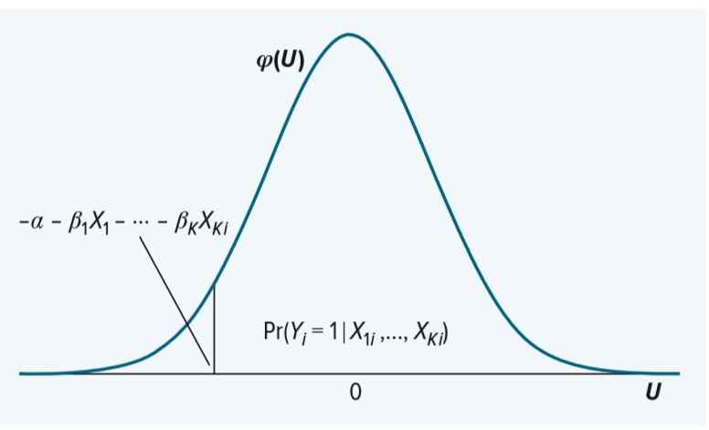
Probit and Logit Models
Probability Y Equals 1 for Given Xs, Assuming Standard Normal Distribution for U
IN THE GRAPH ϕ(U) IS THE PROBABILITY DENSITY FUNCTION (pdf) FOR THE STANDARD NORMAL DISTRIBUTION.

Slide 22
Probit and Logit Models
Since we know U_{i} is a standard normal random variable, simplify the expression for Pr(Y_{i} = 1|X_{1i}, …, X_{Ki})
Normal distribution is symmetric around its mean (which is 0 for U)
Pr(U_{i} > ‒ α ‒ β₁X_{1i} ‒ … ‒ β_{K}X_{Ki}|X_{1i} , …, X_{Ki}) =
Pr(U_{i} < α + β₁X_{1i} + … + β_{K}X_{Ki}|X_{1i} , …, X_{Ki})
Define ɸ(.) as the cumulative distribution function (cdf) for a standard normal random variable U, where ɸ(m) = Pr(U < m)
Pr(Y_{i} = 1|X_{1i}, …, X_{Ki}) = ɸ(α + β₁X_{1i} + … + β_{K}X_{Ki})

Slide 23
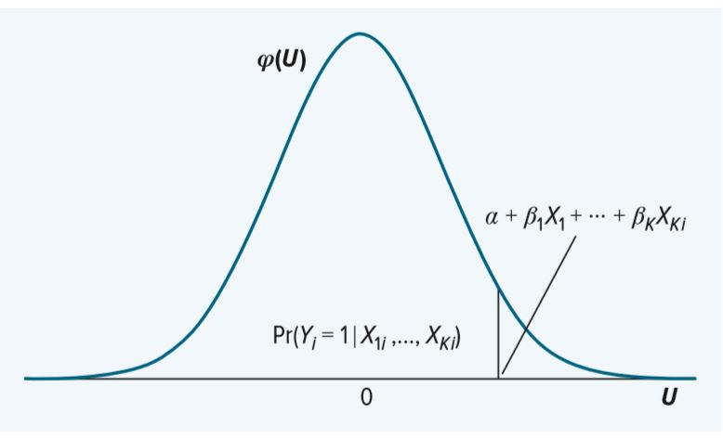
Probit and Logit Models
Probability Y Equals 1 for Given Xs, Assuming Standard Normal Distribution for U and Using cdf for U

Slide 24
Probit and Logit Models
Logit model is a latent variable formulation for a dichotomous dependent variable that assumes a Logistic(0,1) distribution for the unobservables
The logistic distribution generates a simple formula for the probability of Y equaling 1 for a given set of Xs
When we assume that U_{i}~Logistic(0,1), the probability that Y equals 1 for given values of the Xs can be expressed as:
Pr(Y_{i} = 1|X_{1i}, …, X_{Ki}) = $\frac{1}{{1 + e}^{−α−β_{1}X_{1i}{−…− β}_{1}X_{1i}}}$

Slide 25
Marginal Effects
Marginal effect is the rate of change in the probability of a dichotomous dependent variable equaling 1 with one-unit increase in an independent variable (holding all other independent variables constant)
For the linear probability model, the βs in the determining function measure marginal effects

Slide 26
Marginal Effects
Consider the following general latent variable model:
Y*_{i} = α + β₁X_{1i} + … + β_{K}X_{Ki} + U_{i}
The marginal effect of X_{j} is:
MargEff_{xj} = Pr(Y_{i} = 1|X_{1i}, …, X_{ji} +1,..., X_{K}) ‒ Pr(Y_{i} = 1|X_{1i}, …, X_{ji} , …, X_{Ki})

Slide 27
Marginal Effects
For Probit:
MargEff_{xj} = ɸ(α + β₁X_{1i} + … β_{j}(X_{ji} +1) + … + β_{K}X_{Ki}) ‒ ɸ(α + β₁X_{1i} + … + β_{j}X_{ji} + … + β_{K}X_{Ki})
For Logit:
MargEff_{xj} = $\frac{1}{{1 + e}^{−α−β_{1}X_{1i}{−… − β_{j}\left(X_{ji} +1\right)−…− β}_{K}X_{Ki}}}$ ‒ $\frac{1}{{1 + e}^{−α−β_{1}X_{1i}{−… − β_{j}X_{ji}−…− β}_{K}X_{Ki}}}$

Slide 28
Marginal Effects
Probit and logit marginal effects generally depend on the magnitude of the change in the independent variable
Probit and logit marginal effects generally differ depending on the level of X from which a change is being considered
Because the marginal effects we measure depend on the starting point of X, there is not an obvious, single number as the marginal effect of X
In practice, it is common to attempt to summarize the marginal effect of x for a probit or logit model using a single number

Slide 29
Estimation and Interpretation
We have taken the parameters (e.g., α, β) as given, in practice we get estimates for these parameters using the data
For the linear probability model, solve for the parameters using the sample moment equations
Maximum likelihood estimation (MLE) using this approach population level parameters are estimated using values that make the observed outcomes as likely as possible for a given model

Slide 30
Maximum Likelihood Estimation
Consider the following general latent variable model:
Y*_{i} = α + β₁X_{1i} + … + β_{K}X_{Ki} + U_{i}
Let Y_{i} be 1 if the latent variable exceeds 0, and 0 if otherwise
Assuming a probit model:
Pr(Y_{i} = 1|X_{1i}, …, X_{Ki}) = ɸ(α + β₁X_{1i} + … + β_{K}X_{Ki})
To get estimates for our parameters , collect a sample of Ys and Xs of size N

Slide 31
Maximum Likelihood Estimation
The probability of this observation is:
1 ‒ ɸ(α + β₁X_{1i} + … + β_{K}X_{Ki})
Assuming the logit model:
Everything is the same as in the probit example, except the probabilty formulas

Slide 32
Probit Results for SaferContent Data

Slide 33
Logit Results for SaferContent Data

Slide 34
Merits and Shortcomings
Merits of probit and logit models
Help overcome shortcomings of the linear probability model
The latent variable formation places no restrictions per se on the relationship between the determining function and unobservables
Both models predict probabilities rather than the actual value (0 or 1) for the dependent variable

Slide 35
Merits and Shortcomings
Shortcomings of probit and logit models
The probabilities implied by the probit and logit models directly depend on the assumption of a normal or logistic distribution for the unobservables
Added complexity of calculating marginal effects, relative to the linear probability model
Use of instrumental variables and fixed effects

