Slide 1
Kolcaba’s Theory of Comfort

Slide 2
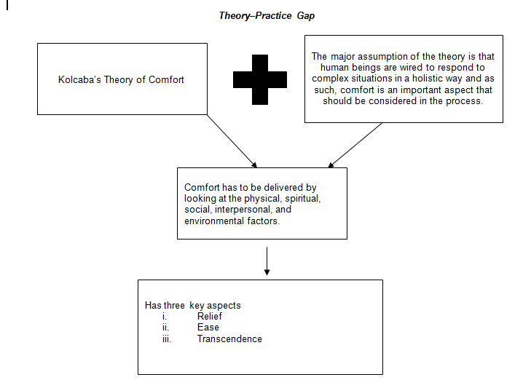
Kolcaba’s Theory of Comfort
Theory-Practice Gap
a

Slide 3
Kolcaba’s Theory of Comfort
Description of Theory, Research, and Practice
Kolcaba’s comfort theory has a key aim of increasing the holistic outcome for patients in the nursing process
Has a key promotion on the quality that is delivered for healthcare by making some key assumptions
There is the desire for comfort
Notes:
Kolcaba’s comfort theory has a key aim of increasing the holistic outcome for patients in the nursing process. Through research, one can realize that the theory has a key promotion on the quality that is delivered for healthcare by making some key assumptions. To begin with, there is the key realization that human beings desire comfort and as such, these are needs that have to be met (Kolcaba et al., 2006). This has a key aspect that looks into meeting the specific needs of the patients.

Slide 4
Kolcaba’s Theory of Comfort
Description of Theory, Research, and Practice
Ease - looks at maintaining calm when situation arises to increase performance
Transcendence – looks at the improvement of patient outcomes in the process
Context that comfort is delivered which is for holistic healing - physical, the spiritual, social or interpersonal, and the environment
Notes:
There is also an aspect that has to look into ease which looks at maintaining calm when a situation arises to increase performance. There is also a focus on transcendence which looks at the improvement of patient outcomes in the process. There is a key look into the context that comfort is delivered which is an aspect that has to consider holistic healing by looking into the aspects of the physical, the spiritual, social or interpersonal, and the environment.

Slide 5
Kolcaba’s Theory of Comfort
Relationship among Assumptions
Nurse has key focus on ensuring that optimum health is delivered to the patient
Key focus on the promotion of good health (Kolcaba, 2006)
Role of comfort in the delivery of psychological aspect to the healing
Research offers guidelines
Notes:
A nurse has to have a key focus on ensuring that optimum health is delivered to the patient. This has a key focus on the promotion of good health (Kolcaba, 2006). The role of comfort has an important role in the process of healing by delivery of a psychological aspect to the healing perspective. There is a key role by which research has guidelines for the implementation of the theory.

Slide 6
Kolcaba’s Theory of Comfort
Relationship among Assumptions
Quality-focused relationship important principle to follow
Enabled by the physical, environmental, social, and spiritual well-being
Combinations work to deliver on theory, practice, and research to identify the gaps and ways of addressing the quality improvement gaps in healthcare
Notes:
A quality-focused relationship is an important principle to follow and is enabled by the physical, environmental, social, and spiritual well-being of individuals. The combinations work in combination to deliver on theory, practice, and research to identify the gaps and ways of addressing the quality improvement gaps in healthcare.

Slide 7
Kolcaba’s Theory of Comfort
Gaps in Literature
Lack of practice standards
Result from newness of the theory
Improved by increasing the application of the theory through an academic focus
Subjecting the theory to experimentation
Notes:
One of the key gaps realized is the lack of practice standards. The gap in nursing standards is probably a result of the newness of the theory which can be improved by increasing the application of the theory through an academic focus. By subjecting the theory to experimentation, there can be an increase in the effectiveness of the theory in application and utilization in the care setting.

Slide 8
Kolcaba’s Theory of Comfort
Gaps in Literature
Guidelines of practice determined to equip nurses with the technical skills
Provision of the comfort theory for the patient to receive holistic healing
Institutions have the ability to develop the necessary policies to ensure the employees are able to deliver the necessary care of the delivery of holistic care.
Notes:
The guidelines of practice can also be determined by the process that can allow for the perspective of the education of the theory to equip nurses with the technical skills that look into the provision of the comfort theory for the patient to receive holistic healing. The institutions have the ability to develop the necessary policies that look into ensuring the employees are able to deliver the necessary care of the delivery of holistic care.

Slide 9
Kolcaba’s Theory of Comfort
Best Course of Action
Have a focus on developing a hypothesis for the course of action
Hypothesis can create an early determination of the possible solutions that can be presented for the problem
Look into the right decision that should be made about the issue by developing a key hypothesis
Notes:
To meet the testing needs required for the theory, there is a need to have a focus on developing a hypothesis for the course of action. The hypothesis is an important part of creating an early determination of the possible solutions that can be presented for the problem. There is a need to look into the right decision that should be made about the issue by developing a key hypothesis. Through an early determination, the is the possibility of a solution being presented on the issue.

Slide 10
Kolcaba’s Theory of Comfort
Best Course of Action
Ensuring that the decisions delivered are accurate by offering assistance
Lack of precision that accompanies the situation
Need to test the hypothesis to determine the sanity of the actions to build on confidence to take the chosen direction while allowing for alternatives
Notes:
The appropriate decision should be made on the issue. The next course of action can also be effective in gathering additional information which can also be important in situations where there is no surety on the extent of time necessary to make a decision. There is also a need to consider the needs of the nurses by ensuring that the decisions delivered are accurate by offering assistance as it recognizes that there is a lack of precision that accompanies the situation. There is also a need to test the hypothesis to determine the sanity of the actions to build on confidence to take the chosen direction while allowing for alternatives in the process.

Slide 11
Kolcaba’s Theory of Comfort
References
Khan, A. A. (2017). Application of Katharine Kolkaba Comfort theory to nursing care of patient. International Journal of Scientific and Research Publications, 7(3): 104-108
Kolcaba, K. (2003). Comfort theory and practice: a vision for holistic health care and research. New York: Springer.
Kolcaba, K., Tilton, C., Drouin, C. (2006). Comfort Theory. The Journal of Nursing Administration 36(11):538-544. DOI: 10.1097/00005110-200611000-00010
Lima, J. V. F., Guedes, M. V. C., Silva, L. F., Freitas, M. C., Fialho, A. V. M. (2016). Usefulness of the comfort theory in the clinical nursing care of new mothers: critical analysis. Rev Gaúcha Enferm.;37(4):e65022. DOI: http://dx.doi.org/10.1590/1983-1447.2016.04.65022.

