Slide 1
MAPPING THE WORLD-SYSTEM

Slide 2
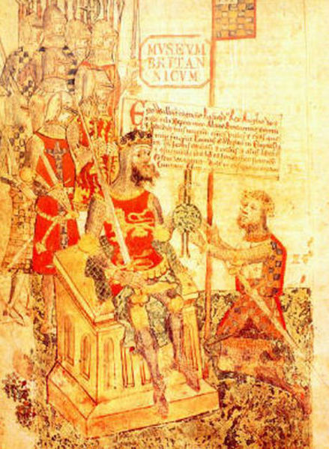
CHEMSHA BONGO (Swahili for ‘scratch the brain’)
Why spell in such weird way the simple word daughter?
AU — from French
GH — mute since Chaucer
Why not modernize English?
Alan the Red’s homage to William the Conqueror,
A.D. 1070

Slide 3
The Differentiation of world regions (gdp per capita in 1990 dollars AccoRDIng to Angus maddison)

Slide 4
The westerns grow in every measure The 1900 parade: british, american, australian, indian, german, french, russian, italian, japanese soldiers

Slide 5
The CLASSICS
MODERNIZATION AS HIGHEST STAGE OF PROGRESS:
SMITH, MALTHUS, MARX, DURKHEIM, WEBER
MODERNIZATION IN THE WEST CAUSED BY:
MARKETS AND INDUSTRY
NEW DEMOGRAPHICS
VALUES OF INDIVIDUATION
EXPERIMENTAL SCIENCE
RATIONAL BUREAUCRACY
ORGANIC SOLIDARITY OF DEMOCRACY
CAPITALISM
TOO GENERAL AND LAW-LIKE;
IGNORE VARIATION; ONLY WESTERN EXAMPLES

Slide 6
MODERNIZATION THEORIES during the cold war, 1950-1980:
The liberal–marxist consensus
(
Overcoming traditional society/феодальные пережитки,
— middle/рабочий class leads all countries to the triumph of — market/плановой economy
— liberal/народной democracy
— consumer society/всенародное благосостояние
— urbanization/смычка города и деревни
— end of ideology/не-антагонистические противоречия
— globalization/пролетарский интернационализм
— post-industrial/эпоха научно-технической революции — advanced capitalism/развитой социализм
— democratic peace/мирное сосуществование
Stress the desired/желаемое подчеркнуть

Slide 7
“The most tenacious orthodoxy does not come alone but in a pair of mutually-exclusive choices, antinomy”
Pierre Bourdieu, French sociologist
Trajectories of Soviet and American hegemonies are not the same — but they surely rhyme

Slide 8
Modernization as geopolitical imperative
“To those who have no steel industry and engineers will come those who have them, without asking permission.”
Stephen Kotkin, Stalin’s World, Vol. I (Princeton, 2014)
Who became metropole — and who became colony?
Why did the incredible dynamism of capitalism foster an incredibly stable hierarchy of wealth and power in world-system?
Who and how could realize the ‘advantages of backwardness’?
(Alexander Gershenkron)
How positions in the world-system division of labor were distributed?
?
?
?
?

Slide 9
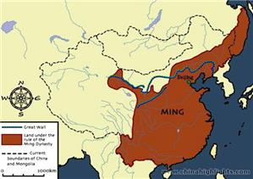
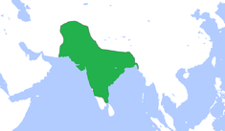
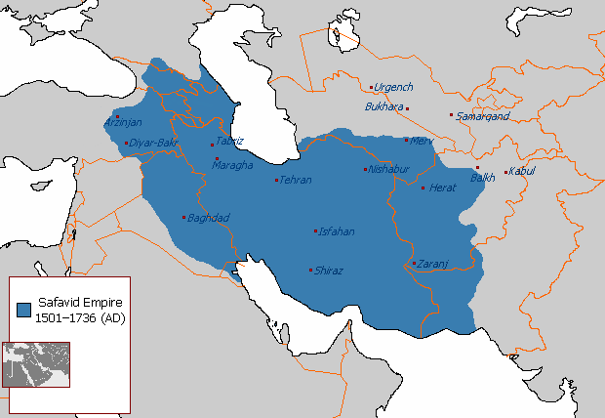
GREAT POWERS, THE RANKING OF 1550
MING CHINA SINCE 1368
INDIA, GREAT MUGHAL (IN FACT UZBEKS) SINCE 1500
PERSIA, SAFAVI DYNASTY SINCE 1500.
10

Slide 10
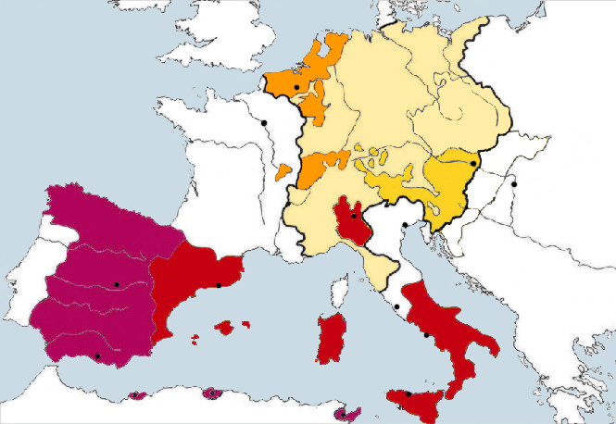
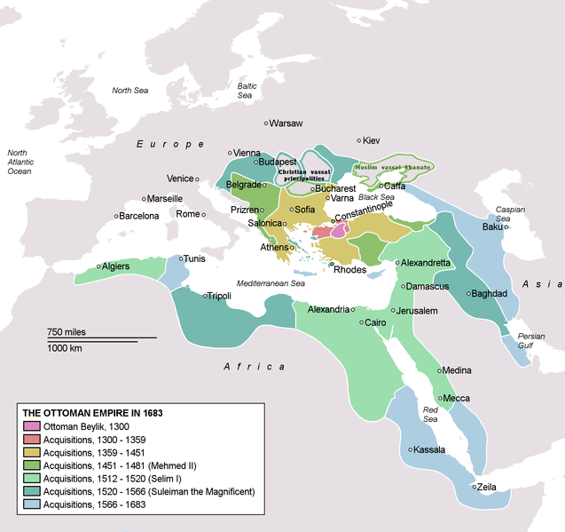
GREAT POWERS, THE RANKING OF 1550
SPANISH HAPSBURGS,
SINCE 1516.
OTTOMAN TURKS,
SINCE 1453
11

Slide 11
“IS IT NOT WONDERFUL THAT A SMALL ISLAND OFF THE COAST OF EUROPE CAME TO DOMINATE INDIAN SUB-CONTINENT? MAHATMA GANDHI
?
AND WHERE ARE THEY ALL
BY 1900
14

Slide 12
A WORLD-SYSTEM
THE “STAR” CORE AND VARIOUS SATELLITE ORBITS
CORE
WORLD-SYSTEM’S PERIPHERY
SEMI-PERIPHERY
THE GEO-ECONOMIC SCHEME OF FERNAND BRAUDEL AND IMMANUEL WALLERSTEIN

Slide 13
MAJOR CORE ADVANTAGES
Democracy is a wonderful situation when State is obligated to issue guarantees against itself.
Terence K. Hopkins
— Wealthy, effective, and bureaucratically ‘rational’ STATES (protection rent)
— Concentration of CAPITAL (investment glut)
— Expensive, hence free and skilled LABOR
— Large middle classes of SPECIALISTS (lawyers, doctors, officers, bankers, artists, educators)
— DEMOCRACY and LEGITIMACY of institutions

Slide 14
PERIPHERAL DISADVANTAGES
— Weak, corrupt states with low legitimacy (e.g. Latin America)
— Lack of native capital and capital flight
— Comprador oligarchy; revolving dictatorships
— Cheap, oppressively controlled (slave and near-slave) labor
— Technological backwardness
— Few middle classes; social polarization
In short: THE REVERSE MODERNIZATION

Slide 15
SEMI-PERIPHERY: THE INTERMEDIATE ZONE OF ACTIVIST STATES
ALL FORMERLY AGRARAIN EMPIRES:
SPAIN, ITALY, SWEDEN, POLAND, TURKEY, IRAN, INDIA, CHINA, RUSSIA — and GEORGIA?

Slide 16
EMPIRICAL CASES
TWO CLASSIC SUCCESSES: PRUSSIA AND JAPAN
TWO CLASSIC FAILURES: POLAND-LITHUANIA AND OTTOMAN EGYPT UNDER MEHMET ALI PASHA
RUSSIAN EMPIRE: THREE MODERNIZING CYCLES
The Dutch Republic and England: two pathbreakers of capitalism

