Slide 1
Pricing Pharmaceuticals

Slide 2
Objectives
Be familiar with pricing terminology and product flow
Recognize basic pricing principles
Understand the uniqueness of pricing pharmaceuticals
Outline factors to consider when pricing pharmaceuticals
Describe value based pricing
Understand the correlation between price sensitivity and medical decision makers
Explain the significance of reimbursement in pricing
Recognize the role of the competition in pricing
Identify generic markets and their role in pricing
Understand contracting in pharmaceuticals and the value of international pricing
Be aware of the future of pharmaceutical pricing

Slide 3
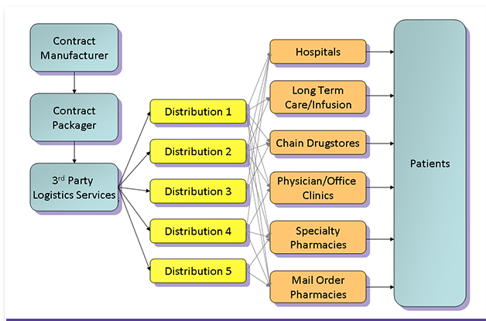
Exclusivity of Pharmaceutical Product Flow
Notes:
This pathway is an example of the channel of distribution common in the pharmaceutical industry.

Slide 4
Pharmaceutical
Channels of Distribution
Unlike those of any other industry
  Consumers cannot buy prescription drugs directly from manufacturers
  Consumers must purchase prescription drugs from a retail pharmacy
  Consumers need valid prescription from a legally licensed physician
Notes:
In the pharmaceutical world, consumers must obtain their product from a pharmacy which in return purchase from the wholesaler who purchases directly from the manufacturer. It is important to note that the consumer can not obtain a prescription medication from a pharmacy without first obtaining a valid prescription from a licensed physician.

Slide 5
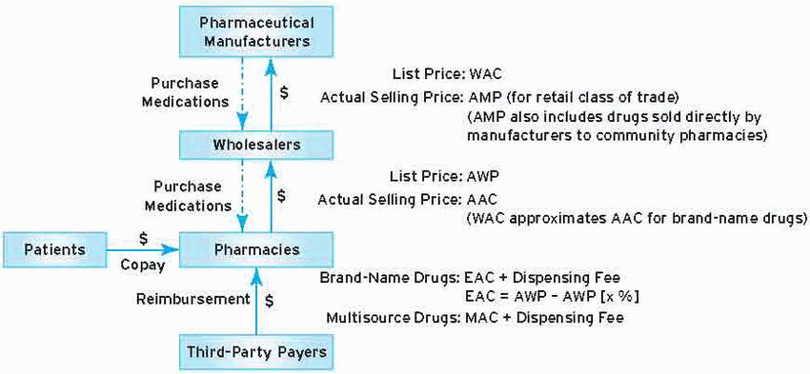
Schematics of Purchase and Reimbursement
Product Cost Terms for Prescription Medication Transactions
Chisholm-Burns, M., et al. Pharmacy Management, Leadership, Marketing, and Finance. 2nd ed. Jones and Bartlet Publishers. 2014. p 260.
Notes:
Two prices apply to medication purchase transactions between pharmaceutical manufacturers and wholesalers and between wholesalers and pharmacies: 1) list prices and 2) actual selling prices. The actual amounts paid by purchasers (actual selling prices) are usually lower than the list prices. When wholesalers purchase medications from pharmaceutical manufacturers, wholesale acquisition cost (WAC ) is the list price and average manufacturer price (AMP) is the actual selling price. When pharmacies purchase medication from wholesalers, average wholesale price (AWP) is the actual list price and actual acquisition cost (AAC) is the actual selling price. WAC and AWP are often used as pricing indices in calculation estimated acquisition price (EAC). Third party payers typically reimburse pharmacies for dispensed prescriptions based on EAC plus a dispensing fee (for brand drugs) or on maximum allowable cost (MAC) plus a dispensing fee (for multisource drugs).

Slide 6
Common Pharmaceutical Pricing Key Terms and Concepts
Wholesale Acquisition Cost (WAC): The manufacturers’ published catalog (list) price for sale of a drug (brand or generic) to wholesalers.
Average Manufacturer Price (AMP): The average price paid by wholesalers to manufacturers for drugs distributed through retail pharmacies or by retail pharmacies that buy directly from manufacturers.
Average Wholesale Price (AWP): A suggested list price for products purchased from wholesalers by pharmacies (both retail and non-retail). This list is publicly available in industry compendia
Actual Acquisition Cost (AAC): The actual amount paid by a pharmacy to a supplier for a product.
Chisholm, M., et al. Pharmacy Management, Leadership, Marketing, and Finance. 1st ed. Jones and Bartlet Publishers. 2014. p 258-60.
OIG.HHS.GOV. Average Sales Price: Manufacturers Reporting and CMS Oversight. 2014 Feb 27. <http://oig.hhs.gov/oei/reports/oei-03-08-00480.pdf>
Notes:
AAC: Third party payers would like to base their reimbursement based on AAC, but are unable to do so because AAC is proprietary information.
AMP: This was once proprietary information but the Deficit Reduction Act of 2005 required AMPs to become publicly available. The AMP is an average of actual transaction prices.
ASP: Total sales in a quarter from a manufacturer for a drug divided by the total units sold of the same drug during the same quarter. (i.e. Pfizer’s total sales for Lipitor in quarter 1 equaled $5 billion. During the same period Pfizer sold 3,000,0000 units of Lipitor to all purchasers. This gives the drug an ASP of $1,667. The ASP is used by CMS to pay for certain drugs covered under Part- B benefits. CMS requires manufacturers to report sales data for drugs covered under Part-B within 30 days of end of each quarter.
EAC: Is what third party payers base their reimbursement on since they are not able to obtain the AAC. EAC is usually expressed as a percentage off AWP (e.g. AWP-15% of AWP).

Slide 7
Additional Key Terms
Estimated Acquisition Cost (EAC): An estimate of the AAC that is commonly used to determine the reimbursement amount for product cost under prescription benefit plans.
Maximum Allowable Cost (MAC): A maximum amount per unit of medication that third party payers will pay pharmacies for multisource drugs.
Average Sales Price (ASP): The manufacturer’s sales of a drug to all purchasers in a calendar quarter divided by the total number of units of the drug sold by the manufacturer in that same quarter.
Chisholm, M., et al. Pharmacy Management, Leadership, Marketing, and Finance. 1st ed. Jones and Bartlet Publishers. 2014. p 258-60
Notes:
WAC: The list price for what pharmaceutical manufacturers charge drug wholesalers. This is an overestimate of what manufacturers actually charge wholesalers.
MAC: The maximum cost that the third party will pay for a multisource drug. Typically is an average of the generic drug price from several manufacturers. Medicaid, PBMS and other insurers usually set their own MAC.
AWP: The AWP is like the sticker price for a car. It is an overestimation of the price paid for the product. In practice, pharmacies usually purchase drugs at an amount lower than AWP.

Slide 8


Who Pays for Drugs?
In the U.S., the patient ultimately bears financial responsibility
Almost always through a third-party insurance plan
Most self-administered drugs are usually reimbursed through a pharmacy benefit plan either private, employer-based, or government sponsored
Administered by a Pharmacy Benefits Manager (PBM), a Health Maintenance Organization (HMO) or a State Health program
Notes:
The patient is the ultimate consumer of the final product so they are financially responsible for the product they consume. The patient usually has insurance plans that sometimes help pay for the medication, but often the patient has co-payments that need to be paid in full before medication can be obtained. This is the case for prescription medications.
Over the counter products often are not covered by insurance plans and the full burden of payment fall on the consumer (patient).
Also note that the insurance plans are often managed by PBMs or HMOs.

Slide 9
Basic Pricing Principles
Value-based pricing
When setting a price, the fundamental question is, will the product’s price be set at:
a) A discount
b) Parity with current treatments
c) Premium over current therapies
Addressing this question is
key to profitable pricing.
Premium
Price
Parity
Discount
Value
Notes:
Explain there are variables that need to be taken into consideration when trying to price a product. The consumer will only purchase the product if the expected value (benefit) is greater than the price of the product.
Parity example: Huggies Diapers developed to compete with Pampers so Proctor and Gamble (Pampers) same up with Luvs. Pampers according to the manufacturer is premium and cannot be compared to Huggies, an inferior product. Luvs is at the same “value” as Huggies.
Premium vs Discount example: Brand pricing over generic. Consumers will pay the brand “premium” pricing because it is the only product available until generic is available. Many will switch to the generic due to the discount price. Some will stick with the brand just because it is expensive, if it costs more it must be better/more effective.

Slide 10

Basic Pricing Principles
Premium price
  Higher value
  Better quality
Discount price
  Reason customer buys the product
  Distinguishing feature of the product
Parity price
  Product is not too different
  Avoid price competition with similar products
Notes:
Define these terms:
Premium price: higher value to customer. Customers usually see these as products of higher quality. (Lexus vs Honda: Both are cars and do the same thing, but Lexus is more expensive. Customers accept this because they value the quality of the product being produced by Lexus, so they are willing to pay more for it).
Discount: Manufacturer wants the customer to consider price as the distinguishing feature. This is a good deal for the customer
Parity: “me too products.” There are already products that do the same out in the market.

Slide 11

Basic Pricing Principles
Value-based perspective
Price can be higher than the reference but still a discount when factoring in value
Developing markets
  Customers may have little experience in assessing, understanding and accepting differences in value
  May misinterpret the pricing position chosen
  Crucial to communicate value during product launch
Notes:
When pricing a product, the most important thing we must establish is the VALUE of said product. When looking to establish pricing positions for a pharmaceutical we have to do it from a value-based perspective.
This is especially true when trying to establish a new product in a new market. This is more difficult because not much is known about the utility of the product.

Slide 12
Why is Pharmaceutical Pricing Different?
The Law of Demand: All things being equal, as price increases, unit sales will decrease and vice versa.
In pharmaceuticals, markets are not driven by the law of supply and demand
Their Purpose: Address need for relief
Prescribed: By a third-party not concerned with the financial transaction
Consumed: By a patient who would rather not consume product, and may have no idea why it was prescribed
Notes:
Pharmaceutical pricing does not respond to the Law of Demand.
They are driven by the need to relieve a symptom (Their Purpose), prescribing habit of a physician, and ultimately the consumer.

Slide 13
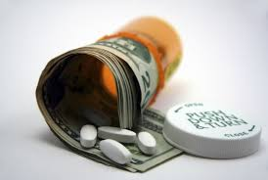
More Evidence on the Difference...
Some patients may not participate drug purchase
  Nursing home residents
  Clinic outpatients
Affected by comparison with the standard of care and:
  Medical
  Biological
  Regulatory
  Epidemiological
  Ethical factors¹
Notes:
Sometimes patients do not take part in the purchasing of the medications they consume (i.e. critically ill patients) and the use of the medications they consume is affected by many factors such as; standard of care, medical, biological, ethical….

Slide 14

What Distinguishes Pharmaceutical Markets From Other Markets?
Prescription drugs are subject to derived demand
They are considered “negative goods”
They are experience goods
Kolassa, E.M. The strategic pricing of pharmaceuticals. 2009; Chp1 (2:8)
Notes:
Read slide… We will be talking about this in the following slides.

Slide 15

Derived Demand
Demanded and sold in response to medical need
Use is influenced by the comparison with the standard of care for the particular disease or affliction
Decision maker is physician
  neither consumes nor pays for the product
  no idea of the price; only knows its value
  Determines which medication(s) best for each individual patient based on patients’ specific characteristics
Notes:
Derived Demand: when there is a demand for a good resulting from demand for an intermediate good or service.
The sale of pharmaceutical products are influenced by medical needs. This is influenced by the prescribing habits of a physician who not always knows the price of the product or by consumer advertisement which allows the consumer to self-diagnose themselves thus leading to an increased demand for the product. They usually prescribe the product based on its value.

Slide 16

Negative Goods
Those who purchase them would rather not
Seen as an unpleasant necessity
Prices will always be considered “too high.”
Notes:
They are considered negative goods because the patient would rather not buy or take the product in the first place. They are bought only because they cure or alleviate an ailment, not because the consumer wants to buy them. Because of their negative nature, pharmaceutical prices for pharmaceuticals will always be considered too high

Slide 17
Experience Goods
Utility not determined until they have been consumed
Value is not known at or before purchase
Usefulness only apparent after it’s first use
Not all patients taking a medication will experience optimal clinical results
  Effect(s) often fall short of what was desired.
  Adverse reactions may be too unpleasant
Notes:
The true value of the pharmaceutical product is not known to the consumer until the product is actually consumed and effects have taken place. The effect of the product is not known at the time of purchase.
A patient evaluating the price of a new drug can’t judge the fairness of it until the drug has been used. Additionally, not all patients taking a medication will experience optimal clinical results. In some instances the actual effect(s) will fall short of what was desired.

Slide 18
Pricing Factors
For many, price = quality and utility
A few exceptions
  Price charged for a drug has little effect on its unit sales
  Demand is driven by:
1) epidemiology of the disease
2) clinical utility of the product¹
Little can be done with price to drive demand higher
  Principal determinant in the success of a medication is its clinical usefulness
Notes:
Price has little influence on demand for pharmaceuticals. It is mainly epidemiology of the disease and the product’s clinical utility what drives demand higher. In most instances there is little that can be done with price to drive demand higher if a product has no relevant clinical value or utility.

Slide 19

Pricing Factors
Medications either work well or not at all
Medications that work somewhat
  Lose favor in the eyes of physicians
  Under-prescribed
  Fade from the market
Communicate the value of the product
  Manufacturers can charge appropriate prices
  Able to stay in business
  Continue to fund new research
Notes:
When pricing a product, it is important to consider how well the product actually works. Depending on how efficacious the product is will determine the prescribing habits of physicians and ultimately determine how well the product does in their respective market. It is imperative to communicate the value of the product in order to get name recognition.

Slide 20
Understanding Value Based Pricing
When customers do not understand the value of a product, their first reaction is to claim the price is too high
Selling the product for a lower price will not “fix” the problem when it has no value in the pharmaceutical market
Problem: poor communication about its value
Notes:
How well a product is marketed will have a great impact on how well that product does. If consumers determine the product’s price is too high they might reject that product and purchase another one. It is the responsibility of the marketer to let the consumer know the value of the product which in turns justifies the price it is being sold at.

Slide 21

Value Based Pricing
Pharmaceuticals have been and still are the most valuable health care intervention that exists¹
Kolassa E.M. The strategic pricing of pharmaceuticals. 2009; Chp 4 (49:54)
Notes:
Pharmaceuticals are expensive

Slide 22
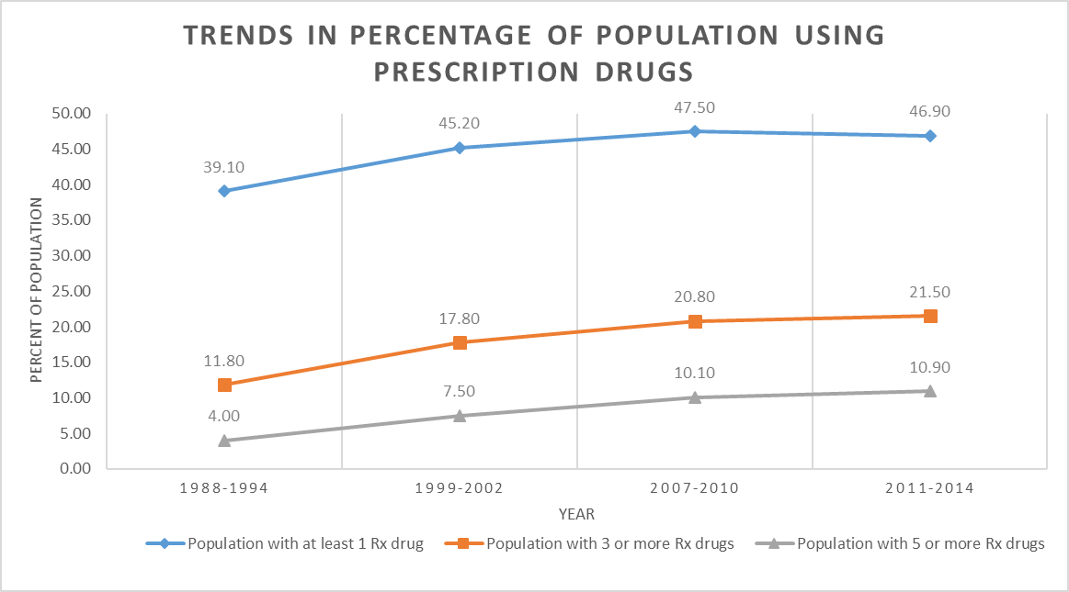
Pharmaceutical Value
The overall trend of the steady increase in the past 2 decades
Notes:
The use of pharmaceuticals have been trending upwards for the past few decades.
Since 1988 there has been an increase of a little over 7.8% in patients taking 1 or more drugs, 9.7% increase in those taking 3 or more drugs, and a 6.9% increase in those taking 5 or more drugs.

Slide 23
Delay or Non-receipt of Needed Medical Care or Prescription Drugs

Slide 24
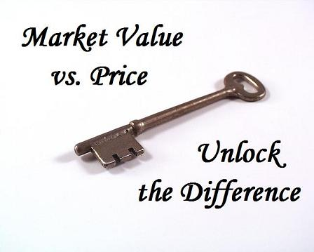
Overpricing Myth
Why does overpricing continue to plague the pharmaceutical industry?
Price based on value in a unique situation
Key components of value determination :
  Physician
  Patient
  Insurance provider
  Health care system
Value varies according to the audience
Kolassa E.M. The strategic pricing of pharmaceuticals. 2009; Chp 2 (11:15)
Notes:
Prices of pharmaceuticals are usually priced based on the value that will be perceived by physicians, patients, insurance providers and the healthcare system. But the value of the product can fluctuate according to the population at hand. (i.e. difference in social economic groups).

Slide 25

Customers and the Perception of Value
Patients are the ultimate consumers of pharmaceuticals
  No knowledge of the product
  No perception of its value
  Most exposed to product cost
  Value in product determined with experience
The utility of the product predominantly determines patient’s perception of value¹
Kolassa E.M. The strategic pricing of pharmaceuticals. 2009; Chp 4 (49:54)
Notes:
The perception of value of the product by the patient does not occur until the patient has taken the medication and a clinical benefit has been obtained from it. Patients are also the consumer that’s often most exposed to the cost, thus experience with the product is very important in determining value from the patient’s prospective. At this point the patient evaluates the value of the product vs. the price of the product.

Slide 26
Physicians and the Perception of Value
Physicians role in U.S.
  Determine what is prescribed to patients
  Educated intermediaries
  Act in the best interest of the patient
  Judge pharmaceuticals based on:
    Clinical merits
    Expected outcomes
    Latest published evidence-based medical knowledge
Notes:
The physician values the pharmaceutical product based on the clinical outcome of the product.

Slide 27

Physicians and the Perception of Value
Some factors affect prescriber’s perception of value
  Prior authorization required by insurance
  Paperwork process before the patient can obtain the medication
  Lowers the physician’s perception of the product’s value
  Too much extra effort required to get the product to patient
Notes:
There are some factors that can affect the way the physician prescribes a medication besides the clinical outcome of the product.
There are “hassles” associated with certain medications. Usually if a medication is not part of an insurer’s formulary, the physician’s office must spend extra time filling out paperwork (prior authorizations), or phone calls in order to have the medication approved. Some physicians see this added burden as a hassle and will eventually prescribe another medication.

Slide 28
Physicians and the Perception of Value
Improved physician value perception
  Product eliminates excessive visits or phone calls from patients
  Reduction in man-hours with those patients
  May perceive value beyond product’s clinical merits
Example: Coumadin® vs Pradaxa®
  Anticoagulants to reduce risk of stroke in patients with atrial fibrillation^{3,4}
Tran A, Cheng-Lai A. Dabigatran Etexilate. Cardiology in Review. 2011;19(3):154-161. doi:10.1097/crd.0b013e3182137758.
Clinical Pharmacology. Chapter 34:Drugs Used in Disorders of Coagulation. Accessed through NSU website on Sept 27 ,2019
Notes:
Here we are giving an example on the “hassles” associated with certain medications and how they might affect the prescribing pattern of a physican.
On the other hand, if the product solves a problem that often drives patient phone calls or excessive visits to the practice, the reduction in man-hours with those patients may increase the physician’s perceived value beyond the product’s clinical merits.
Coumadin Vs Pradaxa

Slide 29
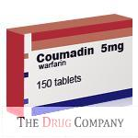
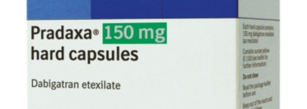
Coumadin® vs. Pradaxa®
Coumadin
Pradaxa
Dose:
  Patient specific
  Monitor patient for best dose
Food interactions:
  Liver
  Soy products
  Green leafy vegetables
INR Monitoring:
  Initially 2-3 times a week
  Reach target then every 4 weeks
  High risk of bleeding may require more frequent monitoring.
Dose:
  Fixed 150 mg twice a day
Food interactions:
  None
INR Monitoring:
  Not routinely required
Notes:
Comparing the difference between Coumadin and Pradaxa

Slide 30
Payers and the Perception of Value
Payers determine value
  Drug’s clinical claims must be advantageous by large portion of member population
Hospitals determine value through Pharmacy and Therapeutics (P&T) committee
  Balance clinical quality and costs
Clinical value must apply to a large portion of member population
Costs evaluated on a per member basis
Complex function of the incremental value offered by the product and the per member per year cost that results from its use
Notes:
Payers (Third party plans, patients) will determine the value of the product if the drug’s clinical claims are advantageous to a large portion of their member population. value by evaluating the relative value of each product they are going to pay for.
The P&T committee in hospitals(the payer) determine the value of a product and if the product is deemed to be valuable to their institution they will add it to their formulary.

Slide 31
Customers and the Perception of Value
In government-run health care systems (UK and Canada)
  Society plays a crucial role in the pharmaceutical decision making process
  Decisions based on a system of “value” checks of national significance
Society now a significant customer in the U.S. health care system
  Examples:
    National Vaccination Programs
    Government effort to eliminate Cipro® patent of after 9/11
    Demand for increased supply of Tamiflu® after 2009 H1N1 influenza pandemic
Kolassa E.M. The strategic pricing of pharmaceuticals. 2009; Chp 4 (52:54)
Notes:
Society will consider a medication valuable if its clinical benefits are going to have national significance.

Slide 32
Relationship of Value and Price from a Societal Perspective
As societal value increases, the socially accepted price increases
At some level of value, society demands the product become a “right”
As such the price is lowered
Example: Vaccines
We expect every child in the U.S. to be vaccinated
Expected Cost/Price
Perceived Societal Value
Notes:
Explain graph. Society will accept a high price for a product as long as society perceives that product to be highly valuable. At a certain point, society no longer accepts the high cost of the product and demands cost to be lowered. Here we have the vaccine example. Society deems vaccines to be highly valuable so cost will be accepted if priced high initially. At a certain point, every child is expected to be vaccinated and the high price is no longer accepted because of the high volume of people that needs to be vaccinated.

Slide 33
Suppliers and the Perception of Value
Value determined when compared to:
  Current standard of care
  No treatment
Final decision to purchase is a judgment call
  Price vs. value
Kleinke’s six categories of value
  Fast Pay
  Slow Pay
  Narrow Pay
  Diffuse Pay
  Pay-me-later
  No Pay
Kolassa E.M. The strategic pricing of pharmaceuticals. 2009; Chp 4 (57:68)
Notes:
The manufacturer will determine the value of their product based on 2 comparisons: What is the current standard of care? This gives the manufacturer a goal to guide them by. The second is, is there are treatment for the disease state? If the medication is the first to come out to treat a condition where no other alternatives are available, the manufacturer has the edge.
According to medical economist and health information technology entrepreneur J.D. Kleinke, there are six categories of values for pharmaceutical products.

Slide 34
Value Categories for Pharmaceuticals
Value Proposition | Example
Fast Pay | Protease Inhibitors Lower short-term costs immediately Great economic value reducing cost of care
Slow Pay | Cholesterol Agents (statins) Clinical benefit and economic value comes several years after treatment initiation
Narrow Pay | Vaccines, COX-2 inhibitors Provide great benefits only to some patients. Benefit is only narrowly received
Notes:
The next 2 slides give example of the value categories. These categories are based on who receives the value and how long it takes to realize that value.

Slide 35
Value Categories for Pharmaceuticals
Value Proposition | Example
Diffuse Pay | Non-sedating antihistamines Use increases cost and employee productivity. Employers receive great benefits but have trouble linking it to health insurance spending
Pay Me Later | HIV drugs or any disease w/o cure They reduce short term costs but guarantee higher costs in long run
No Pay | Lifestyle drugs. Don’t reduce costs and have only minor economic benefit
Notes:
Read Slide

Slide 36
Suppliers and the Perception of Value
The focus of the six value categories
  Direct and indirect economic value
  Value delivered to health care system
  Determinants in pricing pharmaceuticals
Equally important is quality of life value
  Popular in developed societies
  Not quantifiable
  Impart significant value to a product or market
Kolassa E.M. The strategic pricing of pharmaceuticals. 2009; Chp 4 (57)
Notes:
Quality of life is the newest factor to take in consideration when placing a value on a product. This factor has gained popularity in developed societies.

Slide 37

PDE-5 Inhibitors
Lifestyle drugs-Viagra®
Not included in formularies
Pfizer captured this value
  Charging $10 per dose
  Willingly paid out of pocket by many
It’s value at improving erectile dysfunction enabled it’s coverage
Important to conduct economic and systemic evaluation of all value drivers before setting a price
Kolassa E.M. The strategic pricing of pharmaceuticals. 2009; Chp 4 (57)
Notes:
Read Slide: Viagra example PDE-5 Inhibitors were considered by many payers to be lifestyle drugs and upon their launch into the market they were not included in forumlaries. It was its value at improving the treatment of erectile dysfunction what eventually made it covered by many payers

Slide 38
Other Factors Controlling Value
Negative Effects Reduce Value
Risk
Effort
Uncertainty
Value
Benefit
Criticality
Need
Alternatives
Positive Effects Increase Value
Notes:
Here explain that there are negative and positive factors that influence the value of a product. Negative factors such as effort, risk and uncertainty and positive factors such as criticality, benefit, and unmet needs.
The next few slides will touch on each of these factors.

Slide 39
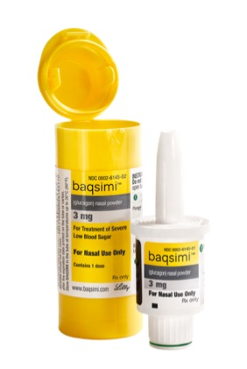
Negative Value - Effort
Viewed as an obstacle in the use of medication
Products that reduce effort posses higher value
Example
  Baqsimi® nasal spray
    Severe hypoglycemia
    Glucagon nasal powder
  Patient can be unconscious
Reduced patient effort increases value of product
Notes:
The next few slides give examples of the negative factors influencing value
Effort - Products that reduce effort compared with their competitive predecessors posses higher value and vice versa. For example medications like baqsimi a nasal form of glucagon used for the treatment of severe hypoglycemia requires no mixing and is much easier to use if the patient is unconscious. Care givers were able to give the required dose more often with the nasal application than injection (94% versus 13%). Another example is Naloxone nasal spray for opioid overdose.

Slide 40
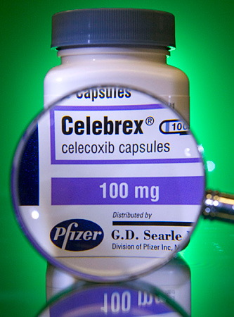
Negative Value - Uncertainty
Associated with disease progression or treatment side effect
Examples:
  Newer chemotherapies
    Increased cancer survival rate
    Decreased uncertainty of disease progression
    Results = higher value
  Celebrex® (COX-2 inhibitor)
    Reduced uncertainty in NSAID-induced ulcers
    Less ulcers = higher value
Notes:
Uncertainty: what the consumer feels when taking a medication. Is it going to work? Can it hurt me? What side effects will develop?

Slide 41

Negative Value - Risk
Probability that expected outcome will not be realized
Composite of uncertainty and effort
Huge value driver
Reduction or increase for the physician, patient or payer greatly influences value
Products that eliminate most risk will be adopted regardless of price
If risk is too high, it could become unethical
Notes:
Risk: The possibility of the product not working once consumed. Risk is a big value driver. The product that can eliminate the risk will be of greatest value and charge highest price.

Slide 42
Positive Value – Unmet Needs
Ability of product to address unmet clinical or economic needs increases its value to the market
More value if the product relieves a previously untreatable disease
Decision makers appraise new drugs by unmet need
  Make comparison to current therapies
  Assess level of unmet need for the specific disease
Notes:
The next few slides give examples of positive factors influencing value
Unmet needs: A new product for a disease state for which no product existed in the past.

Slide 43
Positive Value - Criticality
Urgency to treat or alleviate a disease
  Example: sinusitis vs. stroke
Decisions makers treat critical market differently
  Assume more risks and uncertainty in prescribing new drugs
  Make it to market faster
Higher prices are expected and tolerated
Product deemed more valuable
Notes:
Criticality: The critical need to address a disease state.
Where there is high criticality, decision makers (physicians) may take more responsibility for the risk in prescribing a new drug.

Slide 44
Positive Value - Benefit
Product’s effectiveness
Improved convenience or compliance
Reduction of negative value
Criticality, unmet need and benefit combine to determine the usefulness of product
  When related to alternatives
  Often overlooked by marketers
  Key in influencing acceptance of new product
It is the dynamic between price and these positive and negative features that determines the true value of a pharmaceutical.
Notes:
Benefit: How efficacious the product is. How well it does its job.
The previously mentioned features are all important in the acceptance of a new product.

Slide 45
Price in Medical Decision Making
What role does price play in the decision to prescribe, use or dispense products similar to mine?
Correctly price a new product
  Understanding how prices affect decisions
  If prices affect decisions of product selection
Marketer must understand the decision making process
Marketer must recognize all factors that can manipulate decisions
Kolassa E.M. The strategic pricing of pharmaceuticals. 2009; Chp 5 (75:88)
Notes:
Read Slide
Understanding how, or whether prices affect decisions of product selection and use is key in determining how to correctly price a new product

Slide 46
The Economics of Health Care Decision Making
More response to price sensitivity than price elasticity (supply and demand)
According to Nagle and Holden⁴ there are ten sources of price sensitivity:
1. Unique value effect 6. Perceived substitute effect
2. Switching cost effect 7. Difficult comparison effect
3. Price-quality effect 8. Expenditure effect
4. Shared cost effect 9. End benefit effect
5. Fairness Effect 10. Inventory effect
Each affects the decision to prescribe, purchase or use a drug⁴
Notes:
This slide explains that pharmaceuticals respond to price sensitivity more than to elasticity. Pharmaceutical product markets respond to price sensitivity more than they do to price elasticity (supply and demand)
There are 10 examples of sources of price sensitivity and each one of these sources may affect the decision to prescribe and purchase a medication.

Slide 47
Price Sensitivity Determinants
Three costs determinants to switching products - efficacy, economy, loyalty
Unique value effect: Decision makers less sensitive to price when value differentiates a product from its competitors
  Perfect example: Orphan Drugs.
Perceived substitute effect: More sensitive to price when product lacks a difference with competitors
  Physician’s price awareness
Switching cost effect: Switching to different therapy may be too costly
  Chronic medications
Notes:
The next few slides give example of the 10 sources of price sensitivity
Unique value effect: Decision makers are less sensitive to price when they value the unique attribute that differentiates a product from its competitors. Perfect example: Orphan Drugs. The price does not matter based on the great value demonstrated by the drug.
Perceived substitute effect: When decision makers are aware of the price and the lack of difference from similar products they become more sensitive to price. The greatest barrier to this determinant is price awareness, especially from physicians’ standpoints. Parity drugs. Decision makers will be hesitant to pay for a new drug, at higher cost where there are already alternatives available.
Switching cost effect: When switching from a current therapy to a new one, the switching cost effect is in operation. This is a major reason why patients on chronic medications don’t have their medications switched. The cost (time and money) to switch someone from their current therapy may be too great.

Slide 48
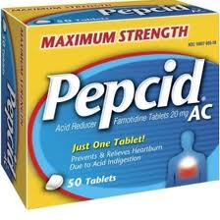
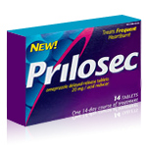

Price Sensitivity Determinants
Difficult comparison effect: Overlook price if straight forward comparison is difficult
  Example: H2 blockers vs PPIs
    Prilosec® higher price than H2 blockers
    Not directly comparable
VS.
Notes:
Difficult comparison effect: head to head comparisons

Slide 49
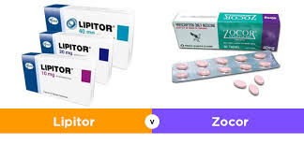
Price Sensitivity Determinants
Price-quality effect: Traditional use of price as a sign of quality
  Example: Research University of Mississippi
    Majority of “heavy” Lipitor® prescribers assumed it was most expensive
    Not the costliest lipid lowering agent on the market
    Cheaper than Zocor® and Pravachol®
    Perceived quality caused them to assume it was the highest priced statin.
Notes:
Price quality effect: displaying price as a quality attribute of the drug.

Slide 50

Price Sensitivity Determinants
Expenditure effect: Higher portion of budget expenditure the more buyers will look for alternatives
  Example: Antibiotics
    Constant focus of cost control in hospitals
    Total amount spent on them is very large
    Feel obligated to take steps to reduce costs
Notes:
Expenditure effect: The biggest portion of a hospital’s pharmacy budget is spent on drugs, therefore it is top priority for these institutions to look for cheaper alternatives in order to keep budget under control.

Slide 51

Price Sensitivity Determinants
Shared cost effect: Individual’s price sensitivity
  Smaller the portion of individual’s responsibility the less price sensitive this person will be
  One rationale behind the creation of managed care and third-party prescription plans
  shift the patient’s focus from total cost to co-pay
Notes:
Share cost effect: This depends on the actual payer (the patient). The more they have to pay out of pocket the more sensitive they will be to the price of the product and vise versa.

Slide 52

Price Sensitivity Determinants
End benefit effect: Total value of the product frames its price
  Example: Neupogen® is very expensive
    Customers complained about the $1400
    Company provided data demonstrating the end benefit - using it saves nearly $6000 with better clinical outcomes
Notes:
End benefit effect: the value of the product is used to determine its price.;

Slide 53
Price Sensitivity Determinants
Fairness effect: Buyers more sensitive to and critical of prices that are higher than what they are accustomed to paying
  Example: Newer short-acting insulins
    Produced with advanced purifying technologies
    Significantly better than older animal insulins
    Companies unwilling to fight for the premiums they should have commanded
Buyers will often use a reference price to assess fairness
Notes:
Fairness effect: Consumers will be more hesitant to pay for a product that costs more than what they are already used to paying.

Slide 54

Price Sensitivity Determinants
Inventory effect: Buyers will purchase in bulk to obtain better pricing
  Advantageous for larger companies
  Store product in warehouses for later shipment
Notes:
Inventory effect: When buyers can store large quantities of a product for later use, they are likely to purchase large volumes if a low price is available or if they anticipate a price increase.

Slide 55
Decision Makers
Hospitals
  Institutional buying centers
  Most price sensitive of all pharmaceutical markets
  Determine the significance of the 10 pricing effects
Buying center complexity
  Removes the simple concept of price elasticity
  Reinforces price sensitivity
Kolassa E.M. The strategic pricing of pharmaceuticals. 2009; Chp 4 (84:88)
Notes:
Here we are talking about the correlation between price and decision makers. In the case of hospitals, they are very sensitive to price and the decision to use a particular drug is taken by a committee not by a single individual (P & T Committee). One of the key considerations that determine the significance of the 10 pricing effects is the role and perspective of the decision makers in the buying center.

Slide 56
Role of Decision Maker
Decision for Antibiotic to treat Ventilator Pneumonia
Role | MD | Nurse | Specialist | Pharmacy | Risk Management | Finance
Initiator | X
User |  | X
Influencer |  |  | X | X | X | X
Buyer |  |  |  |  | X
Gate Keeper |  |  |  |  | X
Decider | X
Notes:
Illustrate how the input of different departments within a hospital is taken into consideration when incorporating a new drug formulary.

Slide 57

Price Sensitivity and Provider Decision
For physicians and other providers, the decision to prescribe, use or administer a drug is affected by:
  Price knowledge
  Reimbursement Issues
  Organizational Economics

Slide 58
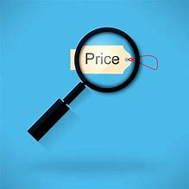
Price Knowledge
Physicians not sensitive to medication prices
  Growth of third-party payers has removed physicians from price awareness
  Exceptions are physician administered drugs
  Relationship between price awareness and use involves breakpoints related to intent to use as a way to control possible misuse
Notes:
In the case of the physician they are not sensitive to price because they don’t know the exact price each patient will pay for a medication. The only exception is office administered medications.

Slide 59
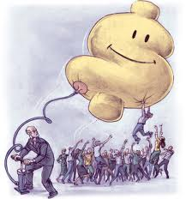
Reimbursement Issues
Providers may be less likely to prescribe a medication if:
  It is not reimbursed directly
  Patient’s out of pocket cost too high
  It requires prior authorization
  Not covered by patient’s insurance
Notes:
Other factors that can influence physician’s prescription habits could be if the drug presents reimbursement problems

Slide 60

Organizational Economics
Concerns in medical practice
  Changes in Medicare (2003)
  Changes in Deficit Reduction Act (2005)
  Reimbursement methods reduce payments to providers
    Physicians affect choice of therapy
    May see loss in patient payments
Notes:
Something that can influence physician’s prescription habits could be these reimbursement problems affect the economic well being of the medical practice.

Slide 61
Reimbursements and Pricing
Prices are influenced by reimbursements
Three types of payers:
  Public third-party payers (federal and state agencies)
    Medicare/Medicaid
    Veterans Health
    SCHIPS
    Cover most services and forms of health care
  Private third-party payers
    Blue Cross and Blue Shield Association
    Aetna
    Humana, etc.
    Complex organizations that vary in structure and profit status
  Patients
  Most reimbursement systems are a combination of at least two payers
Notes:
This slide explain the 3 main types of payers:
Public third-party payers: medicaid, medicare, SCHIP (cover most sites of service and care including outpatient drug coverage)
Private third-party payers: Human, Blue Cross Blue Shield
Out of pocket: the patient

Slide 62
Sites of Care and Reimbursement
Health care is provided in a wide variety of settings
  Public and private payers work differently
  Reimbursement for specific sites of services are the same
Health care services and products reimbursed using one of three conventions:
  Fixed fee
  Cost-based
  Percentage of charges
Notes:
Although healthcare is provided in a variety of settings, the reimbursement mechanisms are essentially the same, fixed fee, cost-based, and percentage of charges.

Slide 63
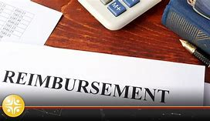
Sites of Care and Reimbursement
Hospital administered drugs
  Inpatient services reimbursed through fixed-fee systems
  Most payers reimburse according to diagnosis
  Paid pre-determined amount for treating the patient
    Including complications
    Regardless of the acuteness of condition
    Services must be delivered at or below cost to avoid financial loss
    Hospital must bear the cost overrun if services exceed reimbursement
Notes:
Hospitals are mainly reimbursed through fixed fee systems by using diagnosis codes. If a patient's treatment exceeds the amount allotted for the diagnosis code, the difference will come out of the hospital’s budget. This is an important consideration when pricing hospital products.
Core measure diagnosis

Slide 64

Sites of Care and Reimbursement
Outpatient Hospitals and Ambulatory Surgery Centers
Transition between traditional inpatient hospitals and physician offices
Procedures reimbursed on a reasonable cost basis
Covered procedures are listed under classification groups
  Assigned a predetermined payment rate
  Includes most supplies, drugs and biologicals
  Less price sensitive than inpatient counterparts
Notes:
Ambulatory surgery centers get reimbursed on a predetermined payment rate based on the type of procedure. Covered procedures are listed under 11 ambulatory payment classification groups that assign a predetermined payment rate which includes most supplies, drugs and biologicals. Pharmaceuticals are included in this rate therefore they are the least price sensitive providers.

Slide 65
Sites of Care and Reimbursement
Office administered medications
Reimbursed under the Resource-Based Relative Value Scale (RBRVS)
  Assigns relative value units to procedures
  Based on professional expertise necessary
  Weighs cost of providing the service and the associated risk
  Pays also for drugs and supplies separately
Single source drugs reimbursed the average sales price (ASP) plus 6%
Multisource drugs reimbursed the ASP or by the federal maximum allowable cost (MAC) limit
Historically this market is not price sensitive
  Sensitivity varies according to the category, cost and clinical value
Most common types of office administered drugs
  Cancer
  Rheumatoid arthritis
  Multiple sclerosis
  Asthma
Notes:
Physician office administered meds: Physicians get reimbursed the Average Sale Price (ASP) + 6%. Historically it has not been a very price sensitive market.
Multisource drugs (generics) usually get reimbursed by the ASP method of by MAC limit in this setting.

Slide 66
Sites of Care and Reimbursement
Outpatient Prescriptions
Most common form of pharmaceutical administration
Currently over 90% of prescriptions purchased in a retail setting are paid for by a third-party entity¹⁴
Online adjudication
  Transaction between the pharmacy and the third-party
  Pharmacist knows immediately if product is covered by the plan
  Patient’s co-payment is disclosed
Formularies arranged in tiers with different co-pay levels
  Generics have the lowest co-pay
  Preferred branded drugs have a medium co-payment
  Non-preferred brand drugs have the highest
KFF. 2018. Number of Retail Prescription Drugs Filled at Pharmacies by Payer. State Health Facts. https://www.kff.org/health-costs/state-indicator/total-retail-rx-drugs/?currentTimeframe=0&sortModel=%7B%22colId%22:%22Location%22,%22sort%22:%22asc%22%7D. Accessed Oct 1, 2019
Notes:
Outpatient prescription is the most common form of pharmaceutical dispensing. 90% outpatient prescriptions are reimbursed through 3rd party payers.
The transaction done by the pharmacy with the third-party is called an online adjudication. This allows the pharmacist to know if the product is covered by the plan and how much the patient needs to pay.

Slide 67
Sites of Care and Reimbursement
Branded products are assigned different tiers
  Generic availability
  Price concessions
  Clinical value
Pharmacies are reimbursed through a two-part formula
  Part of the negotiated payment from the patient
  Remainder received in periodic batches from the payer
Reimbursement may or may not drive behavior within a pharmacy
Don’t proactively encourage the use of one product over another
Pharmacy usually asks patient to gather drug information
  Call insurance company to find out which product is preferred
  Discuss alternatives with their primary physician
Notes:
Pharmacies get reimbursed for a medication + dispensing fee + any other type of clinical services provided. Part of the negotiated payment with the 3rd party payer is collected in the form of patient’s co-payment and the rest is received in periodic payments. Retail pharmacies are not very price sensitive because there is no way for them to know which drugs are going to be covered by each specific patient’s insurance plan. The most common price sensitivity behavior observed in retail is to push for generic drugs because historically generic contracts give better discount and/or rebates meaning more profit for the pharmacy chain. Pharmacists usually get some type of incentive from the chain (i.e. annual bonus if they promote generic use.)

Slide 68
Reimbursement Control Mechanisms
Controlled use of outpatient medications
  Huge percentage of institutions’ budget
  Tiered pharmacy benefit system
    Shift financial burden to the patient for certain drugs
    Discourage use of drugs in higher tiers
  Prior Authorization
  Step therapy
    No reimbursement for therapy until cheaper alternatives fail
  Quantity limits
    Limited amount of therapy received in a period of time
Notes:
3rd party payers are also sensitive to price and have developed mechanisms to try to reduce expenses, especially for outpatient prescriptions because they take the largest budget percentage. Some of the ways to control use and expenses are:
Tiered pharmacy benefit system
Prior authorization
Step Therapy
Quantity Limits

Slide 69

In a Nutshell
Understanding the characteristics of the reimbursement environment surrounding an individual product is essential in maximizing profitability and to gauge its market potential.
Notes:
It is important to understand how product reimbursement works in order to maximize profitability

Slide 70
Pharmaceuticals as Competitors
Products that appear to be competitors may not truly compete
  Many markets - competitive products are obvious
  Pharmaceuticals selected based on the health of the patient
Classified into three types
  Direct Competitor
  Indirect Competitor
  Complementary
Kolassa E.M. The strategic pricing of pharmaceuticals. 2009; Chp 8 (127:146)
Notes:
Pharmaceutical products are divided into different categories in order to understand their competitors.
Direct competitor
Indirect competitor
Complementary

Slide 71

Direct Competitor
Alternate product physician chooses
Achieves the same result
Has same biological mechanism
Example:
  Products in same therapeutic class
  Inhaled corticosteroids for asthma treatment
Marketing and price play important roles
  Keep products at the top of the value scale
Notes:
The direct competitor has the same mechanism of action as the other drugs in its class. i.e. corticosteroids for the treatment of asthma. Marketing is important in order to demonstrate why one product is better than the other (value).

Slide 72
Indirect Competitor
Alternative product a physician would chooses
Achieves a similar result
Has a different biological mechanism
All members of drug class will compete collectively against another class
Differences in marketing efforts
  Differentiating the mechanism of action
  Clinical differences are more important than price
Notes:
Indirect competitors provide the same clinical outcome as other products but works by a different mechanism (i.e. ACE-Inhibitors and Direct Renin Inhibitor). Both drugs work to lower BP, yet they work by different mechanisms.

Slide 73
Complementor
Product improves outcome when used concomitantly with another product
Belong to different therapeutic classes
Benefit from both mechanisms of action
Very little real competition
  Mechanisms of action differ
  Maybe no real competition
Marketing not advised
  Decrease in patient benefit from therapy
  Prescribers would not agree
Notes:
Complementor is a product that is used in comprised of two or more products in order to treat a condition. These products usually have different mechanisms but provide the same therapeutic outcome (i.e. Combivent (albuterol/ipatropium) albuterol works as an agonist at beta 2 receptors of the respiratory tract while ipatropium works as an anticholinergic to cause smooth muscle relaxation of the respiratory tract. At the end, both work together to improve the patient’s respiration.
When used separately, they are not considered competitors.

Slide 74
Competition and Pricing
Assess competitors before pricing product
Evaluate the competition’s category
Competitors play two important roles in setting and managing the price of pharmaceuticals:
  1. Serve as a point of reference for evaluating price
  2. Change a product’s value position through clinical utility
Notes:
Before setting a price for your product is important to evaluate who your competitors are.
Competitors can be used for price references
They could also help you position your product in the clinical value scale if you compare their biological mechanisms of action.

Slide 75
Competition and Pricing
Questions to consider when pricing a new product:
  What are the current competitive alternatives?
  Are competitors using flat pricing where all strengths are priced at the same level or are they using variable pricing for different strengths?
  How are competitors responding to the new product? Are they raising prices or offering discounts?
  Are any other new competitors anticipated?
  What steps might competitors take who feel threatened by the new product?
Notes:
These are questions that should be asked when considering the price of a product.

Slide 76
Generic Markets and Pricing
Early 1980s all states passed generic substitution laws
Generic substitution is required by law in 14 states⁹
Most insurance will approve brand only if generic is not available⁵
Financial incentives in place to promote generic substitution
  Pharmacists offered higher dispensing fees and bonuses
  Generic incentive program to consumers
Generic substitution takes place automatically
Introduction of generic drug should not affect pricing decisions⁶
Notes:
Many states have implemented laws that allow for generic substitution while others have mandated the substitution of a brand product to generic, unless the physician physically writes “Medically Necessary.” We are currently at a place where generic substitution automatically takes place without real consideration by prescribers or pharmacists.
Even though we are living in the “generics era” the introduction of a generic product into a pharmaceutical market should not drastically affect pricing decisions.

Slide 77
Generic Pricing Behaviors
Once approved the first manufacturer sets the AWP for all other generics
Actual price charged by generic manufacturers is usually much lower than AWP
AWP for generics is typically 20% off brand price or less¹³
Principal price driver for generic markets
  Number of competing generics available
  Generic manufacturers must remain price competitive
Notes:
After the approval of a generic the first manufacturer that brings it into the market sets up the average wholesale price (AWP). This price is typically 10 to 20% off the brand’s.

Slide 78
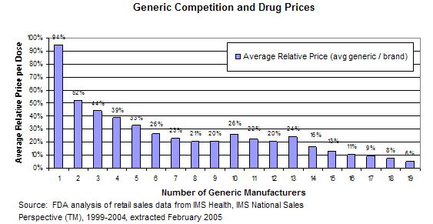
Generic Pricing Behaviors
Exclusivity
  Manufacturer has patent rights
  180 days exclusivity for first generic of its class
  Price set within 25% of the brand¹³
With a competitor pricing drops significantly
Any further competitors will result in steady price decrease
Notes:
The greatest decrease in price results after a 2nd competitor enters the market. Pricing steadily decreases with each subsequent competitor

Slide 79
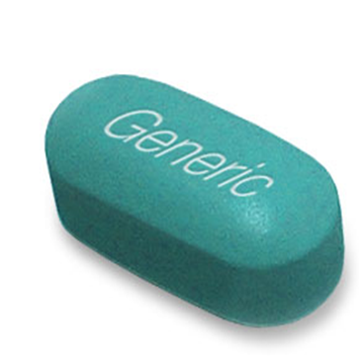
Generic Pricing Behaviors
Loss of patent leads to quick transfer of sales to generic
  Brands in the same class but different molecular make-ups remain relatively unaffected
  Generics generally only affect sales of the originator brand
Generic rarely has affect on products with recognizable difference
  Little effect on ability to price product
  Differentiation is key
Kolassa E.M. The strategic pricing of pharmaceuticals. 2009; Chp 14 (223:235)
Notes:
Historically there has been a tendency for brands drugs companies to worry about the entrance of a new generic into the market. However, it’s been observed that generics only affect the sales of their originator brand. Brands with some level of differentiation on their mechanism of action should take this opportunity to highlight exclusivity.

Slide 80
Pharmaceutical Contracting Basics
Contract should support overall goals of company
  Assess lack of certainty
  Understand negative profit implications
  Estimate administrative expenses
  Goal is reward of positive financial returns
  Avoid losses that might occur if contract is not undertaken
Recognize the opportunity value of a contract
  Reasonable or unreasonable
  Apply to various potential customers
Notes:
Contracting should only take place when it will mean positive financial returns for the firm.

Slide 81
Pharmaceutical Contracting Basics
Major customers contracting to the U.S. pharmaceutical industry
  Hospitals/Integrated delivery networks
  Long term care/Home health care
  Group Purchasing Organizations (GPO)
    Bring together the purchasing power
    Negotiate better pricing for their members
Notes:
The next few slides we will be discussing pharmaceutical contracting.
This slide lists the major customers of the pharmaceutical industry

Slide 82
Pharmaceutical Contracting Basics
Pharmacy Benefit Managers (PBM)
  Manage the pharmacy benefit for employers, health insurance plans, unions etc.
  Encourage the use of formularies
  Emphasize their size in contract negotiations
Health Insurance Plans
  Manage both medical and pharmacy benefits for employers, unions, and other clients
  Reduce the impact of drug therapy on total budget
Medicare Preferred Drug Plans
  Implemented in 2006
  Offered by most major HMOs and PBMs
  Encourage coverage through formularies
  Reduce costs by negotiating rebates from marketers
Notes:
PBMs: Encourage use of formularies, negotiate prices because of purchasing power.
Health insurance plans: Negotiate prices to reduce impact of drug therapy on their budget.
Medicare preferred drug plans: Encourage coverage through formulary and negotiate rebates.

Slide 83
Pharmaceutical Contracting Basics
Clinics/Physician Offices
  Certain therapies (oncology) require drugs administered in an outpatient facility
  Purchase drugs for their own inventory
  Marketing contracts provide incentives
Wholesale/Retail
  Main customer in U.S.
  Significant control over dispensed products
  Decide what drugs to stock.
  Key role in initial distribution of new products
  Marketers usually seek contracts with these entities
Notes:
Physician offices: mainly contract on oncology products. Marketers tend to offer them incentives in exchange for market share.
Retail Pharmacies: Marketers usually seek contract with this entities because they play a key role in the initial distribution of a new product.

Slide 84

Historical Reasons for Contract
Self-defense against government regulations
Historical inertia
Competitive pressure
Salesmanship
Notes:
Reasons to establish a contract

Slide 85
Before Entering into a Contract…
Any marketer considering contracting should:
  Examine net revenue implications before offering a deal
  Rigorously manage the terms of contract
  Consider net revenue
    The context of the product life cycle
    About to lose patent vs newly launched
  Understand customer’s goal and motivation towards contracting
Notes:
These are the factors to consider before making a contract

Slide 86

Contract Structure
  Basic difference between contracts - price incentive
  Typically discounts or rebates
  Discounts preferred by most customers
    Need less working capital to obtain the merchandise
  Rebates are preferred by institutions (PBM, HMO)
    Never take possession of the actual product
    Obtain a percentage of the rebate
Kolassa E.M. The strategic pricing of pharmaceuticals. 2009; Chp 15 (239:253)
Notes:
There are mainly two types of contracts in the pharmaceutical market. The only difference is the type of incentive. Either Discount or Rebate
Discount preferred by most customers’ because it means less capital to obtain the merchandise
Rebates: Preferred by PBM and HMO because they never get the actual drug so they can’t take advantage of discounts.

Slide 87
Frequent Contracting Terms
  Performance rebate
    Tied to a specified performance goal
    Additional rebates given for reaching target goal
  Administrative/Service fee
    Marketers pay customers (PBM, HMO, GPO) fees if they undertake specific actions
    Fixed amounts or percentage of contracted sales
  Most favored nations
    More favorable price offered to competition is extended to the “favored customer”
Kolassa E.M. The strategic pricing of pharmaceuticals. 2009; Chp 15 (239:253)
Notes:
Other types of contracting terms:
Performance Rebates
Administrative/Service Fee
Most favored nation

Slide 88
International Pricing
Competition in the payer environment is almost non- existent outside U.S.
  Usually only a few monopsonistic payers
  No opportunity for an alternative third-party payer
Payer monopsony
  Only one national formulary
  One national authority setting or negotiating prices
  Very little room for negotiation
Most nations believe that national payer monopsonies are advantageous
Kolassa E.M. The strategic pricing of pharmaceuticals. 2009; Chp 16 (255:280)
Notes:
Outside the U.S. there are usually only a couple of medication payers per nation. These countries usually have socialized medicine, one national formulary and one national authority setting or negotiating prices.

Slide 89
International Pricing
Pharmaceutical companies cannot set prices for new products
Pricing and reimbursement controlled by government
Most have national drug formularies
  Price is approved by a national institution
  New product is then listed
  National committees often negotiate reimbursements and price
  Formularies constantly revised and drugs or entire class taken off
Notes:
In international countries pharmaceutical companies are not free to set their prices. Listing of a product into the national formulary occurs only if price is approved by a national institution. Making it to the formulary however doesn’t guarantee anything. Formularies are constantly revised and any drug can be taken off during revisions.

Slide 90
International Pricing
Factors to determine reimbursement
  Value of drug
  Budgetary considerations
  Manufacturer’s contribution to national economy (jobs, exports, R&D expenditures)
  Historical relationships
Reimbursement status of the whole brand is reviewed
  Each approval for a new drug or indication
  Review more likely brings price cut than increase
  Continuously reassessed in product’s lifetime
International marketing of a pharmaceutical
  Effective price management is an ongoing process
  Continues throughout the product’s commercial lifetime
Notes:
In these countries reimbursement is determined by factors ranging from budget, clinical value, company contribution to nation’s GDP to historical relationship of the firm with the government. Reimbursement is not a one time decision but rather is subject to continuous re-assessment. Demonstrating value and coordinating pricing and reimbursement at launch is not enough. Effective price management in these societies continues throughout the products’ lifetime.

Slide 91
New International Tendencies
Risk-sharing agreement
  Recent development in European pricing⁷
  Price of a product is set only temporarily
  Subject to review after more data becomes available
  Data obtained form real-world observational studies
  Future prices fluctuate depending on studies’ results
Huge financial risks to manufacturers
  May end up paying back excess profits generated before new outcomes data becomes available
Notes:
New international tendency for contracting and reimbursement is risk-sharing agreement. Explain to the students what it is, bullet #2. This should be one of the suggested article readings.

Slide 92
Future of Pharmaceutical Pricing
Introduction of managed care in the U.S. has increased the use of pharmaceuticals⁸
Newer pharmaceutical pricing news:
  Pharmaceutical industry trying to rely on innovation
  Consumers poised to disrupt healthcare
  Patient cost-sharing may control mechanisms for high-cost products
J.P. Morgan. 2019, Jan 4. What's the Future of Drug Pricing? https://www.jpmorgan.com/global/research/future-of-healthcare. Accessed Sept 30, 2019
Davis, E. 2019, Jul 27. An Overview of Health Insurance Cost-Sharing. Very Well Health. https://www.verywellhealth.com/what-is-cost-sharing-1738709. Accessed Sept 30, 2019
Notes:
Here we are talking about the future and what is currently in the pipeline.
Industry leaders want to rely on innovation and new drugs and not pricing to encourage growth. Newer health plans are exposing consumers to list price which makes medications ultimately more expensive. This focus on price is leading pharmaceuticals to highlight their innovation and progress and keep pricing flat for the time being.
The percentage of a household costs in healthcare are increasing making consumers more selective. Cost of healthcare grows leading consumers to purchase health plans. This trend will increase the impact patients have on healthcare decision making
Cost sharing may help payers to control high cost products. It keeps premiums low but because there are usually high up front costs patients will delay seeking care.

Slide 93
Future of Pharmaceutical Pricing
Pharmaceutical companies must pay more attention to price management to stay in business
PROFIT = PRICE - COST * VOLUME
The industry’s future will be the result of pricing actions or inactions taken by individual companies…
Notes:
Read Slide.
Pharmaceutical companies will have to pay more attention to the management of their prices in the long term if they want to stay in business
Profit= Price – Cost x Volume

Slide 94
References
Google Images
  http://mrstrategicsolutions.com/MRSS_medicaldevices.html
  http://www.mediabistro.com/ebooknewser/what-is-the-right-ebook-price_b1385
  http://www.hcwreview.com/blue-cross-and-blue-shield-association-supports-patient-safety-awareness-week/
  http://www.seeklogo.com/tag.html?q=AEtna
  http://woodlandhillspharmacy.com/pediatric_compounding.html
  http://threewisedames.com/tag/communications/
  http://mlmbigbrother.com/world-ventures-scam/question-mark-man
  http://patneville.com/blog/westchester-real-estate-befuddled-by-assessed-value-appraised-value-fair-market-value/
  http://www.thedrugcompany.com/blood_thinner/coumadin/5/
  http://breshears.net/?p=81

Slide 95
References
Kolassa E.M. The strategic pricing of pharmaceuticals. 2009; Chp 1(2:8), 2(11-15), 4(49:54), 5(73-76), 8(127:146), 14(223:235), 16(255:280), and 17(281:286).
Tran A, Cheng-Lai A. Dabigatran etexilate: the first oral anticoagulant available in the United States since warfarin. Cardiology In Review [serial online]. May 2011;19(3):154-161. Available from: MEDLINE, Ipswich, MA. Accessed Sept 27, 2019.
Clinical Pharmacology accessed through NSU website on Sept 27, 2019.
Nagle TT, Holden RK.The strategy and tactics of pricing: A guide to profitable decision making.3rd ed. New York: Prentice Hall:2002.
Matrix Healthcare Services. 2017, Feb 22. Mandatory Generic Chart. https://www.mymatrixx.com/wp-content/uploads/2017/04/Mandatory-Generic-Chart-as-of-March-2017.pdf. Accessed Sept 30, 2019.
Kanavos P, Costa-Font J, Seeley E. Competition in off-patent drug markets: Issues, regulation and evidence. Economic Policy [serial online]. July 2008;23(55):499-544. Available from: Business Source Premier, Ipswich, MA. Accessed Sept 29, 2019.
Cook J, Vernon J, Manning R. Pharmaceutical Risk-Sharing Agreements. PharmacoEconomics [serial online]. May 2008;26(7):551-556. Available from: Business Source Premier, Ipswich, MA. Accessed Sept 27, 2019.
Lyles A, Palumbo F. The effect of managed care on prescription drug costs and benefits. PharmacoEconomics [serial online]. February 1999;15(2):129-140. Available from: MEDLINE, Ipswich, MA. Accessed Sept 30, 2019.
"Expanding the Use of Generic Drugs." ASPE Issue Brief. U.S. Department of Health and Human Services, n.d. <http://aspe.hhs.gov/sp/reports/2010/genericdrugs/ib.shtml#apa>. Accessed Sept 30, 2019.
National Center for Health Statistics. Health, United States, 2012: With Special Feature on Emergency Care. Hyattsville, MD. 2013
Shepherd, M et al. Pharmacy Management, Leadership, Marketing, and Finance. 1st ed. Jones and Bartlet Publishers. 2011. p 169-70
OIG.HHS.GOV. Average Sales Price: Manufacturers Reporting and CMS Oversight. http://oig.hhs.gov/oei/reports/oei-03-08-00480.pdf. Accessed Sept 30, 2019.
U.S. Food and Administration. Generic Competition and Drug Prices. 2017 Nov 20. https://www.fda.gov/about-fda/center-drug-evaluation-and-research-cder/generic-competition-and-drug-prices. Accessed Sept 30, 2019.
KFF. 2018. Number of Retail Prescription Drugs Filled at Pharmacies by Payer. State Health Facts. https://www.kff.org/health-costs/state-indicator/total-retail-rx-drugs/?currentTimeframe=0&sortModel=%7B%22colId%22:%22Location%22,%22sort%22:%22asc%22%7D. Accessed Oct 1, 2019

Slide 96

Pricing Pharmaceuticals

