Slide 1


Increase in Hurricane Speeds
Juan Carlos Perez | October 18, 2020 | SCI 100: Perspectives in Natural Science

Slide 2
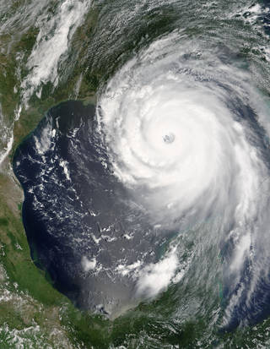
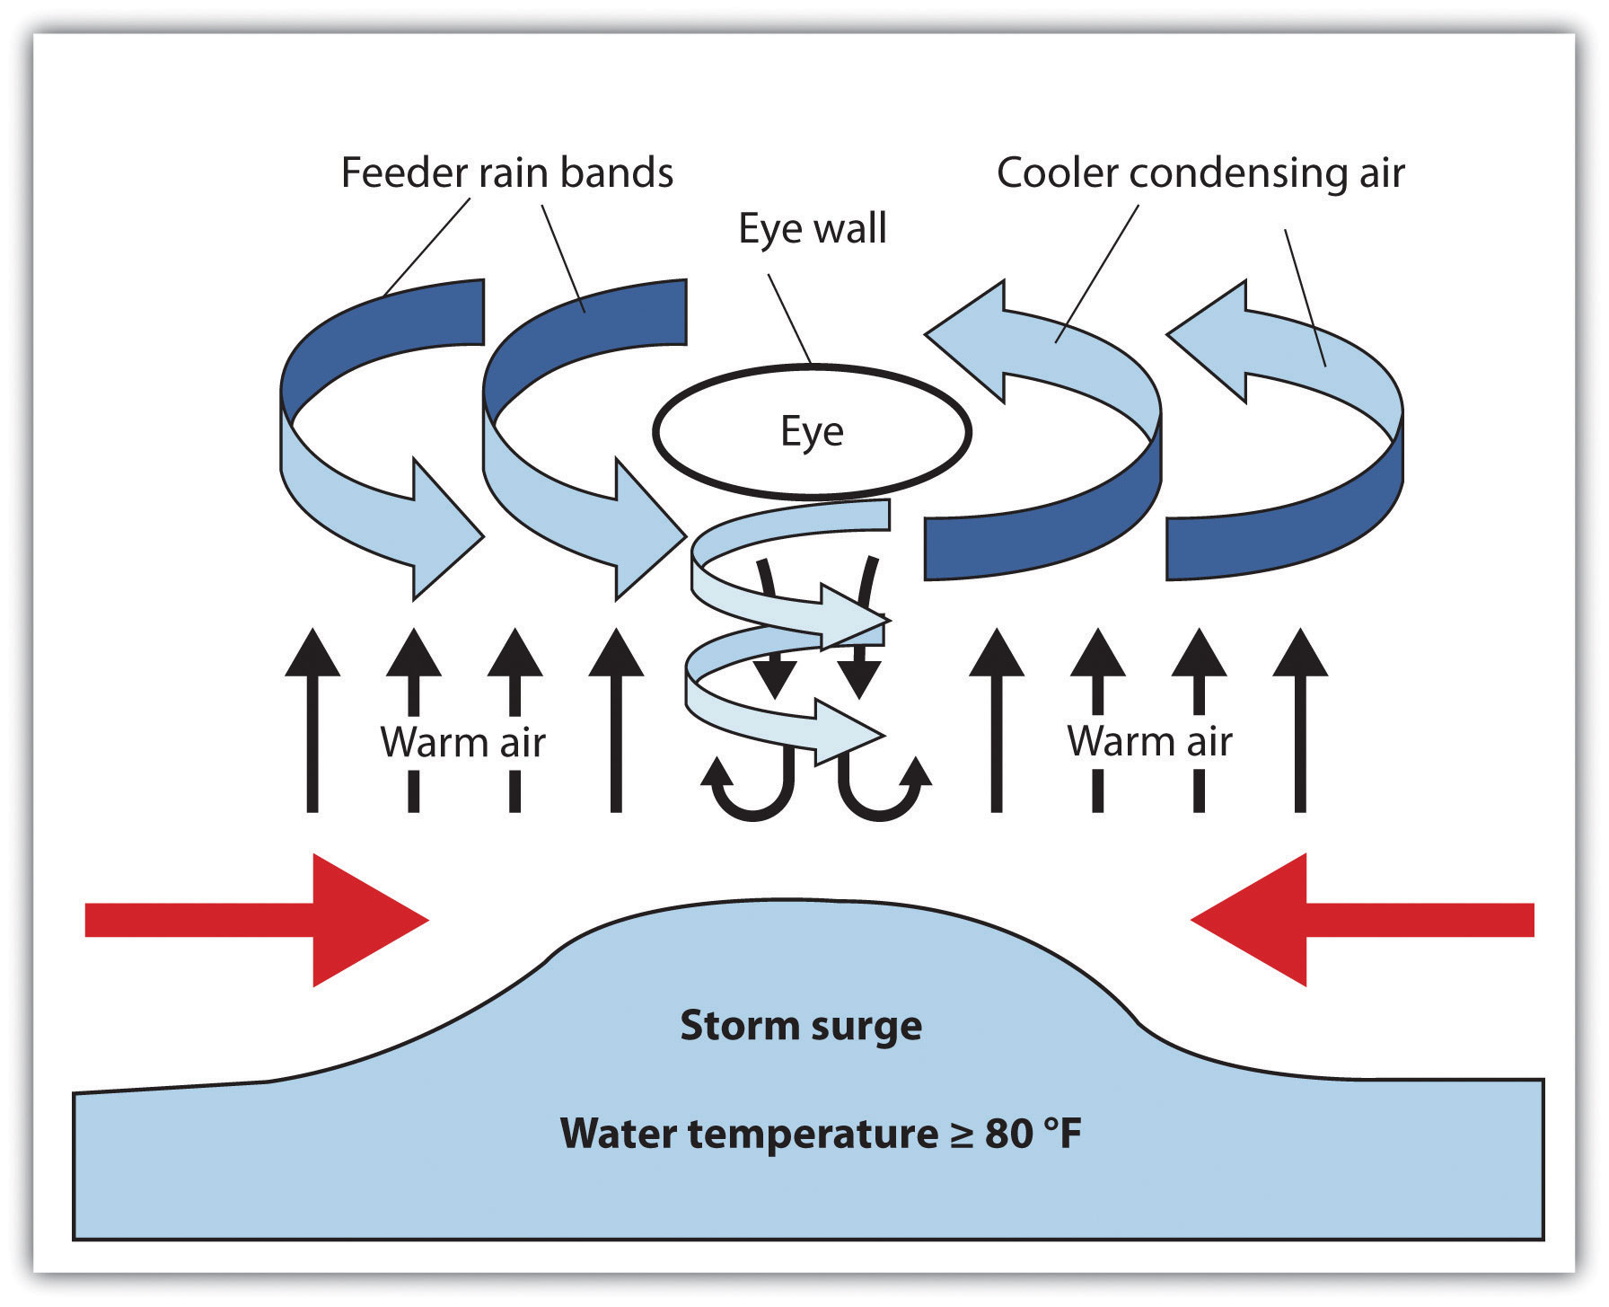
Introduction
The topic for my discussion was the observed increased wind speeds that lead to the formation of tropical storms
Tropical storms result from oscillating winds that form over warm ocean water
Faster winds cause stronger storms
Hurricanes can cause destruction and life loss
Understanding this science has benefits
Notes:
The natural science topic I selected was an increase in the wind speeds that lead to the creation of hurricanes. Hurricanes form as a result of circular winds that form over warm ocean water. The faster the winds circulate the stronger the hurricane. Hurricanes lead to the destruction of property worth millions of dollars and the loss of human life. Hurricane Katrina is one of the most destructive hurricanes to ever make landfall in the continental USA even with the government issuing advance warning. Understanding this topic has a lot of benefits to offer people in the long run

Slide 3
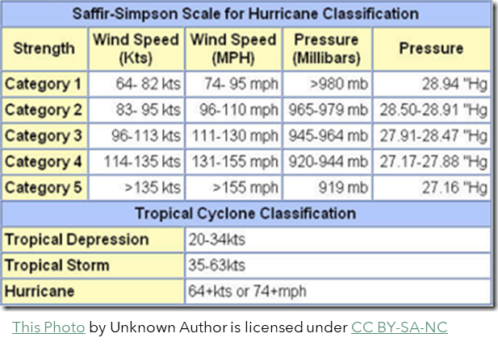
Benefits
Having an understanding of the science behind the topic offers me various benefits
For instance, I get an idea on the science that leads to the formation of hurricanes
It will also help me put my curiosities to rest on the topic as I have a fascination on weather phenomena
I will also benefit other people as it would help them study the resulting weather and their associated effects
It can also inspire people to create technologies to accurately study hurricanes or improve on already existing technologies
Notes:
Learning the science behind this topic has a lot of benefits to both me and other people as well. For instance, I gain an understanding of the phenomenon that results in the formation of hurricanes. I have a fascination about weather phenomena and the understanding of hurricanes will quench my curiosity on the topic. Another benefit is that I also understanding the intricate scientific processes that result in the formation ,of my identified topic on natural science. I will also gain an understanding on the factors that lead to the formation of hurricanes and how frequent they form. It will also benefit others in that they can accurately study hurricanes and their resulting effects. People will also understand just how dangerous hurricanes are and heed warning they receive. An understanding of the science behind it can inspire people to create technologies that can reliably study the science or improve on the already existing technologies.

Slide 4
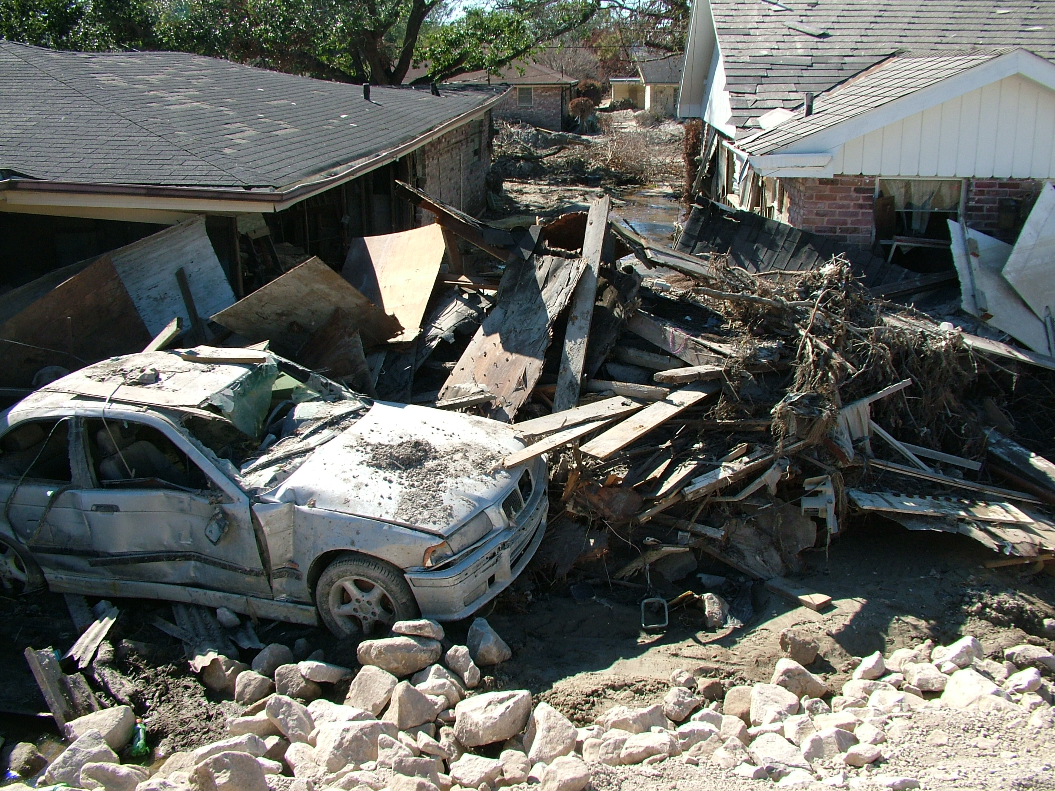
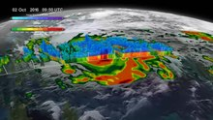
Scientific Question
The question I asked was what people can do to counter the increasing speed of winds that form hurricanes
Answering this question would ensure the safety of people all over the world
It will save people and government institutions money that would have gone to damaged rebuilding infrastructure and structures
Notes:
The scientific question is what we can do to counter the increasing strength of the winds that form hurricanes. Answering this question might effectively give people the power to control hurricanes. It will help in ensuring the safety of people in areas prone to suffering hurricanes. It will also save the people money that they would use in rebuilding after the damage a hurricane would cause.

