Slide 1
Political Parties Parties in Legislative Bodies September 22, 2020
J. Bryan Cole
POLS 3366

Slide 2
The Party in the Government

Slide 3
Overview
During the next couple of weeks, we will explore how the parties in the government work to achieve their objectives, especially desired public policies
Our focus this week concerns legislative bodies, primarily Congress
Broadly, I would like to explore the positive and negative impacts that political parties have on the legislative process

Slide 4
Remember Why Political Parties Form
As we mentioned previously, the pursuit of ideological goals is a big reason for the formation of political parties
Political parties:
Streamline the work necessary to achieve policy goals
Help with elections and reelections

Slide 5
Introduction to Congress

Slide 6
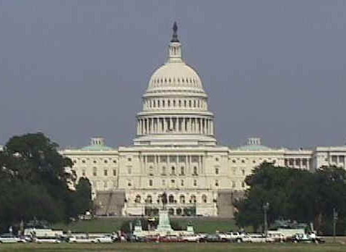
Congress
As the legislative branch, Congress has numerous responsibilities, some of which go far beyond merely passing laws
Remember that the framers believed that Congress would be the most powerful branch of government
Thus, they devoted considerable time and energy to its design

Slide 7
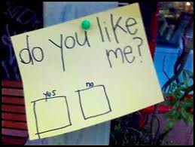
Congress is Very Unpopular
Congress, our nation’s legislative branch, is not known for winning popularity contests!
Wall Street Journal's Interactive Presidential Approval Ratings
Congressional Approval Ratings - Polling Report
Why America Re-elects A Congress It Hates, From NPR, July 16, 2018.
The above clip alludes to what’s known as Fenno’s Paradox

Slide 8
What Do You Think about Congress?
Likes and Dislikes
Role of Political Parties

Slide 9
Powers of Congress
See Article I, Section 8 of the Constitution
Declaring war
Regulate interstate commerce
Power to tax and spend
Ratify treaties (Senate only)
Bureaucratic oversight
To check the power of the President, Congress can:
Ratify treaties (Senate only)
Confirm presidential appointees, including judicial ones (Senate only)
Override presidential vetoes
Impeach the President

Slide 10
The Organization and Operation of Congress

Slide 11
How Congress Operates
Clearly, the U.S. Constitution gives Congress many specific powers and responsibilities
However, it largely allows Congress the freedom to operate itself as it sees fit
Thus, many basic features of Congress have been decided upon by its members; naturally, its members will want to set it up in such a manner as to achieve their goals

Slide 12
How Members of Congress (and Their Political Parties) Achieve Their Goals
Leadership
Committees

Slide 13
Party Leadership in Congress
As we have previously discussed, the political parties in each chamber organize themselves so as to maximize their ability to achieve legislative goals
Party leadership in Congress
House of Representatives
Senate

Slide 14
The 116th Congress: House of Representatives
Speaker of the House Nancy Pelosi (D-CA)
House Minority Leader Kevin McCarthy (R-CA)

Slide 15
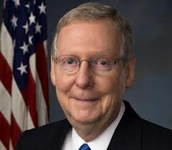
The 116th Congress: Senate
Senate Minority Leader Chuck Schumer (D-NY)
Senate Majority Leader Mitch McConnell (R-KY)

Slide 16
Party Leaders’ Responsibilities Extend Beyond Their Own Parties
In addition to leading one’s own party, the Speaker of the House and Senate Majority Leader are responsible for leading their respective chambers
Crucially, that includes such tasks as agenda setting, e.g. deciding what legislation the chamber will (or won’t) consider

Slide 17
The Work of Congressional Committees
Committees are the basic working units of Congress
They have four basic jobs:
Hold hearings
Review bills and their amendments
Report legislation to the full chamber
Investigate and provide oversight of the executive branch of government

Slide 18
Organization of Committees
The Speaker of the House and Senate Majority Leader:
Refer bills to committees for consideration
Assign members of their caucuses to committees
Likewise, leaders of the minority party assign their own members to committees

Slide 19
Who Gets to Serve on Which Committees?
Bills
Members of Congress
Bills assigned to committees (and subcommittees) on the basis of subject matter
Committees of the House of Representatives
Committees of the United States Senate
Determined by party leadership according to seniority
Members’ preferences are taken into account:
Everyone wants to be on powerful committees
Does it benefit your district/state?

Slide 20
Who Gets to Serve on Which Committees?
Members Make Requests
Party Leaders Have the Final Say
Most members prefer to serve on committees that address issues of special importance to their district/state
Everyone wants to be on powerful committees (Which ones are these?)!
House of Representatives
House Democratic Caucus
House Republican Steering Committee
Senate
Senate Democratic Caucus
Senate Republican Conference

Slide 21
Looking Ahead

Slide 22
Questions to Think About for Next Class
Later this week, we will begin to explore political polarization; bearing that in mind, please think about the question below
What reforms do you think might be necessary to make Congress a more responsive, effective institution?
Here, “effective” means doing what the American people want it to do

