Slide 1
Political Parties
Why Do We Have Political Parties?
September 3, 2020
J. Bryan Cole
POLS 3366

Slide 2
Overview

Slide 3
Political Parties are not Popular
Last class, we saw that two Founding Fathers had grave concerns about political parties
Likewise, while some of you acknowledged purposes that parties serve, the majority expressed concerns about parties
But they date back almost all the way to the beginning of American history, and they aren’t going anywhere anytime soon!

Slide 4
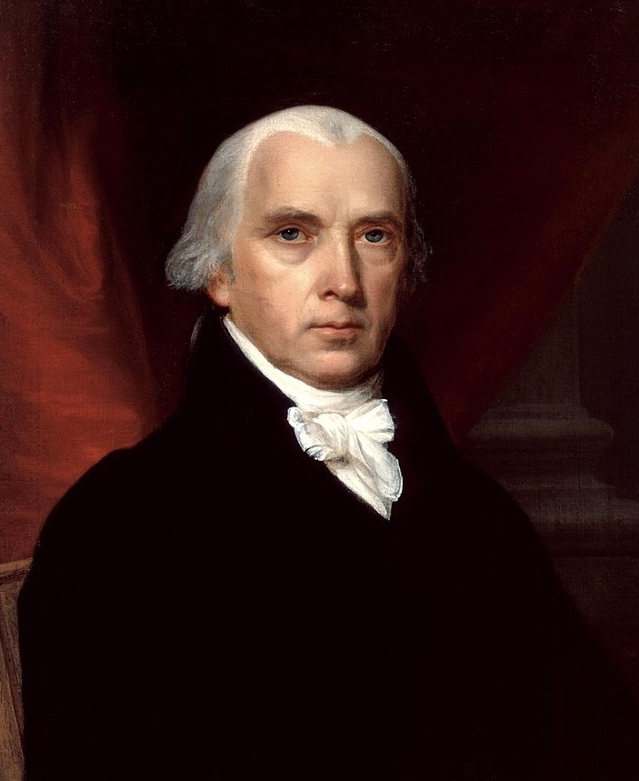
Federalist 51
“Ambition must be made to counteract ambition” (From Federalist 51)
This famous quotation is taken from a discussion of checks and balances in the federal government’s structure
In a few minutes, we will discuss politicians’ ambitions

Slide 5
The Necessity of Political Parties?
Curiously, despite Founding Fathers’ concerns and the public’s lack of enthusiasm, few political scientists believe that democracy is possible in the absence of political parties
The Necessity of Political Parties and the Importance of Compromise | David B. Magleby (18:00-20:34)
“The major political party is the creature of the politicians, the partisan activist, and the ambitious office seeker and officeholder” (Aldrich, Why Parties, p. 5).

Slide 6
Politicians and Political Parties

Slide 7
What Do Politicians Hope to Achieve?
Politicians’ Ambitions
How Must Politicians Realize These Ambitions?

Slide 8
Winning Elections (and Reelections)
As we have discussed, the main purpose of the RNC and DNC is to raise money and maximize the electoral success of their respective parties
Likewise, the following “Hill Committees” are their subsidiaries:
  National Republican Campaign Committee
  Democratic Congressional Campaign Committee
  National Republican Senatorial Campaign Committee
  Democratic Senatorial Campaign Committee

Slide 9
What about Governing?
Likewise, once in office, politicians need to attract a sufficient level of support to implement desired policies
Political parties help to create the coalitions necessary to ensure passage of desired legislation; with parties, such legislation is more likely to pass than if all legislators act independently of one another

Slide 10
Voters and Political Parties

Slide 11
What Do Voters Need to Participate Meaningfully in Elections?

Slide 12
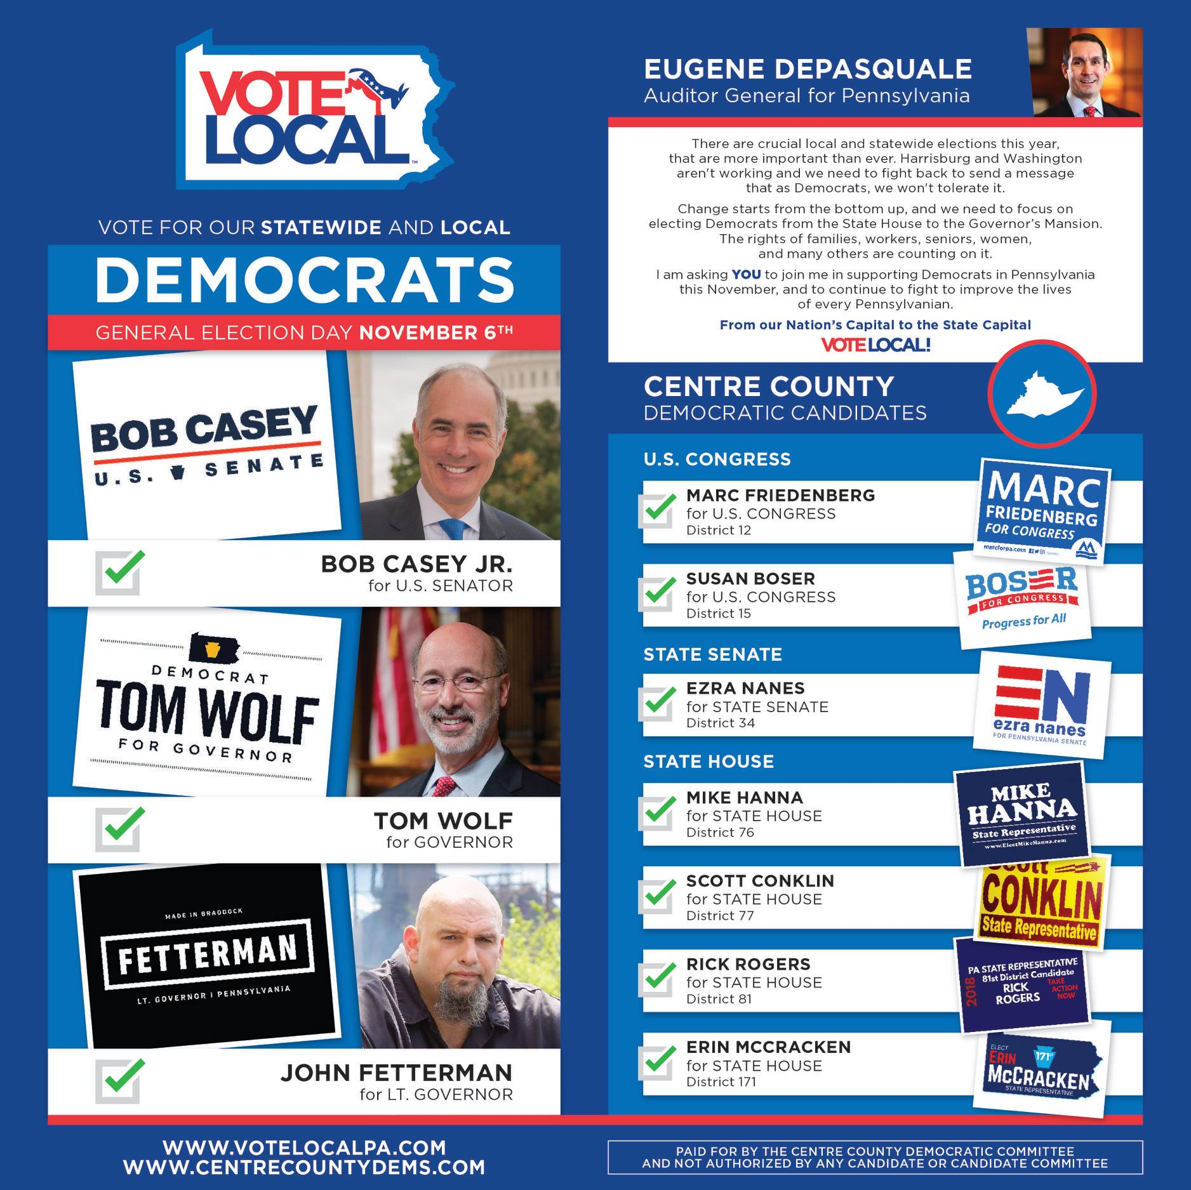
Mobilization of Voters AKA GOTV
Political parties are very active in mobilizing voters
Notice that political parties at all levels can help reduce “costs” for prospective voters

Slide 13
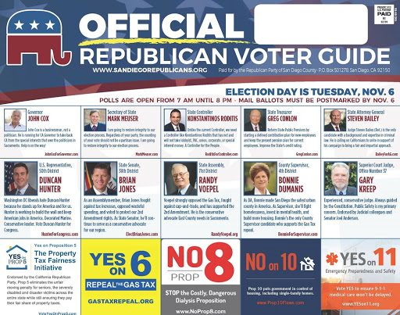
More Voter Mobilization
As you can see with this GOP example, mobilization also includes letting prospective voters know where/when/how to vote
If you’re a candidate, needless to say, you are going to appreciate these efforts

Slide 14
Party Labels
Ideally, if political parties (and their candidates) consistently embrace certain principles, then voters can use these “party labels” to determine more easily whom to support
Notice that the above imply that:
  Candidates must not deviate from what the public expects of them based on their partisan affiliations (at least not drastically)
  The party labels remain consistent across long periods of time

Slide 15
Political Parties and Government Accountability
Political parties also provide a means by which the American people may hold the government accountable
President Obama reflects upon his party's losses in the midterm elections, November 3, 2010.
How do you think that political parties facilitate Americans’ abilities to hold politicians accountable for their actions?

Slide 16
Alternatives to Political Parties

Slide 17
What about Factions?
In this context, factions refer to different groups of people within the same political party
Although some scholars have argued that factions may serve these purposes in places with only one dominant party, others have argued that factions are problematic because they lack:
  Accountability
  Competition
  Durability

Slide 18
Looking Ahead

Slide 19
Political Parties and Political Party Systems are Constants Throughout American History
Over the next week or so, we will explore the history of American political parties and party systems
Although parties and party systems have come and gone, we will see that they have always existed in some form

