Slide 1

Essentials of Sociology
Thirteenth Edition
Chapter 8
Social Class in the
United States

Slide 2
Learning Objectives (1 of 3)
8.1 Explain the three components of social class—property, power, and prestige; distinguish between wealth and income; explain how property and income are distributed; and describe the democratic façade, the power elite, and status inconsistency.
8.2 Contrast Marx’s and Weber’s models of social class.

Slide 3
Learning Objectives (2 of 3)
8.3 Summarize the consequences of social class for physical and mental health, family life, education, religion, politics, and the criminal justice system.
8.4 Contrast the three types of social mobility, review gender issues in research on social mobility, and explain why social mobility brings pain.

Slide 4
Learning Objectives (3 of 3)
8.5 Explain the problems in drawing the poverty line and how poverty is related to geography, race–ethnicity, education, feminization, and age.
8.6 Contrast the dynamics of poverty with the culture of poverty, explain why people are poor and how deferred gratification is related to poverty, and comment on the Horatio Alger myth.
8.7 Discuss the possibility that we are developing a three-tier society.

Slide 5
What is Social Class?
8.1 Explain the three components of social class—property, power, and prestige; distinguish between wealth and income; explain how property and income are distributed; and describe the democratic façade, the power elite, and status inconsistency.
Property
Power
Prestige
Status Inconsistency

Slide 6
Property (1 of 4)
Distinguishing between wealth and income
Distribution of property
Distribution of income

Slide 7

Property (2 of 4)
A mere one-half percent of Americans owns over a quarter of the entire nation’s wealth. Very few minorities are numbered among this 0.5 percent. An exception is Oprah Winfrey, who has had an ultra-successful career in entertainment and investing. Worth $3.0 billion, she is the 239th richest person in the United States. Winfrey has given millions of dollars to help minority children.

Slide 8
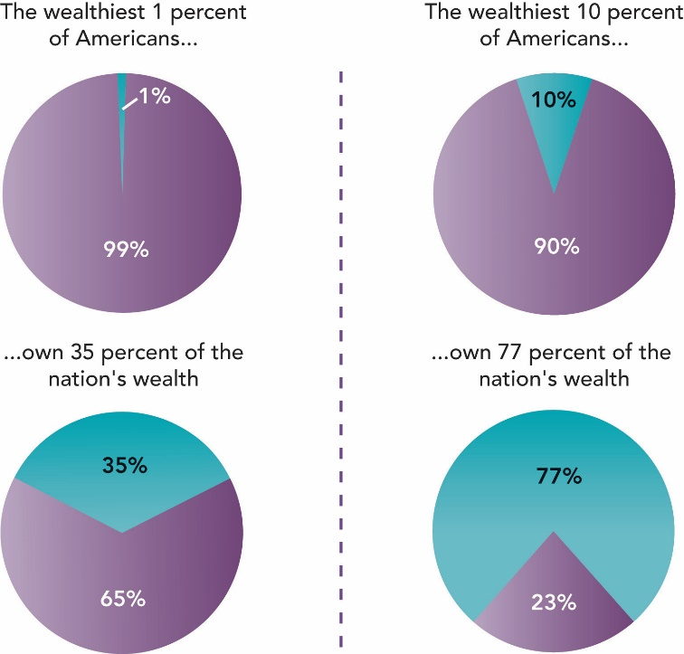
Figure 8.1 Distribution of the Wealth of Americans
Pie charts showing the proportion of wealth in the U.S. owned by the wealthiest people.
Source: By the author. Based on Wolff 2013.

Slide 9
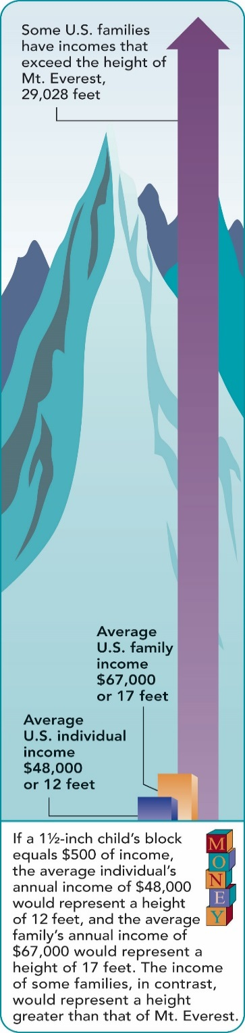
Figure 8.2 How the Income of Americans Is Distributed
Graphic representation of the income differences in the U.S.
Source: By the author. Based on
Statistical Abstract of the United States 2017:Tables 705, 723.

Slide 10
Property (3 of 4)
Table 8.1 The Five Highest-Paid CEOs
Name | Company | Compensation
Marc Lore | Walmart | $237 million
Tim Cook | Apply | $150 million
John Weinberg | Evercore Partners | $124 million
Sundar Pichai | Alphabet | $107 million
Elon Musk | Tesla | $100 million
Source: Melin 2017.

Slide 11
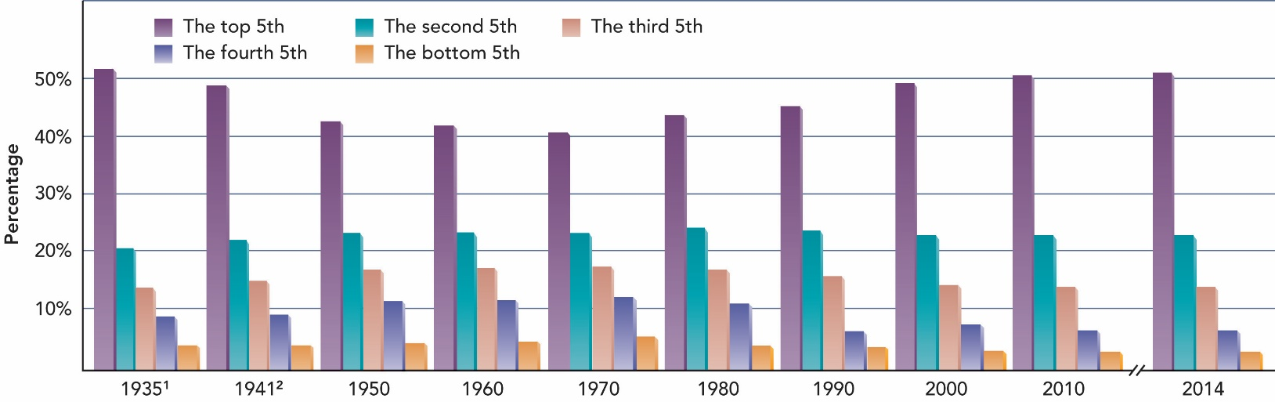
Figure 8.3 The More Things Change, the More They Stay the Same: Dividing the Nation’s Income
¹Earliest year available. ²No data for 1940.
Source: By the author. Based on Statistical Abstract of the United States 1960:Table 417; 1970:Table 489; U.S. Census Bureau. Income, Poverty and Health
Insurance Coverage in the United States: 2014. Historical Tables, Income, Households, Table H-2. 2016 ; Statistical Abstract of the United States 2017:Table 721.

Slide 12

Property (4 of 4)
At 533 feet, the Eclipse is the world's second largest yacht. It is owned by Roman Abramovich of Russia, the world's 11th richest person.

Slide 13
Power
The democratic façade
The power elite

Slide 14
Prestige (1 of 7)
Occupations and prestige
Displaying prestige

Slide 15
Prestige (2 of 7)
Table 8.2 Occupational Prestige: How the United States Compares with Sixty Countries
Occupation | United States | Average of Sixty Countries
Physician | 86 | 78
Supreme Court judge | 85 | 82
College president | 81 | 86
Astronaut | 80 | 80
Lawyer | 75 | 73
College professor | 74 | 78
Airline pilot | 73 | 66
Architect | 73 | 72
Biologist | 73 | 69

Slide 16
Prestige (3 of 7)
Table 8.2 Occupational Prestige: How the United States Compares with Sixty Countries
Occupation | United States | Average of Sixty Countries
Dentist | 72 | 70
Civil engineer | 69 | 70
Clergy | 69 | 60
Psychologist | 69 | 66
Pharmacist | 68 | 64
High school teacher | 66 | 64
Registered nurse | 66 | 54
Professional athlete | 65 | 48
Electrical engineer | 64 | 65

Slide 17
Prestige (4 of 7)
Table 8.2 Occupational Prestige: How the United States Compares with Sixty Countries
Occupation | United States | Average of Sixty Countries
Author | 63 | 62
Banker | 63 | 67
Veterinarian | 62 | 61
Police officer | 61 | 40
Sociologist | 61 | 67
Journalist | 60 | 55
Classical musician | 59 | 56
Actor or actress | 58 | 52
Chiropractor | 57 | 62

Slide 18
Prestige (5 of 7)
Table 8.2 Occupational Prestige: How the United States Compares with Sixty Countries
Occupation | United States | Average of Sixty Countries
Athletic coach | 53 | 50
Social worker | 52 | 56
Electrician | 51 | 44
Undertaker | 49 | 34
Jazz musician | 48 | 38
Real estate agent | 48 | 49
Mail carrier | 47 | 33
Secretary | 46 | 53
Plumber | 45 | 34

Slide 19
Prestige (6 of 7)
Table 8.2 Occupational Prestige: How the United States Compares with Sixty Countries
Occupation | United States | Average of Sixty Countries
Carpenter | 43 | 37
Farmer | 40 | 47
Barber | 36 | 30
Store sales clerk | 36 | 34
Truck driver | 30 | 33
Cab driver | 28 | 28
Garbage collector | 28 | 13
Waiter or waitress | 28 | 23
Bartender | 25 | 23

Slide 20
Prestige (7 of 7)
Table 8.2 Occupational Prestige: How the United States Compares with Sixty Countries
Occupation | United States | Average of Sixty Countries
Lives on public aid | 25 | 16
Bill collector | 24 | 27
Factory worker | 24 | 29
Janitor | 22 | 21
Shoe shiner | 17 | 12
Street sweeper | 11 | 13
NOTE: The rankings are based on 1 to 100, from lowest to highest. For five occupations not located in the 1994 source, the 1991 ratings were used: Supreme Court judge, astronaut, athletic coach, lives on public aid, and street sweeper.
Sources: Treiman 1977: Appendices A and D; Nakao and Treas 1990, 1994: Appendix D.

Slide 21
Status Inconsistency (1 of 2)
Ranking higher on some dimensions of status than others
  Lenski’s study
  Gold’s study
  A health issue

Slide 22
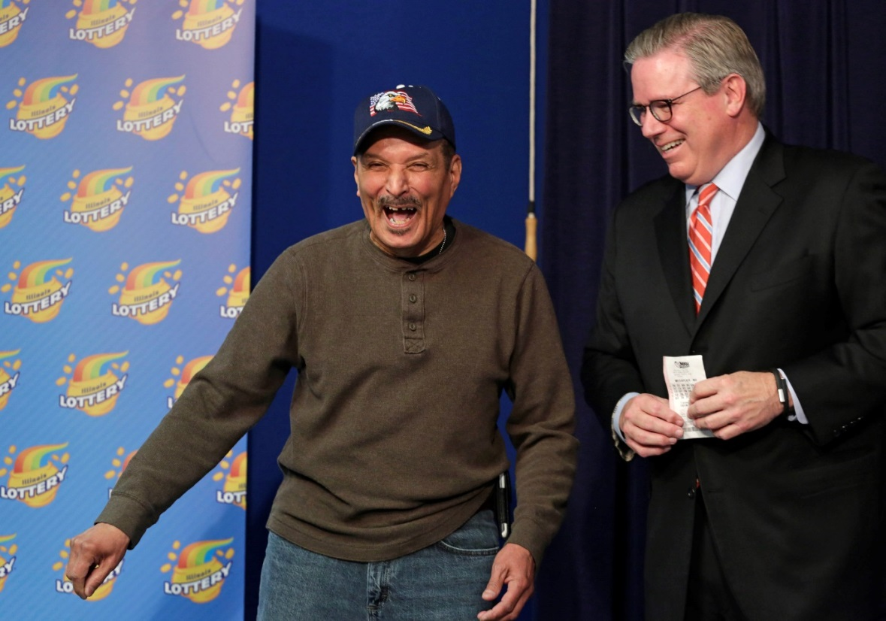
Status Inconsistency (2 of 2)
Jesús Davila, winner of $265 million in the Illinois lottery, who is retired, used to drive cars for a living. How do you think his lottery win will change his life?

Slide 23
Sociological Models of Social Class (1 of 3)
8.2 Contrast Marx’s and Weber’s models of social class.
Updating Marx
Updating Weber

Slide 24
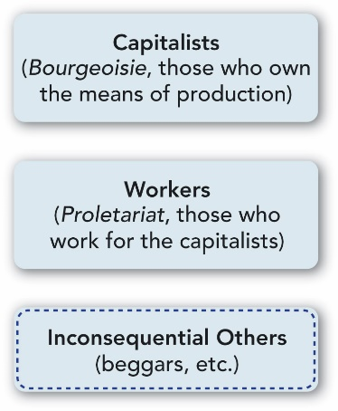
Figure 8.4 Marx’s Model of the Social Classes
Source: By the author.

Slide 25
Figure 8.5 Wright’s Modification of Marx’s Model of the Social Classes
 | 1. Capitalists
 | 2. Petty bourgeoisie
 | 3. Managers
 | 4. Workers

Slide 26
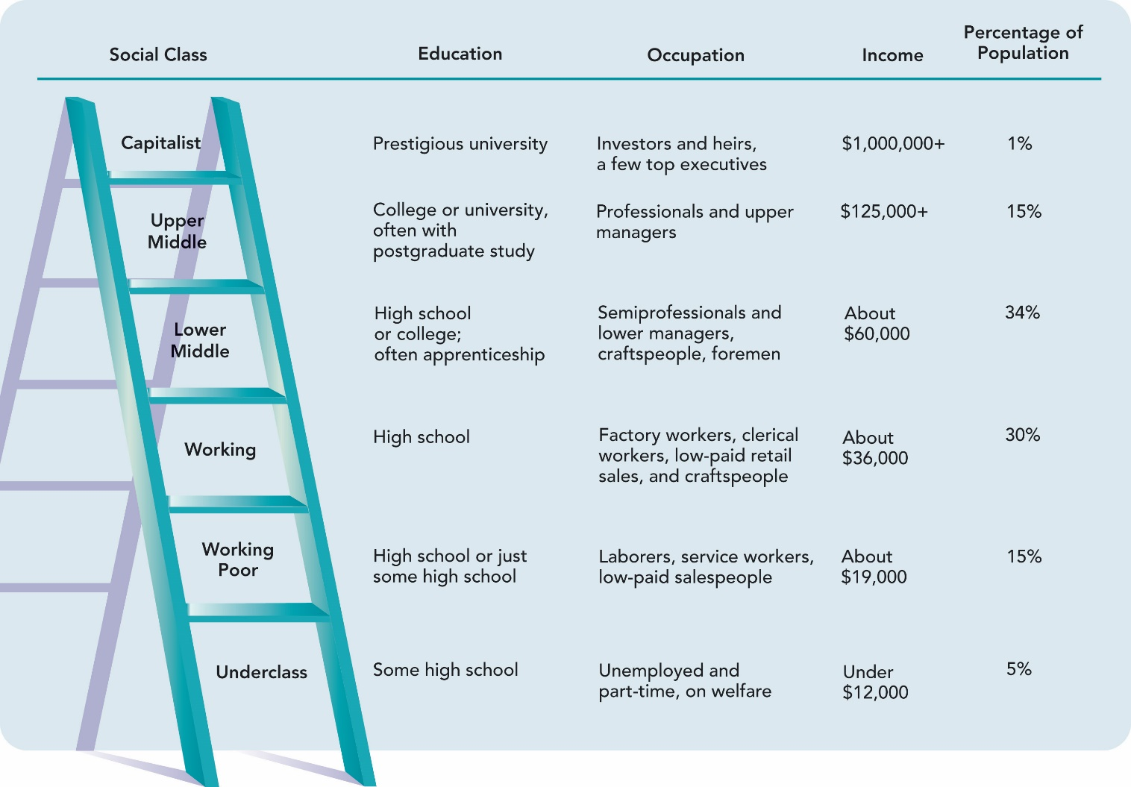
Figure 8.6 The U.S. Social Class Ladder
Source: By the author. Based on Gilbert and Kahl 1998 and Gilbert 2014; income estimates are inflation-adjusted and modified from Duff 1995.

Slide 27

Sociological Models of Social Class (2 of 3)
The wealthiest person on the planet: Bill Gates, the cofounder of Microsoft, is worth $86 billion. He has also given away $30 billion, more than anyone in history.

Slide 28

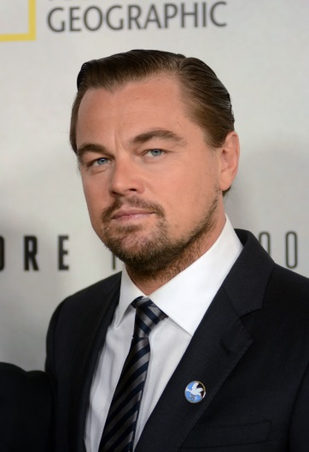

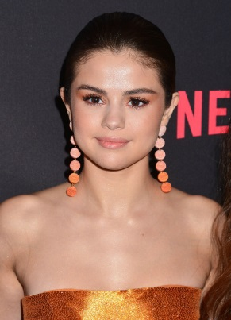
Sociological Models of Social Class (3 of 3)
Sociologists use income, education, and occupational prestige to measure social class. For most people, this works well, but not for everyone, especially entertainers. To what social class do these celebrities belong? Here is their net worth: Leonardo DiCaprio $245 million, Taylor Swift $380 million, Dwayne Johnson $65 million, and Selena Gomez $54 million.

Slide 29
Consequences of Social Class (1 of 4)
8.3 Summarize the consequences of social class for physical and mental health, family life, education, religion, politics, and the criminal justice system.
Physical Health
Mental Health
Family Life
Education
Religion
Politics
Crime and Criminal Justice

Slide 30
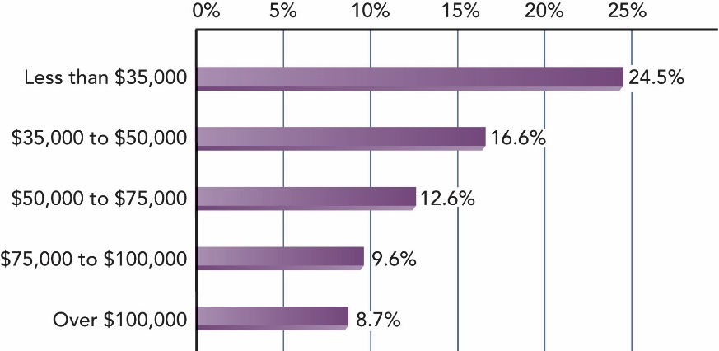
Figure 8.7 Physical Health, by Income: People Who Have Difficulty with Everyday Physical Activities
Bar
graph
showing
the
correlation
between
lower
income
and greater
likelihood
of physical
difficulties.
NOTE: In a national health survey, these people said they had difficulty walking, climbing steps, stooping, reaching overhead, grasping small objects, and carrying over 10 pounds.
Source: By the author. Based on Schiller et al. 2012:Table 19.

Slide 31
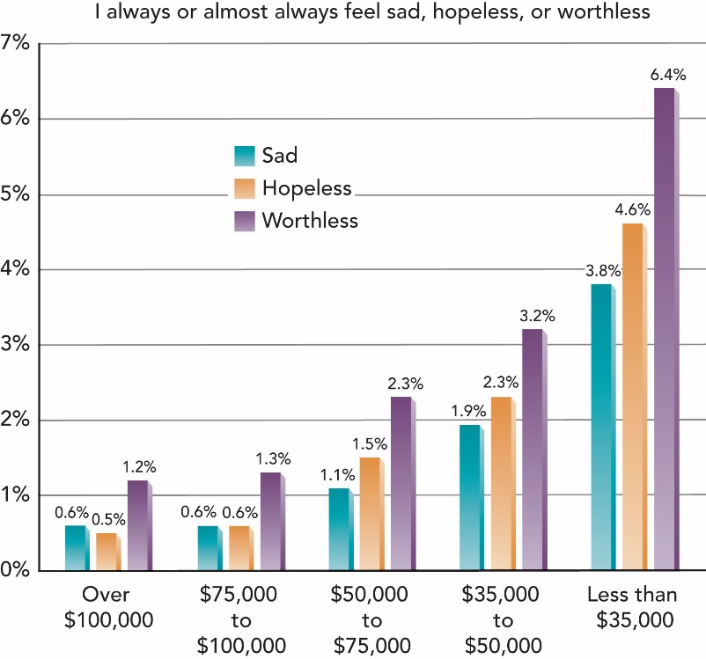
Figure 8.8
Mental Health, by Income: Feelings of
Sadness, Hopelessness, or Worthlessness
Bar graph showing the correlation between lower income and greater likelihood of emotional difficulties.
NOTE: In a national health survey, these people answered “Always” or “Almost
always” when they were asked how often they felt sad, hopeless, or worthless.
Source: By the author. Based on Schiller et al. 2012:Table 14.

Slide 32

Consequences of Social Class (2 of 4)
Among the customs of the rich, sometimes called the monied class, is ostentatious philanthropy. Shown here are women at the Frederick Law Olmsted lunch, a charity event in New York City. The women try to outdo one another with hats created for this event.

Slide 33
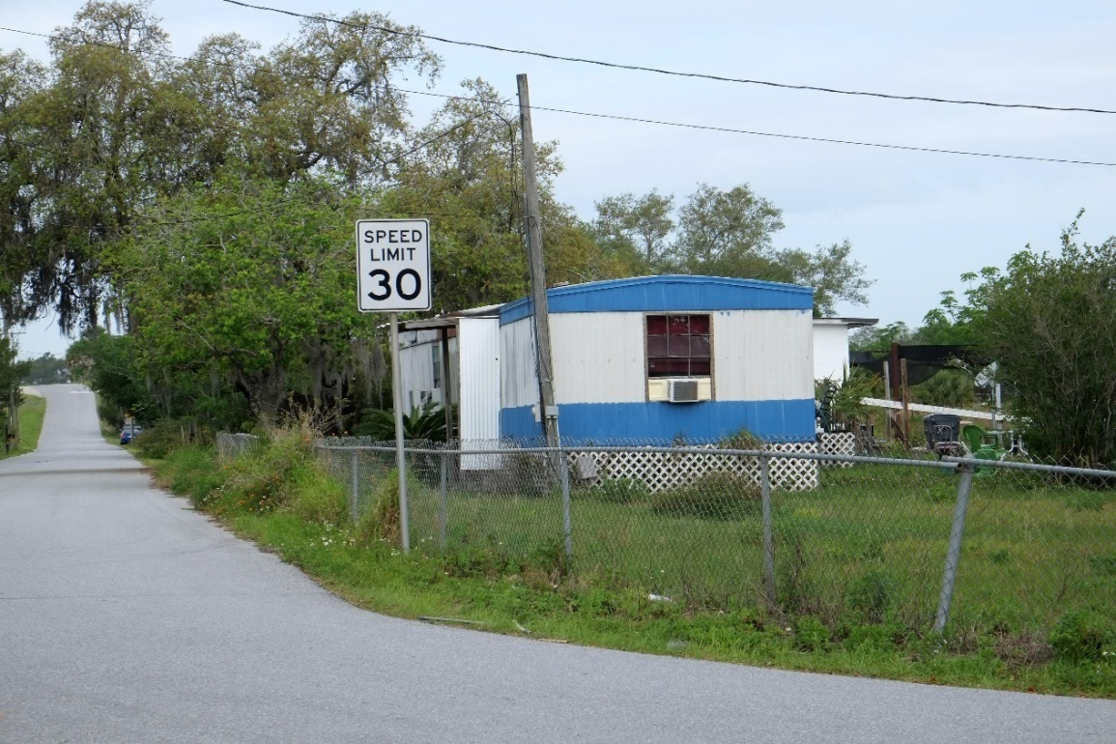
Consequences of Social Class (3 of 4)
The disparities of social class in the United States are extreme. If you take the back roads in rural America, you will see thousands of trailers like this one in Davenport, Florida.

Slide 34
Consequences of Social Class (4 of 4)
Education
  Type as well as amount of schooling
Religion
  Type of denomination
Politics
  Type of view on economic and social issues
Crime and Criminal Justice
  Type as well as amount of consequences

Slide 35
Social Mobility (1 of 2)
8.4 Contrast the three types of social mobility, review gender issues in research on social mobility, and explain why social mobility brings pain.
Three Types of Social Mobility
  Intergenerational mobility
  Structural mobility
  Exchange mobility
Women in Studies of Social Mobility
The Pain of Social Mobility

Slide 36
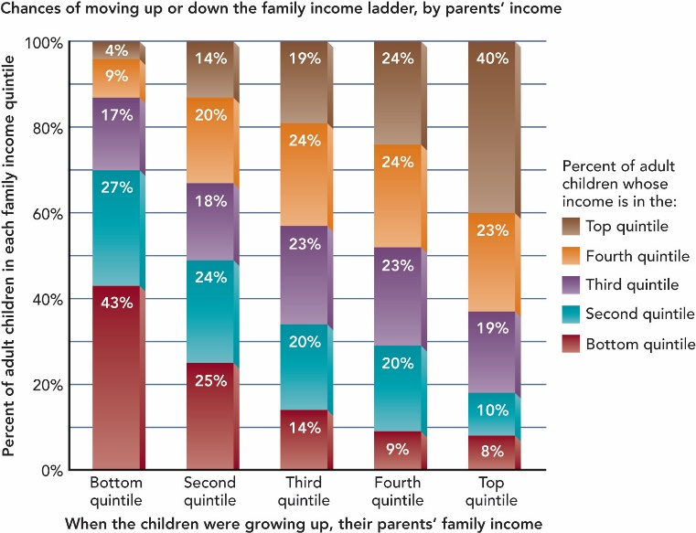
Figure 8.9
Income of
Adult Children Compared with that of Their Parents
Source: Pursuing the American Dream: Economic Mobility Across Generations,
p. 6. © July, 2013 the Pew Charitable Trusts.

Slide 37
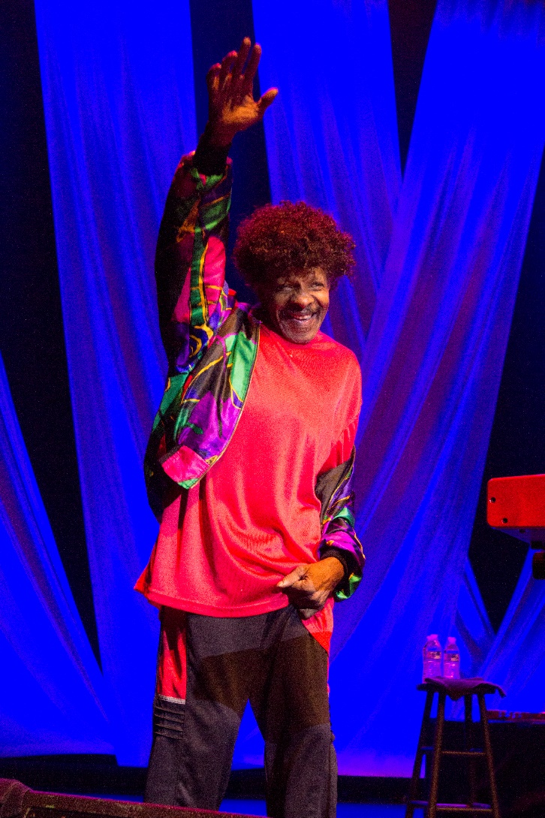
Social Mobility (2 of 2)
Both downward and upward social mobility bring challenges that require life adjustments. An extreme instance is the case of Sly Stone, the front man of the 1970s funk band, Sly and the Family Stone. His saga includes going from wealth of millions to living in a van.

Slide 38
Poverty
8.5 Explain the problems in drawing the poverty line and how poverty is related to geography, race–ethnicity, education, feminization, and age.
Drawing the Poverty Line
Who Are the Poor?
Children of Poverty

Slide 39
Drawing the Poverty Line
Arbitrary line
Official measure of poverty

Slide 40
Who Are the Poor?
The geography of poverty
Race–ethnicity
Education
The feminization of poverty
Old age

Slide 41
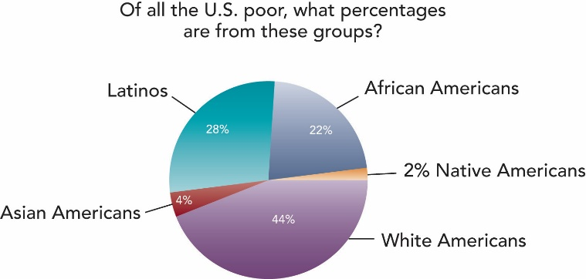
Figure 8.10 An Overview of Poverty in the United States
Pie chart showing the proportion of the poor who are in the various racial-ethnic groups.
Source: By the author. Based on Statistical Abstract of the United States 2017:Table 35.

Slide 42
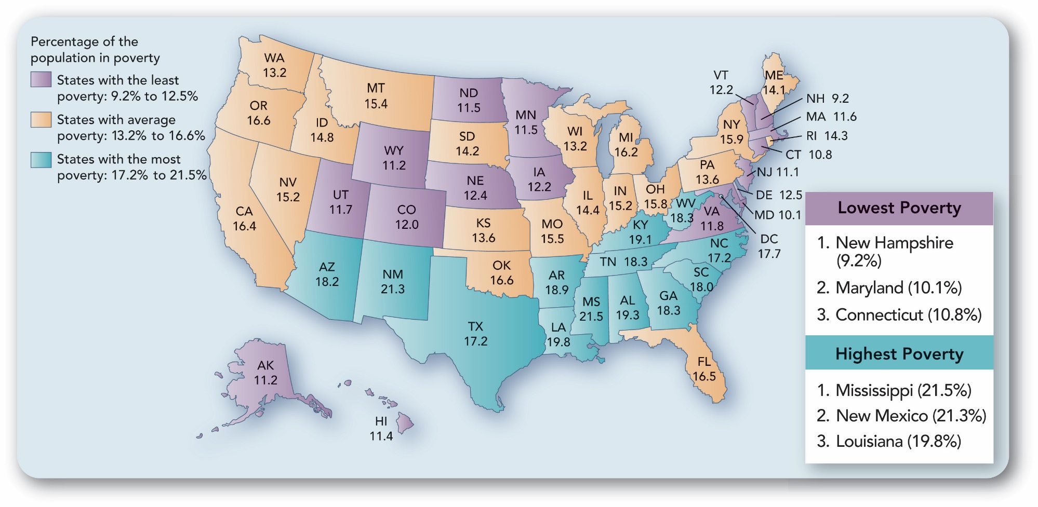
Figure 8.11 Patterns of Poverty
U.S. map showing state-by-state percentages of those in poverty.
Source: By the author. Based on Statistical Abstract of the United States 2017:Table 734.

Slide 43
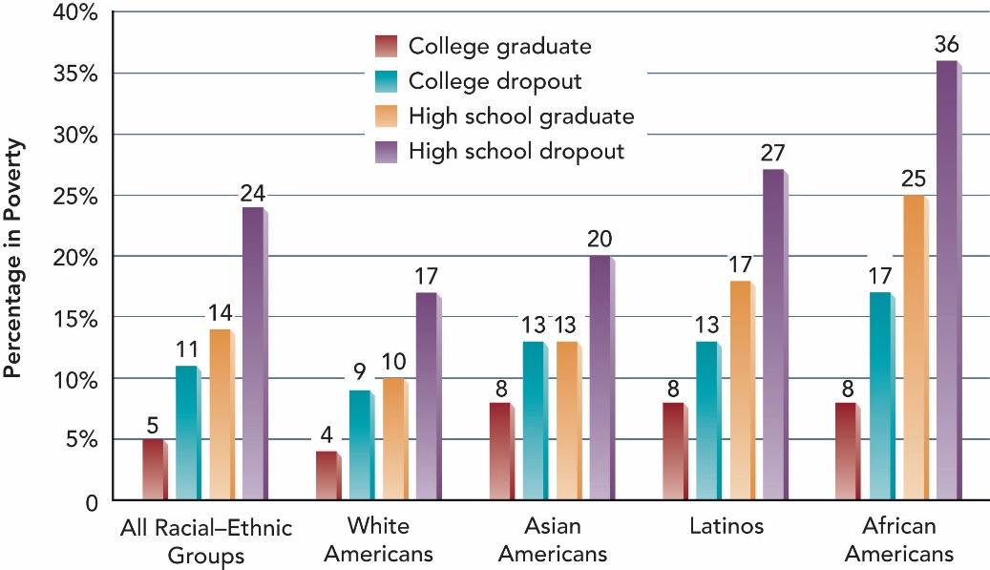
Figure 8.12 Who Ends Up Poor? Poverty by Education and Race–Ethnicity
Source: By the author. Based on U.S. Census Bureau 2016b:Table POV29.

Slide 44
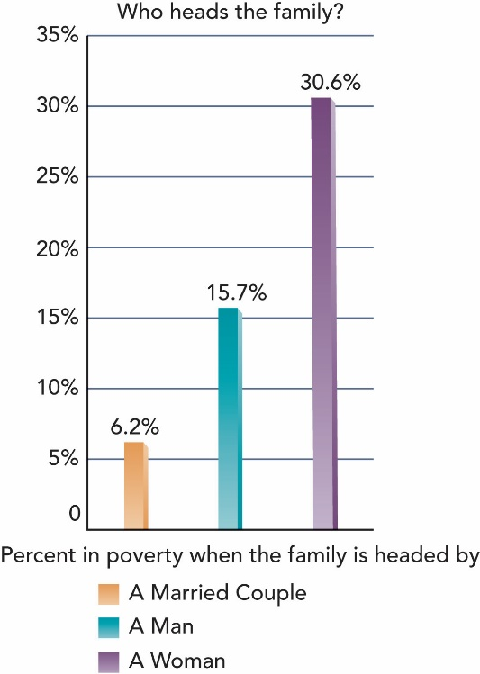
Figure 8.13 Poverty and Family Structure
Bar graph showing the greater likelihood of poverty for female-headed families.
Source: By the author. Based on Statistical Abstract of the United States 2017:Table 741.

Slide 45
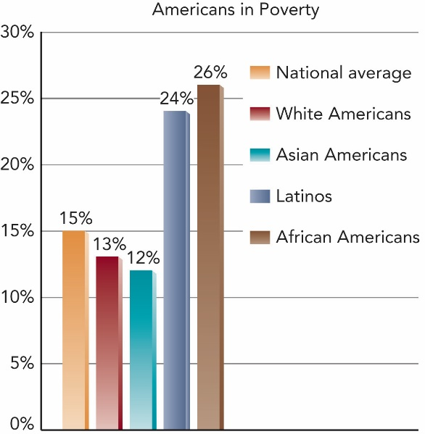
Figure 8.14 Poverty and Race-Ethnicity
Bar graph demonstrating the disproportionate likelihood for Latinos and African Americans to be poor.
Source: By the author. Based on Statistical Abstract of the United
States 2017:Table 738.

Slide 46
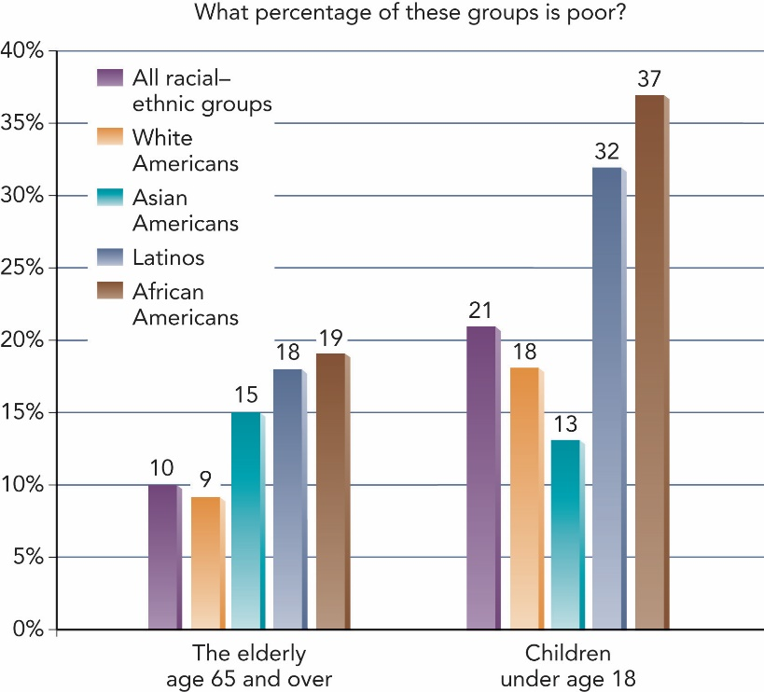
Figure 8.15 Poverty, Age, and Race-Ethnicity
Bar graph demonstrating the greater likelihood of some racial-ethnic groups’ youth and/or elderly to be in poverty than others.
NOTE: Only these groups are listed in the source. The poverty line is $24,230 for a
family of four.
Source: By the author. Based on Statistical Abstract of the United States 2017:Tables
35, 735, 738.

Slide 47
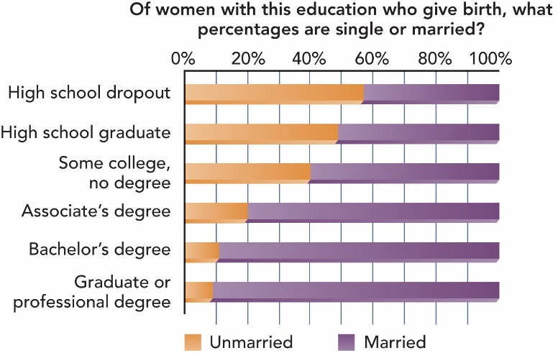
Figure 8.16
How Does
Education Influence Births to
Single Women
Bar graph showing the correlation between higher levels of education and lower percentages of births to single women.
Source: Shuttuck and Kreider 2013:Table 2.

Slide 48
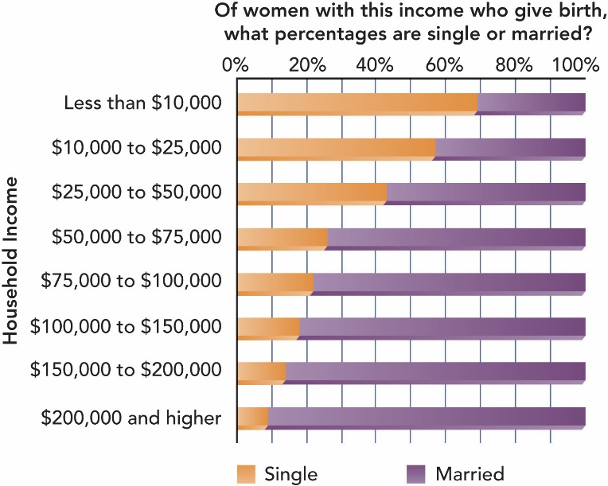
Figure 8.17
How Does
Income
Influence
Births to
Single Women
Bar graph showing the correlation between higher incomes and lower percentages of births to single women.
Source: Shuttuck and Kreider 2013:Table 2

Slide 49
Children of Poverty
Children are more likely to be poor
  Especially when Latino or African American
  Especially when compared with the elderly

Slide 50
The Dynamics of Poverty Versus the Culture of Poverty
8.6 Contrast the dynamics of poverty with the culture of poverty, explain why people are poor and how deferred gratification is related to poverty, and comment on the Horatio Alger myth.
Why Are People Poor?
Deferred Gratification
Where is Horatio Alger?
  The social functions of a myth

Slide 51
Why Are People Poor?
Social structure
Characteristics of individuals
Poverty triggers

Slide 52
Deferred Gratification
Behaviors of the poor
  Cause or result of poverty?

Slide 53
Where is Horatio Alger? The Social Functions of a Myth
Encourages people to strive to get ahead
Blames individuals for their failures

Slide 54
Peering into the Future: Will We Live in a Three-Tier Society?
8.7 Discuss the possibility that we are developing a three-tier society.
Three Tiers
  Wealthy
  Technically trained
  Jobless poor
Two “Solutions” to Defer Upheaval
  Pacification
  Militarization of police

