Slide 1
Kolcaba’s Theory of Comfort

Slide 2
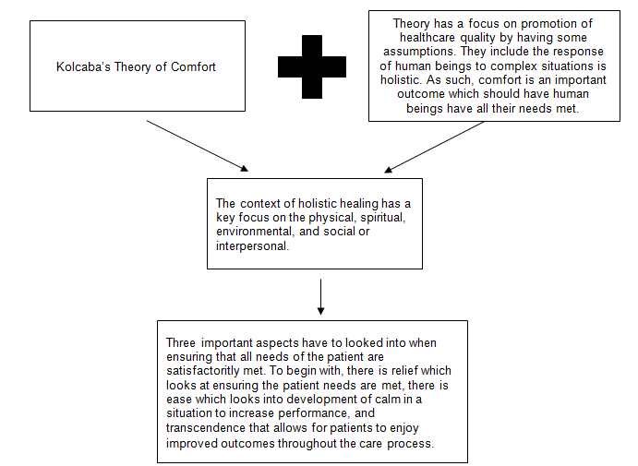
Kolcaba’s Theory of Comfort
a
a
Notes:
Kolcaba’s theory of comfort is important as it focuses on the creation of outcomes that cover various aspects of the human being in the nursing environment. The theory has a key promotion of healthcare quality by making some key assumptions. The assumptions include that human beings have a holistic response to complex situations, as an outcome comfort is desired, and human beings look at ensuring the patient needs are met (Kolcaba et al., 2006). This has an effect on nursing practice by looking into the identification of various states to be considered as aspects that look into ensuring that various needs of the patient are met. There is a key aspect of ease that looks at having calm when a situation arises to increase performance. This is also supported by the transcendence which looks at having the patient enjoy improved outcomes from the process. There is a key focus on the context which looks at having holistic healing and has a focus on the physical, spiritual, social, and the environment in delivery of care. The context is an important part that looks into the mix of the various states to have improved outcomes.

Slide 3
Kolcaba’s Theory of Comfort
References
Kolcaba, K., Tilton, C., Drouin, C. (2006). Comfort Theory. The Journal of Nursing Administration 36(11):538-544. DOI: 10.1097/00005110-200611000-00010

