Slide 1
Learning outcomes
After completing this chapter, you should be able to:
  Explain the nature of, and the benefits of follower-centric approaches to understanding leader-follower relations and the leadership process.
  Understand positivist/entity and social constructionist perspectives on relational leadership.
  Explain how the dyadic and group relationships dynamics influence the leadership process.
  Critically discuss the competing views of what distributed leadership represents in organizations.
  Engage critically with important themes in team leadership.

Slide 2
Introduction
Follower-centric approaches cultivate the opinion that followers’ self-concept – how we perceive ourselves through attitudes, values, perceptions, emotion - directly influences the leader-follower relationship and effectiveness, which has given rise to relational and distributed leadership theories.
Follower-centric theories explore leadership as an interdependent relationship that involves the leader and follower (s), entwined in a socially constructed purposeful relational process of influence (Adair 2008; Shamir et al. 2007; Riggio et al., 2008).

Slide 3
Introduction
Distributed theories of leadership shift the focus away from leaders in hierarchical positions within the organization to viewing followers as reflective and proactive: as leaders across the organization.

Slide 4
Classical relational studies
Individuals not only shape the relations they engage in, but also are simultaneously shaped by reciprocal human interactions.
For Simmel (1858-1918), society is constituted of a web of interactional forces between individuals and groups, and his focus on the concept of reciprocity emphasized that every single social phenomenon has meaning only through its relationships with others.

Slide 5
Classical relational studies
Simmel investigated the influence of numbers upon human relationships, whereby the size of a group influences how individuals interact with one another (refer Figure 8.1).
In general, the larger the size of the group, the more its members can become dissimilar to each other, and more independence and intellectual development can take place. However, Simmel observed that the individual’s inner personal unity is based upon the interaction and connection of many elements and determinants.

Slide 6
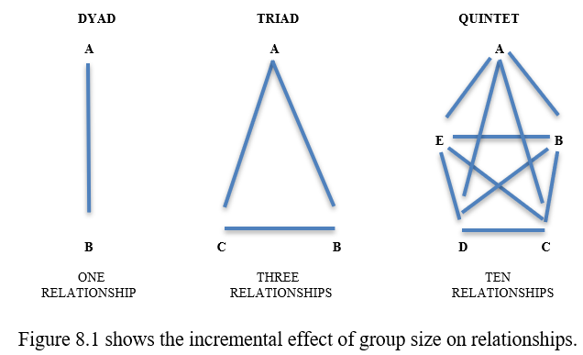
Classical relational studies

Slide 7
Classical relational studies
Mead analyzed in detail how the human self is created by social processes, emphasizing that the human mind developed thanks to co-operation and complex social relationships.
He also wrote that, “We attempt…to explain the conduct of the individual in terms of the organized conduct of the social group, rather than…in terms of the conduct of the separate individuals belonging to it” (1934, p. 7).

Slide 8
Classical relational studies
Mead’s theory of self incorporates the crucial condition of “reflexiveness” – the ability to unconsciously turn-back the experience of the individual upon himself – for the development of the human mind.
Mead views the mind in terms of what it does, the role it plays in human interaction. He emphasized the significance of human intersubjectivity: a myriad of human interactions, individual self-reflection and meaning that is modified through social interaction.

Slide 9
Contemporary theories of relational leadership
The focus is on dynamic leadership relationship between leaders and followers in which influence is interactionally and dialectically achieved leading to reconfiguration of management practices and relationship development.
Subsequently, the focus is extended onto the nature of the vertical interactions leaders engage in with each of their followers because leadership effectiveness depends on the ability of a leader to create high-quality relationships with others in the organization.
Where leadership is always dependent on the context, the context is established by positive symbiotic relationships.

Slide 10
Contemporary theories of relational leadership
Relational leadership has been defined as:
  A social influence process through which emergent coordination (i.e. evolving social order) and change (e.g. new values, attitudes, approaches, behaviours, and ideologies) are constructed and produced (Uhl-Bien, 2006, p. 655).
    This definition proposed that a ‘relational’ orientation to understanding leadership starts not with an individual leader or follower but with social interaction, and views leadership as relationally co-constructed (Fairhurst, 2007).

Slide 11
Contemporary theories of relational leadership
Ontology and relational leadership
  ‘Does social reality exist independent of our perceptions?’
  ‘Is what passes for reality merely a set of mental constructions?’
    If we lean more to the first question, the more we move towards the positivist position. This view maintains that there is such a thing as social reality and it is the researcher’s job to discover what that reality is.
    If we lean more to the second question, the more we move towards the social constructionist position, whereby the view is that there are no facts, only interpretations.

Slide 12
Contemporary theories of relational leadership
  ‘Is social reality largely fixed, something that individuals and groups have to confront but over which they little or no control, akin to the weather?’
  ‘Is social reality not necessarily pre-existing but fluid, and open to be shaped by individuals and groups through their social interactions and agency?’
    The same conclusion is reached here as the first set of questions asked.

Slide 13
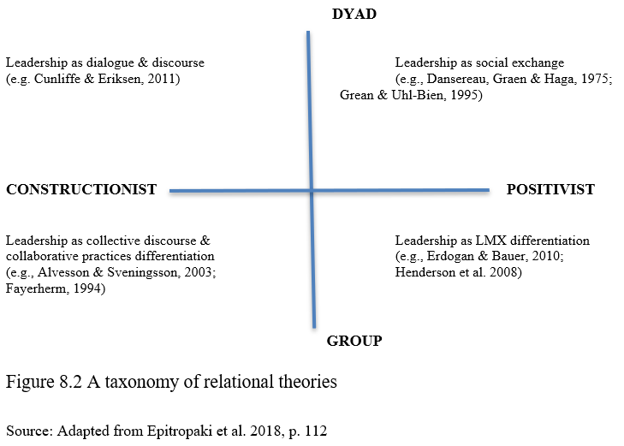
Contemporary theories of relational leadership

Slide 14
Positivist dyadic relational perspectives
Leaders and followers are treated as stable entities that have different roles in the organizational context.
Leader-member exchange (LMX) theory focuses on the quality of the dyadic relationship between a leader and an individual (see Figure 8.3). It argues that because followers are uniquely different, leaders should establish a special relationship with each of her or his followers, rather than treating followers as a homogeneous group.

Slide 15
Positivist dyadic relational perspectives
Antecedents of dyadic relationship quality:
  Role of contextual forces and organizational imperatives
  Leader attributes
  Follower characteristics
  Interactional factors between leader and follower – Perceived Congruence and Psychological Contract
  Concept of equity
Differentiated LMX Relationships
  In-group – relationships based on expanded role responsibilities
  Out-group – relationships based on restricted role responsibilities

Slide 16
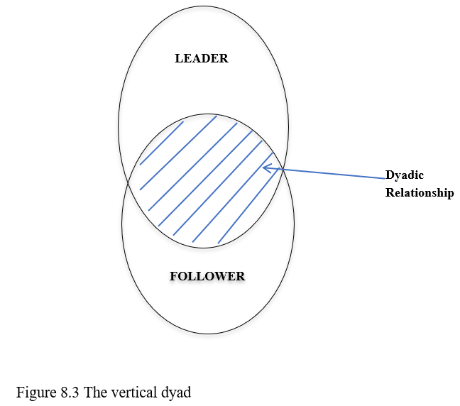
Positivist dyadic relational perspectives

Slide 17
Social constructionist group-level relational perspectives
Through positivist perspective, 3 distinct streams of differentiated LMX theorizing are produced:
  perceived LMX differentiation (Hooper and Martin, 2008) – seeks to capture perceived variability within a group
  relative LMX (Hu and Liden, 2013) and group-level LMX differentiation (Erdogan and Bauer, 2010) – analyzes dyadic relationships in work groups, characterized by complexity and interdependency
  These studies underscore the importance of context and role conditions.

Slide 18
Social constructionist group-level relational perspectives
Through a social-cultural prism, a constructionist position is adopted to view relationships:
  Self-concept is vital
  Leadership does not exist as an entity but rather it emerges through processes of interaction and co-construction
  Sensemaking shapes human relationships
  Leadership is not possessed by an individual but “leadership resides… in the between space of the relationship” (Epitropaki et al. 2018, p. 125, emphasis added)

Slide 19
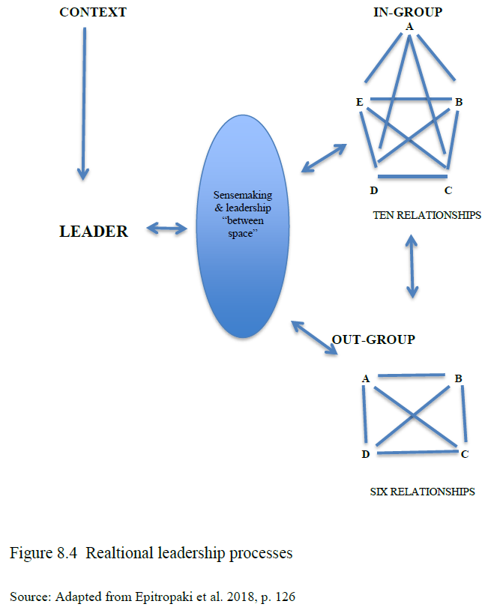
Social constructionist group-level relational perspectives

Slide 20
The growth of distributed leadership
Shifts the focus from hierarchy to heterarchy; from heroic to ‘post heroic’ leadership – leadership resides in every individual of the organization, who takes on the role of leading a group, not just those positioned at the top of the organization.
Propose ‘lead from behind’ through employee empowerment (Spillane, 2006).
Facilitate than being an ‘all-knowing’ expert (Hill, 2008).
Most effective when tasks are interdependent, complex and leader capabilities within the organization and teams have developed.

Slide 21
The growth of distributed leadership
Distributed Leadership - an interactive process disassociated from the hierarchy.
Self-management work teams (SMWT) movement proclaimed the need for redesigning organizations to allow members to undertake a wider range of tasks, including self-inspection, decision-making and leadership responsibilities.
Team Leadership – any behavior that helps the team identify task-related or person-related problems and generate and implement in solutions.

Slide 22
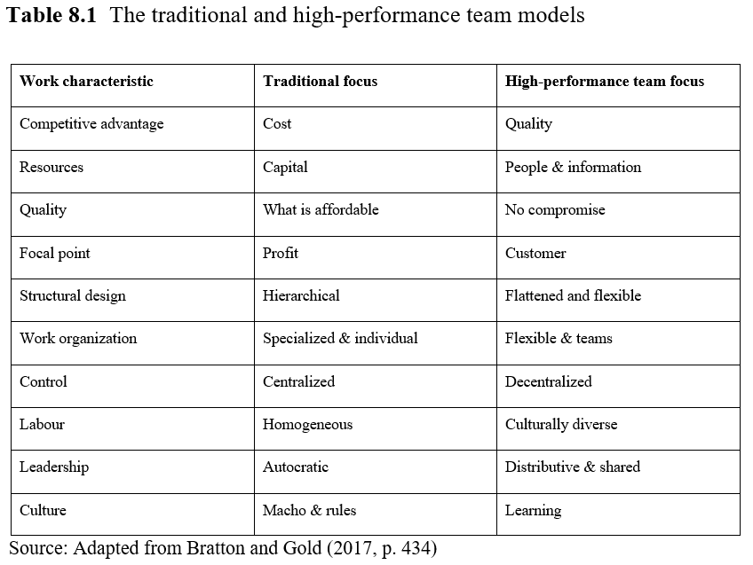
The growth of distributed leadership

Slide 23
Practising distributed and shared leadership
Structural and Work Design
  Structural Design: the planning and implementation of a structural configuration of roles and modes of operation, often displayed in an organizational chart.
  Job/Work Design: the process of assigning tasks to a job, including the interdependency of those tasks to other jobs.
HRM Policies and Practices
  The core of this subject can assist the development of distributed/team leadership (Danford et al., 2008).

Slide 24
Practising distributed and shared leadership
The Role of Appointed Leaders
  Empowering employees is the key.
Organizational Culture and Climate
  Vital influences.

