Slide 1
Learning outcomes
After completing this chapter, you should be able to:
Explain the meaning of charismatic and transformational leadership
Critically analyze the charismatic and transformational approach to leadership
Critique charismatic and transformational perspectives of leadership and explain some ethical issues

Slide 2
Introduction
The ability to use language to stir emotion, to persuade and to mobilize people can be called, for simplicity, the charismatic effect.
Charismatic and transformative leadership share a common view, that leaders as individuals who inspire others through language to change.
While both take a leader-centred perspective on leadership, the focus is on a set of behaviours and skills that can be learned and developed.

Slide 3
The nature of charismatic leadership
The English word ‘charisma’ derives from the Greek kharisma, itself drawn from the word kharis meaning favour or grace.
It generally describes a speaker’s personal talent to “command and compel an audience” (Perloff, 2006, p. 158).
When charismatic organizational leaders put into words, and communicate through conversations they can reassure, inspire and alter peoples’ perceptions of change.

Slide 4
The nature of charismatic leadership
It is important to note here, therefore, that the power of persuasion may be less to do with the leader’s personal qualities but, instead, comes through the audience, when the speech stirs their emotions and meets the need of the hearers for a visible personification of their deeper emotions.
Communication scholars suggest that charisma is a personal attribute – command of language, use of non-verbal communications (e.g. hand motions, eye contact) - that can be cultivated, that many individuals may have and that some have more than others.

Slide 5
The nature of charismatic leadership
Charismatics are effective leaders depends, to some extent, on the context.
Charismatic leaders do not always act in the best interests of their followers, shareholders or communities in which they are based.
Weber also explained that charismatic power emerges as a quality conferred on a “supernatural” leader only during periods of “extraordinary” social crisis.

Slide 6
Neo-charisma and competencies
House’s reinterpretation of charisma identified the necessary persuasive competencies to influence people and, importantly, proposed that individual-deference predictors of charismatic leaders might be empirically quantifiable – establishing the “foundations for how charisma is studied today” (Antonakis, 2018, p. 63). This reconstruction also known as ‘organizational charisma’ or ‘nurtured charisma’.
House also argued that the charismatic effect is the emotional interaction between a leader and his/her followers.

Slide 7
Neo-charisma and competencies
To explain how leaders engage followers, House and Shamir (1993) proposed that leaders have extraordinary effects on followers, who are motivated by enhanced levels of self-identity that lead to personal commitment to the leader’s mission, self-sacrificial behaviour and fulfilment.
Contrary to Weber,
House suggests that there are many charismatic leaders whose charisma did not diminish with time.
Bass noticed that charisma can still be present in leaders beyond the moment of crisis and that they still retain their charisma despite “failing to perform”.

Slide 8
Neo-charisma and competencies
Conger and Kanungo (1998) further developed charismatic leadership by proposing that charisma is an attributional phenomenon, this happens through a three-stage behaviour process that engender high trust in the leader and enhanced follower performance:
Leader articulates an attainable vision that will inspire follower collective action to achieve objectives that are necessary in fulfilling the vision.
Leader creates an aura of confidence about the vision.
Leader who uses unconventional and novel strategies or practices to achieve the vision.

Slide 9
Transformational leadership
Transactional leadership (rooted in the employment relationship) is primarily defined as an exchange relationship in which the leader and follower are engaged in some kind of agreement (e.g. these transactional exchanges constitute the ‘psychological contract’ – the implicit contract between employer and employee – which remains rooted in such an exchange process), whether economic (e.g. reward), social (e.g. group membership) or psychological (e.g. self-esteem).
On the other hand, Transformational leadership’s objective is that leaders appealed to their followers’ sense of values beyond their own self-interests. It has to be the benefit of the organization, not the leader.

Slide 10
Transformational leadership
Bass and Riggio’s Transformational Leadership Model
Transformational leaders are able to inspire followers to transcend their self-interests for the good of the organization, with 4 essential behaviours:
Idealized influence
Inspirational motivation
Intellectual stimulation
Individualized consideration

Slide 11
Transformational leadership
Transformational leaders link their visions to their employees’ growth needs and values through responding to individual followers’ learning and growth needs by empowering them.
In addition, there are two other elements of the leader (transactional factors):
Contingent reward
Management-by-exception

Slide 12
Transformational leadership
Therefore, transactional leadership, particularly contingent reward, provides a broad basis for effective leadership, but extraordinary performance and employee satisfaction, commitment, and loyalty is possible from transactional leadership if augmented by transformative leadership (Bass & Riggio, 2006).

Slide 13
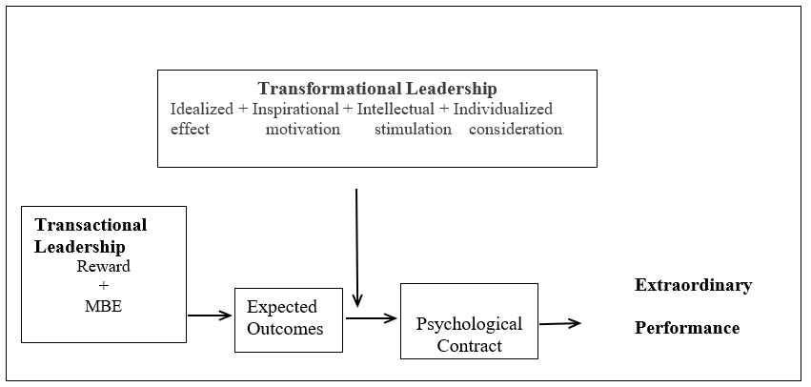
Transformational leadership
Figure 7.1 The Augmented Effect of Transformational Leadership
Source: Adapted from Bass and Riggio (2006)

Slide 14
Transformational leadership
Charismatic, Ideological, and Pragmatic (CIP) model of leadership (Lovelace et al., 2019) emphasized a leader's “sensemaking” process before outlining the resulting leader behaviours. Through sensemaking, leaders help followers see the past and to envision what is ahead more clearly.
Cross-cultural studies seem to confirm the universality of some aspects of charismatic leadership, though the influence of leadership is particularly popular in the United States and significantly less so in Nordic countries (see House, 1999).

Slide 15
Transformational leadership
Numerous leadership writers suggest that leadership can help facilitate innovation and organizational change:
Leaders can facilitate change by communication that inspires and challenging employees to look at old problems in new ways (Kotter, 2012).
Essentially an emotional bonding between leader and followers results in followers doing things they would probably never would have done under a non-charismatic leader (Bass and Riggio).

Slide 16
Transformational leadership
Value of employee ‘voice’ in the innovation and change process (Emmott, 2015).
In summary, transformational leadership must be inclusive, open, and engaging or trust, knowledge creation and sharing will falter (see, for example, Adler, 2005; Marchington, 2012).

Slide 17
Authentic, ethical and servant theories of leadership
Authentic Leadership
A recent theory is still in the process of defining itself (Caza and Jackson, 2011).
Nascent endeavours have framed authentic leadership around the developmental processes (Gardner et al., 2005), and in terms of a leader’s self-awareness of work-related attitudes and behaviours, beyond what transformational leadership offered (Walumbwa et al. 2008).
Authentic leaders know what values they believe in, and they act on those values.

Slide 18
Authentic, ethical and servant theories of leadership
Ethical Leadership
Ethical theories of leadership emphasize integrity and consistency between a leader’s espoused values and behaviour.
An ethical leader is someone “who does the right thing, the right way, and for the right reasons” (Ciulla and Forsyth, 2011, p. 239).
An ethical leader has the crucial responsibility to create the ethical expectations for all organizational members (Stouten et al., 2012).

Slide 19
Authentic, ethical and servant theories of leadership
Servant Leadership
Leaders should go beyond their self-interest and focus on opportunities to empower and help develop followers and be attentive to their needs (Greenleaf 1970; Spears 2002).
Empathizing, listening, persuading and developing followers’ full potential are some of the characteristic behaviours of servant leadership (Van Dierendonck, 2011).
All three theories conceptualize leadership using value-loaded language and explicitly address the role of leaders in creating ethical organizational practices.

Slide 20
Critiquing charismatic and transformational leadership
Transformational leadership treats leadership as a personality trait rather than a behaviour or competency that people can learn (Bryman, 1992).
Transformational leadership also reinforces the “heroic leader” perspective (Yukl, 1999) because of its basic premise that it is the leader who inspires and mobilizes followers to do exceptional things.
The charismatic nature of transformative leadership presents significant risks for organizations (Conger, 1999). Reverence and blind obedience to a leader can risk the Icarus paradox.

Slide 21
Critiquing charismatic and transformational leadership
Charismatic-transformational leadership theories downplay the importance of power.
Charismatic and transformational leaders achieve, and expect, obedience by a combination of charismatic and rational-legal types of authority.
Persuasion by transformational leaders for followers to accept the need for “commitment” by displaying certain behavioural competencies, simultaneously, as the spectre of precarious work is omnipresent (Hewison, 2016), alongside an acceptance of increased insecurity in the employment relationship, is arguably ethically deficient.

