Slide 1
Global Climate Change
METR112 Writing Assignment

Slide 2
Requirement
This is a writing assignment for METR112. You can choose from one of the topics mentioned here
Topic I: Climate myth vs climate science
Topic II: What surprise you most in the content we covered in METR112
Due date August 10, 2020 in the final week.
Weight: 25pt

Slide 3
Topics I
There are many information and misinformation about Climate change online and some news outlet.
Please check out some typical arguments about climate change
Myth vs Science
https://www.skepticalscience.com/argument.php
https://www.wwf.org.uk/updates/10-myths-about-climate-change

Slide 5
Please pick one topic
At first, the Myth claim sounds plausible to you, e.g. like this one.
Climate's changed before
Climate is always changing. We have had ice ages and warmer periods when alligators were found in Spitzbergen. Ice ages have occurred in a hundred thousand year cycle for the last 700 thousand years, and there have been previous periods that appear to have been warmer than the present despite CO2 levels being lower than they are now. More recently, we have had the medieval warm period and the little ice age. (Richard Lindzen)
But after you read current scientific studies
Basic
https://www.skepticalscience.com/climate-change-little-ice-age-medieval-warm-period-basic.htm
Intermediate
https://www.skepticalscience.com/climate-change-little-ice-age-medieval-warm-period-intermediate.htm

Slide 6
Or as discussed on https://www.wwf.org.uk/updates/10-myths-about-climate-change
1. THE EARTH’S CLIMATE HAS ALWAYS CHANGED
Over the course of the Earth’s 4.5-billion-year history, the climate has changed a lot. This is true. But the rapid warming we’re seeing now can't be explained by natural cycles of warming and cooling. The kind of changes that would normally happen over hundreds of thousands of years are happening in decades.
Global temperatures are now at their highest since records began. In fact, 17 of the 18 warmest years on record have all taken place since 2001.
This much faster warming corresponds with levels of carbon dioxide in the atmosphere, which have been increasing since the industrial revolution. So, when people talk about climate change today, they mean anthropogenic (man-made) climate change. This is the warming of Earth’s average temperature as a result of human activity, such as burning coal, oil and gas to produce energy to fuel our homes and transport and cutting down trees to produce the food we eat.

Slide 7
Please write a short essay
Briefly describe the claim of the ‘climate myth’
~ 100 words
What are the current scientific research results and understanding about it?
~ 200 words
Use your own words and reasoning to rebut the climate myth.
100-200 words

Slide 8
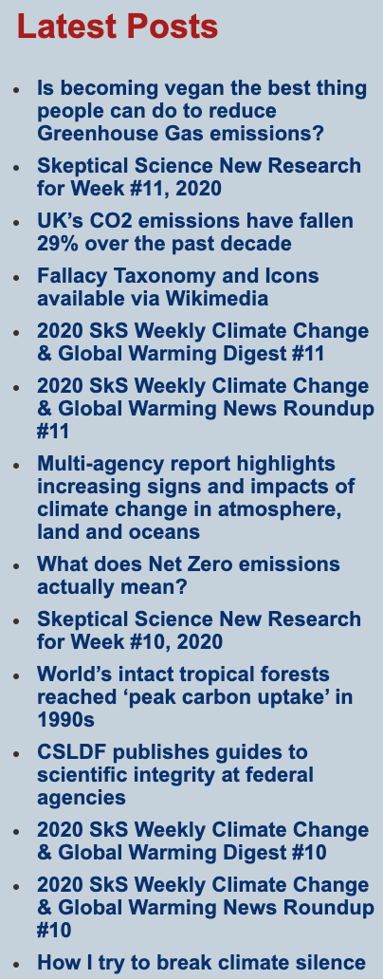
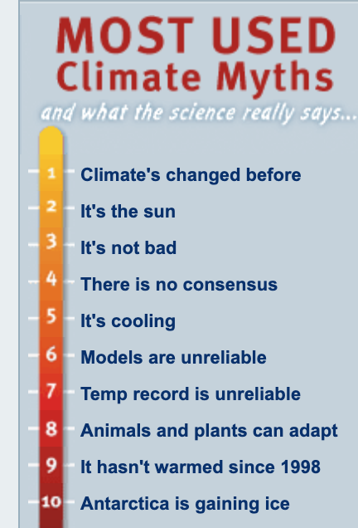
Suggestions on topics to choose from
The one you think your family member has some misunderstanding and you can use what you learned to convince them.
Please keep the discussion civil. A peaceful learning experience is beneficial, while polarized debate is not.
Other topics
https://www.skepticalscience.com/
On the left hand side of the website

