Slide 1
Chapter 2: Social Responsibility and Human Resource Management
© 2019 Cengage. May not be scanned, copied or duplicated, or posted to a publicly accessible website, in whole or in part.

Slide 2
Societal Factors Affecting HRM
Factors affecting Strategic HRM include:
  Sustainability
  Demographics and diversity
  Ethics

Slide 3
Diversity
Demographic changes in society have greatly impacted the composition of the workforce. In addition, numerous laws protect diverse groups in our society from discrimination in employment Most organizations have developed some kind of diversity management program in response to one of both of these factors.
Diversity initiatives can be designed to ensure legal compliance or to truly promote and encourage respect for others and differences. There is a marked difference between these motivations, as illustrated in Exhibit 2.1.
Diversity is a strategic business issue for an overwhelming majority of organizations/employers.

Slide 4
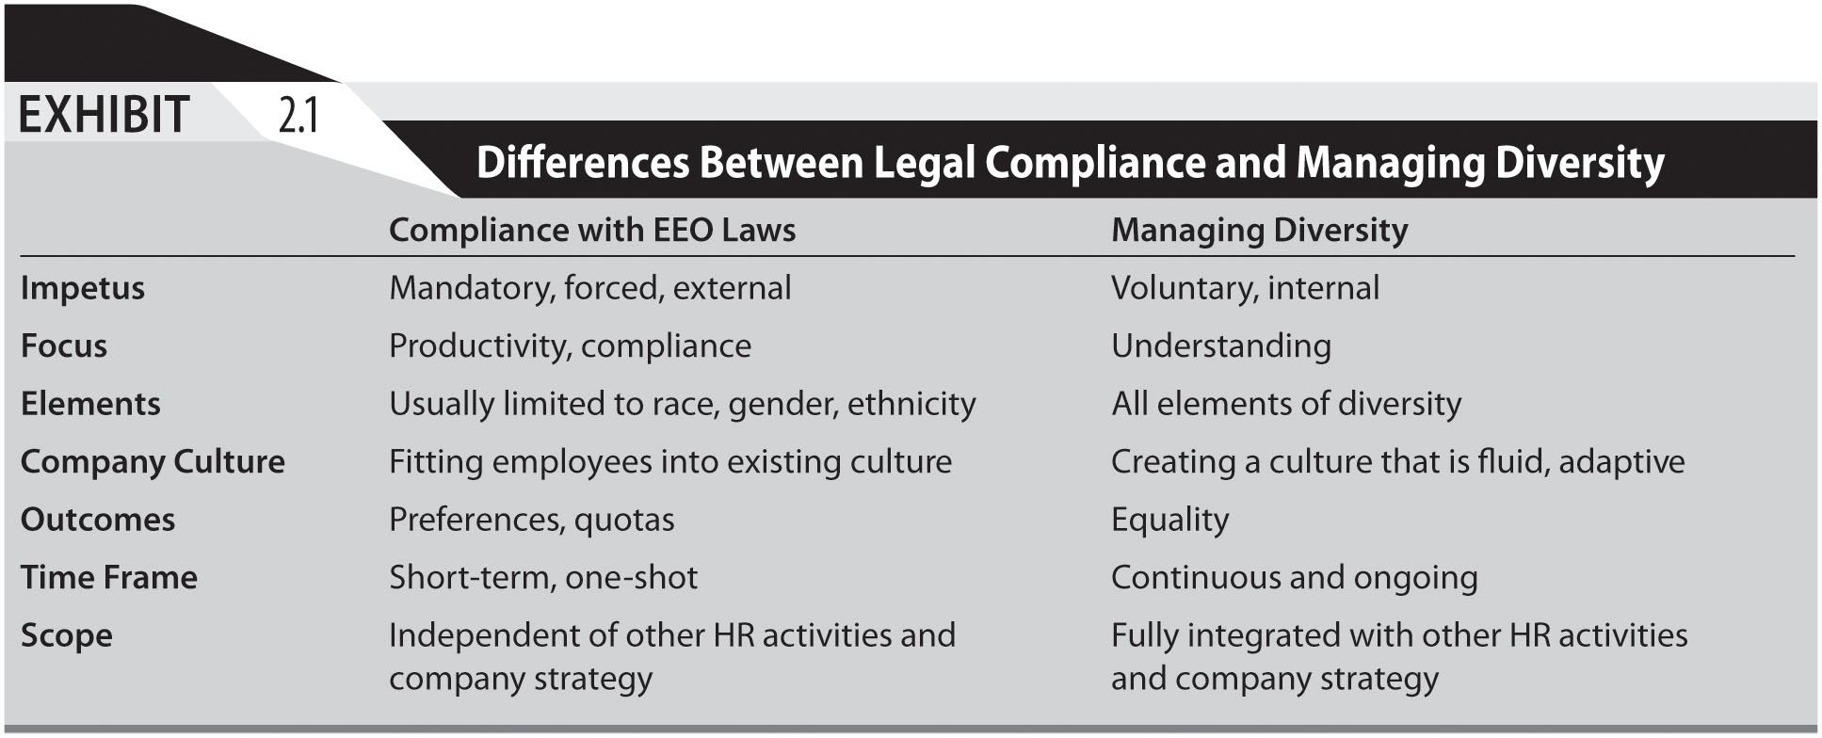
Exhibit 2.1

Slide 5
Generational Diversity
Generational diversity is becoming increasingly prevalent as individuals live and remain in the workplace longer than in previous years.
Different generations need to be able to work alongside each other in contemporary organizations. Exhibit 2.2 illustrates some of the characteristics of different generations found in the workplace.

Slide 6
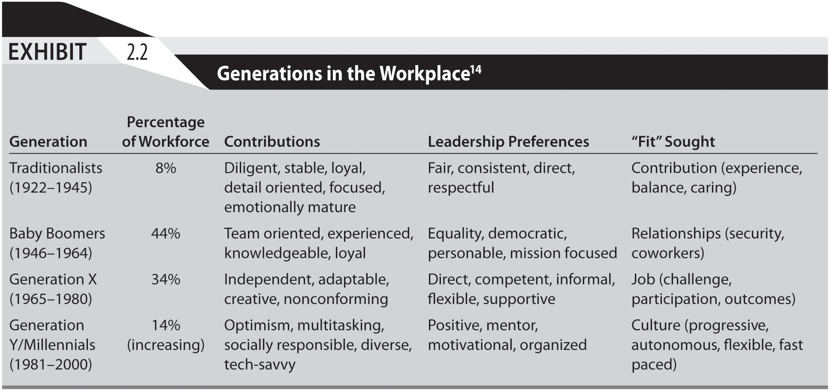
Exhibit 2.2

Slide 7
Workforce Demographic Changes:
“Graying” of Workforce
Negative aspects of older workers
  Perceived resistance to change by older workers
  Increased health-care costs for senior workers
  Blocking advancement opportunities for younger workers
  Higher wage & salary costs for senior workers
Positive aspects of older workers
  As productive or more productive than younger workers
  Have more organizational loyalty than younger workers
  Possess broader industry knowledge & professional networks

Slide 8
Workforce Demographic Changes (1)
Baby Boomers (1945–1962)
  In excess supply in middle management ranks
  HR challenge is to manage “plateaued” workers
Baby Busters (1963–mid-1970s)
  Are career bottlenecked by Boomers
  Have skills in high demand and frustrated
  Also entrepreneurial opportunities

Slide 9
Workforce Demographic Changes (2)
Generation “X” (mid 1970s–early 1980s)
  Have life-long exposure to technology & constant change
  Seek self-control, independence, personal growth, creativity
  Not focused on job security or long-term employment
Generation “Y” / “Baby Boom Echo” (mid 1980s 1999)
  High comfort level with technology
  Global & tolerant outlook on life
  Highly entrepreneurial
  Shorter attention span
  Opting for more transient & variable project work

Slide 10
Workforce Demographic Changes (3)
Generation Z (2000 - )
  Many traits on common with Generation Y, including desire for flexibility and work/life balance, preference for less control
  Distinctive with greater aspirations for self- employment or working for smaller organizations as well as being more socially progressive
  Less loyal than predecessors to their employer

Slide 11
Workforce Demographic Changes (4)
Sexual orientation and gender identity/expression
  89% of Fortune 500 employers prohibit discrimination based on sexual orientation; 66% prohibit discrimination based on gender identity / expression with this number rapidly increasing
  State laws presented in Exhibit 2.3
  Can have significant impact on “bottom line”
Disabilities
  54 million Americans with disabilities
  Often not included in diversity initiatives
  Many supervisors do not understand needs of employees with disabilities
  Stereotypes

Slide 12
New Employee/Workplace Dynamics (1)
Emphasis on management of professionals
  Establishment of separate career tracks
    Technical/Professional, Managerial/Administrative
  Use of project teams
Less employee loyalty, more loyal to self
  Staying with employers for shorter periods; demanding more meaningful work & involvement in organizational decisions

Slide 13
New Employee/Workplace Dynamics (2)
Increased personal & family dynamic effects
  More single-parent families, dual-career couples, & domestic partners
Increased nontraditional work relationships
  Part-time, consulting, & temporary employment flexibility
  Outsourcing & entrepreneurial opportunities

Slide 14
Ethnicity
2010
  Ethnic minority share of workforce exceeds 30%
  Up from 22% in 1990 & 18% in 1980
By 2050
  Close to 50% of US population will be non-Caucasian
By 2025
  African-Americans will represent 14% of population
  Up from 12% in 1994
  Hispanics will represent 17% of population
  Up from 10% in 1994
  Asians & Pacific Islanders will represent 8% of population
  More than double from 1994

Slide 15
Managing Workplace Diversity
Understanding & appreciating diversity
  Critical to effectively marketing to ethnic & minority groups
  Promoted by having diverse workforce at all levels
  Helps ensure hiring & promotion decisions are unbiased by personal differences
Diversity management programs or initiatives
  Must be integrated with organization’s mission & objectives
  Help key decision makers identify diversity’s benefits to organization
  Make critical decisions about implementing optimal program/initiative contingent on organization & its people, mission & culture.

Slide 16
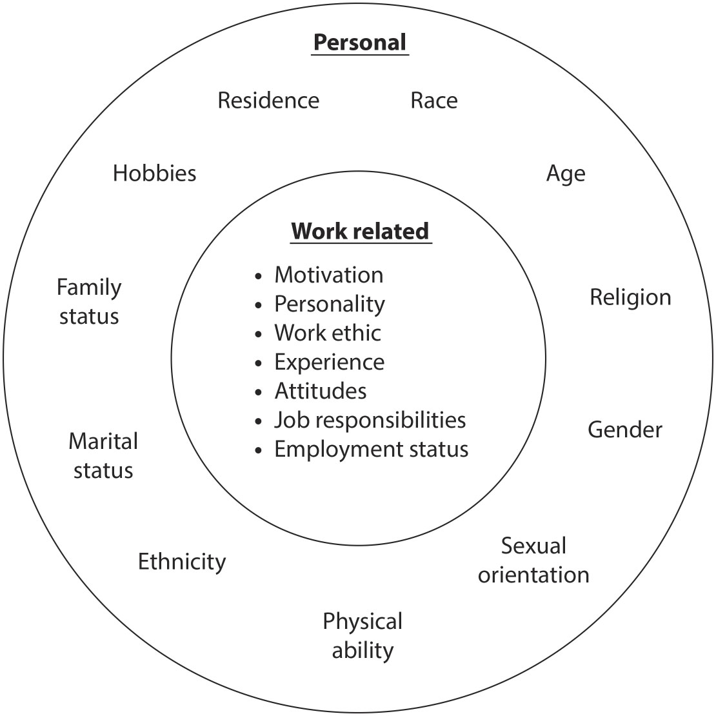
Exhibit 2.4

Slide 17
Strategic Management of Diversity
Determine why diversity is important
Articulate how diversity relates to mission & strategic objectives
Define diversity & determine how inclusive its efforts will be
Make a decision as to whether special efforts should be extended to attract diverse workforce
Assess how existing employees, customers & other constituencies feel about diversity
Determine specific types of diversity initiatives that will be undertaken

Slide 18
Ethical Behavior
Many employers are now considering ethics and ethical behavior in light of major bankruptcies, scandals and business meltdowns. However, ethics are subject to personal values and convictions.
Common ethical concerns for HR include
  off-duty behavior, especially use of medical marijuana
  ownership of work
  non-compete clauses

Slide 19
Sarbanes-Oxley Act of 2002
Provides sweeping measures to control deception in accounting and management practices by
  increasing government oversight of financial reporting
  holding senior executives more responsible that previously
  protecting whistle blowers

Slide 20
Codes of Ethics
Many organizations and some industries have developed their own code of ethics. The Society of Human Resource Management (SHRM) has developed such a code for HR professionals. This code presents core principles, intent and guidelines in a number of areas, including: Professional Responsibility; Professional Development; Ethical Leadership; Fairness and Justice; Conflicts of Interest; and Use of Information.
Exhibit 2.6 provides some guides for developing a code of ethics or code of conduct.

Slide 21
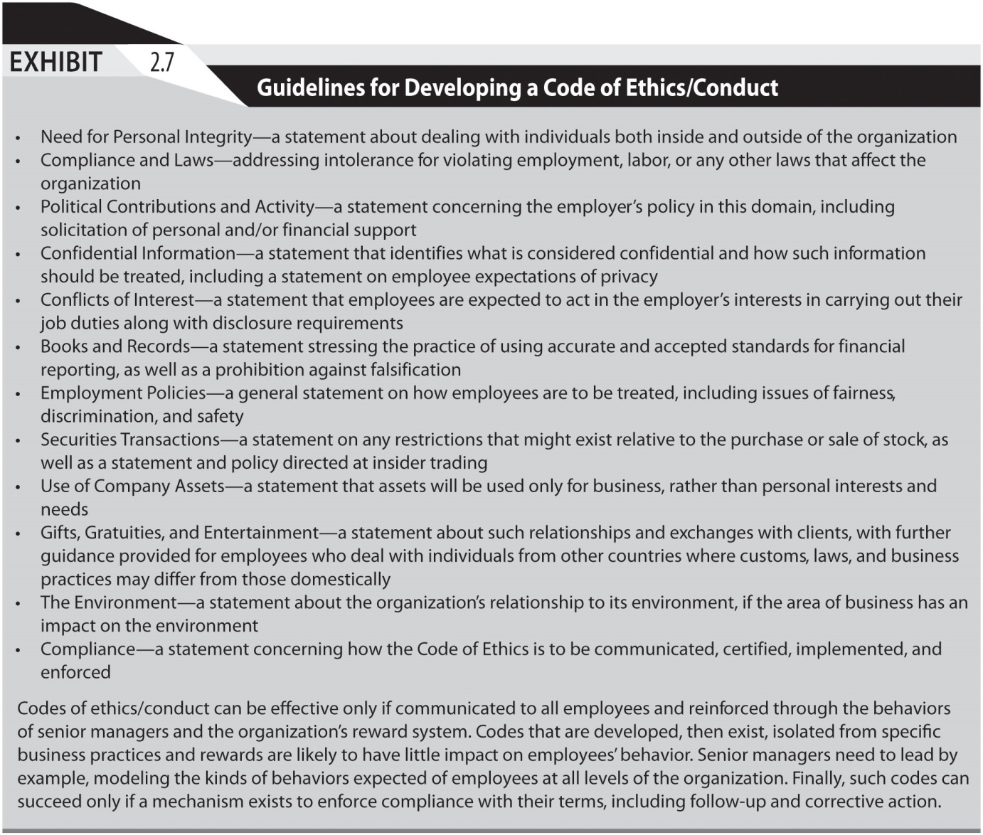
Exhibit 2.7

Slide 22
Sustainability
Sustainability (and social responsibility in general) take a more macro approach to managing an organization’s relationship with its external environment.
Organizations are being increasingly expected to consider the effects of their operations, decision and business on the social and natural environment.
General Electric has developed a model program related to sustainability and Gap, Inc. has set standards for offshoring of its manufacturing operations.

Slide 23
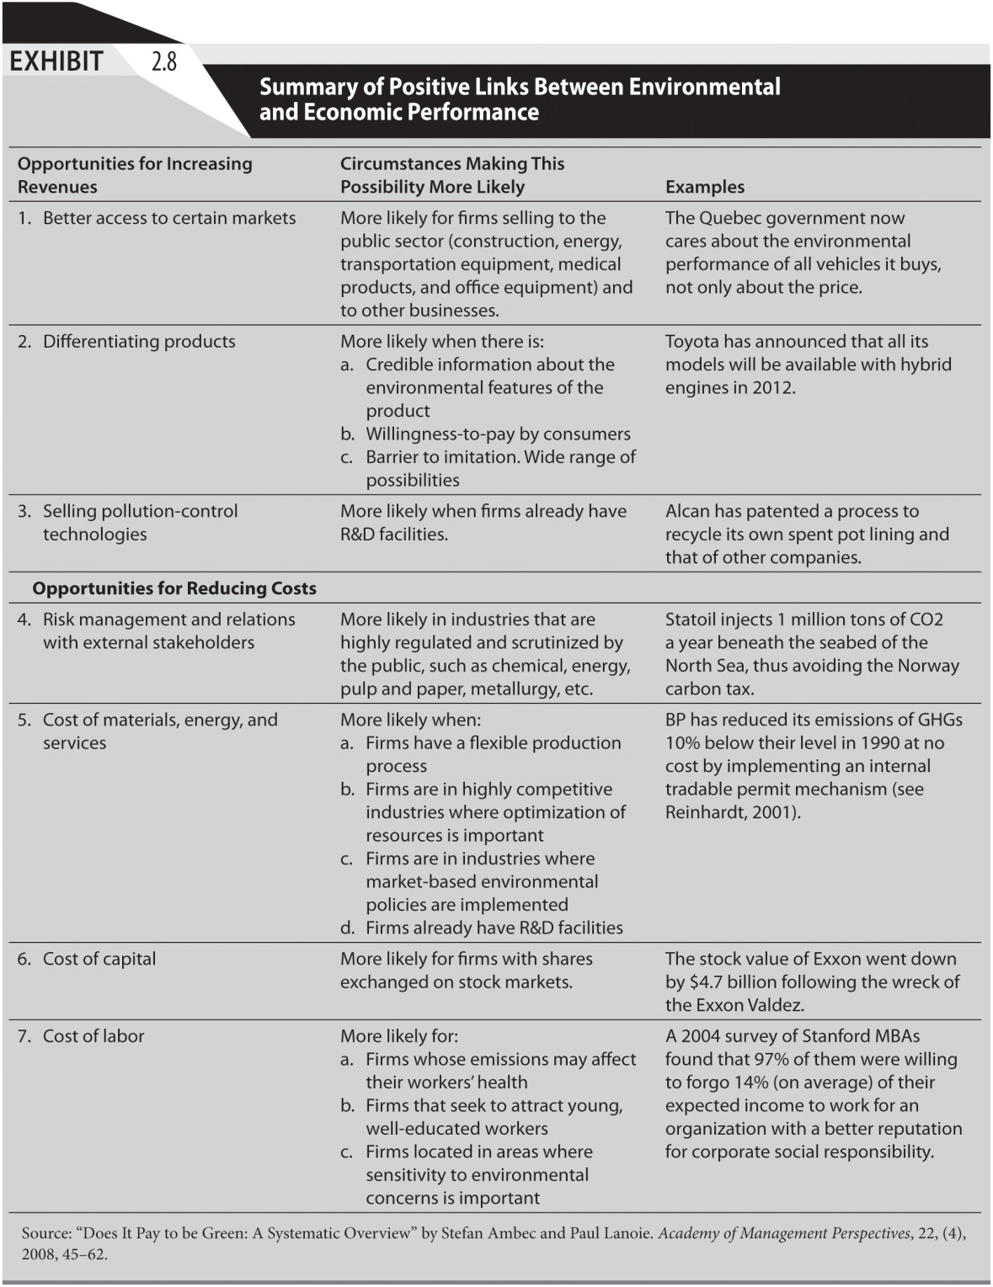
Exhibit 2.8

