Slide 1
Chapter 1: An Investment Perspective of Human Resource Management
© 2019 Cengage. May not be scanned, copied or duplicated, or posted to a publicly accessible website, in whole or in part.

Slide 2
The Strategic View of Human Resources
Employees are human assets
  Increase in value to organization and marketplace when investments of appropriate policies and programs are applied
Effective organizations recognize that employees have value
  Much as organization’s physical and capital assets have value
Employees are valuable source of sustainable competitive advantage

Slide 3
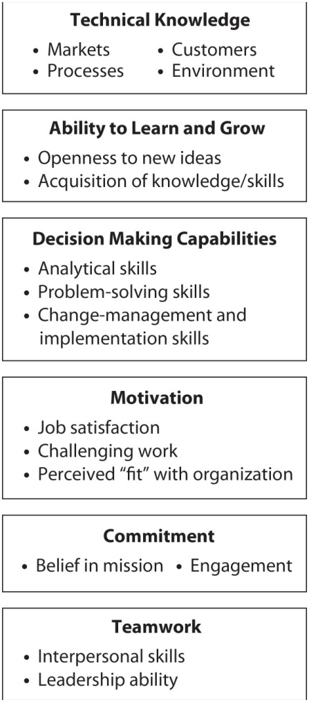
Exhibit 1.1: Sources of Employee Value

Slide 4
Sources of Employee Value
Technical Knowledge
  Markets, processes, customers, environment
Ability to Learn and Grow
  Openness to new ideas
  Acquisition of knowledge and skills
Decision Making Capabilities
Motivation
Commitment
Teamwork
  Interpersonal skills, leadership ability

Slide 5
Adopting an Investment Perspective
Determines how to best invest in people
Costs
  Out-of-pocket
  Opportunity
Human assets become competitive advantage
Required skills become less manual, more knowledge-based
Appropriate, integrated, strategy-consistent approach is needed

Slide 6
A Dilemma
Failure to invest in employees causes
  Inefficiency
  Weakening of organization’s competitive position
Human assets are risky investment
Require extra effort to ensure that they are not lost

Slide 7
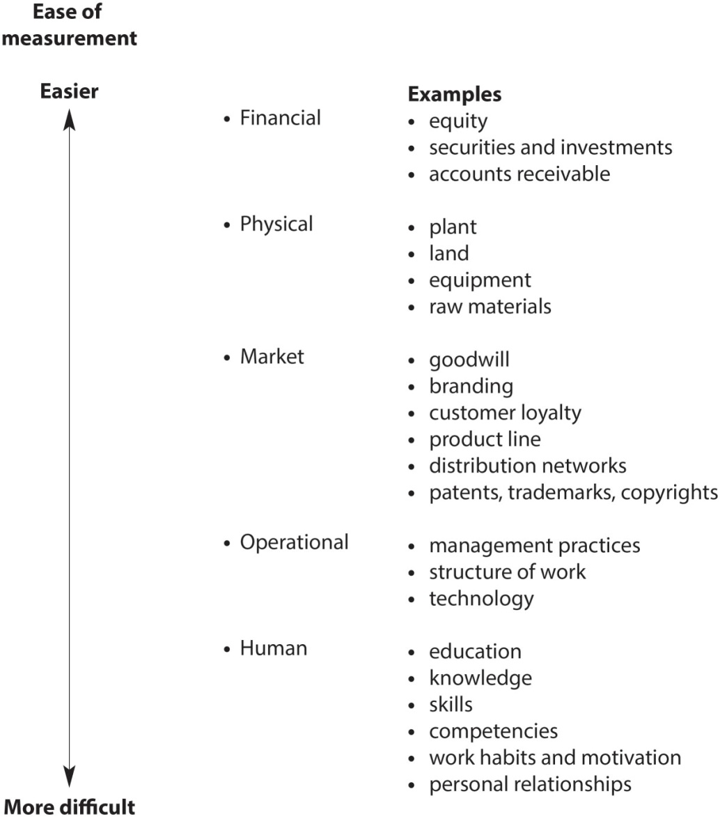
Exhibit 1.2: Types of Organization Assets/Capital

Slide 8
Research Findings
HR practices directly related to profitability and market value
Primary reason for profitability:
  Effective management of human capital
Integrated management of human capital can result in 47% increase in market value
Top 10% of organizations studied experienced 391% return on investment in management of human capital

Slide 9
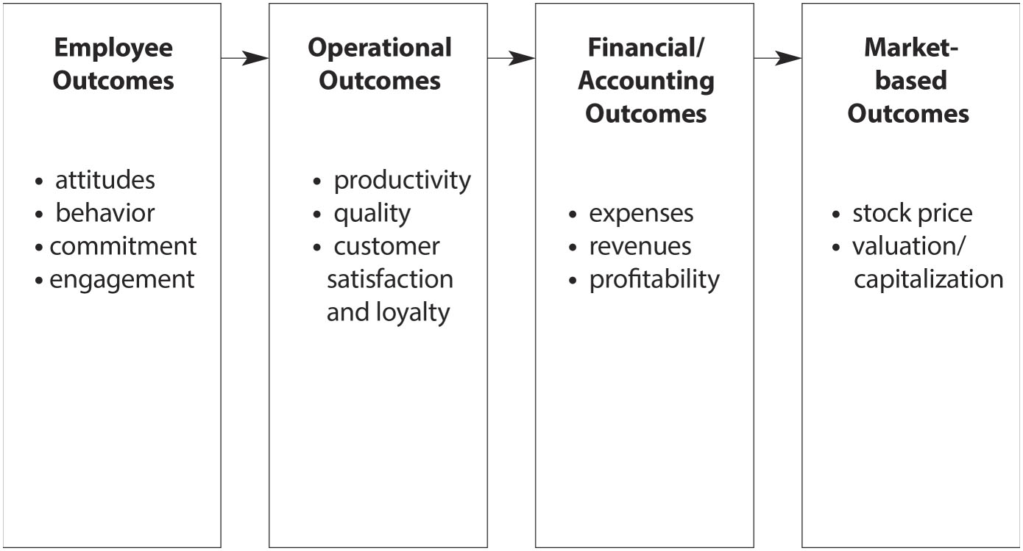
Exhibit 1.3: The HR Value Chain

Slide 10
Human Resource Metrics
Wall Street analysts still generally fail to acknowledge human capital in assessing the value of an organization and the effect that human resources can have on stock price
This is rooted in the fact that there are no “standard” metrics or measures of human capital, much as there are for other organizational assets
Exhibit 1.4 lists some Common HR Metrics while Exhibit 1.5 displays the means of calculating five common metrics. However, the appropriate metrics for any given organization will be dependant on that organization’s strategy.

Slide 11
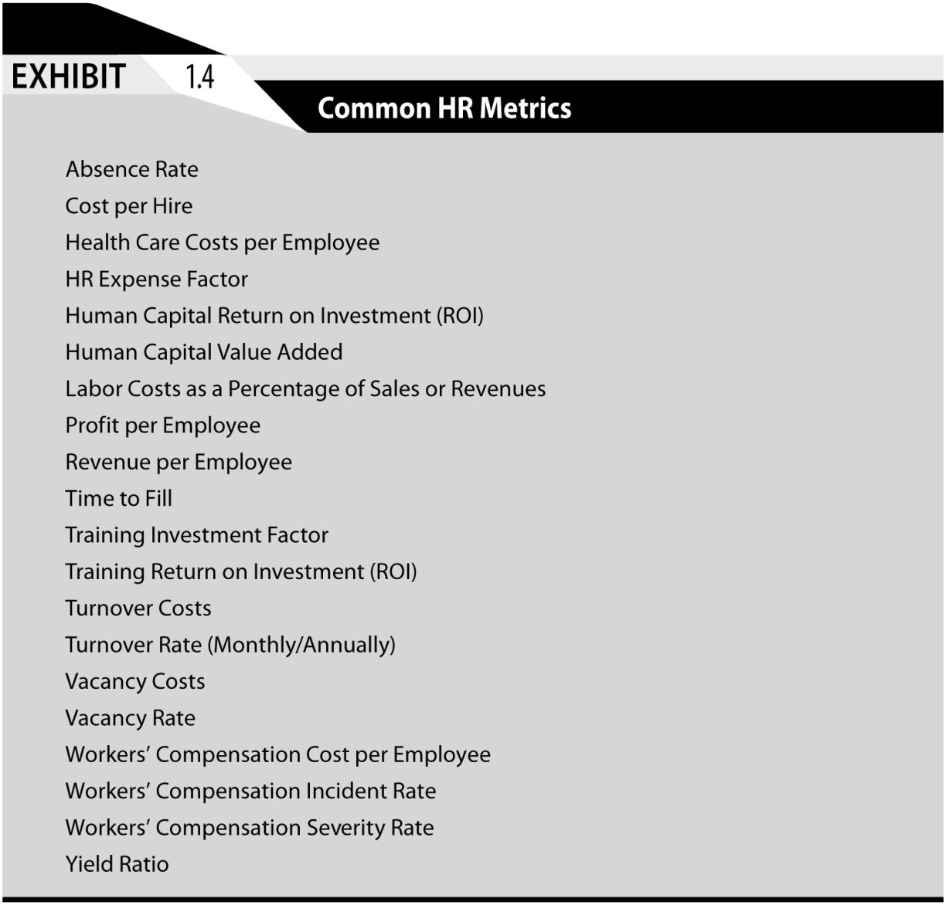
Exhibit 1.4: Common HR Metrics

Slide 12
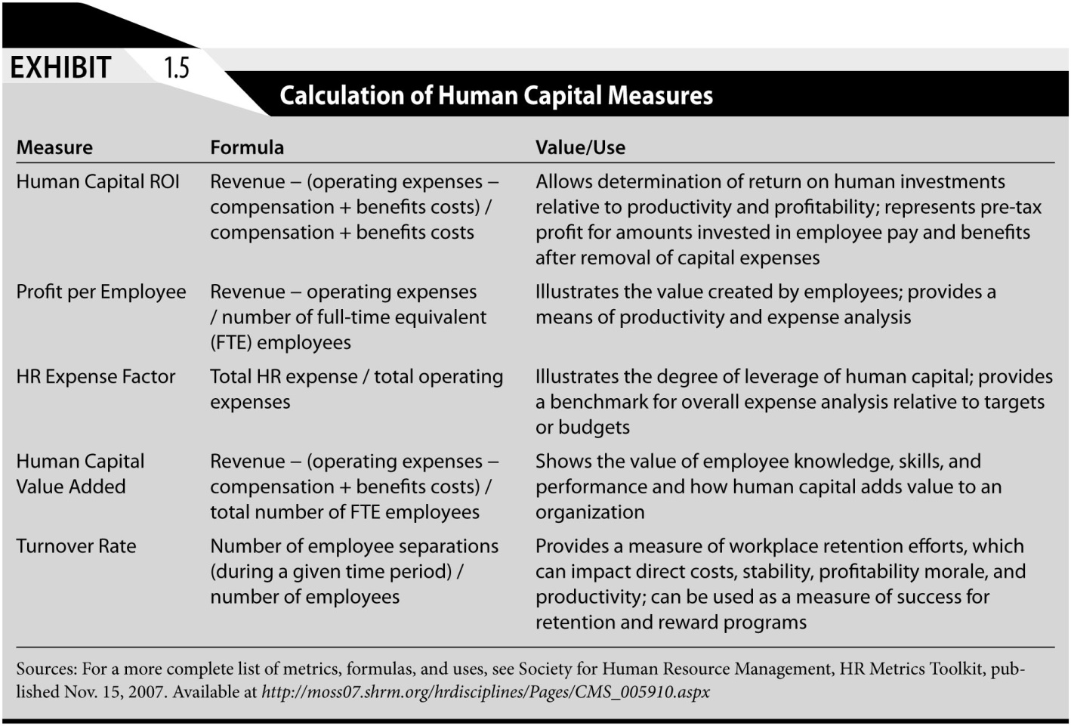
Exhibit 1.5: Calculation of Human Capital Measures

Slide 13
HR Metrics Are Complex
90% of Fortune 500 organizations evaluate HR operations on basis of three metrics:
  Employee retention and turnover
  Corporate morale
  Employee satisfaction
These metrics do not necessarily illustrate how HR impacts
  Profits
  Shareholder value

Slide 14
Mercer Model of Measuring HR Impact
Identify problem HR can impact
Calculate actual cost of problem
Choose HR solution that addresses problem
Calculate cost of solution
Calculate value of improvement 6 to 24 months after implementation
Calculate specific return on investment
ROI in human assets often not realized until some time in future

Slide 15
HR Analytics
  Analytics is the systematic collection, reporting and analysis of various metrics which are critical to effective performance
  Analytics often involve the process of benchmarking where the organization compares actual performance to goals and/or to the performance on a similar metric by competing organizations
  Exhibit 1.6 shows some examples of the types of relationships which HR analytics can document and analyze

Slide 16
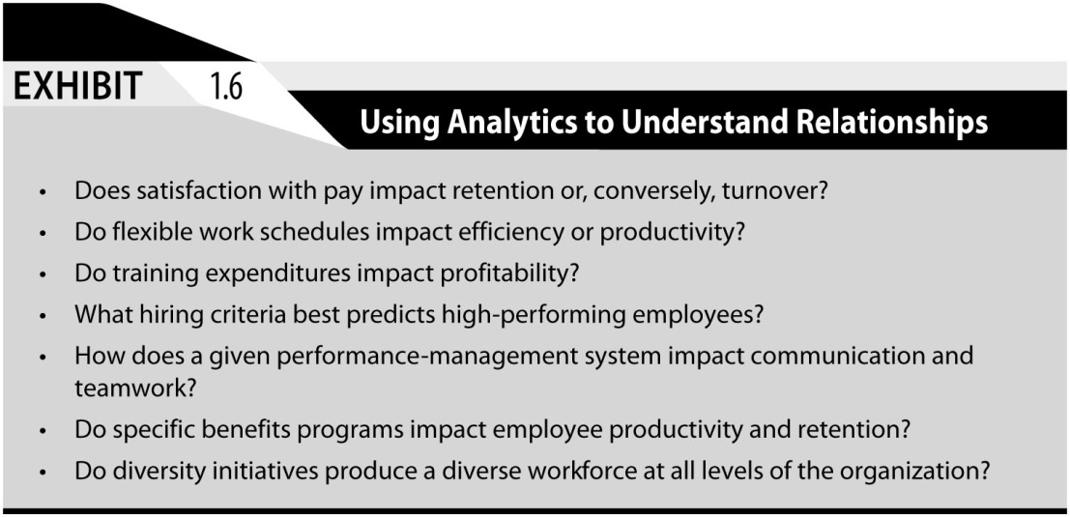
Exhibit 1.6: Using Analytics to Understand Relationships

Slide 17
Investment-Oriented Organization
Sees people as central to mission and strategy
Mission statement and strategic objectives espouse value of human assets in achieving goals
Management philosophy encouraging development and retention of human assets
Does not treat human assets in same ways as physical assets

Slide 18
Investment Orientation Factors (1)
Senior Management Values and Actions
  Managers need “investment orientation” toward people
Attitude Toward Risk
  Investment in human resources inherently riskier
  Human assets never absolutely “owned”
Nature of Skills Needed by Employees
  The more marketable employee skills, the riskier the firm’s investment in skill development

Slide 19
Investment Orientation Factors (2)
Utilitarian (“Bottom Line”) Mentality
  Attempt made to quantify employee worth through cost-benefit analysis
  “Soft” benefits of HR programs difficult to objectively quantify
Availability of Outsourcing
  Given availability of cost-effective outsourcing, investments in HR should produce highest returns and sustainable competitive advantages.

Slide 20
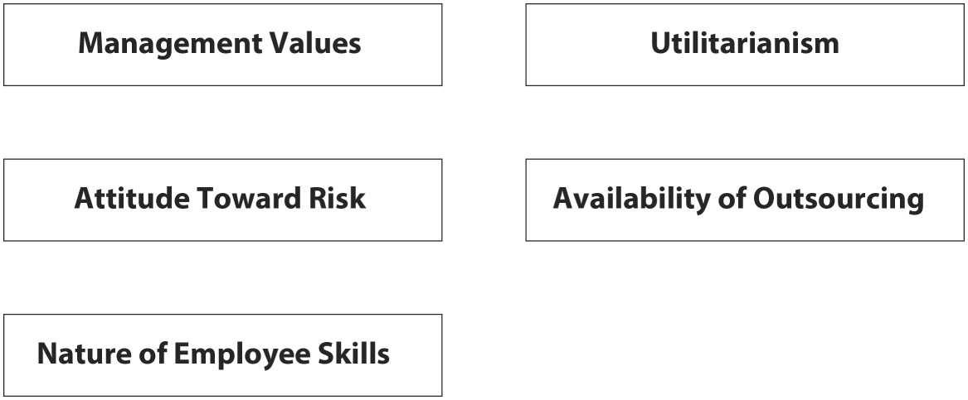
Exhibit 1.7: Factors Influencing an Organization’s Investment Orientation

