Slide 1
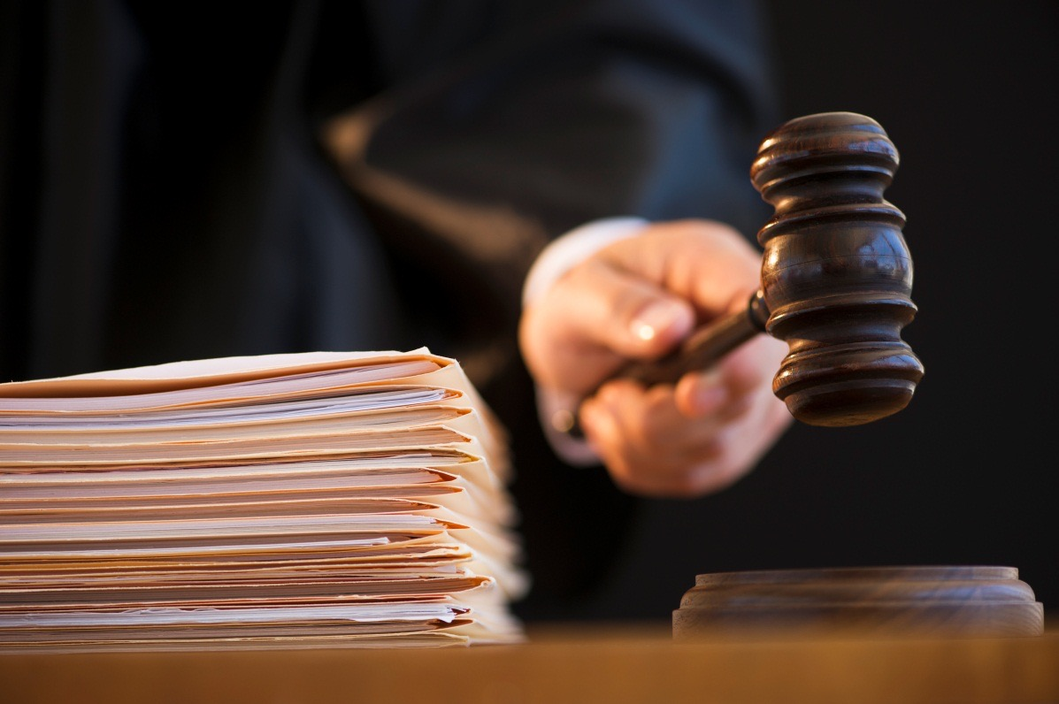

Ethical Dilemmas and Decisions in
Criminal Justice
Tenth Edition
Chapter 3
Justice and Law
© 2019 Cengage. All rights reserved.

Slide 2
Learning Objectives
Describe the three themes included in the definition of justice.
Define Aristotle’s distributive and corrective justice.
Distinguish between substantive and procedural justice, including how procedural justice impacts wrongful convictions and perceptions of racial discrimination.
Explain the concept of restorative justice and the programs associated with it.
Describe civil disobedience and when it may be appropriate.

Slide 3
Introduction
Three themes when discussing justice:
  Fairness: Equal treatment
  Equality: Equal shares
  Impartiality: Not favoring one party or interest more than another.
Notes:
LO 1: Describe the three themes included in the definition of justice.

Slide 4
Anthony Walsh
Cheaters: are those who do not engage in “reciprocal altruism” (basically, cooperation)
Suckers: are those who are continually taken advantage of by cheaters. They are not optimally adapted for survival, and if they perish, cheaters would perish as well because they need victims to take advantage of.
grudgers: evolved as a response; they may be fooled once by cheaters, but they are outraged and demand punishment when they are victimized.

Slide 5
Origins of the Concept of Justice
The concept of justice originates in the Greek word dike, which refers to everything staying in its proper place.
Plato believed justice was achieved by maintaining the social status quo. He classed it as one of the four civic virtues (along with wisdom, temperance, and courage).
Aristotle believed justice was the basis of law, defining it as the unwritten customs of a people that distinguish between what is and is not honorable.
Notes:
LO 1: Describe the three themes included in the definition of justice.

Slide 6
Aristotle
Distributive justice: concerns what measurement should be used to allocate society’s resources, dealing with issues such as affirmative action, welfare, free schooling, and other goods and opportunities and how society distributes them among its members.
Corrective justice: concerns unfair advantage or undeserved harm between people. Justice demands remedies or compensations to the injured party.
A major conflict in distributive justice is between need and merit.

Slide 7
Distributive Justice (1 of 4)
Justice involves rightful possession of:
Economic goods (income or property)
Opportunities for development (education or citizenship)
Recognition (honor or status)
Since some possessions are scarce, justice requires that goods be distributed using standards of entitlement such as need and desert.
Notes:
LO 2: Define Aristotle’s distributive and corrective justice.

Slide 8
Distributive Justice (2 of 4)
Various theories can be categorized as:
Egalitarian theories: Start with the basic premise of equality or equal shares for all.
Marxist theories: Place need above desert or entitlement.
Libertarian theories: Promote freedom from interference by government in social and economic spheres; therefore, merit, entitlement, and productive contributions are given weight over need or equal shares.
Utilitarian theories: Attempt to maximize benefits for individuals and society with a mixed emphasis on entitlements and needs.
Notes:
LO 2: Define Aristotle’s distributive and corrective justice.

Slide 9
Distributive Justice (3 of 4)
John Rawl’s theory of justice:
Each person is to have an equal right to the most extensive total system of basic liberties compatible with a similar system of liberty for all.
Social and economic inequalities are to be arranged so that they are both reasonably expected to be to everyone’s advantage and attached to positions and offices open to all.
Notes:
LO 2: Define Aristotle’s distributive and corrective justice.

Slide 10
Distributive Justice (4 of 4)
Criticisms of Rawls
The veil of ignorance cannot counteract human selfishness and self-interest.
Preferring the least well-off is bad for a society; leads to lack of incentive, decline of standards.
Rawls’s approach to distribution ignores desert and merit.
Notes:
LO 2: Define Aristotle’s distributive and corrective justice.

Slide 11
Substantive justice:
Refers to issues of inherent fairness (1 of 3)
Retributive Justice:
Balance and proportionality (lex talionis & lex salica).
The offender must suffer a pain or loss proportional to what the victim was made to suffer.
Reform or rehabilitation may be a laudable goal, but it has no place in a retributive scheme of justice.
Consideration must be given to intent, capacity, and victim precipitation.
Rawls: retributive punishment is limited to what benefits the least advantaged; in this philosophy of justice, the offender is punished until the advantage changes and the offender becomes the least advantaged.
Mercy—different from desert.
Notes:
LO 3: Distinguish between substantive and procedural justice, including how procedural justice impacts wrongful convictions and perceptions of racial discrimination.

Slide 12
Substantive justice:
Refers to issues of inherent fairness (2 of 3)
Utilitarian Justice:
Punishment is to deter offenders from future crime.
Cesare Beccaria & Jeremy Bentham (hedonistic calculus) Measure to determine the amount of punishment needed to deter

Slide 13
Substantive justice:
Refers to issues of inherent fairness (3 of 3)
Utilitarian justice: The type of justice that looks to the greatest good for all as the end
Hedonistic calculus: Jeremy Bentham’s rationale for calculating the potential rewards of a crime so the amount of threatened pain could be set to deter people from committing that crime ( one must threaten a slightly higher degree of pain or punishment than the gain or pleasure that comes from the criminal act; otherwise, there would be no deterrent value in the punishment)

Slide 14
Corrective Justice (1 of 2)
Procedural justice: steps taken to reach determination of guilt or punishment
  Herrera v. Collins (1993)
  In re Troy Anthony Davis (2009)
  Holland v. Florida (2010)
Notes:
LO 3: Distinguish between substantive and procedural justice, including how procedural justice impacts wrongful convictions and perceptions of racial discrimination.

Slide 15
Quality Of Mercy
Merchant of Venice - Shakespeare
“Moral rights” may differ from “legal rights,” and “legal interests” may not be moral.

Slide 16
Procedural Protections
Due Process: Constitutionally mandated procedural steps designed to eliminate error in any governmental deprivation of protected liberty, life, or property.
Notice of charges
    Neutral hearing body
    Right of cross-examination
    Right to present evidence
    Representation by counsel
    Statement of findings
    Appeal
Notes:
LO 3: Distinguish between substantive and procedural justice, including how procedural justice impacts wrongful convictions and perceptions of racial discrimination.

Slide 17
Corrective Justice (2 of 2)
Procedural justice research
  Illustrates importance of procedural justice as it affects legitimacy of entire justice system
  Elements of procedural justice:
    Voice
    Neutrality
    Respect
    Trustworthiness
Notes:
LO 3: Distinguish between substantive and procedural justice, including how procedural justice impacts wrongful convictions and perceptions of racial discrimination.

Slide 18
Wrongful Convictions (1 of 2)
One reason people distrust justice system
National registry of false convictions created by University of Michigan Law School and Center on Wrongful Convictions at Northwestern University School of Law
Innocence Project
Case of Michael Morton

Slide 19
Wrongful Convictions (2 of 2)
Reasons for false convictions
Defense lawyers’ incompetence
Suppression of exculpatory evidence
False/mistaken eyewitness identification
Invalid forensic science
Informant/jailhouse informant perjured testimony
Government misconduct
Bad lawyering

Slide 20
Race, Ethnicity, and Justice
Perceptions of blacks and whites differ regarding the criminal justice system.
Race permeates the criminal justice system.
  Disproportional representation of black arrests in certain crime categories
  Racial profiling by police
  Lack of access to competent attorneys
  Disparate sentencing
Blacks disproportionately arrested for crime could be result of:
  Racial profiling
  Saturation patrols
  Central Park 5:
  CBS Morning (7mins)
  NY Times (doc. 1.5 hours)

Slide 21
Restorative Justice
Emphasizes compensation over retribution
Returns focus to rights and needs of the victim
Requires restoration of victims, offenders, and communities injured by crime
Integrates victims, offenders, and communities more into the justice process
Leaves government responsible for order, but makes community responsible for peace
Modeled after Native American justice
Notes:
LO 4: Explain the concept of restorative justice and the programs associated with it.

Slide 22
Restorative Justice Summary
Hallmarks of community justice models include the following:
The process of justice employs local leadership, is informal, and invites
The goal is to repair the harm done to a community member by another community member in a way that will restore the health of the community relationship.
The authority of the justice is through the customs and traditions accepted by all members.
In community or restorative justice models, crime is viewed as a natural human error that should be dealt with by the community.
Types of restorative justice programs include victim-offender mediation, reparative boards, family group conferencing, circle sentencing.
There are potential problems with and some criticism of, these types of programs. For instance victims may feel pressured to forgive before they are ready. There can also be unequal punishments given out for identical offenses.

Slide 23
Immoral Laws and the Moral Person
(1 of 4)
Immoral laws deprive certain groups of liberty or treat some groups differently, giving them either more or fewer rights and privileges than other groups.
Unjust laws have the following characteristics:
  They are degrading to humans.
  They are discriminatory against certain groups.
  They are enacted by unrepresentative authorities.
  They are unjustly applied.
Most ethical systems condemn such laws.
Notes:
LO 5: Describe civil disobedience and when it may be appropriate.

Slide 24
Immoral Laws and the Moral Person
(2 of 4)
The most common example of immoral laws are those that deprive certain groups of liberty or treat some groups differently, giving them either more or fewer rights and privileges than other groups.
Boss described unjust laws as having the following characteristics:
  They are degrading to humans.
  They are discriminatory against certain groups.
  They are enacted by unrepresentative authorities.
  They are unjustly applied.

Slide 25
Immoral Laws and the Moral Person
(3 of 4)
Most ethical systems would condemn such laws.
The religious ethical framework would probably not provide moral support for their action because it runs contrary to some basic Christian principles; ethical formalism could not be used to support this law because it runs counter to the categorical imperative that each person must be treated as an end rather as a means.
Civil disobedience is the voluntary disobedience of established laws based on one’s moral beliefs. Rawls defined it as a public, nonviolent, conscientious, yet political act contrary to law and usually done with the aim of bringing about a change in the law or policies of the government.
There is a widespread belief that law is synonymous with morality and that as long as one remains inside the law, one can be considered a moral person.

Slide 26
Immoral Laws and the Moral Person
(4 of 4)
Civil disobedience: voluntary disobedience of established laws
Milgram experiments
Widespread belief that law is synonymous with morality
Notes:
LO 5: Describe civil disobedience and when it may be appropriate.

Slide 27
Discussion Questions
How do the Egalitarian, Marxist, Libertarian, and Utilitarian theories apply to the wide disparities in salaries found in the United States? See Box 3.1 for CEO salary examples.
Explain your thoughts on media coverage of police shootings with respect to the race of the shooters. Do media outlets cover incidents differently?
Can you think of a scenario in which restorative justice would not be the best approach? Why?

