Slide 1
INBS 561: The Strategy and Structure of Int’l Business
Module 3a:
Basic Strategies of International Business
Copyright 2017 Montclair State University

Slide 2
What is International Business Strategy?
The plans and actions that managers use to attain the goals of their firm
International business strategy is influenced by:
  Competition: it prompts a firm to build its own international capabilities
  Currency: currency movements can affect profitability of international sales and/or the cost of producing in different foreign locations
  Country: each foreign country carries political risk alongside the attractiveness of the local market
  International business firms face two conflicting types of competitive pressure
    Pressure for cost reduction – that is to keep unit costs low
    Pressure to be locally responsive – adapt product offering to meet local needs and preferences (this strategy comes with high unit costs)

Slide 3
.
Figure 3.1: Four Basic Multinational Strategies
Global Standardization Strategy
Transnational
Strategy
High
Pressure for Cost
Reductions
International
Strategy
Localization
Strategy
Low
Low
High
Pressure for Local Responsiveness
Note: Some textbooks refer to international strategy as home replication strategy or export strategy; localization strategy as multidomestic strategy; and global standardization strategy as global strategy.

Slide 4
Four Basic Strategic Choices
International Strategy — sells products made for the home market internationally with little customization. This strategy is appropriate when cost pressures and local responsiveness are low.
Global Standardization Strategy — develops and sells a standardized market offering across countries. The goal is to increase profitability by leveraging low-cost advantages. This strategy is appropriate when the pressure for cost reductions is high and pressures for local responsiveness is low.

Slide 5
Four Basic Strategic Choices
  Transnational Strategy — simultaneously tries to achieve low-cost advantages and local responsiveness. The firm differentiates its product across geographic markets while standardizing certain components of its product. This strategy is appropriate when both pressures for low cost and pressures for local responsiveness are high.
  Localization Strategy — customizes market offering to match the tastes and preferences in different national markets. This strategy is appropriate when there are substantial differences in local tastes and preferences, and cost pressures are low.

Slide 6
INBS 561: The Strategy and Structure of Int’l Business
Module 3b:
The Structure of Int’l Business

Slide 7
Organizational Structures for the Four Basic Strategic Choices:
International division structure—a typical organizational structure the first time a firm expands abroad using the international strategy.
Problems:
  Foreign subsidiary managers in this organizational structure are given insufficient voice relative to heads of domestic divisions
  Poor coordination between the international division activities with the rest of the firm.
  This is often a temporary structure that does not last beyond the initial overseas expansion

Slide 8
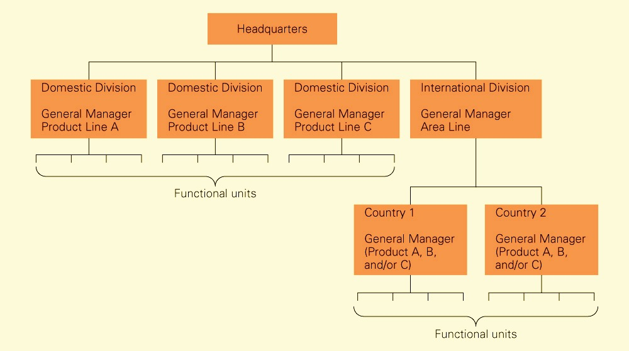
.
Figure 3b.1: The International Division

Slide 9
Organizational Structures for the Four Basic Strategic Choices:
Global product division structure—considers each product division as a stand-alone entity with worldwide responsibilities for its activities. It is appropriate for a global strategy.
Problem:
  - It is weak on local responsiveness

Slide 10
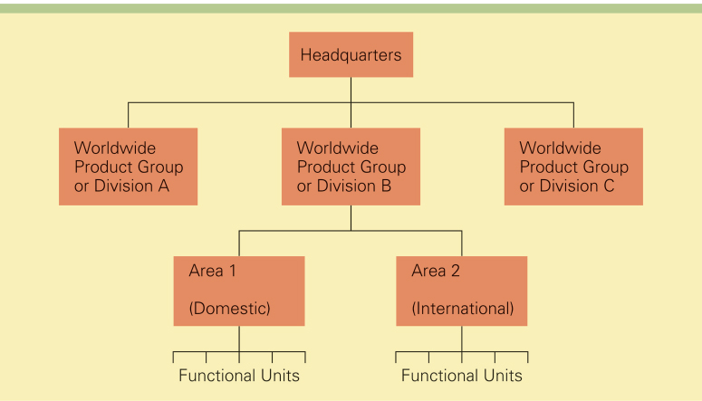
.
Figure 3b.2: Global Product Divisional Structure

Slide 11
Organizational Structures for the Four Basic Strategic:
Global matrix structure—supports the goals of the transnational strategy. However, it is often difficult to completely deliver the goals of the transnational strategy using this structure.
Problems:
  Adds layers of management, slow decision-making speed, and increases costs with little performance improvement.
  Often does not work as well as the theory predicts
  Difficult to ascertain accountability in this structure
  May lead to conflict and perpetual power struggles between the areas and the product divisions

Slide 12
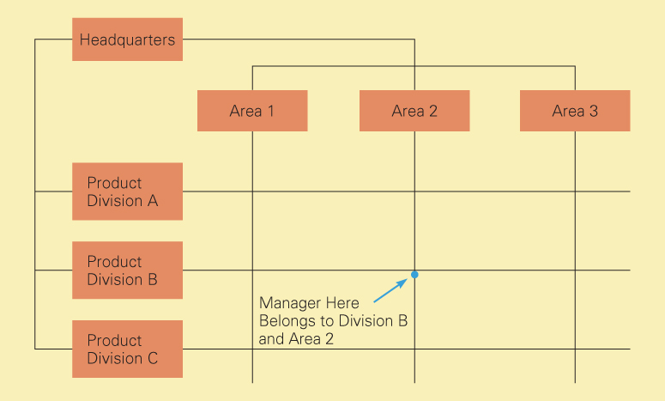
.
Figure 3b.3: Global Matrix Structure

Slide 13
Organizational Structures for the Four Basic Strategic:
Global area structure—organizes the firm according to different geographic areas (a country if the market is large enough or a group of countries). It is appropriate for the localization strategy. Although it facilitates local responsiveness, it encourages fragmentation.
Problem:
  May lead to the fragmentation of the company into highly autonomous, hard-to-control “fiefdoms”.

Slide 14
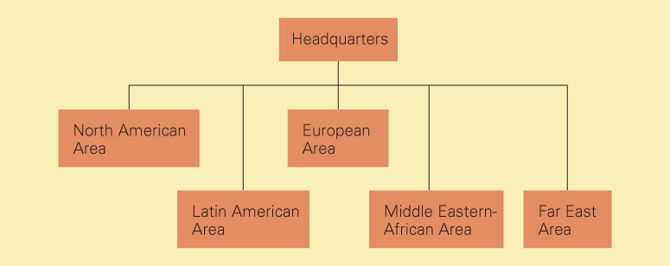
.
Figure 3b.4: Global Area Structure

