Slide 1
Difference, Discourse, Stereotyping, and Prejudice

Slide 2
What is Challenging About Difference?
1. Difference is new/novel

Slide 3
What is Challenging About Difference?
1. Difference is new
2. New ideas challenge the status quo

Slide 4
What is Challenging About Difference?
1. Difference is new
2. New ideas challenge the status quo
3. Changes in SQ disrupt the social order

Slide 5
What is Challenging About Difference?
1. Difference is new
2. New ideas challenge the status quo
3. Changes in SQ disrupt the social order
4. Disruptions to social order challenge authority

Slide 6
What is Challenging About Difference?
1. Difference is new
2. New ideas challenge the status quo
3. Changes in SQ disrupt the social order
4. Disruptions to social order challenge authority
5. Challenges to authority disrupt the social hierarchy

Slide 7
What is Challenging About Difference?
1. Difference is new
2. New ideas challenge the status quo
3. Changes in SQ disrupt the social order
4. Disruptions to social order challenge authority
5. Challenges to authority disrupt the social hierarchy
6. This threat to hierarchy requires policing

Slide 8
What is Challenging About Difference?
6. This threat to hierarchy requires policing
7. Policing moralizes differences and this leads to fundamentalism

Slide 9
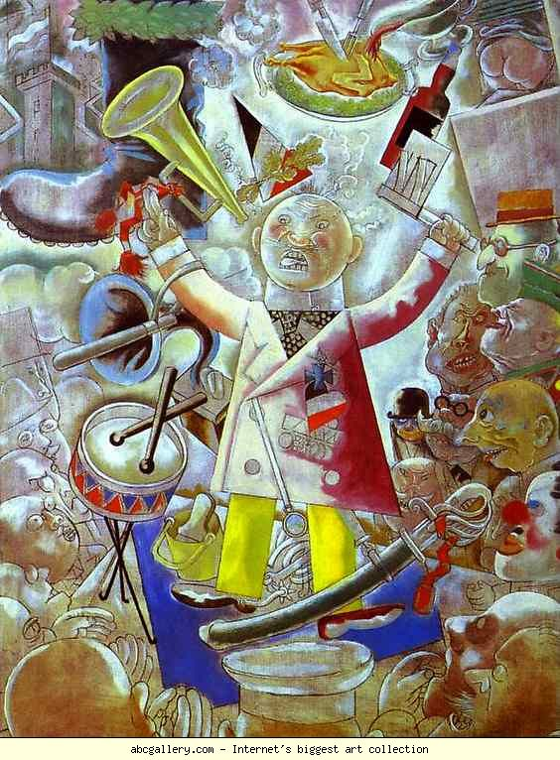
George Grosz The Agitator

Slide 10
Fascism
Mann defines fascism as the pursuit of a transcendant and cleansing nation-statism through paramilitarism. Mann argues that this definition contains five essential terms: (a) Nationalism, (b) Statism, (b) Transcendence, (c) Cleansing, and (d) Paramilitarism.

Slide 11
Nationalism
Fascists have always expressed a populist commitment to an “organic” nation.
This produces a distaste for ethnic diversity and multi-culturalism.
This nationalism is sometimes coupled with a call to return to a time imagined to be more pure in “organic” national identity.

Slide 12
Transcendence
Transcendence is reflected in the fascist belief that the destruction of the social order was necessary to accomplish the return to these more desirable times.
Fascism, and the nation-state would overcome social conflict by engaging in acts of violence and repressing those who would oppose them. Fascism has always viewed violence and war as a means to achieve political ends.

Slide 13
Paramilitarism
Paramilitarism is both a value and a tool of fascism. Paramilitarism is a value of fascism because it is a tangible representation of the fascist disdain of pacifism. It represents the value of the fist and the bullet that has embodied fascism in its many forms.
Paramilitarism may be used by the elites but it is essentially a bottom-up movement. Paramilitarism would bring credibility to elites and electoral popularity.

Slide 14
Interpersonalizing Salience
The experience of being salient
  Feelings of the salient
  Consequences of being salient

Slide 15
Stereotyping
Things to come: Blatant stereotyping, subtle stereotyping, and other relevant theories

Slide 16
Theories of Blatant Stereotyping
Social Identity Theory
Self Categorization Theory
Optimal Distinctiveness Theory
Subjective Uncertainty Reduction
Various Intergroup Ideologies

Slide 17
Social Identity Theory
Presuppositions:
Importance of social identity
The competitive dynamic between groups
Artifacts of this competitive dynamic

Slide 18

Valknot, or "knot of the slain,"

Slide 19

Thor’s Hammer

Slide 20

The Tyr rune, named after the Tyr was a god of warfare and battle.

Slide 21
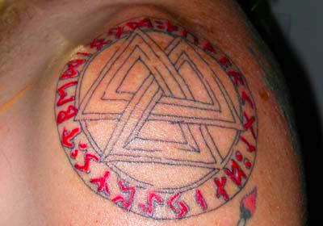

Slide 22
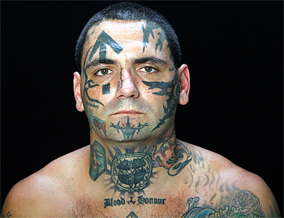
Andrew Michael Carter

Slide 23
14 Words
"We must secure the existence of our people and a future for white children."

Slide 24
88
The eighth letter of the alphabet is "H." Eight two times signifies "HH, " shorthand for the Nazi greeting, "Heil Hitler."

Slide 25
5 words
"I have nothing to say."

Slide 26
4/19
The anniversary date of two events: the confrontation between Federal agents and the Branch Davidians in Waco, Texas in 1993, and the 1995 Oklahoma City bombing carried out by Timothy McVeigh. This date is sometimes used as a tattoo by anti-government racists.

Slide 27
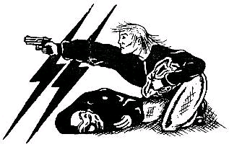
Art Work—Female Aryan Warrior

Slide 28
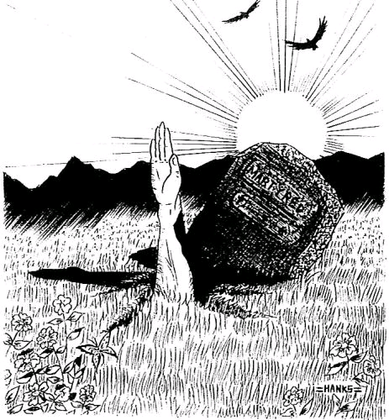
Martyr—Image of the Lone Wolf

Slide 29


Soy Boys: Insults of Alt Right

Slide 30


Xenaphobia of Alt Right

Slide 31
Self Categorization Theory
Self is not fixed
Self is dependent on context
Emphasized the multidimensionality of self

Slide 32
Optimal Distinctiveness Theory
People seek both autonomy and cohesion
Choose groups that achieve this balance

Slide 33
Subjective Uncertainty Reduction Theory
Importance of in-group norms

Slide 34
Intergroup Ideologies
Social Dominance Theory
Right Wing Authoritarianism
Terror Management Theory
System Justification Theory

Slide 35
Social Dominance Theory
Social Hierarchies
Myths
Consequences of high and low social dominance orientation

Slide 36
Right Wing Authoritarianism
Authoritarianism defined
  Traditional value
  Obedience
  Sanctions
  Intense group identification
  Fundamental beliefs RWA
  Producerism
  Demonizing Rhetoric
  Conspiricism
  Apocolyptic Thinking

Slide 37
Terror Management Theory
Influence of mortality and death
Cherished worldviews
How do we validate worldviews in dangerous circumstances?

Slide 38
System Justifications Theory
The comfort of ideology
Preserve the status quo

Slide 39
Automatic Stereotyping
Category confusions
Aversive racism
Stereotyping and cognitive load
Stereotyping and motivational control

Slide 40
Other Aspects of Subtle Stereotyping
Ambiguous stereotyping
Ambivalent stereotyping
Implications for minority identity
Implications for majority identity

Slide 41
The End of Stereotyping
?
Will I. Am: If you only have love for your own race, you only leave space to discriminate . . . And then ya get irate.
Guest (White) on Bill Maher: Maybe when Barak Obama wins this election we can stop talking about race in elections.
Katt Williams: We’ve got to talk about race.

