Slide 1
Chapter 6:
Transcultural Perspectives in the Nursing Care of Children

Slide 2
Children in a Culturally Diverse Society #1
Cultural survival depends on the transmission of values and customs from one generation to the next.
Culture influences child growth, development, health, and illness.

Slide 3
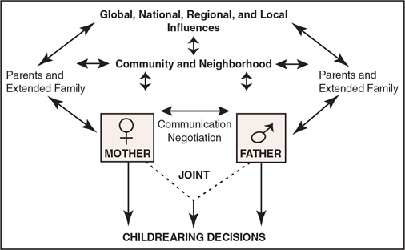
Children in a Culturally Diverse Society #2

Slide 4
Children as a Population
Elements to consider:
  Racial and ethnic composition
  Poverty
  Children’s health status
  Growth and development
  Infant attachment
  Crying

Slide 5
Culture-Universal and Culture-Specific Child Rearing #1
In all cultures, infants and children are valued and nurtured because they represent the promise of future generations.
Parental cultural beliefs and practices influence behaviors and interventions.

Slide 6
Culture-Universal and Culture-Specific Child Rearing #2
Culture influences child rearing:
  Nutrition: feeding and eating behaviors
  Sleep
  Elimination
  Menstruation
  Parent–child relationships and discipline
  Child abuse
  Gender differences

Slide 7
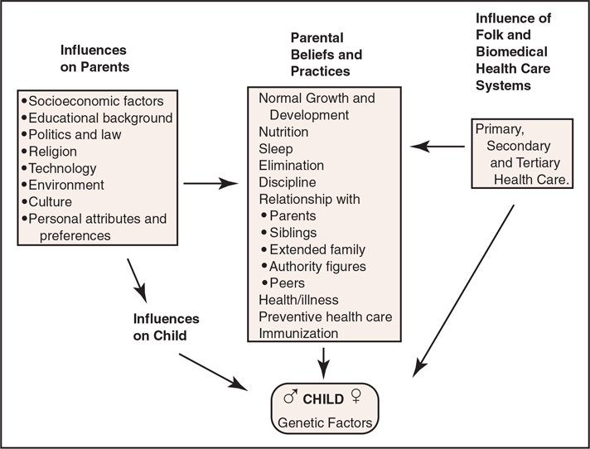
Culture-Universal and Culture-Specific Child Rearing #3

Slide 8
Question #1
Is the following statement true or false?
Differences between boys and girls are generally subtle, first appear at puberty, and exert minimal influence on adult roles within a culture.

Slide 9
Answer to Question #1
False
Rationale: Differences between boys and girls appear early in life and form the basis for adult roles within a culture.

Slide 10
Health and Health Promotion #1
Parents might persist with culturally based beliefs and practices even when scientific evidence refutes them.
The family is the primary health care provider for infants, children, and adolescents.

Slide 11
Health and Health Promotion #2
Influencing factors:
  Illness
  Health belief systems
  Biocultural influences on childhood disorders
    Immunity, intermarriage, ethnicity, race
  Beliefs regarding causes of chronic illness/disability
  Special health care needs of adolescents

Slide 12
Question #2
Is the following statement true or false?
Illness is viewed by many cultures as a form of punishment.

Slide 13
Answer to Question #2
True
Rationale: A family and/or child with a chronic illness or disability may believe that they have been cursed by a supreme being, have sinned, or violated a taboo.

Slide 14
Culturally Competent Nursing Care for Children and Adolescents #1
Nursing Assessment of the Family
  Cultural background
  Family belief systems
    Mother may be most influential
  Family structures
    Nuclear, single-parent, blended, extended

Slide 15
Culturally Competent Nursing Care for Children and Adolescents #2
Nursing Interventions
  Physical care/hygiene
  Communication
    With child and family
Evaluation of the nursing care plan
  Ask questions to determine if mutual goals were established

Slide 16
Question #3
Is the following statement true or false?
All family members of a cultural group follow the culture of the larger group.
  Example: All Chinese North American children show respect for authority, have polite social behavior, and a moderate-to-soft voice.

Slide 17
Answer to Question #3
False
Rationale: Each family modifies the culture of the larger group in ways that are uniquely its own.
Individual differences, changing norms over time, the degree of acculturation, the length of time the family has lived in a country, and other factors account for variations from the stereotype.

