Slide 1
Project Initiation

Slide 2
Project Initiation
Purpose of initiation phase
Comparing project options
Total cost of ownership
The project charter

Slide 3
The Initiation Phase
Business problem or opportunity defined
Solution is defined
Project is formed
Business case created
Project team appointed

Slide 4
The Business Case
Problem or opportunity: Detailed description
Introduction
Problem/opportunity statement
Assumptions and Constraints
Alignment with organizational objectives
A list of benefits, costs, and issues
Description of the preferred solution
Main project Requirements
Potential risks
Summarized plan for implementation
Schedule
Financial analysis

Slide 5
Comparing Options
Weighted Decision Matrix
Criteria | Weight | SJS Enterprises | Game Access | DVD Link
Educational | 15% | 90 | 0 | 0
Sports-related | 15% | 90 | 90 | 90
Secure payment | 10% | 90 | 50 | 50
 | (rows left out here—see textbook)
Weighted Project Scores | 100% | 56 | 14.5 | 12.5

Slide 6
Financial Considerations
Can compare projects based on
Net present value
Internal Rate of Return (Return on Investment or ROI)
Payback Analysis

Slide 7
Net Present Value Analysis
Considers the time value of money
Costs for future years must be discounted to the present time
Tangible benefits also discounted to the present time
Must identify an appropriate discount rate
Take risk into consideration

Slide 8
NPV Calculation
R_{t}
(1 + i)^{t}
t is the time of the cash flow
R_{t} is the cash flow at time t
i is the interest rate
Apply the above formula to each annual inflow and outflow of cash
Add all terms together to get the NPV

Slide 9
NPV Analysis
If… | It means… | Then…
NPV > 0 | the investment would add value to the firm | the project may be accepted
NPV < 0 | the investment would subtract value from the firm | the project should be rejected
NPV = 0 | the investment would neither gain nor lose value for the firm | indifferent in the decision This project adds no monetary value. Decision should be based on other criteria, e.g., strategic positioning or other factors not explicitly included in the calculation.

Slide 10
Rate of Return
(Total benefits – Total costs) / Total costs
Can be used to compare different options
Organization may have a minimum acceptable rate of return for projects

Slide 11
Payback Analysis
Compares cumulative costs to cumulative benefits
Easiest to see in graphical format
Time on horizontal axis, money on vertical

Slide 12
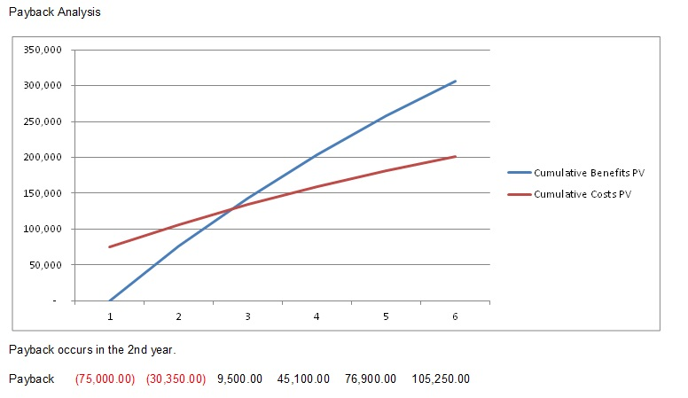
Payback Analysis

Slide 13
The Project Charter

Slide 14
Purpose of the Project Charter
When signed off, you have approval to proceed to detailed planning, followed by carrying out your project.

Slide 15
Organizational Process Assets
Is there a standard format for project charters?
Is there a standard process for developing and getting approval for a project charter?
What can the PMO do for you? What does the PMO require of you?
Are there applicable “lessons learned” available from other projects?
If you are inexperienced, is there a mentor available?
Etc.

Slide 16
Project Charter – Typical Contents
Identification section
Project purpose or justification
Measurable project objectives and related success criteria
High-level requirements
Assumptions and constraints
High-level project description and boundaries
High-level risks
Summary milestone schedule
Summary budget
Stakeholder list
Approvals

Slide 17
Identification
Name of the project—make it meaningful
Name, title, department of project sponsor
Name of project manager

Slide 18
Clear Objective
SMART
Specific
Measurable
Acceptable
Realistic
Time based

Slide 19
Business Need or Opportunity
A concise statement of how the project’s deliverables will contribute to organizational objectives

Slide 20
Scope
Clearly defines what is in and out of the project
Major Milestones
Identifiable points in time
Target dates will be added LATER

Slide 21
Major Deliverables
Break down the overall objective into smaller measurable units
Assumptions
Things you are not certain of but can proceed if you behave as if they are true

Slide 22
Constraints
Anything that limits your ability to deliver or the range of acceptable solutions
Preliminary Cost Estimates
How will the costs be defined and controlled

Slide 23
Risks
High-level statement about risks identified so far
Include the risk of NOT doing the project

Slide 24
Stakeholder List
The stakeholders identified so far, including their roles
Approval
A place for the project sponsor and the project manager to sign

Slide 25
Project Initiation: Summary
The first phase
Relationship of project to business objectives is key
Compare alternatives using weighted matrix
Financial analysis: NPV, ROI, payback
Project Charter is the primary output;
it includes the stakeholder list
Completion of Project Initiation is the signal that the project has approval to proceed to the project planning phase.

Slide 26
Questions?

