Slide 1
ITS 835 enterprise risk management
Chapter 15
Embedding ERM into Strategic Planning at the City of Edmonton

Slide 2
introduction
Edmonton –Past and present ERM
Links to strategic plan and to other strategic tools
Selecting and testing tools and framework
Recommended strategic ERM approach
Lessons learned

Slide 3
Edmonton past and present erm
Edmonton –Capital of Alberta, Canada
  Over 800,00 population
ERM piloted in 2005
CORPORATE Business Risk Planning (CBRP) model
  Not fully implemented
  Based on COSO
Adopted strategic plan
  The Way Ahead
  Strategic ERM

Slide 4
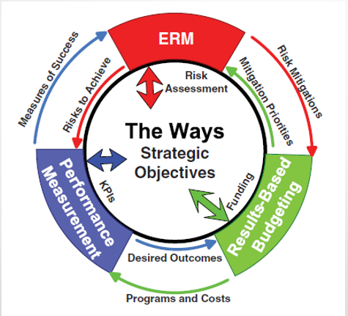
Links to strategic plan

Slide 5
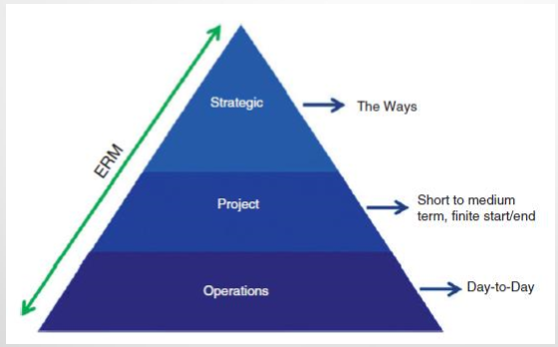
Selecting and testing tools and framework

Slide 6
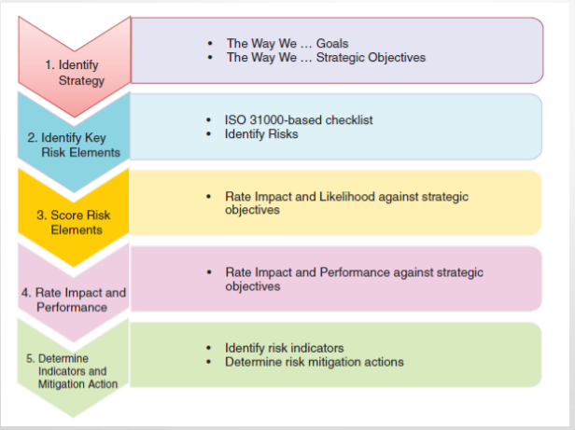
Selecting and testing tools and frameworks

Slide 7
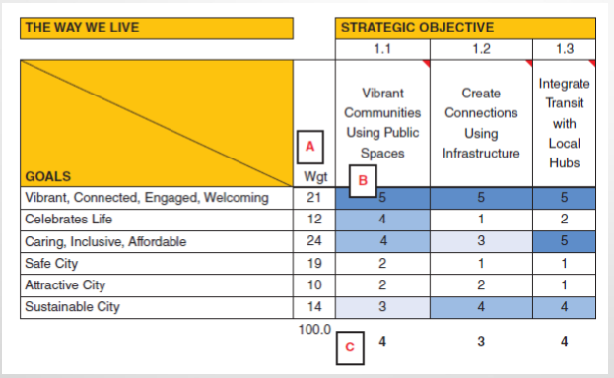
Strategic goals and objectives

Slide 8
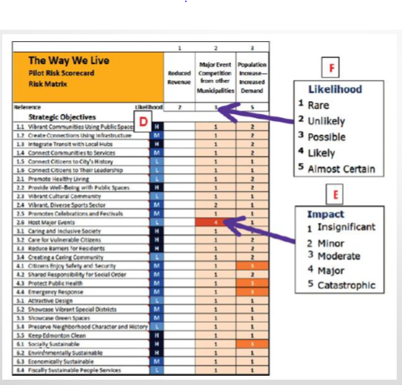
Risks and strategic objectives

Slide 9
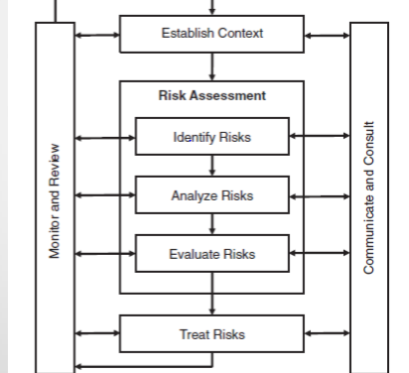
Iso 31000 risk management

Slide 10
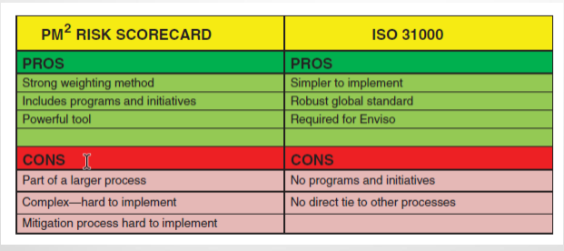
Pm2 versus iso 31000

Slide 11
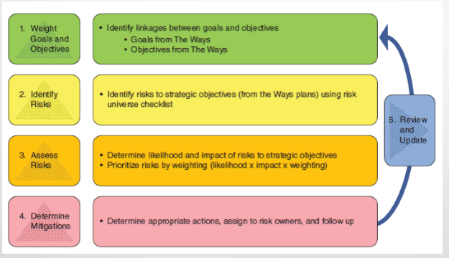
Proposed erm framework

Slide 12
Lessons learned
Key success factors
  Senior management buy-in
  Culture of innovation
  Consistency of model across goals
  Resource requirements for department SMEs
  Department accountability for key risks
Process of selecting and implementing framework
  Takes linger than expected
  No system is perfect
  Do not roll out all at once
  Clearly define all milestones and deliverables

