Slide 1

Chapter 13
Global Marketing
© McGraw-Hill Education. All rights reserved. Authorized only for instructor use in the classroom. No reproduction or further distribution permitted without the prior written consent of McGraw-Hill Education.

Slide 2
Chapter Outline
The competitive advantage of nations
Organizing for global marketing
Programming for global marketing
Entry and growth strategies for global marketing

Slide 3
Global Marketing
Firms invest in foreign countries for the same basic reasons they invest in their own country
Reasons vary from firm to firm but fall under the categories of achieving offensive or defensive goals

Slide 4
Goals of Global Marketing
Offensive goals
  Increase long-term growth and profit prospects
  Maximize total sales revenue
  Take advantage of economies of scale
  Improve overall market position
Defensive goals
  Compete with foreign companies on their own turf
  Gain access to technological innovations in other countries
  Take advantage of differences in operating costs
  Preempt competitors’ global moves
  Avoid being locked out of future markets by arriving too late
Jump to Goals of Global Marketing, Appendix

Slide 5
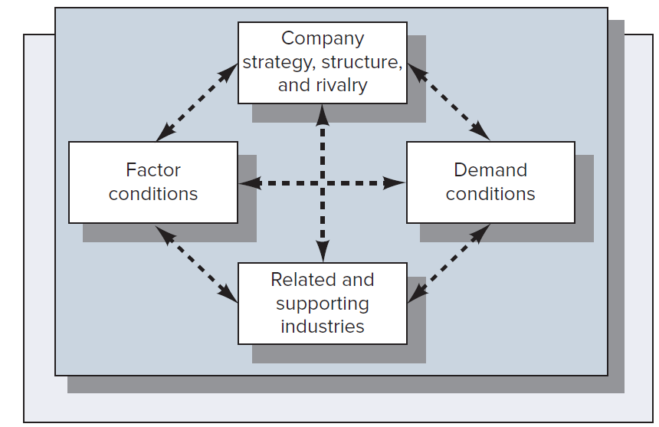
Figure 13.1: Porter’s Diamond of
National Advantage
Source: The Competitive Advantage of Nations by Michael E. Porter.
Jump to Figure 13.1: Porter’s Diamond of National Advantage, Appendix

Slide 6
Competitive Advantage of Nations
Factor conditions
  Nation’s ability to turn its natural resources, skilled labor, and infrastructure into a competitive advantage
Demand conditions
  Nature of domestic demand and the sophistication of domestic customers for the industry’s product or service
Related and supporting industries
  Existence or absence in the country of supplier and related industries that are also internationally competitive
Company strategy, structure, and rivalry
  Conditions in the nation that govern how companies are created, organized, and managed, and how intensely they compete domestically
Jump to Competitive Advantage of Nations, Appendix

Slide 7
Problems with Entering Foreign Markets, 1
Cultural misunderstanding
Areas in which differences occur
  Communication
  Spatial boundaries
  Perception of time
  Behavior
Managers must make the necessary efforts to learn, understand, and adapt to the cultural norms of customers and managers and sales team members in countries in which they do business
Sensitivity to cultural differences is essential

Slide 8
Problems with Entering Foreign Markets, 2
Political uncertainty
Government instability
Social unrest
Armed conflict
Import restrictions
Tariffs, quotas, and other types of restrictions
Established to promote self-sufficiency and can be a roadblock for multinational firms

Slide 9
Problems with Entering Foreign Markets, 3
Exchange controls and ownership restriction
Established by nations experiencing balance-of-payment problems
Important considerations in the decision to expand into a foreign market
Economic conditions
  Differences in economies due to political upheaval or social changes

Slide 10
Organizing the Multinational Company
Types global companies
Multidomestic company: Pursues different strategies in each of its foreign markets
Global company: Views the world as one market and pits its resources against competition in an integrated fashion
Alternatives to organizing global companies
Worldwide product divisions
Divisions responsible for all products sold within a geographic region
Matrix system that combines elements of both of these arrangements

Slide 11
Factors Affecting Global Strategy
External factors
  Market factors
  Economic factors
  Environmental factors
  Competitive factors
Internal factors
  Structure
  Management processes
  Culture
  People
Jump to Factors Affecting Global Strategy, Appendix

Slide 12
Organizational Issues to Be Considered in Global Marketing Research, 1
Population characteristics
Demographic variables, such that the number and size of families, education, occupation, and religion, are important
Ability to buy
  Gross national product or per capita national income
  Distribution of income
  Rate of growth in buying power
  Extent of available financing

Slide 13
Organizational Issues to Be Considered in Global Marketing Research, 2
Willingness to buy
  Related to cultural values and attitudes, tastes, and habits
Differences in research tasks and processes
  Language
  Data content
  Timeliness
  Availability in the United States

Slide 14
Global Product Strategy
Global marketing research helps determine whether there is:
Unsatisfied need for which a new product could be developed to serve a foreign market
Unsatisfied need that could be met with an existing domestic product, either as is or adapted to the foreign market

Slide 15
Global Distribution Strategy
Role of the distribution network is as important in foreign markets as it is at home
Channel arrangements range from no control to almost complete control of the distribution system by manufacturers
Influencing both home country and foreign country channels is challenging

Slide 16
Global Pricing Strategy
Pricing task is more complicated in foreign markets because of problems associated with tariffs, antidumping laws, taxes, inflation, and currency conversion
Constraints
Import duties
Rigidity in price structures

Slide 17
Global Advertising Strategy
Issues related to advertising
Language barrier
Selection of media
  Limited media availability and their inability to reach out to potential buyers
  Lack of accurate media information
  Type of agency to be used to prepare and place the firm’s advertisements
Sales promotion
Used as a strategy for bypassing restrictions on advertisements placed by some foreign governments
Effective means for reaching people in rural locations where media support for advertising is virtually nonexistent

Slide 18
Entry and Growth Strategies for Global Marketing
Strategy depends on analysis of market opportunities, company capabilities, degree of marketing involvement and commitment, and risk tolerance
Company can decide to:
Make minimal investments of funds and resources by limiting its efforts to exporting
Make large initial investments of resources and management effort to try to establish a long-term share of global markets
Take an incremental approach

Slide 19
Growth Strategies for Global Marketing: Exporting
Firm produces the product outside the final destination and then ships it there for sale
Advantages
Disadvantages
  Avoids the cost of establishing manufacturing operations in the host country
  It may help a firm achieve experience-curve and location economies
  Higher cost associated with the process
  Necessity of the exporting firm to pay import duties or face trade barriers
  Delegation of marketing responsibility for the product to foreign agents
Jump to Growth Strategies for Global Marketing: Exporting, Appendix

Slide 20
Growth Strategies for Global Marketing: Licensing
Organization’s granting of patent rights, trademark rights, and the right to use technological processes to foreign markets
Advantages
Disadvantages
  Firm does not have to bear the development costs and risks associated with opening up a foreign market
  Attractive option in unfamiliar or politically volatile markets
  Firm does not have tight control over manufacturing, marketing, and strategy
  There is the risk that foreign companies may capitalize on the licensed technology
Jump to Growth Strategies for Global Marketing: Licensing, Appendix

Slide 21
Growth Strategies for Global Marketing: Franchising and Joint Ventures
Franchising: Franchisor sells limited rights to use its brand name in return for a lump sum and share of the franchisee’s future profits
Employed by service firms, as opposed to manufacturing firms
Offers an effective mix of centralized and decentralized decision making
Joint ventures: Sharing management with one or more collaborating foreign firms

Slide 22
Advantages and Disadvantages of Joint ventures
Advantages
  Firm may be able to benefit from a partner’s knowledge of the host country
  Firm gains by sharing costs and risks of operating in a foreign market
  Sole option when political considerations make joint ventures the only feasible entry mode
  Firms can take advantage of a partner’s distribution system, technological know-how, or marketing skills
Disadvantages
  Firm may risk giving up control of proprietary knowledge to its partner
  Firm may lose the tight control over a foreign subsidiary needed to engage in coordinated global attacks against rivals
Jump to Advantages and Disadvantages of Joint ventures, Appendix

Slide 23
Growth Strategies for Global Marketing: Strategic Alliances
Partnerships where two or more firms invest in each other to gain competitive advantages on a worldwide versus local level
Long term in nature
Advantages
Reduced manufacturing costs, accelerated technological diffusion, and new product development
Legal and trade barriers can be overcome
  Disadvantage: Increased risk of competitive conflict between the partners

Slide 24
Growth Strategies for Global Marketing: Direct Ownership
Establishment of a wholly owned subsidiary or acquisition where it owns 100 percent of the stock
Advantages
Complete control over its technology and operations
Immediate access to foreign markets
Instant credibility and gains in the foreign country
Ability to install its own management team
Disadvantages: Huge costs and significant risks

Slide 25
APPENDIces

Slide 26
Goals of Global Marketing, Appendix
There are 2 small rectangular boxes partially overlapping 2 large rectangular boxes. Each pair of small and large boxes is placed one below the other. The content in the large box explains the term provided in the small box. In the first pair of boxes, the small box is labeled offensive goals. The large box has 4 points. Starting from the top, the points are increase long-term growth and profit prospects, maximize total sales revenue, take advantage of economies of scale, and improve overall market position. In the second pair of boxes, the small box is labeled defensive goals. The large box has 4 points. Starting from the top, the points are compete with foreign companies on their own turf, gain access to technological innovations in other countries, take advantage of differences in operating costs, preempt competitors’ global moves, and avoid being locked out of future markets by arriving too late.
Jump back to Goals of Global Marketing

Slide 27
Figure 13.1: Porter’s Diamond of National
Advantage, Appendix
There are two overlapping boxes in the figure. One is a base box and the other on it is a slightly smaller box. Two dashed, double-ended arrows form a cross at the center of the smaller box. Each of the four arrowheads points to a box. The upper arrowhead points to a box that is labeled company, strategy, structure, and rivalry. The right arrowhead points to a box that is labeled demand conditions. The lower arrowhead points to a box that is labeled related and supporting industries. The left arrowhead points to a box that is labeled factor conditions. Two dashed, double-ended arrows extend from either side of the box labeled company, strategy, structure, and rivalry and point to the factor conditions box on the left and the demand conditions box on the right. Two dashed, double-ended arrows extend from each of these boxes and point to related and supporting industries box below.
Jump back to Figure 13.1: Porter’s Diamond of National Advantage

Slide 28
Competitive Advantage of Nations, Appendix
There are 4 small rectangular boxes partially overlapping 4 large rectangular boxes. Each pair of small and large boxes is placed one below the other. The content in the large box explains the term provided in the small box. In the first pair of boxes, the small box is labeled factor conditions. The content in the large box reads nation’s ability to turn its natural resources, skilled labor, and infrastructure into a competitive advantage. In the second pair of boxes, the small box is labeled demand conditions. The content in the large box reads nature of domestic demand and the sophistication of domestic customers for the industry’s product or service. In the third pair of boxes, the small box is labeled related and supporting industries. The content in the large box reads existence or absence in the country of supplier and related industries that are also internationally competitive. In the fourth pair of boxes, the small box is labeled company strategy, structure, and rivalry. The content in the large box reads conditions in the nation that govern how companies are created, organized, and managed, and how intensely they compete domestically.
Jump back to Competitive Advantage of Nations

Slide 29
Factors Affecting Global Strategy, Appendix
There are 2 small rectangular boxes partially overlapping 2 large rectangular boxes. Each pair of small and large boxes is placed one below the other. The content in the large box explains the term provided in the small box. In the first pair of boxes, the small box is labeled external factors. The large box has 4 points. Starting from the top, the points are market factors, economic factors, environmental factors, competitive factors. In the second pair of boxes, the small box is labeled internal factors. The large box has 4 points. Starting from the top, the sub-points are structure, management processes, culture, and people.
Jump back to Factors Affecting Global Strategy

Slide 30
Growth Strategies for Global Marketing: Exporting, Appendix
The slide contains 2 rectangular boxes. Starting from the left, the header of the first box reads advantages and 2 points are listed below the header. The first point reads avoids the cost of establishing manufacturing operations in the host country, and the second point reads it may help a firm achieve experience-curve and location economies. The header of the second box reads disadvantages and 3 points are listed below the header. The first point reads higher cost associated with the process, the second point reads necessity of the exporting firm to pay import duties or face trade barriers, and the third point reads delegation of marketing responsibility for the product to foreign agents.
Jump back to Growth Strategies for Global Marketing: Exporting

Slide 31
Growth Strategies for Global Marketing: Licensing, Appendix
The slide contains 2 rectangular boxes. Starting from the left, the header of the first box reads advantages and 2 points are listed below the header. The first point reads firm does not have to bear the development costs and risks associated with opening up a foreign market, and the second point reads attractive option in unfamiliar or politically volatile markets. The header of the second box reads disadvantages and 2 points are listed below the header. The first point reads firm does not have tight control over manufacturing, marketing, and strategy, and the second point reads there is the risk that foreign companies may capitalize on the licensed technology.
Jump back to Growth Strategies for Global Marketing: Licensing

Slide 32
Advantages and Disadvantages of Joint Ventures, Appendix
There are 2 small rectangular boxes partially overlapping 2 large rectangular boxes. Each pair of small and large boxes is placed one below the other. The content in the large box explains the term provided in the small box. In the first pair of boxes, the small box is labeled advantages. The large box has 4 points. Starting from the top, the points are firm may be able to benefit from a partner’s knowledge of the host country, firm gains by sharing costs and risks of operating in a foreign market, sole option when political considerations make joint ventures the only feasible entry mode, allow firms to take advantage of a partner’s distribution system, technological know-how, or marketing skills. In the second pair of boxes, the small box is labeled disadvantages. The large box has 2 points. Starting from the top, the points are firm may risk giving up control of proprietary knowledge to its partner, and firm may lose the tight control over a foreign subsidiary needed to engage in coordinated global attacks against rivals.
Jump back to Advantages and Disadvantages of Joint ventures

