Slide 1
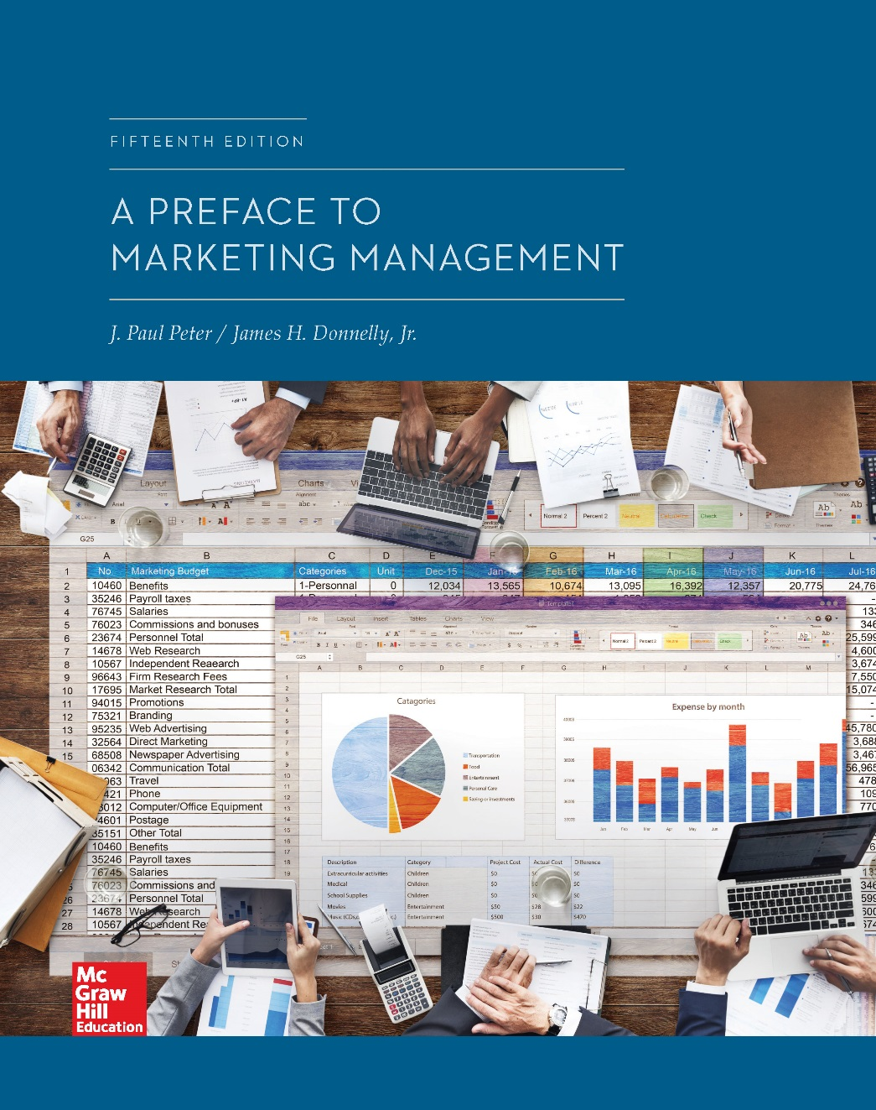
Chapter 12
The Marketing of
Services
    © McGraw-Hill Education. All rights reserved. Authorized only for instructor use in the classroom. No reproduction or further distribution permitted without the prior written consent of McGraw-Hill Education.

Slide 2
Chapter Outline
Important characteristics of services
Providing quality services
Overcoming the obstacles in service marketing
Implications for service marketers

Slide 3
Services: Definitions
Service products: Products that are intangible, or at least substantially so
Difficult to identify as they come into existence at the same time they are bought and consumed
Services: Activities performed by sellers and others that accompany the sale of a product and that aid in its exchange or its utilization

Slide 4
Figure 12.2: Unique Characteristics Distinguishing
Services from Goods, 1
Characteristic | Services | Goods
Intangibility | The customer owns only memories, outcomes, or feelings. | The customer owns objects that can be used, resold, or given to others.
Inseparability | Services often cannot be separated from the person providing them. They are often produced and consumed at the same time. | Goods are usually produced and sold by different people.
Perishability | Services can be used only at the time they are offered. They cannot be inventoried, stored, or transported. | Goods can be placed in inventory for use at another time.

Slide 5
Figure 12.2: Unique Characteristics Distinguishing
Services from Goods, 2
Characteristic | Services | Goods
Client relationship | Services often involve a long-term personal relationship between buyer and seller. | Goods often involve an impersonal short-term relationship although in many instances relationship strength and duration are increasing.
Customer effort | Customers are often heavily involved in the production. | Customer’s involvement may be limited to buying the completed product and using it.
Uniformity | Because of inseparability and high involvement on the part of the buyer, each service may be unique, with the quality likely to vary. | Variations in quality and variance from standards can be corrected before customers purchase products.

Slide 6
Providing Quality Services, 1
Determination of good service quality is difficult because of the gap between:
Consumer expectations and management perceptions of consumer expectations
Management perceptions of consumer expectations and the firm’s service quality specifications
Service quality specifications and actual service quality
Actual service delivery and external communications about the service

Slide 7
Providing Quality Services, 2
Determinants of service quality
Tangibles: Physical evidence of the service
Reliability: Consistency and dependability of the service performance
Responsiveness: Willingness or readiness of employees or professionals to provide service
Assurance: Knowledge and competence of service providers and the ability to convey trust and confidence
Empathy: Service provider’s efforts to understand the customer’s needs and to then provide individualized service delivery

Slide 8
Customer Satisfaction Measurement or C M S, 1
Research on service quality and customer satisfaction concentrates on the following issues:
Understanding the expectations and requirements of the customer
Determining how well a company and its major competitors are succeeding in satisfying these expectations and requirements

Slide 9
Customer Satisfaction Measurement or C M S, 2
Research on market leaders’ C S Ms have the following aspects in common:
Marketing and sales employees were primarily responsible for designing C S M programs and questionnaires
Top management and the marketing function championed the programs
Measurement involved a combination of qualitative and quantitative research methods that primarily included mail questionnaires, telephone surveys, and focus groups
Evaluations included both the company’s and competitors’ satisfaction performance

Slide 10
Customer Satisfaction Measurement or C M S, 3
Results of all research were made available to employees, but not necessarily to customers
Research was performed on a continual basis
Customer satisfaction was incorporated into the strategic focus of the company via the mission statement
Commitment to increasing service quality and customer satisfaction was found in employees at all levels within the organization

Slide 11
Internal Marketing
Continual process by which managers actively encourage, stimulate, and support employee commitment to the company, its goods and services, and its customers
Successful internal marketing efforts are instrumental to success in service marketing

Slide 12
Critical Components of Successful Internal Marketing
Careful selection process in hiring frontline employees
Clear, concrete message
Significant modeling by managers
Emphasis on good attitudes
Energetic follow-through process
Jump to Critical Components of Internal Marketing, Appendix

Slide 13
Obstacles in Service Marketing
Reasons for lack of innovative marketing on the part of service marketers
Limited view of marketing
Lack of strong competition in the past
Lack of creative management
No obsolescence

Slide 14
Implications for Service Marketers
Overdependence on one or two elements of the marketing mix should be avoided by service marketers
Services must be made available to prospective users
New services should be developed

Slide 15
APPENDICES

Slide 16
Critical Components of Internal Marketing, Appendix
There are five small rectangular boxes partially overlapping five large rectangular boxes. Each pair of small and large boxes is placed one below the other. Content is presented in the small boxes, and the large boxes are empty.
The first small box reads careful selection process in hiring frontline employees. The second box reads clear, concrete message. The third box reads significant modeling by managers. The fourth box reads energetic follow-through process. The fifth box reads emphasis on good attitudes.
Jump back to Critical Components of Internal Marketing

