Slide 1
Chapter 30
Occupational Health

Slide 2
Occupational Health Nursing
The specialty practice that focuses on the promotion, prevention, and restoration of health within the context of a safe and healthy environment …
– American Association of
Occupational Health Nurses (2012)

Slide 3
Occupational Health Nursing …
… includes the prevention of adverse health effects from occupational and environmental hazards.
… provides for and delivers occupational and environmental health and safety programs and services to clients.
… is an autonomous specialty, and nurses make independent nursing judgments in providing health care services.
– American Association of
Occupational Health Nurses (2004)

Slide 4
Occupational Health Nursing … (Cont.)
… has a multidisciplinary base:
  Nursing science
  Medical science
  Occupational health sciences
  Epidemiology
  Business and economic theories, concepts, and principles
  Social and behavioral sciences
  Environmental health
  Legal and ethical issues

Slide 5
Occupational Health Nursing Knowledge Domains
Figure 30-1 From Rogers B: Occupational health nursing expertise, AAOHN J 46:477-483, 1998. Copyright © Bonnie Rogers, 1998.

Slide 6
Evolution of Occupational Health Nursing: Part 1
1888: Betty Moulder hired by a group of coal mining companies
1895: Ada Mayo Stewart was “first industrial nurse”
1897: Anna B. Duncan visited sick employees at home
1899: Nursing service established for employees at worksite
1912: Workers’ compensation legislation passed; cost-effectiveness of providing health care to employees was achieving increased recognition

Slide 7
Evolution of Occupational Health Nursing: Part 2
1913: A registry of industrial nurses initiated
1915: Basis for Industrial Nurses Organization formed
1916: Factory Nurses Conference organized
1917: First educational course for industrial nurses offered at Boston University’s College of Business Administration
Great Depression: Nurses lost jobs because industrial nursing was considered nonessential

Slide 8
Evolution of Occupational Health Nursing: Part 3
World War I: Government demanded health services for workers at factories and shipyards holding defense contracts
World War II: Increased number of women in workforce
1942: Health conservation of the “industrial army” was the most urgent civilian need during the war
1938-1943: Number of occupational health nurses increased by 10,000
1942: American Association of Industrial Nurses formed

Slide 9
Evolution of Occupational Health Nursing: Part 4
1951: AAIN voted to remain an independent, autonomous association, not merge with NLN
1953: Industrial Nurses Journal formed (now AAOHN Journal)
1977: AAIN became American Association of Occupational Health Nurses (AAOHN)
1989: AAOHN developed first research agenda
1993: Office of Occupational Health Nursing established by OSHA
1999: AAOHN Foundation established and competencies in the specialty were delineated.

Slide 10
Evolution of Occupational Health Nursing: Part 5
2003: Annual joint conference, the American Occupational Health Conference was abolished even though it was 60 years old
2005: AAOHN held its first separate occupational health nursing conference
21st Century: AAOHN continues to expand specialty borders, emphasizing the importance of occupational health concepts and population-based practice.

Slide 11
Demographic Trends and Access Related to Occupational Health Care
Industrial transformations in the 21st century:
  Changing workforce demographics
  Rising health care costs
  Diversity of health care systems with the integration of managed care
  Influence of the world economy
  Shift in production from goods to services
  Proliferation of advanced technologies
Industry moving away from large facilities to smaller, service-based businesses

Slide 12
Occupational Health Nursing Practice and Professionalism
Often the only on-site health care professional.
Collaborates with workers, employers, and other professionals.
Roles are diverse and complex.
Coordinates comprehensive, holistic services.
Practice guided by AAOHN’s Standards of Occupational and Environmental Health Nursing Practice and Code of Ethics (2012).
Empowered, well-trained, usually educated at the baccalaureate level.

Slide 13
The Occupational Health Nurse
Practice guided by an ethical framework.
Encourages and enables individuals to make informed decisions about health care concerns.
Is a worker advocate; upholds professional standards and codes.
Responsible to and compensated by management; must practice within a framework of company policies and guidelines.
Fosters equitable and high-quality health care services and safe, healthy work environments.

Slide 14
Occupational Health and Prevention Strategies
Prevention of exposure to potential hazards
  Biological-infectious hazards
  Chemical hazards
  Enviromechanical hazards
  Physical hazards
  Psychosocial hazards

Slide 15
Primary Prevention Strategies
Health promotion
  Facilitates lifestyle changes
    Enhances awareness
    Increases motivation
    Builds skills
    Creates environments that supports positive health practices
  One-on-one interaction is an important strategy for evaluating risk reduction behavior for individuals

Slide 16
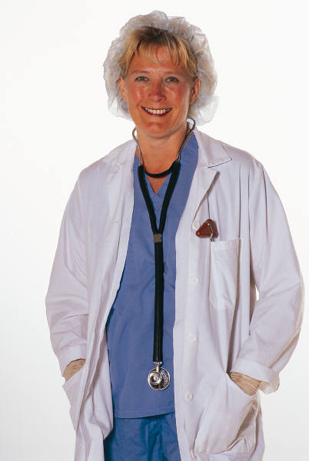
Primary Prevention Strategies (Cont.)
Disease prevention
  Recognize health risks, diseases, or environmental hazards
  “Seize the moment” with every employee encounter
  Use aggregate-focused intervention strategies
  “Walk-throughs” on a regular basis
    Recognize potential and existing hazards
    Maintain communications with safety and industrial hygiene resources to prevent illness and injury from occurring

Slide 17
Primary Prevention Strategies (Cont.)
Overall health promotion
  Health fairs, on-site fitness center, etc.
Nonoccupational programs
  Cardiovascular health, cancer awareness, personal safety, immunization, prenatal and postpartum health, accident prevention, retirement health, stress management, and relaxation techniques
  Emergency response, CPR, first aid and CPR, right-to-know training, immunization programs for international business travelers, back injury prevention with proper lifting and ergonomics

Slide 18
Primary Prevention Strategies (Cont.)
Women’s health and safety issues
  Maternal-child health, reproductive health, breast cancer early detection, stress management, work-home balance, etc.
Racial and ethnic minority groups
  Basic health concerns for this population and the illnesses traditionally associated with these groups or workers
  Programs must be culturally and linguistically appropriate
Veterans special health needs

Slide 19
Secondary Prevention Strategies
Aimed at early diagnosis, early treatment interventions, and attempts to limit disability.
Focus is on identification of health needs, health problems, and employees at risk.
  Conduct assessments and provide treatment and referrals
  Health screenings at worksite with relative ease, minimal cost
  Pre-placement evaluations for baseline medical and occupational health history, and a targeted physical assessment and medical tests (ADA compliance)

Slide 20
Secondary Prevention Strategies (Cont.)
Focus (Cont.)
  Periodic assessments to document any health changes
    Annual and biannual
    Specific protocols for exposure to substances or irritants (e.g., lead, asbestos, noise, chemicals)
  Job transfer evaluations
    Document any changes in health while working in a specific area or with a specific process
    Comply with OSHA regulations or NIOSH recommendations
  Assessment of commonly occurring health conditions

Slide 21
Tertiary Prevention Strategies
Rehabilitation and restoration of the worker to an optimal level of functioning
  Avoiding disability syndrome
Case management for the disabled employee’s successful return to work
Negotiation of workplace accommodations appropriate to the employee’s health limitations
Counseling and support for workers returning to work

Slide 22
Skills and Competences of Nurses
Competent
  Confident, has mastery of skills, ability to cope with specific situations, stresses consistency of practice rather than individual differences
Proficient
  Increased ability to perceive situations as a whole based on past experiences, predict the events to expect, able to alter protocols when needed
Expert
  Extensive experience, broad knowledge base, able to grasp situation quickly and initiate appropriate action; a sense of salience grounded in practice guiding actions and priorities
– Benner (1984)

Slide 23
Skills and Competencies of the Occupational Health Nurse
Skills and competencies
  Clinical and primary care
  Case management
  Workforce, workplace, and environmental issues
  Legal and ethical responsibilities
  Management and administration
  Health promotion and disease prevention
  Occupational and environmental health and safety education
  Research
  Professionalism
  Nursing Code of Ethics

Slide 24
Federal Legislation and Occupational Health
Occupational Safety and Health Act—OSHA (1970)
  Employers must “furnish a place of employment free from recognized hazards that are causing or likely to cause death or serious physical harm to employees.”
Workers’ Compensation Acts (state based)
  Provide income replacement and health care for employees who sustain a work-related injury or death.
Americans with Disabilities Act—ADA (1990)
  Employers must make “reasonable accommodations” to enhance opportunities for individuals with disabilities; prohibits discrimination on the basis of disability.

Slide 25
Legal Issues in Occupational Health
The occupational health nurse is professionally primarily accountable to workers and worker populations and to the employer, the profession, and self. (AAOHN, 2012)
Liability and legal issues relate to…
  The employee-nurse relationship
  The employment capacity of the occupational health nurse
  Any acts of negligence

Slide 26
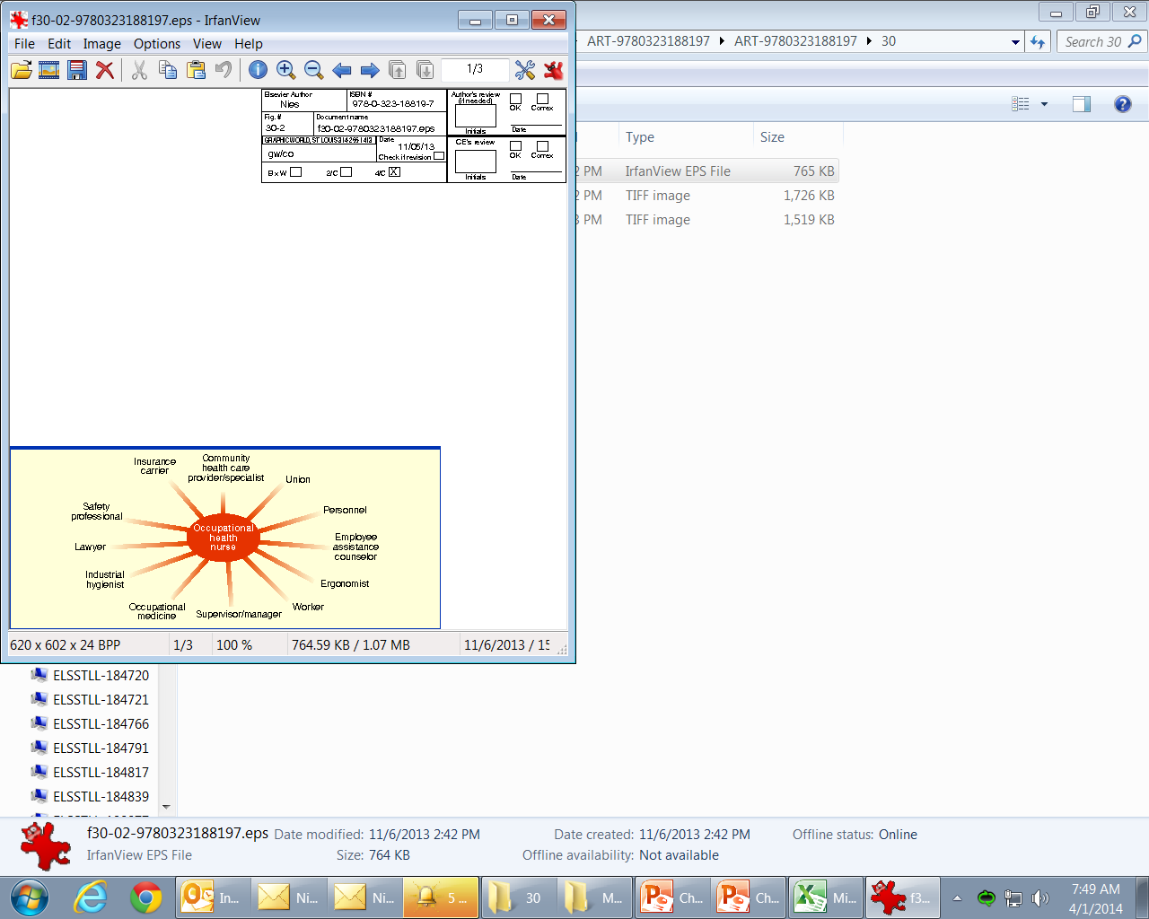
Multidisciplinary Teamwork
Figure 30-2

