Slide 1
Chapter 8
Community Health Education

Slide 2

Health Education …
… is any combination of learning experiences designed to predispose, enable, and reinforce voluntary behavior conducive to health in individuals, groups or communities.
– Green and Kreuter, 2004

Slide 3
Health Education’s Goals
To understand health behavior and to translate knowledge into relevant interventions and strategies for health enhancement, disease prevention, and chronic illness management
To enhance wellness and decrease disability

Slide 4
Health Education’s Goals (Cont.)
Attempts to actualize the health potential of individuals, families, communities, and society
Includes a broad and varied set of strategies aimed at influencing individuals within their social environment for improved health and well-being

Slide 5
Learning Theories
Humanistic theory helps individuals develop their potential in a self-directing and holistic manner.
Cognitive theory recognizes the brain’s ability to think, feel, learn, and solve problems; theorists in this area train the brain to maximize these functions.
Social learning is based on behavior that explains and enhances learning through the concepts of efficacy, outcome expectation, and incentives.

Slide 6

Adult Learners
Need to know
Concept of self
Experience
Readiness to learn
Orientation to learning
Motivation
– Knowles (1980, 1989)

Slide 7

Health Education Models
Health Belief Model (HBM)
Perceived susceptibility
Perceived severity
Perceived benefits
Perceived barriers
Self-efficacy
Demographics
Cues to action

Slide 8

Health Education Models (Cont.)
Health Promotion Model (HPM)
Individual characteristics and behaviors
  Prior behaviors, personal factors
Behavior—specific cognitions and affect
  Activity-related affect, interpersonal influences, situational factors, commitment to plan of action, perceived self-efficacy, immediate competing demands and preferences, perceived benefits of health-promoting behaviors, perceived barriers to health-promoting behaviors
Behavioral outcome
  Health-promoting behavior

Slide 9
Model of Health Education Empowerment
… nurses cannot assign power and control to the individual within the community but rather … the “power” must be taken on by the individual and community with the nurse guiding this dynamic process.
– Van Wyk, 1999

Slide 10
Model of Health Education Empowerment (Cont.)
Process includes examining
  Education
  Health literacy
  Gender
  Racism
  Class
Recognizes the structural and foundational changes that are needed to elicit change for socially and politically disenfranchised groups

Slide 11
Problem-Solving Education …
  …centers on empowerment (Freire, 2005)
  Allows active participation and ongoing dialogue
  Encourages learners to be critical and reflective about health issues
  Involves individuals as subjects, not objects
  Increases health knowledge through a participatory group process
Involves activism on the part of the educator
  Facilitator-educator is a resource person and is an equal partner with the other group members
  Leads to sustainable lateral relationships

Slide 12
Participatory Action Research (PAR)
Goal of PAR is social change
Embraces the use of community-based participatory methods
  Participation and action from stakeholders and knowledge about conditions and issues helps to facilitate strategies reached collectively

Slide 13
Community Empowerment
Community members take on greater power to create change
Based on community cultural strengths and assets
Attention must be given to collective rather than individual efforts to ensure that outcomes reflect voices of the community and truly make a difference in people’s lives

Slide 14


The Nurse’s Role in Health Education
Become a partner with individuals and communities
Serve as catalyst for change
Activate ideas
Offer appropriate interventions
Identify resources
Facilitate group empowerment

Slide 15
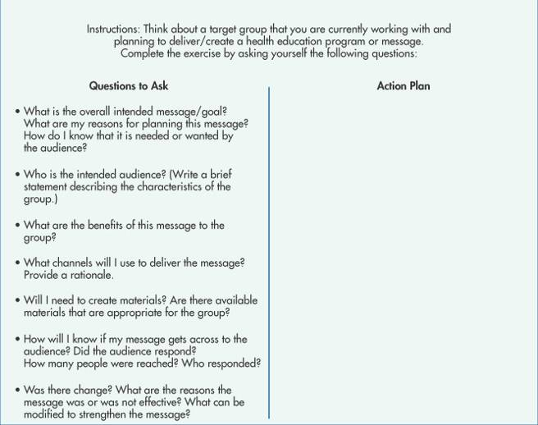
Framework for Developing
Health Communications
Figure 8-1

Slide 16
Health Education Model
Stage I: Planning and strategy selection
Questions to Ask
  Who is the intended audience?
  What is known about the audience and from what sources?
  What are the communication and education objectives and goals?
  What evaluation strategies will the nurse use?
  What are the issues of most concern?
  What is the health issue of interest?

Slide 17
Health Education Model
Stage I: Planning and strategy selection (Cont.)
Collaborative Actions to Take
  Review the available data.
  Get community partners involved.
  Obtain new data.
  Determine perceptions of health problems.
  Determine the community’s assets and strengths.
  Identify underlying issues and knowledge gaps.
  Establish goals and objectives.
  Assess resources.

Slide 18
Health Education Model
Stage II: Developing and pretesting concepts, messages, and materials
Questions to Ask
  What channels are best?
  What formats should be used?
  Are there existing resources?
  How can the nurse present the message?
  How will the intended audience react to the message?
  Will the audience understand, accept, and use the message?
  What changes may improve the message?

Slide 19
Health Education Model
Stage II: Developing and pretesting concepts, messages, and materials (Cont.)
Collaborative Actions to Take
  Identify the messages and materials.
  Decide whether to use existing materials or produce new ones.
  Select channels and formats.
  Develop relevant materials with the target audience.
  Pretest the message and materials and obtain audience feedback.

Slide 20
Health Education Model
Stage III: Implementing the program
Questions to Ask
  How should we launch the health education program?
  How do we maintain interest and sustainability?
  How can we use process evaluation?
  What are the strengths of the health program?
  How can we keep on track within timeline and budget?
  How do we know if we have reached our intended audience?
  How well did each step work (process evaluation)?
  Are we maintaining good relationships with partners?

Slide 21
Health Education Model
Stage III: Implementing the program (Cont.)
Collaborative Actions to Take
  Work with community organizations to enhance effectiveness.
  Monitor and track progress.
  Establish process evaluation measures.

Slide 22
Health Education Model
Stage IV: Assessing effectiveness and making refinements
Questions to Ask
  What was learned?
  How can outcome evaluation be used to assess effectiveness?
  What worked well, and what did not work well?
  Has anything changed about the intended audience?
  How can we refine methods, channels, and formats?
  What lessons were learned? What modifications could strengthen the health education activity?
Notes:
22

Slide 23
Health Education Model
Stage IV: Assessing effectiveness and making refinements (Cont.)
Collaborative Actions to Take
  Conduct outcome evaluations.
  Reassess and revise goals and objectives.
  Modify unsuccessful strategies or activities.
  Generate continual support from community groups.
  Provide justification for continuing/ending the program.
  Summarize in an evaluation report.
Notes:
23

Slide 24
Health Literacy Definitions Evolved Over Time
National Literacy Act (1991)
  Literacy is operationally defined as the ability to read and write at the fifth-grade reading level in any language and can be measured according to a continuum.
IOM Report (2004)
  The capacity to obtain, interpret, and understand basic health information and services and the competence to use such information and services to enhance health

Slide 25
Health Literacy
In 1999, the AMA’s Report of the Council on Scientific Affairs reported that patients with the most health care needs are often the least able to read and understand information that would enable them to function successfully within
the health care system.

Slide 26

Health Literacy (Cont.)
Health literacy is about empowerment …
  Having access to information, knowledge, and innovations
  Increasingly important for social, economic, and health development
  A key public health issue in the delivery of safe, effective care

Slide 27
Low Literacy
Increases the use of health care services
Decreases self-esteem; increases shame and stigma
Adversely affects outcomes and treatment of some medical conditions
Poses barriers to obtaining informed consent
Impacts participation in research
Leads to health care and linguistic isolation
Impedes patient-provider communication

Slide 28
Literacy Concerns
Serious mismatch exists between the reading levels of materials and patient’s reading skills.
Materials often fail to incorporate the intended audience’s cultural beliefs, values, languages, and attitudes.
Low literacy prevents many from gaining the full benefits of health care.

Slide 29
Literacy Concerns (Cont.)
Inability to read and understand instructions influences self-care abilities and health and wellness.
Individuals with very low literacy skills are at an increased risk for poor health, which contributes to health disparities.

Slide 30

Levels for Interventions
Functional/basic literacy
  Increasing basic reading/writing skills
Communicative/interactive literacy
  Understanding and using information with providers
Critical literacy*
  Analyzing and using information in life situations
*Most important because it increases empowerment and success in everyday situations

Slide 31
Helpful Tips for Effective Teaching
Assess reading skills
Determine what client needs to know
Identify motivating factors
Stick with essentials
Set realistic goals and objectives
Use clear and concise language
Develop a glossary of common words
Space teaching over time
Personalize health messages
Incorporate methods of illustration, demonstration, and real-life examples
Give and get

Slide 32
Helpful Tips for Effective Teaching (Cont.)
Summarize often
Be creative
Use appropriate resources and materials
Put patients at ease
Praise patients
Be encouraging
Allow time for questions
Employ teach-back methods
Remember that comprehension and understanding take time and practice
Conduct learner verification
Evaluate the teaching plan

Slide 33
Assess Materials
Become a Wise Consumer and User
  Evaluate health materials, including websites, before disseminating them
  Materials should strengthen previous teaching
  Materials should be used as an adjunct to health instruction

Slide 34

Assessing the Relevancy of Health Materials
Do materials match the intended audience?
Are materials appealing and culturally and linguistically relevant?
Do they convey accurate and up-to-date information?
Are messages clear and understandable?
Do messages promote self-efficacy and motivation?

Slide 35
Assessment of Reading Level
Assess reading levels of intended audience
  Rapid estimate of adult literacy in medicine (REALM)
  Single Item Literacy Screener (SILS)
  Short Assessment of Health Literacy for Spanish-Speaking Adults (SAHLSA)
Assess readability of educational resources
  SMOG readability formula
  Flesch-Kincaid formula (on most computers)
Verify understanding of learner

Slide 36
Role of Social Media
Numerous platforms now available
May reach diverse community constituents with important public health messages
Potential to…
  Facilitate interactive communication
  Increase sharing of health information
  Personalize and reinforce health messages
Can empower community members to make informed health decisions

