Slide 1

Managing and Using Information Systems:
A Strategic Approach – Sixth Edition
Keri Pearlson, Carol Saunders,
and Dennis Galletta
© Copyright 2016
John Wiley & Sons, Inc.

Slide 2
Chapter 5
IT and Business Transformation

Slide 3
Sloan Valve
What was wrong with their Product Development Process?
What did Sloan do? What is NPD?
Did it help?
Are all enterprise system implementations this successful?
Notes:
Complex and slow; 16 units had to coordinate; took 18-24 months to bring new products to market; >50% of ideas didn’t make it; nobody accountable
New Product Development: Adoption of ERP. Process: team included members across the firm; proposed new process of (1) ideation (2) business case development, (3) project portfolio management, (4) product development, (5) product/process validation, (6) launch
Results: Time to market reduced to 12 months, poor ideas filtered out early; better access to info and customer feedback; better accountability
Other firms: No, some failed, such as: Overstock.com, Levi Strauss, Avis Europe

Slide 4
SILO PERSPECTIVE
VERSUS
BUSINESS PROCESS PERSPECTIVE

Slide 5
Silo (Functional) Perspective
Specialized functions (sales, accounting, production, etc.
Advantages:
  Allows optimization of expertise.
  Group like functions together for transfer of knowledge.
Disadvantages:
  Sub-optimization (reinvent wheel; gaps in communication; bureaucracy)
  Tend to lose sight of overall organizational objectives.
Executive Offices
CEO
President
Operations
Marketing
Accounting
Finance
Administration

Slide 6
The Process Perspective
Examples of processes:
  Fulfill customer orders
  Manufacturing, planning, execution
  Procurement (see below)
Processes have:
  Beginning and an end
  Inputs and outputs
  A process to convert inputs into outputs
  Metrics to measure effectiveness
They cross functions
Receive Requirement for Goods/Services
Create and Send Purchase Order
Receive Goods
Pay Vendor
Verify Invoice

Slide 7
Cross-Functional Nature of Business Processes

Slide 8
How to Manage a Process
Identify the customers of processes (who receives the output?)
Identify the customers’ requirements (how do we judge success?)
Clarify the value each process adds to the organizational goals
Share this perspective so the organization itself becomes more process focused

Slide 9
Comparison of Silo Perspective and
Business Process Perspective
 | Silo Perspective | Business Process Perspective
Definition | Self-contained functional units such as marketing, operations, finance | Interrelated, sequential set of activities and tasks that turns inputs into outputs
Focus | Functional | Cross-functional
Goal Accomplishment | Optimizes on functional goals, which might be suboptimal for the organization | Optimizes on organizational goals, or the “big picture”
Benefits | Highlighting and developing core competencies; functional efficiencies | Avoiding work duplication and cross-functional communication gaps; organizational effectiveness
Problems | Redundancy of information throughout the organization; cross-functional inefficiencies; communication problems | Difficult to find knowledgeable generalists; sophisticated software is needed

Slide 10
What do you do when things change?
Dynamic and agile processes
Examples:
  Agile: Autos are built with wires and space for options
  Dynamic: Call centers route incoming or even outgoing calls to available locations and agents
  Software defined architectures (see chapter 6)
IT is required to pull this off well

Slide 11
Techniques to Transform a Static Process
Radical process redesign
  Also known as business process reengineering
Incremental, continuous process improvement
  Including total quality management (TQM) and Six Sigma

Slide 12
Incremental Change
Total Quality Management
Often results in favorable reactions from personnel
  Improvements are owned and controlled
  Less threatening change
Six-Sigma is one popular approach to TQM
  Developed at Motorola
  Institutionalized at GE for “near-perfect products”
  Generally regarded as 3.4 defects per million opportunities for defect (6 std dev from mean)
Improve-ment
Time

Slide 13
Radical Change
Business Process Reengineering (BPR)
Sets aggressive improvement goals.
Goal is to make a rapid, breakthrough impact on key metrics in a short amount of time.
Greater resistance by personnel.
Use only when radical change is needed.
Improve-ment
Time

Slide 14
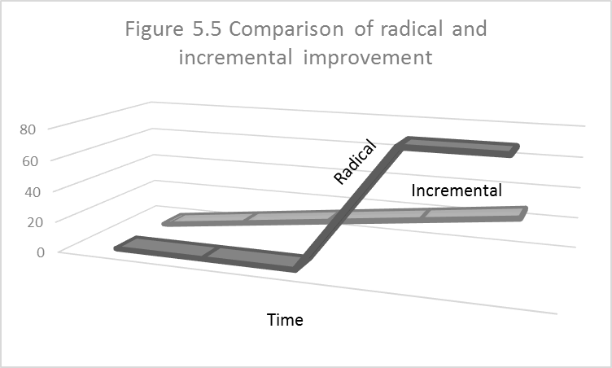
Comparing the Two
Improve-ment

Slide 15
Key Aspects of Radical Change Approaches
Need for quick, major change
Thinking from a cross-functional process perspective
Challenge to old assumptions
Networked (cross-functional organization)
Empowerment of individuals in the process
Measurement of success via metrics tied to business goals and effectiveness of new processes

Slide 16
Workflow and Mapping Processes
Workflow diagrams show a picture of the sequence and detail of each process step
Objective is to understand and communicate the dimensions of the process
Over 200 products are available to do this
High-level overview chart plus detailed flow diagram of the process

Slide 17
BPM
Information systems tools used to enable information flow within and between processes.
Comprehensive, enterprise software packages.
Most frequently discussed:
  ERP (Enterprise Resource Planning),
  CRM (Customer Relationship Management),
  SCM (Supply Chain Management)
Designed to manage the potentially hundreds of systems throughout a large organization.
SAP, Oracle, Peoplesoft are the most widely used ERP software packages in large organizations.

Slide 18
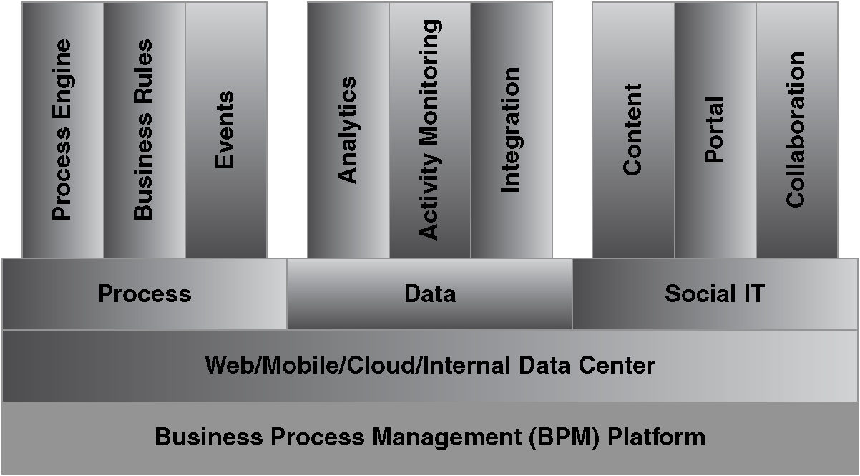
BPM Architecture

Slide 19
Standardization vs Integration
 |  | Business Process Standardization
 |  | Low | High
Business Process Integration | High | Single face to customers and suppliers but standards not enforced internally | High needs for reliability, predictability, and sharing; single view of process
 | Low | Decentralized design; business units decide how to meet customer needs | Tasks are done the same way across units, but there is little need for business units to interact
Source: J. Ross “Forget Strategy: Focus IT on your Operating Model,”
MIT Center for Information Systems Research Briefing (December 2005)

Slide 20
Enterprise Systems (Enterprise Resource Planning or ERP)
Seamlessly integrate information flows throughout the company.
Reflect industry “best” practices.
Need to be integrated with existing hardware, OSs, databases, and telecommunications.
Some assembly (customization) is required
The systems evolve to fit the needs of the diverse marketplace.

Slide 21
ERP Advantages and Disadvantages
Advantages | Disadvantages
Represent “best practices” Modules throughout the organization communicate with each other Enable centralized decision-making Eliminate redundant data entry Enable standardized procedures in different locations | Enormous amount of work Require redesign of business practices for maximum benefit Require customization if special features are needed Very high cost Sold as a suite, not individual modules Requires extensive training High risk of failure

Slide 22
ERP II
Makes information available to external stakeholders too
Enables e-business applications
Integrates into the cloud
Includes ERP plus other functions (see Figure 5.8)

Slide 23
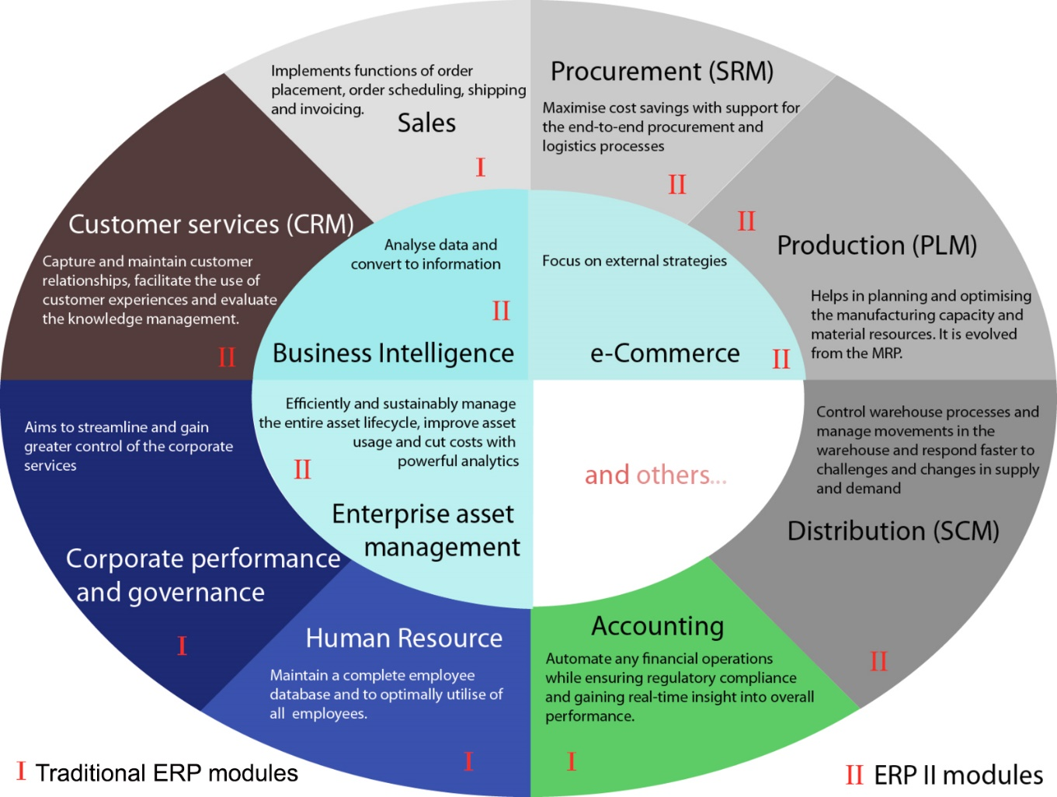
ERP and ERP II Functions

Slide 24
Customer Relationship Management
Customer Relationship Management (CRM) is a natural extension of applying the value chain model to customers.
CRM includes many management activities performed to
  obtain,
  enhance relationships with, and
  retain customers.
CRM can lead to better customer service, which leads to competitive advantage for the business.

Slide 25
CRM
Common systems are:
  Oracle
  SAP
  Salesforce.com (web-based cloud system)
Oracle and SAP integrate into their ERP systems

Slide 26
Supply Chain Management (SCM)
An enterprise system that manages the integrated supply chain
Translation: processes are linked across companies
The single network optimizes costs and opportunities for all companies in the supply chain
Every part of the supply chain has the latest information about sales expected and inventories from source materials at all stages
Bullwhip effect occurs when the supplier at each stage adds a small “buffer” for it’s suppliers in case demand is higher than expected

Slide 27
Difficulties in Integrated Supply Chains
Information integration requires agreement of what information to share, how to share it, and the authority to view it.
Trust must be established
Planning must be synchronized carefully
Workflow must be coordinated between partners to determine what to do with the information they obtain

Slide 28
Advantages and Disadvantages of Enterprise Systems

Slide 29
The Adoption Decision
The enterprise system sometimes should drive business process redesign when:
  Just starting out.
  Organizational processes are not relied upon for strategic advantage.
  Current systems are in crisis.
It is inappropriate for the enterprise system to drive business process redesign when:
  Changing an organization’s processes that are relied upon for strategic advantage.
  The package does not fit the organization.
  There is a lack of top management support.

Slide 30
Managing and Using Information Systems:
A Strategic Approach – Sixth Edition
Keri Pearlson, Carol Saunders,
and Dennis Galletta
© Copyright 2016
John Wiley & Sons, Inc.

