Slide 1
CH. 14 ~ Culture
Bus 160

Slide 2
Organizational Culture
The norms & values that dictate people’s behavior in the organization, for dominant & sub- culture
The “unwritten rules” of acceptable behavior
Origins
Top Management Characteristics & selection (people)
Structure & Communication Channels (property rights)
Ethical Behavior (Chapter 22)
Transmitted through Socialization Tactics
Individualized v. Institutionalized
Localization v. Standardization

Slide 3
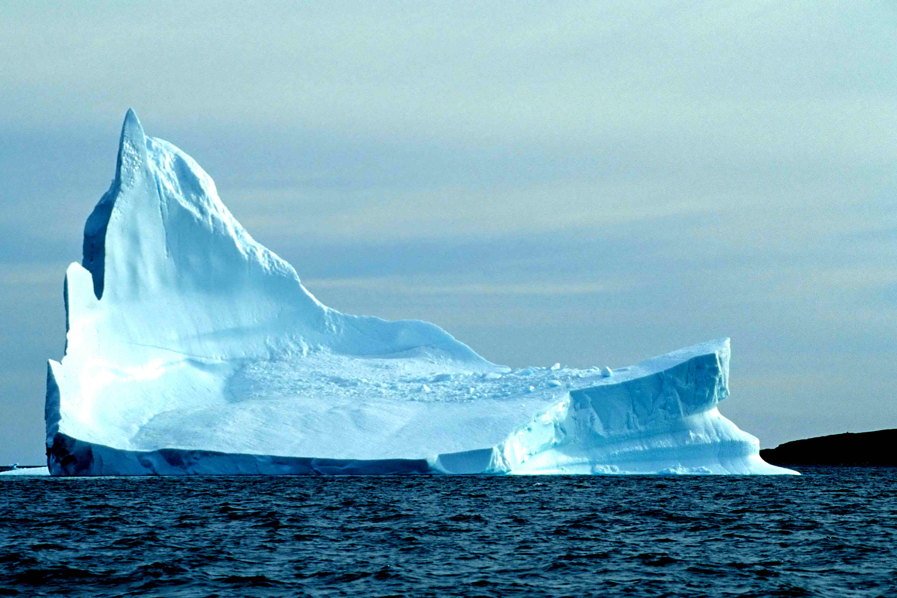
Components of Culture
Observable: the components of culture that can be seen in an organization = Overt
Surface-level diversity
Unobservable: the components that lie beneath the surface (VABEs) = Covert
Deep-level diversity

Slide 4
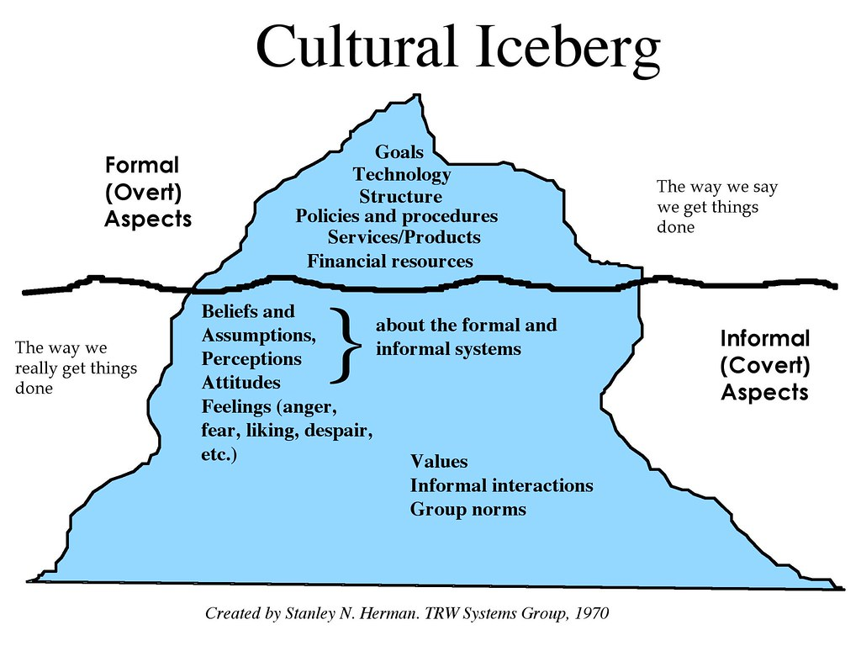
VABEs = Values, Attitudes/Assumptions, Beliefs, Expectations

Slide 5
Why Study Organizational Culture
Functions of…
Dysfunctions of…
External Adaptation
Pattern of shared basic assumptions, goals, tasks, methods, processes…
Internal Integration
Shared identity and practices for working together…
Change Hindrances
Obstacles that impede progress/adaptation…
Diversity Hindrances
Obstacles that limit membership…
Merger/Acquisition Hindrances
Obstacles that make it hard to merge…

Slide 6
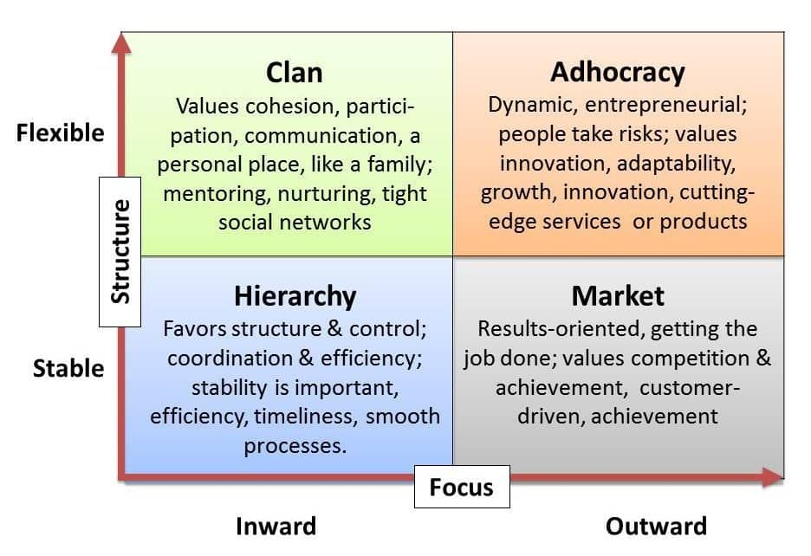
Competing Values Framework (Quinn & Kimberly, 1984)
discretion
Human Relationships
Change
control
Stability
Accomplishment
integration
adaptation

Slide 7
Organizational Culture Affects:
Attitude toward innovation & creativity
Attitude toward risk-taking and aggressiveness
Formalization of rules & procedures
Stakeholder orientation
Individual v. Team orientation
Attitude toward diversity
Dedication to company (work ethic)
Dress code, décor
Communication & Language (interpersonal)
Tolerance of fun
Discipline & Ethical standards
Most companies don’t have written rules, but the culture takes a clear stance on them…

Slide 8
Effort: The serious attempt to accomplish a task
Cultural Norms…
Effort is more meaningful when we are faced with challenge…
Routine effort is expected and seldom rewarded…
There is a strong relationship between diversity, ethics, and effort…
We respect effort when it is consistent with the values of the dominant culture (society)

Slide 9
“In emotionally intelligent organizations, people share a vision of who they are collectively, and they share a special chemistry (synergy). They have the feeling of a good fit, of understanding and being understood, and a sense of well-being in the presence of others.”
(p253)

Slide 10
Cultural Distinctions
Dominant Culture
When majority group shares the same core values…
Sub-culture
When minority group have different values than dominant group
Counter-culture
When group’s values differ greatly from everyone else
Dominant Culture
Sub-Culture
Counter-
culture

Slide 11
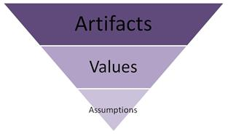
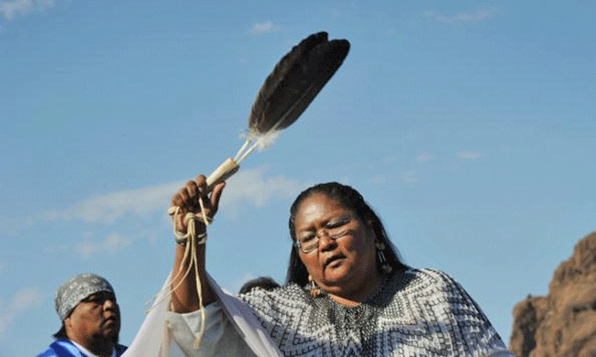
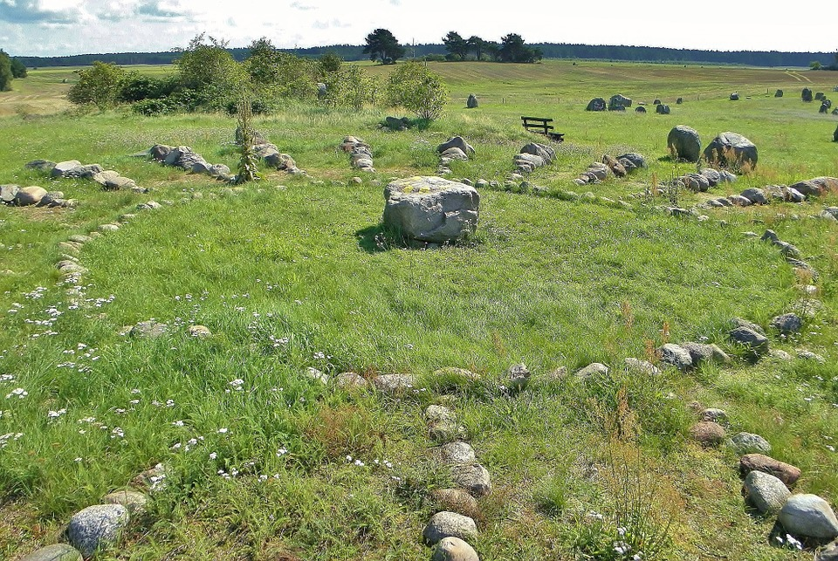
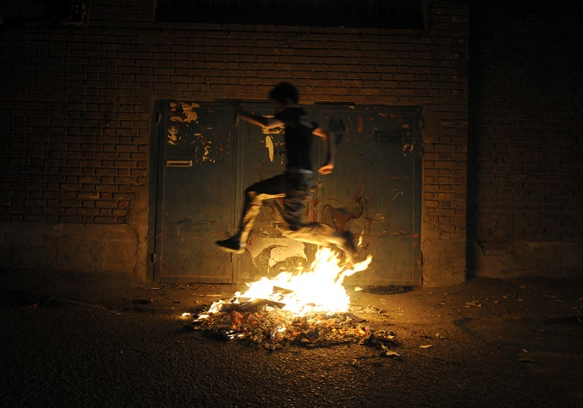
Artifacts of Culture
Stories
Symbols
Rituals
Ceremonies
Language

Slide 12
Thinking Globally (Hofstede)
Power Distance: degree to which people perceive power unequally (status & hierarchy)
Uncertainty Avoidance: degree to which people prefer structure and predictability (ambiguity)
Risk Aversion: degree to which people avoid risky behavior & risk-taking
Individualism v. Collectivism: orientation toward
Masculinity v. Femininity: achievement perspective
Time Orientation: degree to which people are sensitive to time and long v. short orientations

