Slide 1
2001 - 2017
Juan Carlos Perez
ECO 202
Dr. Tasto
Notes:
Choose a title for your presentation.
Include your name, the course name and the assignment name.

Slide 2
Ten-Year Period of U.S. Economic History Overview (2007-2017)
Deep economic recession in 2007 to 2008
Barack Obama is elected president 2009 to 2017
Focused on reviving economy using fiscal expansion
Implemented the American Recovery and Reinvestment Act of 2009
Economic stimulus program
Pumped $831 million through tax cuts, infrastructure spending, and unemployment benefits
There was little rise in the median wages
Notes:
The period of 2007 to 2017 was marked by various economic activities. In the period of 2007 to 2009, there was the great recession that resulted from the burst of the housing industry. In 2009, Barack Obama was elected as president and served until 2017. He is the first black American president to have held the position. The main focus of President Obama was the economic recovery of the country. He did this by implementing the American Recovery and Reinvestment Act of 2009 which was an economic stimulus program that pumped $831 million dollars into the economy. The stimulus program focused on tax cuts, infrastructure sending, and unemployment benefits. There was little rise in the median wages during the period.

Slide 3
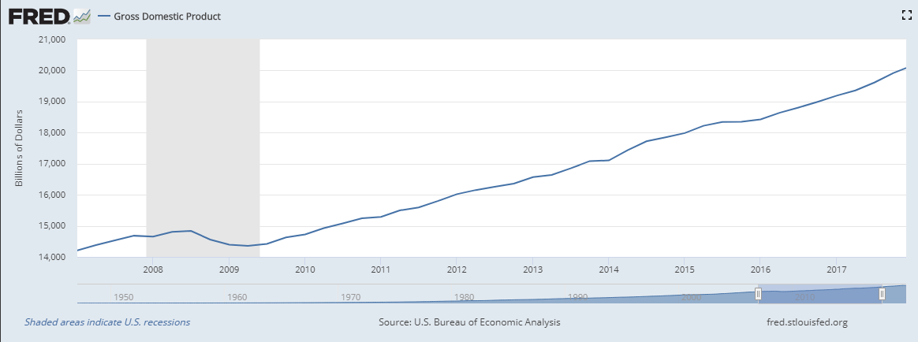
GDP 2007 to 2017 (U.S. Bureau of Economic Analysis, Gross Domestic Product, n.d.)
Notes:
The US GDP during the period of 2007 to 2017 had a steady growth rate. The period began with a 14,208 billion dollar GDP and grew to slightly over 20,000 billion dollars at the end of the fourth quarter in 2017. There is a visible dip in the period of 2008 to 2009. This was during the recession caused by the burst in the housing industry. The bubble was caused by increased demand and serving of mortgages without clear analysis of the customer’s credit worthiness leading to mass default. There was consequent inflation. 2009 was marked by a rebound that lasted for long period lasting the remaining ten-year period. Tax cuts were influential in putting more money into people and businesses.

Slide 4
GDP
Inflation causes increase in prices leading to everything being expensive and unsustainable
Reduced purchasing power, increased spending due to assumption inflation will get worse leading to worse inflation
Tax cuts for the lower and middle-class increases the spending power of consumers
Leads to increased aggregate demand
Leads to higher economic growth; also there is increased incentive to work leading to higher productivity
Notes:
Inflation is marked by an increase in prices of commodities that lead to everything being expensive and unsustainable. This leads to a reduction the purchasing power leading to increased spending based on the assumption that there is a need to spend now since in the future prices will increase. This leads to further increase in prices and worse inflation. The tax-cuts implemented to the lower and middle-class increased the spending power of the consumers. This lead to increased aggregate demand which reflected in increased economic growth. Also, the tax cuts acted as an incentive to work more leading to increased productivity and increased economic growth in GDP output.

Slide 5
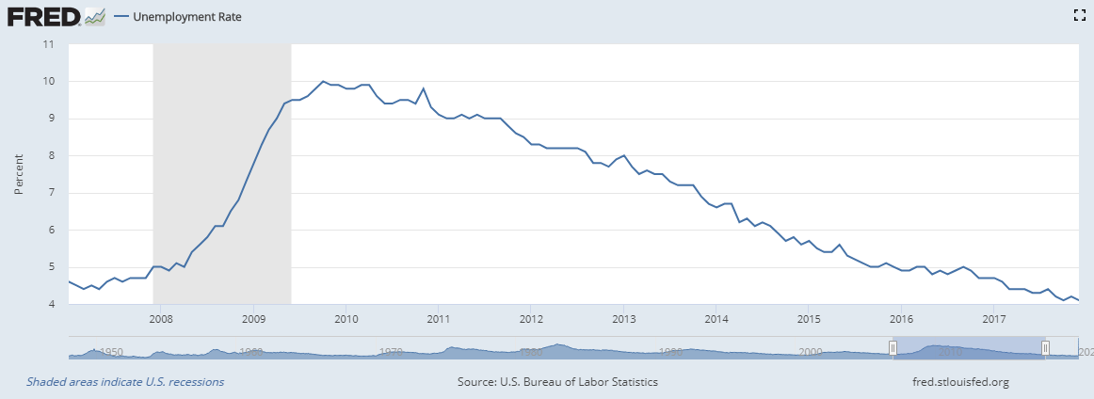
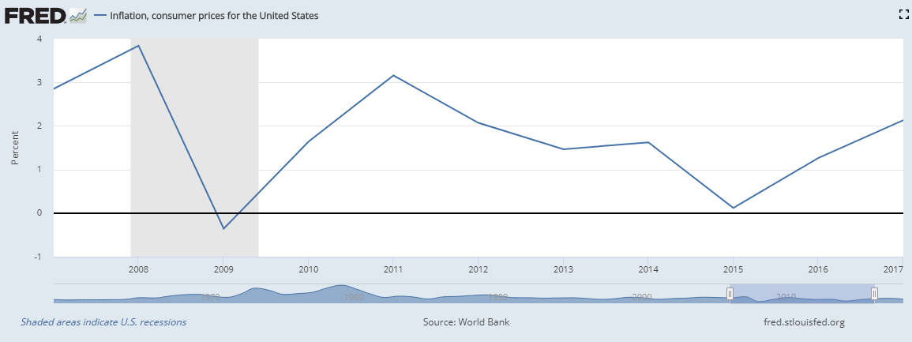
Unemployment and Inflation (U.S. Bureau of Labor Statistics, Unemployment Rate, n.d., World Bank, Inflation, consumer prices for the United States, n.d.)
Notes:
The rate of inflation and unemployment generally declined over the ten-year period of 2007 to 2017. The steepest decline in inflation came at the period of end of first quarter of 2009 to about mid of the third quarter in 2009. This corresponds to the rebound of the GDP in the period where the tax cuts were introduced leading to a rebound in productivity. There is a increase in unemployment from the beginning of the period to beginning of 2009. This corresponds to the decline in GDP over the same period that was associated with high inflation rates and housing bubble preceding the period.
The unemployment rate was calculated by considering the part of the population that was 16 years and above that reside in either of the states and are not in an institution such as aged and mental health facilities. The inflation was calculated as average monthly change in consumer goods and service prices and includes food, clothing, shelter, fuel and transport changes as well as service fees such as water and sewer services. The index is calculated as price changes against their weighted importance to the spending of a specific group.

Slide 6
Unemployment and Inflation
Two events – 2008 recession and 2009 rebound
In 2007 to 2008 recession there is increasing unemployment
Due to lack of investments and reducing purchasing power
Based on Philips curve, inflation decreases
As such, 2008 inflation decreases due to reduced money supply
2009, economic rebound leads to increase in employment opportunities – unemployment reduces
Inflation increases steadily although is limited by increased government intervention
Notes:
The focus is on two main events – the 2008 recession and the 2009 rebound. In the period 2008 to 2009, the recession lead to an increase in unemployment. Due to lack of adequate investments and reducing purchasing power, the economy plummeted leading to increasing unemployment. However, according to Phillips curve, an increase in unemployment leads to a decrease in inflation. As such, inflation reduced during the 2008 period due to reduced money supply. In 2009, there was a rebound in the economy leading to increasing employment opportunities. The unemployment rates reduced and inflation increased but was limited by government intervention.

Slide 7
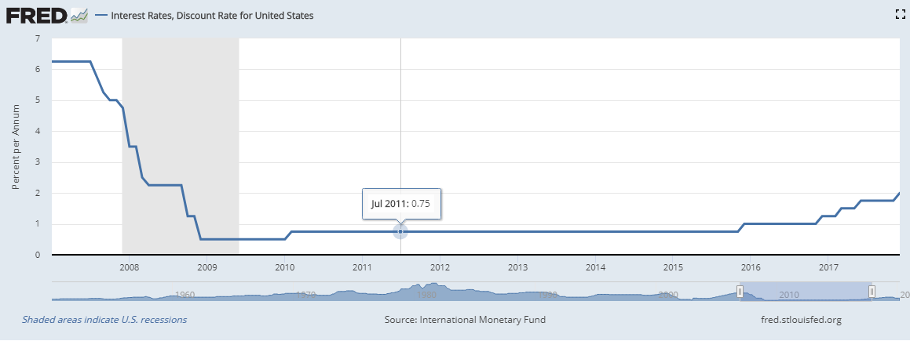
Interest Rates (International Monetary Fund, Interest Rates, Discount Rate for United States, n.d.)
Notes:
The interest rates generally declined over the period. In the same period there was a decline in the inflation rates. However, close observation shows inverse proportion between inflation and interest rates. With a decrease in interest rates in the period coming from the 2008 depression leading to increased borrowing leading to increased circulation of money which had an effect of slight increase in inflation rates. Investments would increase as a result of reduced interest rates as well as foreign trade. The GDP would be increased as a result due to the increase in investments. An increase in interest rates leads to increase in opportunity cost of capital leading to reduction in the aggregate demand curve which leads to reduction in GDP.

Slide 8
References
World Bank, Inflation, consumer prices for the United States [FPCPITOTLZGUSA], retrieved from FRED, Federal Reserve Bank of St. Louis; https://fred.stlouisfed.org/series/FPCPITOTLZGUSA, May 17, 2020.
U.S. Bureau of Labor Statistics, Unemployment Rate [UNRATE], retrieved from FRED, Federal Reserve Bank of St. Louis; https://fred.stlouisfed.org/series/UNRATE, May 17, 2020.
U.S. Bureau of Economic Analysis, Gross Domestic Product [GDP], retrieved from FRED, Federal Reserve Bank of St. Louis; https://fred.stlouisfed.org/series/GDP, May 16, 2020.

