Slide 1
Research Paper

Slide 2
Paper Components
Introduction with thesis sentence and a “roadmap” that lets the reader know the subject of your paper
Article Overview by section (article has 7 primary sections) – this is where sub-headings will be used!
Discuss why or why not brands are personally important to you.
Assume you are an executive for an independent hotel property. Would you recommend or not recommend converting under a major brand? Why or why not?
Conclusion that summarizes your paper and reminds the reader what your paper was about

Slide 3
Paper Standards
Minimum of 3 pages (references do not count in the page count)
Typed double-spaced on 8 1/2 x 11-inch white paper
1-inch margins on the top, bottom, left, and right
Headings and sub-headings used to help organize paper
Citations for any ideas not the student’s own are fully and accurately cited so a third party can easily find the original source (APA format).
Link To APA Citing Resource
https://owl.purdue.edu/owl/research_and_citation/apa_style/apa_formatting_and_style_guide/general_format.html

Slide 4
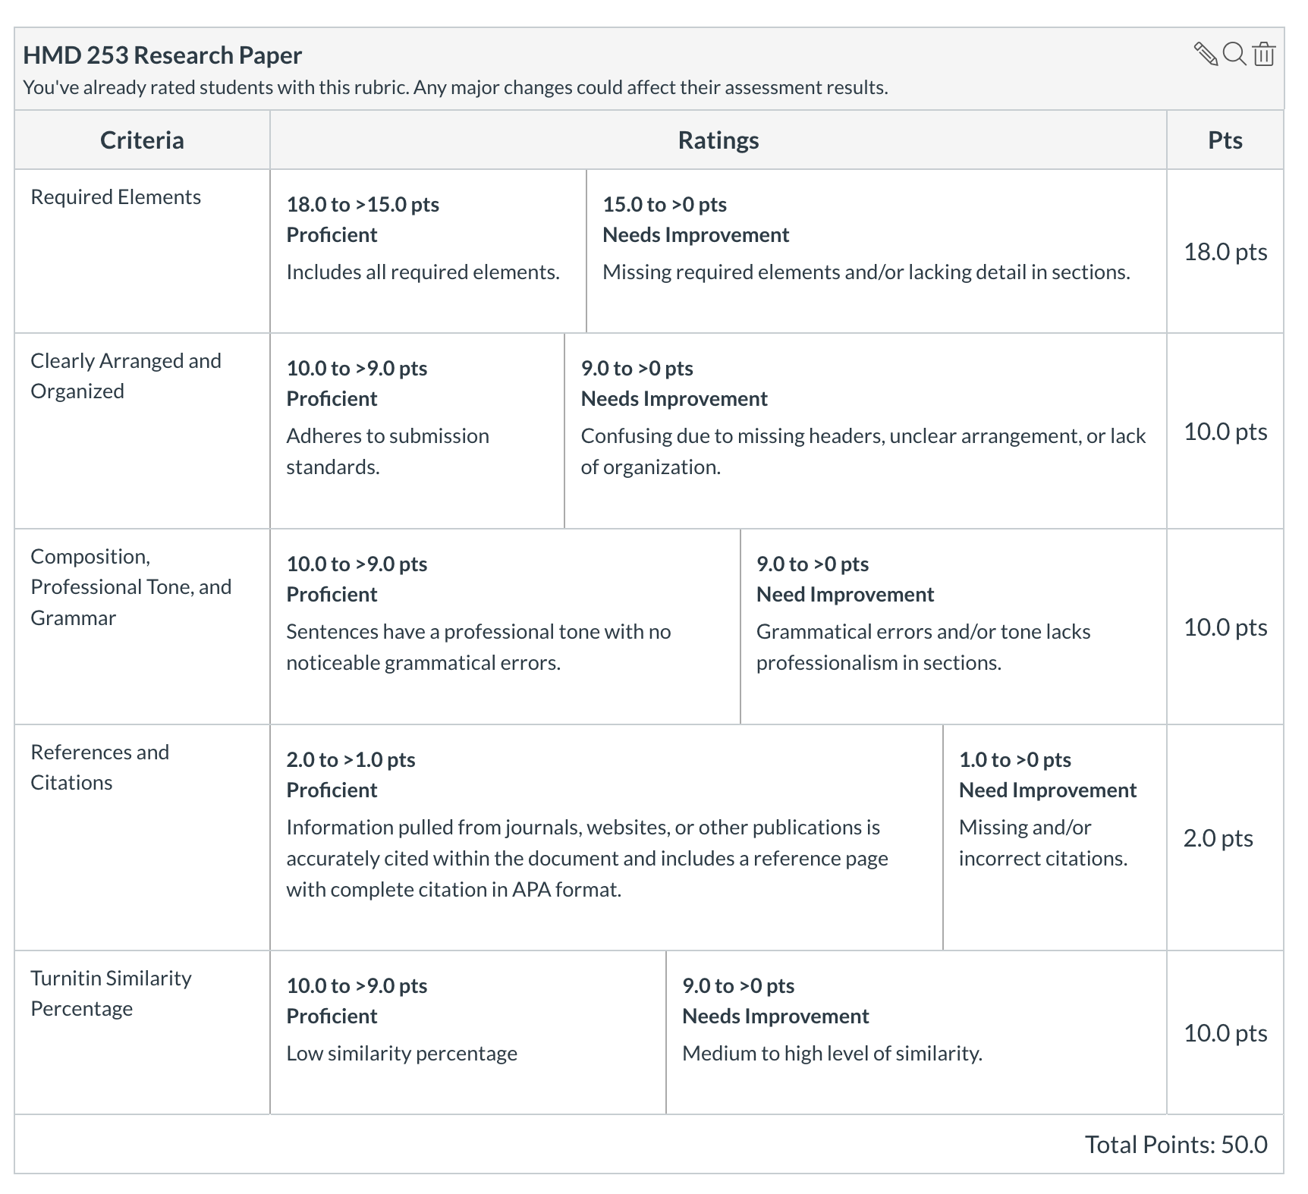
Grading Criteria

Slide 5
Headers
Introduction
Article Synopsis
Overview of Branding
Value of Brands
How Brands Create Value
Relationship Between Guest Satisfaction and Hotel Brands
Hotel Brand Extension
Relationship Between Hotel Branding and Franchising
Suggestions for Future Research
Opinion on Importance of Brand
Recommendation
Conclusion

Slide 6
Headers
Introduction
This is where you will introduce the article and complete a citation.
Article Synopsis
Overview of Branding
Value of Brands
How Brands Create Value
Relationship Between Guest Satisfaction and Hotel Brands
Hotel Brand Extension
Relationship Between Hotel Branding and Franchising
Suggestions for Future Research
Opinion on Importance of Brand
This is where you discuss why or why not brands are personally important to you.
Recommendation
This is where you assume you are an executive for an independent hotel property. Would you recommend or not recommend converting under a major brand? Why or why not?
Conclusion
Don’t Forget Reference Page with Complete Citation

