Slide 1
CHAPTER 9
Responsibility Accounting
PowerPoint Author:
Debby Bloom, CMA, CFM, CSCA
©2020 McGraw-Hill Education. All rights reserved. Authorized only for instructor use in the classroom. No reproduction or further distribution permitted without the prior written consent of McGraw-Hill Education.
Notes:
Chapter 9: Responsibility Accounting
In Chapter 9, we will look at how managers in large organizations have to delegate some decisions to those who are at lower levels in the organization. This chapter explains how responsibility accounting systems, return on investment (ROI), and residual income measures are used to help managers evaluate and control decentralized organizations.

Slide 2
Learning Objective 9-1
Explain the primary features of decentralization.
Notes:
Learning objective number 1 is to explain the primary features of decentralization.

Slide 3
Responsibility Accounting
An accounting system that provides information . . .
Relating to the responsibilities of individual managers.
To evaluate managers on controllable items.
Notes:
A responsibility accounting system uses the concept of controllable costs to evaluate a manager’s performance. Responsibility for controllable costs is clearly defined and performance is evaluated based on the ability to manage and control those costs.

Slide 4
Advantages of Decentralization
Encourages upper-level management to concentrate on strategic decisions.
Improves the quality of decisions by delegating authority down a chain of command.
Motivates managers to improve productivity.
Trains lower-level managers for increased responsibilities.
Improves performance evaluation.
Notes:
Decentralization provides several advantages:
It encourages upper-level management to concentrate on strategic decisions.
It develops lower-level managers by providing them with decision-making experience.
It improves the quality of decisions because managers closest to the operation, with a greater knowledge of the operation, make the decisions.
It improves productivity because decisions are made more quickly by local managers.
It improves performance evaluation as managers can be evaluated on the quality of their decisions.

Slide 5
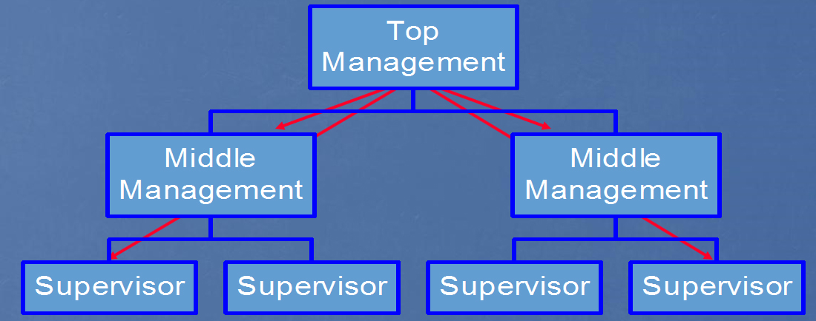
Decentralization
Decentralization often occurs as organizations continue to grow.
Decision making is pushed down.
Access the text alternative for slide images.
Notes:
Decentralization refers to the process of pushing the decision-making authority down to lower levels in an organization to those people who are closest to the operations impacted by the decision.

Slide 6
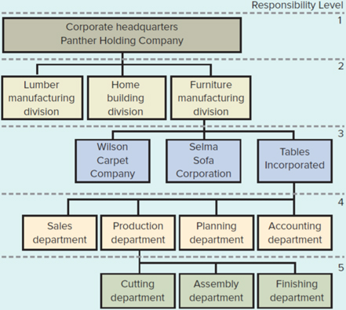
Organization Chart
Exhibit 9.1
Organization Chart
Access the text alternative for slide images.
Notes:
Managers within a company have different levels of responsibility for decision making, and are held accountable for the decisions that they make. These managers can be held accountable for controlling costs, generating revenue, and/or making investment decisions. Each one of the divisions or departments in Panther Holding Company may be called a responsibility center.

Slide 7
Responsibility Centers
Cost center.
An organizational unit that incurs expenses but does not generate revenue.
Profit center.
An organizational unit that incurs expenses and generates revenue.
Investment center.
Investment center managers are responsible for revenues, expenses, and the investment of capital.
Notes:
A responsibility center is an organizational unit that controls identifiable revenue or expense items.
A cost center is an organizational unit that incurs expenses but does not generate revenue. In Panther Holding Company the finishing department and the production department are cost centers. Cost centers normally fall on the lower levels of an organization chart. Managers are judged on their ability to control costs.
A profit center incurs costs but also generates revenue. In Panther Holding Company, Wilson Carpet, Selma Sofa, and Tables Incorporated are considered profit centers. Managers of profit centers are judged on their ability to produce revenue in excess of expenses.
Investment center managers are responsible for revenues, expenses, and the investment of capital. In Panther Holding Company, the Lumber Manufacturing Division, Home Building Division, and Furniture Manufacturing Division are investment centers. Managers of investment centers are accountable for assets and liabilities as well as earnings.

Slide 8
Responsibility Reports
Prepared for each manager who controls a responsibility center.
Compares the expectations for the manager’s responsibility center with the center’s actual performance.
A typical report lists:
Items under the manager’s control.
The budgeted and actual amounts for each item.
The differences between budgeted and actual amounts (variances).
Notes:
A responsibility accounting system includes:
❶ Preparing budgets for each responsibility center.
❷ Measuring the performance of each responsibility center.
❸ Preparing timely performance reports comparing actual amounts with budgeted amounts.

Slide 9
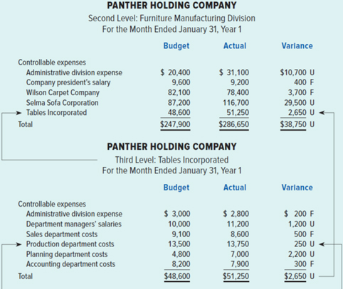
Responsibility Reports for Panther Holding Company Part One
Exhibit 9.2
Responsibility Reports
Notes:
Let’s see how the responsibility reports are assembled and interrelated for Panther Holding Company. Tables Incorporated has its own responsibility report that flows into the report of the Furniture Manufacturing Division. Responsibility reports contain the controllable expenses of the center and compare budgeted and actual expenses. Variance amounts are investigated.

Slide 10
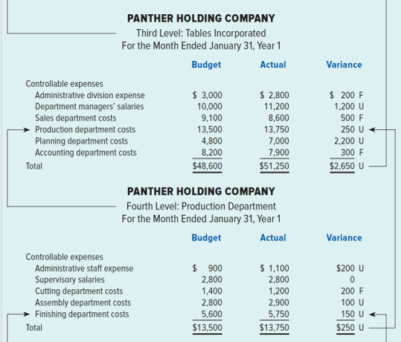
Responsibility Reports for Panther Holding Company Part Two
Exhibit 9.2
Responsibility Reports
Notes:
The fourth-level Production Department has its own responsibility report that is part of the third-level Tables Incorporated report. The total unfavorable variance of $250 on the responsibility report of the Production Department is carried forward to the responsibility report of Tables Incorporated.

Slide 11
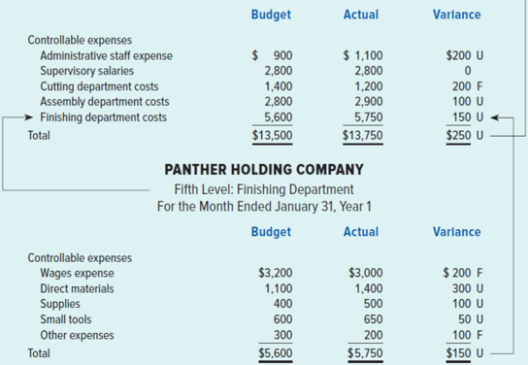
Responsibility Reports for Panther Holding Company Part Three
Exhibit 9.2
Responsibility Reports
Notes:
The Production Department’s report includes summaries of the cutting, assembly, and finishing departments. For purposes of illustration, we show you the detail responsibility report for the Finishing Department. Notice that the $150 unfavorable variance flows forward to the responsibility report of the Production Department.

Slide 12
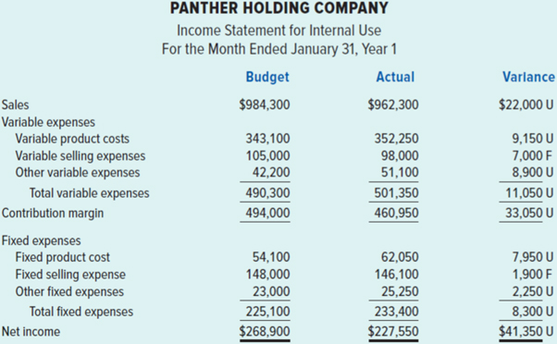
Panther Company Income Statement
Exhibit 9.3
Panther Income Statement (Contribution Margin Format)
Notes:
The complete responsibility accounting report would include the first responsibility level, corporate headquarters. At the first level, the responsibility report normally includes year-to-date income statement information to inform management of the company’s overall performance. To facilitate decision making, these income statements are normally prepared using the contribution margin format.

Slide 13
Management by Exception—Amount of Detail
Amount of detail varies according to level in an organization.
Department manager receives detailed reports.
Store manager receives summarized information from each department.
Notes:
The amount of detail in performance reports varies according to level in an organization. In general, lower-level managers receive detailed reports, but the level of detail decreases at higher levels. Top management receives reports that are highly summarized. If a problem arises, top management can request greater detail to look into the problem. This procedure is known as management by exception because top management only gets involved in detailed operations if a problem (exception) arises.

Slide 14
Controllability Concept
Managers should only be evaluated on revenues or costs they control.
Since the exercise of control may be clouded, managers are usually held responsible for items over which they have predominant rather than absolute control.
Notes:
Managers should be evaluated on how well they manage controllable costs. A cost is controllable by a manager if the manager has the power to determine, or strongly influence, the amounts incurred. For example, production managers are generally considered to be responsible for the amount of material used in their departments, but not for the cost of insurance on the building in which the departments are located. Since the exercise of control may be clouded, managers are usually held responsible for items over which they have predominant rather than absolute control.

Slide 15
Qualitative Reporting Features
To be of maximum benefit, responsibility reports should . . .
Be timely.
Be issued regularly.
Be understandable.
Compare budgeted and actual amounts of controllable items.
Notes:
Responsibility performance reports should be timely, issued on a regular schedule, and presented in a usable, easily understood format to be of maximum benefit to managers. Since performance is being evaluated and reported, the responsibility report should include comparisons of budgeted costs and actual costs.

Slide 16
Managerial Performance Measurement
 | Evaluation Measures
Cost Center | Cost control Quantity and quality of services
Profit Center | Profitability
Investment Center | Return on investment (R O I) Residual income (R I)
Notes:
Cost centers are evaluated on the ability to control costs relative to an expected level of quantity and quality of output. The primary tools are budgets and standard costs. Profit centers are evaluated on profitability. The primary tool is the contribution format income statement, emphasizing product or segment margin. Investment centers are evaluated using return on investment (ROI) and residual income.

Slide 17
Learning Objective 9-2
Evaluate investment opportunities using return on investment.
Notes:
Learning objective number 2 is to evaluate investment opportunities using return on investment.

Slide 18
Return on Investment Defined
Return on investment is the ratio of income to the investment used to generate the income.
Notes:
One of the most common means of evaluating the performance of an investment center is return on investment (ROI). ROI is the percentage return on the average capital invested in operating assets that are used to generate the operating income in a period of time.

Slide 19
Return on Investment for Panther Holding Company
Panther Holding Company provides the following information for the company’s second-level investment centers.
 | Lumber Manufacturing Division | Home Building Division | Furniture Manufacturing Division
Operating income | $ 60,000 | $ 46,080 | $ 81,940
Operating assets | 300,000 | 256,000 | 482,000
Let’s calculate ROI.
Notes:
Here is information that will permit the chief financial officer of Panther Holding to calculate the return on investment for its second-level investment centers. See if you can calculate the ROI for all three divisions before going to the next screen.

Slide 20
Return on Investment for Each Division
Notes:
How did you do? All other things being equal, higher ROIs indicate better performance. In our case the Lumber Manufacturing Division manager is the best performer. If Panther had additional funds to invest in one of the three centers, which investment center is more likely to receive the additional funds?

Slide 21
Qualitative Considerations
Why do companies compute ROI using operating income and assets instead of net income or total assets?
If corporate HQ closes a plant, it would be inappropriate to include these in the denominator of the ROI calculation.
If Panther sells the plant at a gain, including the gain in the numerator would distort the result.
Since the manager of the Furniture Manufacturing Division does not control closing the plant or selling it, it is unreasonable to include the effects of these decisions in computing the R O I.
Notes:
Qualitative considerations are important for motivating managers to make the correct decisions not only for their own divisions but also for the company as a whole.

Slide 22
Measuring Operating Assets
Using the book value of operating assets to calculate ROI will result in a higher R O I.
 | Northern Division’s Vending Machine | Southern Division’s Vending Machine
Original cost | $ 5,000 | $ 5,000
Less accumulated depreciation | (1,000) | (3,000)
Book value | $4,000 | $2,000
Notes:
Using book value as the valuation base can distort the ROI and cause severe motivational problems. Using book value (i.e., acquisition cost less accumulated depreciation) of operating assets to calculate ROI will result in a higher ROI. With this approach, ROI mechanically increases over time as the accumulated depreciation increases. Managers will consider comparisons between different investment centers unfair because the ROIs do not accurately reflect performance. Furthermore, managers may avoid replacing obsolete equipment because purchasing new equipment would increase the dollar amount of operating assets, reducing the ROI.
An alternative to book value is using cost of operating assets, which ignores accumulated depreciation. With this approach, ROI does not grow automatically over time.

Slide 23
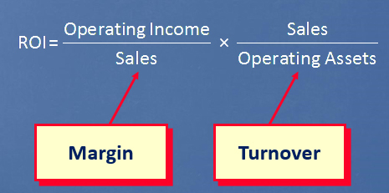
Factors Affecting Return on Investment
Notes:
Sometimes it’s helpful to take a more detailed look at ROI by considering two additional financial ratios that are components of ROI. A company’s margin is defined as operating income divided by sales. Turnover is sales divided by operating assets. You can see that sales is common to both margin and turnover. When we multiply margin times turnover, we get ROI.

Slide 24
Expanded ROI Part One
The Lumber Manufacturing Division reported the following information:
Operating Income | $ 60,000
Sales | 600,000
Operating Assets | 300,000
Let’s calculate ROI using the expanded equation.
Notes:
Here we can see some information for Lumber Manufacturing Division of Panther Holding. Before advancing to the next screen, calculate ROI for this division.

Slide 25
Expanded ROI Part Two
Notes:
Part I
Did you find ROI to be 20 percent?
Now let’s calculate ROI by using the margin and turnover ratios.
Part II
We can calculate margin by dividing the $60,000 operating income by $600,000 in sales. Turnover is $600,000 in sales divided by the $300,000 of operating assets. Now we can compute ROI by multiplying the 10 percent margin times the turnover of 2.

Slide 26
Improving Profitability and ROI
The expanded formula shows that profitability and R O I can be improved in three ways:
Increase R O I by increasing sales.
Increase R O I by reducing expenses.
Increase R O I by reducing the investment base (reducing the amount of funds invested in operating assets).
Notes:
As business managers, it’s important to know there are three ways to improve your return on investment. The first is to increase sales prices. The second is to reduce your expenses (which increases your operating income), and the third way is to reduce your invested capital.

Slide 27
Increase ROI by Increasing Sales
The Lumber Manufacturing Division was able to increase sales to $660,000, which increased operating income to $72,600.
There was no change in operating assets.
The division’s ROI increased from 20 percent to 24.2 percent.
Notes:
Let’s return again to the Lumber Manufacturing Division example, but in this case, the division manager was able to increase sales to $660,000. That led to an increase in operating income to $72,600. Operating assets are unchanged at $300,000. Let’s calculate ROI using margin and turnover.
Part I
Calculate ROI using margin and turnover.
Part II
Margin is the $72,600 income divided by $660,000 in sales. Turnover is $660,000 in sales divided by the $300,000 of operating assets. Now we can compute ROI by multiplying the 11 percent margin times the turnover of 2.2. The ROI increased from 20 percent to 24.2 percent.

Slide 28
Increase ROI by Reducing Expenses
The Lumber Manufacturing Division was able to reduce expenses, which increased operating income to $72,000.
There was no change in operating assets.
The division’s ROI increased from 20 percent to 24 percent.
Notes:
Let’s return again to the Lumber Manufacturing Division example, but in this case, the division manager was able to decrease expenses. As a result, operating income increases from $60,000 to $72,000.
Part I
Calculate ROI using margin and turnover.
Part I
Margin is the $72,000 income divided by $600,000 in sales. Turnover is $600,000 in sales divided by the $300,000 of operating assets. Now we can compute ROI by multiplying the 12 percent margin times the turnover of 2.0. The ROI increased from 20 percent to 24 percent.

Slide 29
Increase ROI by Reducing the Investment Base
The Lumber Manufacturing Division was able to decreased the assets employed to $240,000.
There was no change in income.
The division’s ROI increased from 20 percent to 25 percent.
Notes:
Let’s return again to the Lumber Manufacturing Division example, but in this case, the division manager institutes a JIT system, which reduces investment in inventory. Let’s calculate ROI using margin and turnover.
Part I
Calculate ROI using margin and turnover.
Part II
Margin is the $60,000 income divided by $600,000 in sales. Turnover is $600,000 in sales divided by the $240,000 of operating assets. Now we can compute ROI by multiplying the 10 percent margin times the turnover of 2.5. The ROI increased from 20 percent to 25 percent.

Slide 30
Learning Objective 9-3
Evaluate investment opportunities using residual income.
Notes:
Learning objective number 3 is to evaluate investment opportunities using residual income.

Slide 31
Residual Income Defined
Access the text alternative for slide images.
Notes:
Another measure of performance is known as residual income. Residual income is operating income above some minimum return on invested capital specified by the company. The dollar amount of the minimum return on invested capital is called an investment charge. On your screen you see the investment charge subtracted from operating income to get residual income.

Slide 32
Residual Income
The Lumber Manufacturing Division currently earns $60,000 of operating income with the $300,000 of operating assets it controls.
Panther has an 18 percent desired R O I.
Residual income = Operating income − (Operating assets × Desired ROI)
= $60,000 − ($300,000 × 0.18)
= $60,000 − $54,000
= $6,000
Notes:
Let’s use the information on the screen to calculate the residual income for the Lumber Manufacturing Division.
Part I
The Lumber Manufacturing Division should earn a desired operating income of $54,000. We determine this amount by multiplying the amount of operating assets controlled by the division by Panther’s desired return on investment.
Part II
Residual income is the difference between the division’s reported operating income of $60,000, and the desired income of $54,000. So, the Lumber Manufacturing Division produced residual income of $6,000 during the period.

Slide 33
Residual Income Advantages and Disadvantages
To avoid suboptimization (which occurs when managers choose to benefit themselves at the expense of their businesses), many businesses base managerial evaluation on residual income.
An advantage of residual income is that it encourages managers to make profitable investments that would be rejected by managers using ROI.
A disadvantage of residual income is that it measures performance in absolute dollars.
A manager’s residual income may be larger simply because her investment base is larger.
Notes:
The residual income approach encourages managers to make investments that are profitable for the entire company but that would be rejected by managers who are evaluated using ROI. This occurs when the ROI associated with an investment opportunity exceeds the company’s minimum required return but is less than the ROI being earned by the division manager evaluating the investment opportunity.
Note that residual income is unfair to managers of smaller divisions. A manager’s residual income may be larger simply because of the larger investment base of larger divisions.

Slide 34
Responsibility Accounting and the Balanced Scorecard
The balanced scorecard is a holistic approach to evaluating managers.
Balanced Scorecard:
Multiple financial measures.
Multiple nonfinancial measures.
Notes:
It would be shortsighted for a business to maximize one performance measure at the expense of other, possibly equally important, performance measures. Businesses have the responsibility to serve several interested parties, including employees, owners, and customers. A balanced approach to serving all parties will lead to long-run success.
It may not be obvious to managers how to increase ROI and residual income in a way that is consistent with the company’s strategy. A well-constructed balanced scorecard can provide managers with a road map containing multiple performance measures that guide decision making.

Slide 35
Learning Objective 9-4
Describe how transfer prices may be established (Appendix).
Notes:
Learning objective number 4 is to describe how transfer prices may be established (Appendix).

Slide 36
Transfer Pricing
Goods and services are often transferred internally from
one division (selling division) to another (buying division).
The transfer price can be the subject of considerable controversy.
Notes:
In most vertically integrated companies, it is common for goods and services to be sold, or transferred, internally from one investment center to another. Because the manager of each investment center is responsible for their own division’s profit, the price at which the goods or services are transferred can be the subject of considerable controversy.

Slide 37
Transfer Pricing Methodologies
Market-Based Prices
Negotiated Prices
Cost-Based Prices
Notes:
Companies use three common approaches to establish transfer prices: (1) price based on market forces; (2) price based on negotiation; and (3) price based on cost.
Market-based transfer prices are preferable because they promote efficiency and fairness. Market forces coupled with the responsibility for profitability motivate managers to use their resources effectively.
However, sometimes a division makes a unique product that is used only by the company’s other division, and no external market price is available. In other instances, the market price may not be the optimal price. In those cases, a reasonable transfer price is negotiated somewhere between the market price, if available, and the selling division’s avoidable product cost.
Cost-based prices are the least desirable, as this method removes the profit motive, and the incentive to control cost is diminished. When a company uses cost-based transfer prices, it should use standard rather than actual costs.

Slide 38
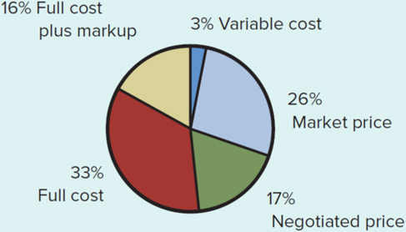
Transfer Pricing in Use
Exhibit 9.4
What Companies Actually Use as Transfer Prices
Access the text alternative for slide images.
Notes:
Exhibit 9.4 shows some specific measures and the frequency of their use in domestic transfer pricing.

Slide 39
End of Chapter 9

Slide 40
Accessibility Content: Text Alternatives for Images

Slide 41
Decentralization - Text Alternative
The top of the flowchart is labeled Top Management. This connects to a box on the left and a box on the right both labeled Middle Management. These two boxes each connect to two boxes labeled Supervisor. Arrows connect from the top of the flowchart to each level to represent the downward flow of decision-making.
Return to parent-slide containing images.

Slide 42
Organization Chart - Text Alternative
Responsibility level 1 is Corporate Headquarters: Panther Holding Company. This breaks out into Lumber manufacturing division, Home building division, and Furniture manufacturing division. These make up Responsibility level 2. The furniture manufacturing division breaks down into three parts: Wilson Carpet Company, Selma Sofa Corporation, and Tables Incorporated. These make up Responsibility level 3. Tables Incorporated breaks down into four departments: Sales, Production, Planning, and Accounting. These make up Responsibility level 4. The Production department further branches out to three departments: Cutting, Assembly, and Finishing. These make up Responsibility level 5.
Return to parent-slide containing images.

Slide 43
Residual Income Defined - Text Alternative
At the top of the diagram is an equation box that reads: Operating Income minus Investment charge equals Residual income. An equation box appears below and to the right of this and it reads: Operating Assets times Desired ROI equals Investment charge, and this box points back to the first. A third box, appearing below and to the right, reads: Investment center's cost of acquiring investment capital, and this box points back to the Desired ROI line in the previous box.
Return to parent-slide containing images.

Slide 44
Transfer Pricing in Use- Text Alternative
A pie chart shows what companies actually use as transfer prices. The chart shows 16% use full cost plus markup; 3% use variable cost; 26% use market price; 17% use negotiated price; and 33% use full cost.
Return to parent-slide containing images.

