Slide 1
CHAPTER 8
Performance Evaluation
PowerPoint Author:
Debby Bloom, CMA, CFM, CSCA
©2020 McGraw-Hill Education. All rights reserved. Authorized only for instructor use in the classroom. No reproduction or further distribution permitted without the prior written consent of McGraw-Hill Education.
Notes:
Chapter 8: Performance Evaluation
This chapter focuses on how managerial accountants frequently prepare flexible budgets, based on different levels of volume, to help them with the management plan and evaluation of performance. Flexible budgets flex, or change, when the volume of activity changes.

Slide 2
Learning Objective 8-1
Describe flexible and static budgets.
Notes:
Learning objective 8-1 is to describe flexible and static budgets.

Slide 3
Flexible Budgets Defined
The master budget, sometimes called a static budget, is based solely on the planned volume of activity.
Flexible budgets differ from static budgets in that they show expected revenues and costs at a variety of volume levels.
Notes:
The master budget that we previously prepared is really a static budget because it is only applicable to one plan and one level of activity. On the other hand, a flexible budget can be prepared for any level of activity, including the actual level of activity. Flexible budgeting is much more helpful in management’s decision process.

Slide 4
Preparing a Flexible Budget for Melrose Manufacturing
Melrose Manufacturing, a producer of small high-quality trophies, plans to make and sell 18,000 trophies during Year 1.
Melrose uses a standard cost system as outlined below:
Per-unit sales price and variable costs | Blank
Expected sales price | $ 80.00
Standard materials cost | 12.00
Standard labor cost | 16.80
Standard overhead cost | 5.60
Standard general, selling, and administrative cost | 15.00
Total fixed costs | $291,600
Notes:
Melrose Manufacturing provided us with some information about its proposed sales for the coming year. The company plans to sell 18,000 trophies. We have detailed information about the expected selling price and the standard cost of materials, labor, and overhead. In addition, the company has calculated the variable standard general, selling, and administrative costs, as well as information about its fixed costs.

Slide 5
Preparing Flexible Budgets
With very little effort, the accountant can provide management with a flexible budget for both budgeted and actual levels of activity.
The flexible budget is a critical tool in effective performance evaluation.
Notes:
With the help of electronic spreadsheets, accountants can provide managers with flexible budgets for both planned and actual levels of activity. The flexible budget is an effective way for managers to determine whether their subordinates are effectively controlling revenues and expenses.

Slide 6
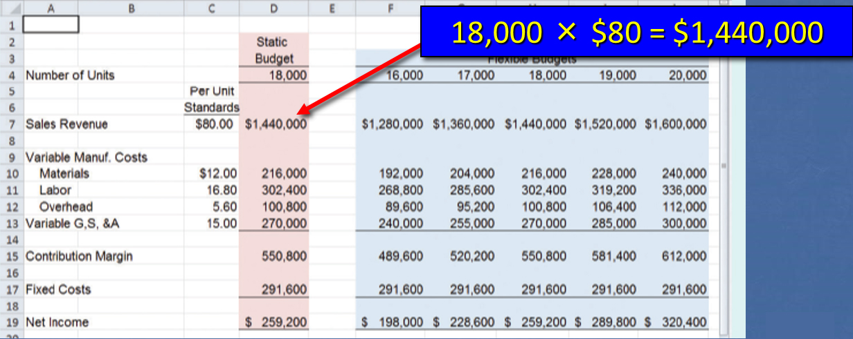
Exhibit 8.1: Static and Flexible Budgets in Excel Spreadsheet
From the standard cost information, Melrose prepares the following static and flexible budgets.
Notes:
Part I
This Excel spreadsheet shows a static budget for the planned level of activity of 18,000 units sold. We can calculate revenue and all of our variable expenses by multiplying the number of units sold times the unit cost.
Part II For example, our anticipated sales revenue is $1,440,000, that is, 18,000 units times $80 per unit. In addition to the static budget, we prepared our flexible budget at various levels of activity between 16,000 and 20,000 units sold. The flexible budgets are prepared with the same per-unit standard amounts and fixed cost data used to produce the static budget. Note that fixed costs do not change with changes in the number of units produced and sold. It would be a good idea to take a few minutes and make sure you can calculate the amounts shown in the flexible budget.

Slide 7
Learning Objective 8-2
Classify variances as being favorable or unfavorable.
Notes:
Learning objective 8-2 is to classify variances as being favorable or unfavorable.

Slide 8
Favorable and Unfavorable Variances
The differences between standard and actual amounts are called variances.
A variance may be favorable or unfavorable.
When actual sales are less than expected, an unfavorable sales variance exists.
When actual sales revenue is greater than expected revenue, a company has a favorable sales variance.
Notes:
In accounting, the difference between a standard amount and an actual amount is called a variance. The variance can be favorable or unfavorable. A company has a favorable sales variance because higher sales increase net income. When actual sales are less than expected, an unfavorable sales variance exists.

Slide 9
Favorable and Unfavorable Variances for Costs
Variances are not limited to the evaluation of revenues.
They can also be used to understand the differences between standard and actual amounts of costs.
When actual costs are less than standard costs, cost variances are favorable because lower costs increase net income.
Unfavorable cost variances exist when actual costs are more than standard costs.
Notes:
Variances are not limited to the evaluation of revenues. When actual costs are less than standard costs, cost variances are favorable because lower costs increase net income. Unfavorable cost variances exist when actual costs are more than standard costs.

Slide 10
Learning Objective 8-3
Compute and interpret sales and variable cost volume variances.
Notes:
Learning objective 8-3 is to compute and interpret sales and variable cost volume variances.

Slide 11
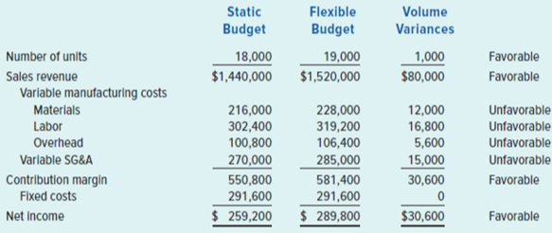
Sales Volume Variances
The difference between the static budget sales amount and the flexible budget sales amount is a measure of the sales volume variance.
Exhibit 8.2
Melrose Manufacturing’s volume variances
Notes:
This Excel spreadsheet shows one of the problems managers face when there’s a difference between the static budget and the flexible budget. As we can see, we are comparing a static budget based upon sales of 18,000 units to a flexible budget with sales of 19,000 units. The company actually sold 19,000 trophies during the year. It exceeded its planned number of units sold of 18,000. Can we compare the actual sales of 19,000 units to the planned sales of 18,000 units and arrive at any meaningful conclusions?
We have a favorable volume variance because we sold more units than planned. All our variable expenses show an unfavorable variance because it is logical that we would spend more at a higher level of activity. It doesn’t appear that comparing these two budgeted amounts is likely to yield meaningful results. Let’s see how we might solve the problem.

Slide 12
Interpreting the Volume Variances
In a standard cost system, marketing managers are usually responsible for the volume variance.
Because sales volume drives production, production managers have little control over volume.
In the case of Melrose, the marketing manager exceeded planned sales volume by 1,000 units, resulting in an $80,000 favorable revenue variance ($80 × 1,000).
The unfavorable cost variances are somewhat misleading. Melrose incurred higher costs because it manufactured and sold more units than planned.
Notes:
In a standard cost system, the marketing department is usually responsible for any volume variance. The production department has little or no control over the volume of units sold. Once again, in the case of Melrose we had a favorable volume variance of 1,000 units.

Slide 13
Learning Objective 8-4
Compute and interpret flexible budget variances.
Notes:
Learning objective 8-4 is to compute and interpret flexible budget variances.

Slide 14
Flexible Budget Variances
For effective performance evaluation, management must compare the actual results achieved to the flexible budget based on the actual volume of activity.
Here is a comparison of the standard amount and actual amount per unit for the current period.
Blank | Standard | Actual
Sales price | $80.00 | $78.00
Variable materials cost | 12.00 | 11.78
Variable labor cost | 16.80 | 17.25
Variable overhead cost | 5.60 | 5.75
Notes:
Here is some information gathered from Melrose at the end of the accounting period. We can see the standard amounts developed at the start of the year, and the actual amounts achieved as we move through the year.

Slide 15
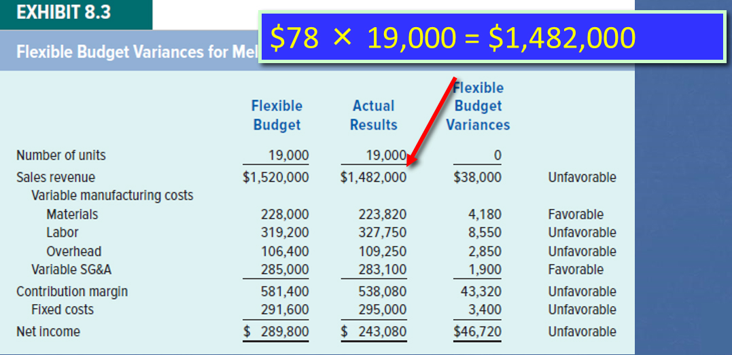
Comparing Flexible Budget to Actual Results
Now we are comparing actual results achieved with the results that should have been achieved at the activity level.
Notes:
Part I On this screen we have prepared a flexible budget for 19,000 units sold, using our standard amounts. We will compare the flexible budget to the actual results achieved. Notice that the volume variance is zero. Both the budget and actual amounts are based upon unit sales of 19,000 units. We determine the flexible budget amounts by multiplying the 19,000 units times the various per-unit amounts at standard.
Part II We determine the actual amounts by multiplying the 19,000 units times the actual amounts achieved during the period. For example, our revenue was determined by multiplying 19,000 units times $78 per unit. We carried out similar calculations for the other variable costs. We are now in a position to determine the variances and seek explanations for major unfavorable or favorable variances. We see that we have an unfavorable $38,000 sales revenue variance. This is because the actual selling price of $78 dollars per unit is less than the planned selling price of $80 per unit. As a supervisor, I would want to know why the unit sales price was lower than anticipated.

Slide 16
Calculating Sales Price Variance
Actual sales (19,000 units x $78 per unit) | $ 1,482,000 | Blank
Expected sales (18,000 units x $80 per unit) | 1,440,000 | Blank
Total sales variance | $ 42,000 | Favorable
Alternatively:
Activity variance (sales volume) | $ 80,000 | Favorable
Sales price variance | (38,000) | Unfavorable
Total sales variance | $ 42,000 | Favorable
Notes:
Part I We can isolate the sales price variances as shown on the screen. Our actual sales were $1,482,000, while our expected sales were $1,440,000. In effect, we had a $42,000 favorable sales price variance.
Part II We can calculate this amount differently. We can take the favorable volume variance of $80,000 and subtract from that the unfavorable sales price variance of $38,000 to arrive at an overall favorable total sales variance of $42,000.

Slide 17
The Human Element Associated with Flexible Budget Variances
Flexible budget cost variances offer insight into management efficiency.
As with sales variances, cost variances require careful analysis.
A favorable materials variance could mean that purchasing agents are good negotiators, or it might be caused by paying low prices for inferior goods.
Notes:
Part I Flexible budget cost variances offer insight into management efficiency. For example, Melrose Manufacturing Company’s favorable materials variance could mean purchasing agents were shrewd in negotiating price concessions, discounts, or delivery terms and therefore reduced the price the company paid for materials. Similarly, production employees may have used materials efficiently, using less than expected. The unfavorable labor variance could mean managers failed to control employee wages or motivate employees to work hard. As with sales variances, cost variances require careful analysis.
Part II A favorable variance may, in fact, mask unfavorable conditions. For example, the favorable materials variance might have been caused by paying low prices for inferior goods. Using substandard materials could have required additional labor in the production process, which would explain the unfavorable labor variance. Again, we caution that variances, whether favorable or unfavorable, alert management to investigate further.

Slide 18
Learning Objective 8-5
Calculate and interpret fixed cost variances.
Notes:
Learning objective 8-5 is to calculate and interpret fixed cost variances.

Slide 19
Fixed Cost Spending Variance
Companies frequently pay more or less than expected for fixed costs.
The difference between the actual fixed cost and the budgeted fixed cost (amount shown in the static budget) is called a fixed cost spending variance.
For Melrose this amount is $3,400.
($295,000 actual fixed cost – $291,600 budgeted fixed cost).
Notes:
Companies frequently pay more or less than expected for fixed costs. The difference between the actual fixed cost and the budgeted fixed cost (amount shown in the static budget) is called a fixed cost spending variance. For Melrose this amount is $3,400 (or $295,000 actual fixed cost – $291,600 budgeted fixed cost).

Slide 20
Accountability for Fixed Cost Spending Variances
Fixed costs that are controllable by a specific manager must be disaggregated and tagged for individual analysis.
Uncontrollable fixed costs should also be reported for management oversight.
Even if these costs are not controllable in the short term, management should stay abreast of them because they may be controllable in the long term.
Notes:
Fixed costs that are controllable by a specific manager must be disaggregated and tagged for individual analysis. Uncontrollable fixed costs should also be reported for management oversight. Even if these costs are not controllable in the short term, management should stay abreast of them because they may be controllable in the long term.

Slide 21
Fixed Cost Volume Variances Part One
Because actual volume is not known until the end of the period, the selling price must be based on planned volume. At the planned volume of 18,000 units, Melrose’s fixed cost per unit is expected to be as follows:
Budgeted fixed cost | ÷ | Planned volume of activity | ₌ | Allocation rate
$291,600 | ÷ | 18,000 units | ₌ | $16.20 per unit

Slide 22
Fixed Cost Volume Variances Part Two
The applied fixed cost is determined by multiplying the predetermined overhead rate by the actual volume of production.
Melrose produced and sold 19,000 units of product during Year 1.
Predetermined Overhead Rate | × | Actual Volume of Activity | ₌ | Applied Fixed Cost
$16.20 | × | 19,000 units | ₌ | $307,800
Notes:
Since the higher than expected volume decreases the fixed cost per unit, the volume variance is favorable. A favorable fixed cost volume variance suggests that a company utilized its facilities to make and sell more than the planned volume of activity. In summary, a fixed cost volume variance indicates over- or underutilization of facilities, not over- or underspending.

Slide 23
Summary of Two Fixed Cost Overhead Variances
Fixed cost spending variance = Actual fixed cost − Budgeted fixed cost.
If actual costs are less than the budgeted costs, the variance is favorable.
If actual costs are greater than the budgeted costs, the variance is unfavorable.
Fixed cost volume variance = Applied fixed cost based on actual volume − Budgeted fixed cost based on planned volume.
If actual volume is more than the planned volume, the variance is favorable.
If actual volume is less than the planned volume, the variance is unfavorable.
Notes:
Changes in the fixed cost per unit have important implications for decision making. If actual volume is less than planned volume, products will be underpriced, causing lower than expected profits. Just as detrimental are overpriced goods because they encourage competitors to enter the market and draw away customers.

Slide 24
Responsibility for the Fixed Cost Volume Variance
Determining the amount of the variance is the easy part of performance evaluation.
Determining responsibility is usually more difficult.
Normally, upper-level marketing managers are held accountable for the fixed cost volume variance because they control the volume of sales.
Notes:
Determining the amount of the variance is the easy part of performance evaluation; determining responsibility is usually more difficult. Changes in the fixed cost per unit have important implications for decision making. For example, consider the impact on cost-plus pricing decisions. Normally, upper-level marketing managers are held accountable for the fixed cost volume variance because they control the volume of sales, which in turn dictates the volume of production.

Slide 25
Learning Objective 8-6
Describe the features of a standard cost system and compute price and usage variances.
Notes:
Learning objective 8-6 is to describe the features of a standard cost system and compute price and usage variances.

Slide 26
Standard Cost Systems
A standard represents the amount a price, cost, or quantity should be, based on certain anticipated circumstances.
Accountants, engineers, purchasing agents, and production managers combine efforts to set standards that encourage efficient future production.
Notes:
Establishing standard costs within an organization is really a team effort. To be successful, we need representatives from the accounting, engineering, purchasing, production, and marketing departments.
Once standard costs have been established, they must be continually revised and updated in light of changing economic consequences in the industry.

Slide 27
Establishing Standards
A standard represents the amount that a price, cost, or quantity should be under certain anticipated circumstances.
Ideal standards represent what costs should be under the best circumstances.
Practical standards represent what an average worker performing diligently would be able to achieve.
Lax standards represent easily attainable goals.
Notes:
Part I
Ideal standards can only be attained under the best circumstances. They allow for no work interruptions and they require employees to continually work at 100 percent peak efficiency.
Part II
Practical standards are tight but attainable. They allow for normal machine downtime and employee rest periods, and can be attained through reasonable, highly efficient efforts of the average worker. Practical standards can also be used for forecasting cash flows and planning inventory.
Part III
Lax standards represent easily attainable goals. Employees can achieve standard performance with minimal effort. Lax standards do not motivate most people.

Slide 28
Need for Standard Costs
Standard costs help managers plan and establish benchmarks against which actual performance can be judged.
Management by exception focuses on material differences between actual and expected results.
Notes:
Standard cost systems help managers benchmark actual performance. Management by exception is the process of focusing on material differences between actual and expected results.

Slide 29
Selecting Variances to Investigate
Management by exception tells us to consider:
the materiality of a variance,
how frequently it occurs,
the capacity to control the variance, and
the characteristics of the items behind the variance.
Notes:
A good manager will consider four variables when investigating variances.
The first is the material nature of the variances. The higher the dollar amount of the variance, the more significant the impact.
Second, a manager must look at how frequently the variance occurs. If the variance occurs monthly, corrective action is required.
The third variable is how likely it is that we can control the variance. If it is extremely difficult to control the variance, we may not want to waste our time investigating it.
Finally, a good manager always examines the characteristics of the items behind the variance. We really want to know what is causing the variance.

Slide 30
Manufacturing Cost Variances 1
We will use the following information provided by Melrose Manufacturing to calculate manufacturing variances.
Blank | Standard | Actual
Variable Materials Cost Per Unit of Product | $ 12.00 | $ 11.78
Variable Labor Cost Per Unit of Product | 16.80 | 17.25
Variable Overhead Cost Per Unit of Product | 5.60 | 5.75
Total Per-Unit Variable Manufacturing Cost (a) | $ 34.40 | $ 34.78
Total Units Produced (c) | 19,000 | 19,000
Total Variable Manufacturing Cost (a x b) | 653,600 | 660,820
Fixed Manufacturing Cost | 201,600 | 210,000
Total Manufacturing Cost | $ 855,200 | $ 870,820
Notes:
Part I Melrose Manufacturing has provided standard and actual manufacturing costs. Take a moment to review the information given.
Part II Additionally, Melrose has provided the total quantity of materials used at standard and actual. Each unit produced should require a standard 6 pounds of raw material. During the year, the company was able to produce its 19,000 units using 6.2 pounds of raw materials per unit.

Slide 31
Manufacturing Cost Variances 2
Blank | Standard | Actual
Actual Production Volume | 19,000 | 19,000
Pounds of Materials Per Unit of Product | 6.0 | 6.2
Total Quantity of Materials | 114,000 | 117,800
Notes:
Part I Melrose Manufacturing has provided standard and actual manufacturing costs. Take a moment to review the information given.
Part II Additionally, Melrose has provided the total quantity of materials used at standard and actual. Each unit produced should require a standard 6 pounds of raw material. During the year, the company was able to produce its 19,000 units using 6.2 pounds of raw materials per unit.

Slide 32
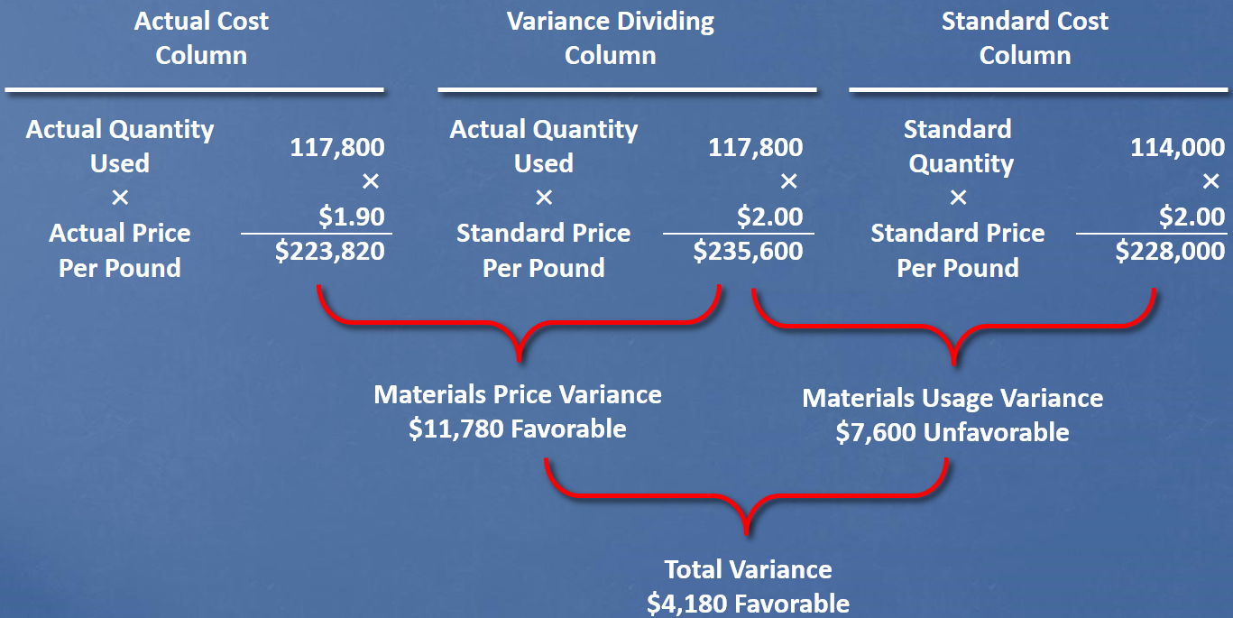
Materials Price and Usage Variances Part One
Access the text alternative for slide images.
Notes:
Part I Here is a general model for isolating material price and usage variances. The left column is referred to as the actual cost column, the middle column is the variance dividing column, and the column on the right is referred to as the standard cost column. You can see the amounts that we multiplied together in each of the three columns.
Part II First, we calculate the material price variance of $11,780 favorable. We multiply the actual quantity used times the difference between the standard price and the actual price to arrive at the material price variance.
Part III Next, we calculate the material usage variance of $7,600 unfavorable. The material usage variance multiplies the standard cost times the difference between the actual quantity used and the standard quantity that should have been used.
Part IV Finally, we combine the two variances for a total variance of $4,180 favorable.

Slide 33
Materials Price and Usage Variances Part Two
Notes:
Part I We can calculate the materials price and usage variance using the equations. The material price variance is the difference between the actual price and the standard price times the actual quantity used.
Part II In our equation, we have $1.90 less $2 times 117,800 pounds. This yields a favorable price variance of $11,780. We know that the price variance is favorable because we paid less than standard for the materials we purchased.
Part III For the material usage variance, we take the difference between the actual quantity and the standard quantity, and multiply that amount by the standard price.
Part IV In our example, we have an unfavorable variance of $7,600. We know the variance is unfavorable because we used more material than the standard called for.

Slide 34
Responsibility for Materials Variances
A purchasing agent is normally responsible for the materials price variance.
Management must be careful to identify the real causes of unfavorable price variances.
The nature of the materials usage variance is readily apparent from the quantity data.
If management seeks to minimize cost, using more materials than expected is unfavorable.
Notes:
Part I Here we have a good example of the “blame game.” The production manager may claim not to be responsible for the unfavorable material quantity variance because the purchasing agent acquired inferior goods.
Part II In response, the purchasing manager may say that because the production manager did a poor job of scheduling, she had to place “rush orders” and pay higher than normal prices for the raw materials.

Slide 35
Labor Variances
Assume the labor cost per unit is as follows.
Blank | Actual Data | Standard Data
Price per hour | $11.50 | $12.00
Quantity of labor per unit of product | × 1.5 hours | × 1.4 hours
Cost per unit of product | $ 17.25 | $ 16.80
Based on this, the total quantity of labor is.
Blank | Actual Data | Standard Data
Actual production volume | 19,000 units | 19,000 units
Quantity of labor per unit of product | × 1.5 hours | × 1.4 hours
Total quantity of labor | 28,500 hours | 26,600 hours
Notes:
Now let’s change the subject and look at labor variances. Melrose has provided information about actual pay rates and actual number of hours used to produce one unit of good output. We can now compare this information to the standard. We also have information about the total number of hours required to manufacture the 19,000 trophies.

Slide 36
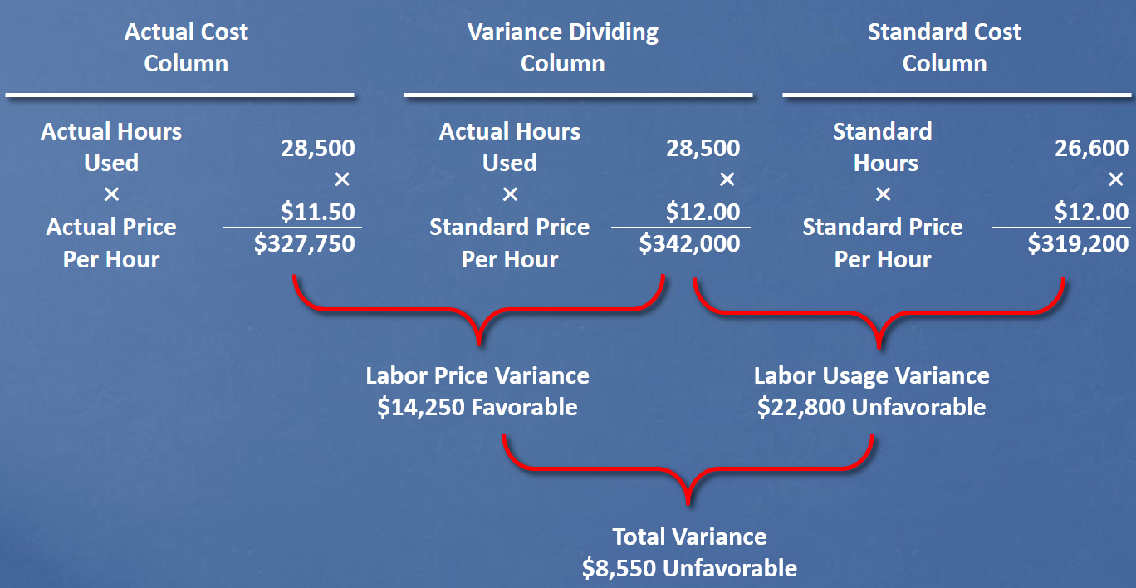
Labor Price and Usage Variances Part One
Access the text alternative for slide images.
Notes:
Part I Once again we use the three-column approach. Take a few seconds and make sure you understand the values that we’re multiplying together.
Part II First, calculate the labor price variance. The variance is $14,250 favorable. We know the variance will be favorable because our hourly pay rate was less than the standard.
Part III Next, we’ll calculate the labor usage variance, which turns out to be $22,800 unfavorable. The variance is unfavorable because we used 1,900 more hours than we were permitted by this standard.
Part IV
Finally, we combine the labor price variance and the labor usage variance and get a total unfavorable variance of $8,550.

Slide 37
Labor Price and Usage Variances Part Two
Notes:
Part I Once again we can calculate the price and usage variance using equations. Let’s start with the price variance. To calculate the price variance, we find the difference between the actual price and the standard price, and multiply that amount by the actual hours.
Part II Our calculations show us a favorable $14,250 price variance.
Part III We calculate the usage variance by finding the difference between the actual hours and the standard hours, then multiplying this amount by the standard wage rate.
Part IV Just like using the column approach, we get a $22,800 unfavorable usage variance.

Slide 38
Responsibility for Labor Price Variances
The labor price variance is favorable when the actual rate paid for labor is less than the standard rate.
The production supervisor is usually responsible for the labor price variance.
Production department supervisors control which workers are assigned to which tasks and are therefore accountable for the resulting labor price variances.
Notes:
Labor variances are partially controllable by employees within the production department. For example, production managers/supervisors can influence the:
Deployment of highly skilled workers and less skilled workers on tasks consistent with their skill levels.
Level of employee motivation within the department.
Quality of production supervision.
Quality of training provided to the employees.

Slide 39
Responsibility for Labor Usage Variances
Labor usage variances measure the productivity of the labor force.
When more labor is used than expected, the labor usage variance is unfavorable.
Possible causes are low morale, poor supervision, machine breakdowns, inferior materials, and poor planning.
Production department supervisors generally are responsible for labor usage variances.
Notes:
Labor variances are not entirely controllable by one person or department. For example:
The maintenance department may do a poor job of maintaining production equipment. This may increase the processing time required per unit, thereby causing an unfavorable labor efficiency variance.
The purchasing manager may purchase lower-quality raw materials, resulting in an unfavorable labor efficiency variance for the production manager.

Slide 40
Variable Overhead Variances Part One
Variable overhead variances are based on the same general formulas used to compute the materials and labor price and usage variances.
Unique characteristics require special attention.
Variable overhead represents many inputs.
Variable overhead cost pool assigned to products based on predetermined rate.
Notes:
Unique characteristics of variable overhead costs require special attention since they represent many inputs, such as supplies, utilities, and indirect labor.

Slide 41
Variable Overhead Variances Part Two
For Melrose’s Flexible Budget
Notes:
Part I To calculate the variable overhead variance, we take the difference between the actual cost and the standard cost and multiply this amount by the actual units produced.
Part II For Melrose, the variable overhead variance is $2,850 unfavorable.

Slide 42
Selling, General, and Administrative Cost Variances
Variable SG&A costs can have price and usage variances.
Businesses frequently compute variances for SG&A costs such as sales commissions, food and entertainment, postage, and supplies.
The same algebraic formulas used to compute variances for variable manufacturing costs apply to computing variable SG&A costs.
Notes:
Variable SG&A costs can have price and usage variances. Fixed SG&A costs are also subject to variance analysis. The general formulas for these variances are presented in Exhibit 8.7.

Slide 43
Algebraic Formulas for Variances
The general formulas for determining price and usage variances are shown below.
EXHIBIT 8.7
Algebraic Formulas for Variances
Variable cost variances (materials, labor, and overhead)
a. Price variance
b. Usage variance

Slide 44
End of Chapter 8

Slide 45
Accessibility Content: Text Alternatives for Images

Slide 46
Materials Price and Usage Variances Part One - Text Alternative
Overall model is laid out in three sections across. First section is titled Actual Cost Column. Under this head are Actual Quantity Used of 117,800 times Actual Price Per Pound of $1.90 for a total of $223,820.
Second section is titled Variance Dividing Column. Under this head are Actual Quantity Used of 117,800 times Standard Price Per Pound of $2.00 for a total of $235,600.
Third section is titled Standard Cost Column. Under this head are Standard Quantity of 114,000 times Standard Price Per Pound of $2.00 for a total of $228,000.
A bracket appears below the totals in sections 1 and 2 and is labeled: Materials Price Variance, $11,780 Favorable. Another brace appears below the total figures in sections 2 and 3 that is labeled: Materials Usage Variance, $7,600 Unfavorable. A third bracket appears below these two bracketed labels and it reads Total Variance, $4,180 Favorable.
Return to parent-slide containing images.

Slide 47
Labor Price and Usage Variances Part One - Text Alternative
Overall model is laid out in three sections across. First section is titled Actual Cost Column. Under this head are Actual Hours Used of 28,500 times Actual Price Per Hour of $11.50 for a total of $327,750.
Second section is titled Variance Dividing Column. Under this head are Actual Hours Used of 28,500 times Standard Price Per Hour of $12.00 for a total of $342,000.
Third section is titled Standard Cost Column. Under this head are Standard Hours of 26,600 times Standard Price Per Hour of $12.00 for a total of $319,200.
A bracket appears below the totals in sections 1 and 2 and is labeled: Labor Price Variance, $14,250 Favorable. Another brace appears below the total figures in sections 2 and 3 that is labeled: Labor Usage Variance, $22,800 Unfavorable. A third bracket appears below these two bracketed labels and it reads Total Variance, $8,550 Unfavorable.
Return to parent-slide containing images.

