Slide 1
CHAPTER 7
Planning for Profit and Cost Control
PowerPoint Author:
Debby Bloom, CMA, CFM, CSCA
©2020 McGraw-Hill Education. All rights reserved. Authorized only for instructor use in the classroom. No reproduction or further distribution permitted without the prior written consent of McGraw-Hill Education.
Notes:
Chapter 7: Planning for Profit and Cost Control
In Chapter 7, we will spend much of our time developing a master budget. Budgeting is an important process of planning for profits and controlling costs. It’s important that everyone in the organization understand the goals and objectives of the budgeting process. Using Microsoft Excel makes the budgeting process much easier than it used to be.

Slide 2
Learning Objective 7-1
Describe the budgeting process and the benefits it provides.
Notes:
Learning objective 7-1 is to describe the budgeting process and the benefits it provides.

Slide 3
Three Levels of Planning
Strategic planning involves making begin underline long-term end underline decisions such as defining the scope of the business, determining which products to develop or discontinue, and identifying the most profitable markets.
Capital budgeting focuses on begin underline intermediate-range end underline planning and involves decisions such as whether to buy or lease equipment, whether to stimulate sales, or whether to increase company assets.
The operations budget describes begin underline short-term end underline objectives in specific amounts of sales targets, production goals, and financing plans.
Notes:
Within an organization there are really three levels of planning. Strategic planning involves making long-term decisions about the business. This level of planning is usually the domain of senior management and the board of directors. Capital budgeting focuses on intermediate-range planning and involves decisions such as whether to lease or buy equipment or to commit organizational resources to relatively long-term projects. The operations budget is a planning tool that deals with the very short-term objectives of sales production and financing. We will spend almost all of our time looking at the master budgeting process.

Slide 4
Advantages of Budgeting
Budgeting.
Promotes Planning.
Promotes Coordination.
Enhances Performance Measurement.
Enhances Corrective Actions.
Notes:
There are many advantages to budgeting. Listed on your screen are just four of the advantages. Certainly budgeting promotes planning. If you budget in your personal life, you already know planning for the future is a “must.” Business budgeting also promotes coordination within an organization. Budgeting is not done by one department but is really the product of many departments. Coordination among these departments is essential to the preparation of the successful budget. We can compare actual results to budgeted results and take whatever corrective action is necessary as a result of any variances.

Slide 5
Budgeting and Human Behavior
Upper management must be sensitive to the impact of the budgeting process on employees.
Budgets are constraining. They limit individual freedom in favor of an established plan.
Many people find evaluation based on budget expectations stressful. Think of students and exams.
Upper management must demonstrate that budgets are sincere efforts to express realistic goals employees are expected to meet.
Notes:
Part I Upper management of the organization must be sensitive to the impact of the budgeting process on the employees. It is not always obvious how employees will react to budgets.
Part II By definition, budgets are constraining. They limit individual freedom in favor of an established plan. Some employees may feel that the established plan is not in the best interest of the company, but they can do little to change the budgeting process.
Part III Many people within the organization find evaluation based upon budgeted expectations to be extremely stressful. Think about the stress that you find yourself under when you’re preparing for an exam. The exam is one way to measure actual performance against expected performance.
Part IV It is absolutely essential that top management actively demonstrate that budgets are sincere efforts to express realistic goals that, with a reasonable effort, can be met by employees. If this is not the case, employees will become very distressed.

Slide 6
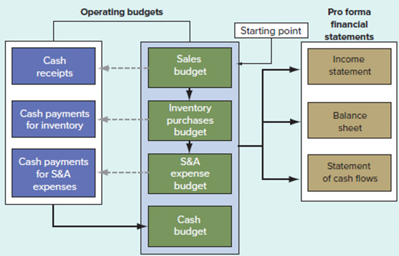
Information Flows in the Master Budget
Exhibit 7.1
Information Flows in the Master Budget
Access the text alternative for slide images.
Notes:
On this page we have prepared a schematic of the entire budgeting process that we will go through in the remainder of this presentation. Notice that the middle column shows the sales budget, the inventory purchases budget, and the selling and administrative expense budget. Each of these budgets implies a collection or payment of cash. As a result of these collections and payments of cash, we can prepare our cash budget. After all the information is assembled we will prepare pro forma financial statements.

Slide 7
Learning Objective 7-2
Prepare a sales budget and related schedule of cash receipts.
Notes:
Learning objective 7-2 is to prepare a sales budget and related schedule of cash receipts.

Slide 8
Sales Budget Defined
Detailed schedule prepared by the marketing department showing.
Expected sales for the coming periods, and
Expected collections on those sales.
It is critical to the success of the entire budgeting process.
Notes:
Preparing the master budget begins with the sales forecast. The accuracy of the sales forecast is critical because all the other budgets are derived from the sales budget. The budgeting process begins with the detailed sales budget prepared by the marketing department. An accurate sales forecast is critical to the success of the entire budgeting process. Students studying marketing frequently take a course in marketing research or in forecasting.

Slide 9
Sales Budget
Hampton Hams (H H) is preparing a sales budget for the last quarter of the year.
Sales of hams are expected to peak in the months of October, November, and December (the holiday season).
The store sales for October are expected to total $160,000 ($40,000 in cash sales, and $120,000 in sales on account).
Sales are expected to increase by 20 percent per month for November and December.
Let’s prepare a sales budget.
Notes:
We will prepare a sales budget for Hampton Hams. Management knows that sales will peak in the holiday months of October, November, and December. The store expects to have total sales of $160,000 in October. Of this amount, $40,000 will be cash sales. The remaining $120,000 will be sales on account. Sales are expected to grow by 20 percent per month for November and December. Sales on account are collected the following month. Let’s prepare our sales budget for October, November, December, and for the total quarter.

Slide 10
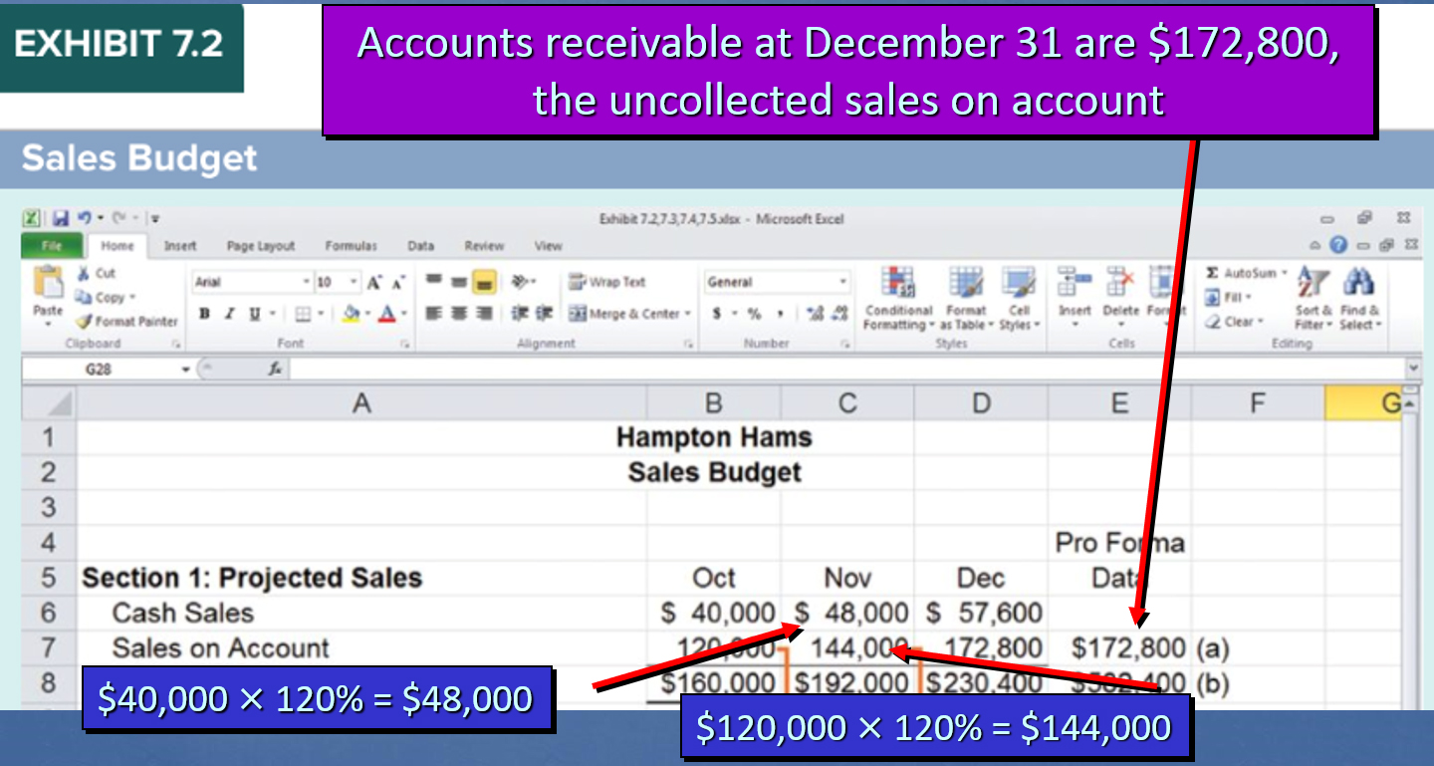
Sales Budget: Projected Sales Section
Access the text alternative for slide images.
Notes:
Part I We are using Microsoft Excel to prepare all of our budgets for Hampton Hams. We will begin with the sales budget and enter the given information for October. The sales budget has two sections—Projected Sales (shown here) and Schedule of Cash Receipts (shown on slide 12).
Part II Cash sales are expected to increase by 20 percent in November and December, so you can see that the $48,000 cash sales is equal to the October sales of $40,000 times 120 percent. We may also compute the amount by adding 20 percent of $40,000 to the original amount of $40,000, to get the same $48,000.
Part III We prepared the same type of computation for sales on account.
Part IV
Accounts receivable at December 31 are equal to $172,800, the uncollected sales on account.

Slide 11
Information on Cash Receipts
Hampton Hams (H H) will collect cash sales in the month of sale.
Past experience shows the company will collect cash from its credit sales in the month following the month of the sale (October credit sales will be collected in full in November).
Let’s prepare the cash receipts budget.
Notes:
The company will collect cash sales in the month of sale. Based on past experience, the company knows it will collect cash from its credit sales in the month following the month of sale. That is, it will collect October credit sales in November. Knowing this information, let’s prepare the cash receipts budget.

Slide 12
Sales Budget: Schedule of Cash Receipts
Exhibit 7.2
Sales Budget
Notes:
Part I
The only cash collected in October is from the cash sales.
Part II The October sales on account will be collected in November, and the November sales on account will be collected in December.
Part III The sales revenue on the pro forma income statement will be $582,400, the sum of the budgeted sales. Total cash collections for the quarter will be $409,600.

Slide 13
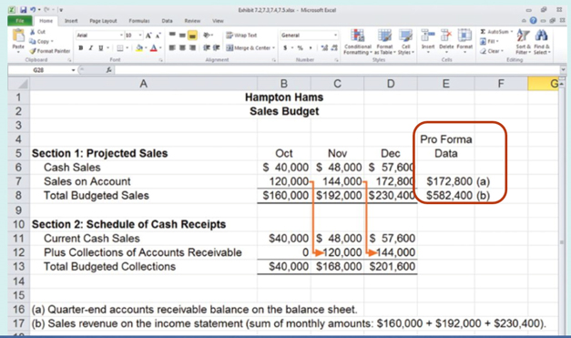
Pro Forma Statement
Exhibit 7.2
Sales Budget
Notes:
The Pro Forma Data column in the sales budget displays two figures HH will report on the quarter-end (December 31) budgeted financial statements.
Since HH expects to collect December credit sales in January, the accounts receivable balance will be $172,800 on the December 31 pro forma balance sheet (shown later in Exhibit 7.7).
The $582,400 of sales revenue in the Pro Forma Data column will be reported on the budgeted income statement for the quarter (shown later in Exhibit 7.6). The sales revenue represents the sum of October, November, and December sales ($160,000 + $192,000 + $230,400 = $582,400).

Slide 14
Learning Objective 7-3
Prepare an inventory purchases budget and related schedule of cash payments.
Notes:
Learning objective 7-3 is to prepare an inventory purchases budget and related schedule of cash payments.

Slide 15
Inventory Purchases Budget
The total amount of inventory needed for each month is equal to the amount of the cost of budgeted sales plus the desired ending inventory.
Required purchases is equal to the total inventory needed less the beginning inventory.
Cost of budgeted sales | XXX
Plus: Desired ending inventory | XXX
Total inventory needed | XXX
Less: Beginning inventory | (XXX)
Required purchases | XXX
Notes:
Now we can move on to the inventory purchases budget. The general format used to determine the amount of the purchases is to take the cost of budgeted sales, plus the desired ending inventory, minus the beginning inventory. This computation gives us the amount we need to purchase.

Slide 16
Inventory Information for Hampton Hams
H H’s policy is that ending inventory should be equal to 25 percent of next month’s projected cost of goods sold. At H H, cost of goods sold normally equals 70 percent of sales.
Suppliers require H H to pay 60 percent of inventory purchases in the month goods are purchased and the remaining 40 percent in the month after the purchase.
Let’s prepare the inventory purchases budget and the schedule of cash payments for inventory purchases.
January’s cost of goods sold is budgeted at $140,000.
Notes:
To prevent a stock-out of inventory, management has decided that ending inventory should always be equal to 25 percent of next month’s projected cost of goods sold. Cost of goods sold normally equals 70 percent of sales.
Based on past experience, management knows that suppliers require that 60 percent of the inventory purchases be paid for in the month of purchase and 40 percent be paid for in the month following the month of purchase.
Given this additional information, let’s prepare two budgets. The first will be the inventory purchase budget and the second will be the cash payments schedule for inventory purchases. January’s cost of goods sold is budgeted at $140,000.

Slide 17
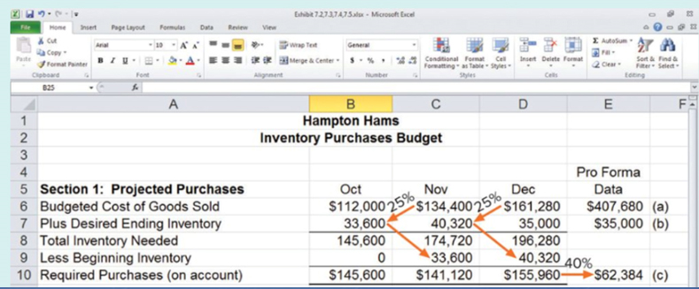
Exhibit 7.3: Inventory Purchases Budget
Exhibit 7.3
Inventory purchases Budget
Notes:
Part I
The inventory purchases budget has two sections: (1) projected purchases, showing required purchases needed for each month (shown here) and (2) the schedule of cash payments for inventory purchases (shown on the next slide).
This slide shows the budget of purchases on account for the quarter. Notice that there is no beginning inventory in October. The budgeted cost of goods sold for October is equal to 70 percent of the sales for October of $160,000.
Part II The desired ending inventory for October is $33,600. We determine this amount by taking the budgeted cost of goods sold for November of $134,400 times 25 percent. Once again, the budgeted cost of goods sold for November is equal to 70 percent of November’s budgeted sales of $192,000.
Part III The ending inventory in October becomes the beginning inventory in November, and the November ending inventory is equal to the December beginning inventory. Budgeted cost of goods sold for January amounts to $140,000.
Part IV
Accounts payable at December 31 will be $62,384. This amount represents 40 percent of the unpaid December purchases on account.

Slide 18
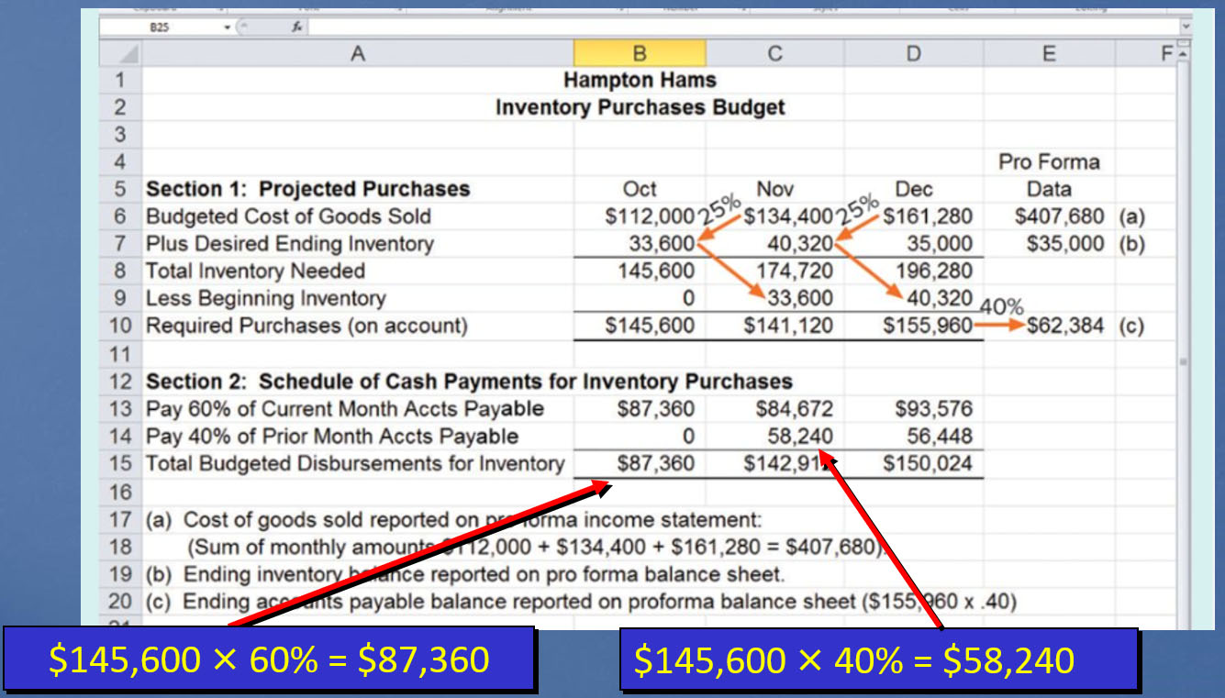
Exhibit 7.3: Inventory Purchases and Schedule of Cash Payments
Access the text alternative for slide images.
Notes:
Part I
Here is the schedule of cash payments for inventory purchases for the quarter. Budgeted collections for October are equal to the October required purchases on account of $145,600 times 60 percent, the amount that we must pay that month.
Part II In November, we will pay the remaining 40 percent of the $145,600. Note that the desired ending inventory for the quarter in total is the desired ending inventory for December, the last month of the quarter. The beginning inventory for the quarter is the beginning inventory for October, the first month of the quarter.
Part III
The Pro Forma Data column in the inventory purchases budget displays three figures HH will report on the quarter-end budgeted financial statements: (1) the $407,680 cost of goods sold reported on the pro forma income statement (Exhibit 7.6) is the sum of the monthly cost of goods sold amounts ($112,000 + $134,400 + $161,280 = $407,680); (2) the $35,000 ending inventory as of December 31 is reported on the pro forma balance sheet (Exhibit 7.7). December 31 is the last day of both the month of December and the three-month quarter represented by October, November, and December; and (3) the $62,384 of accounts payable reported on the pro forma balance sheet (Exhibit 7.7) represents the 40 percent of December inventory purchases HH will pay for in January ($155,960 × 0.40).

Slide 19
Learning Objective 7-4
Prepare a selling and administrative expense budget and related schedule of cash payments.
Notes:
Learning objective 7-4 is to prepare a selling and administrative expense budget and related schedule of cash payments.

Slide 20
Selling and Administrative Expense Budget
The details of the selling and administrative (S&A) budget are shown next.
It is important to note that sales commission (based on 2 percent of sales) is paid in the month following the sale, while supplies expense (based on 1 percent of sales) is paid in the month of the sale.
The utility expense is paid in the month following the usage of the electricity, gas, and water.
Notes:
The selling and administrative budgets are shown on the next two screens. The most important thing to note is that the sales commission, based upon 2 percent of sales, is paid in the month following the sale, while the supplies expense, based on 1 percent of sales, is paid in the month of sale. The utility expense is paid in the month following the usage of the electricity, gas, and water.

Slide 21
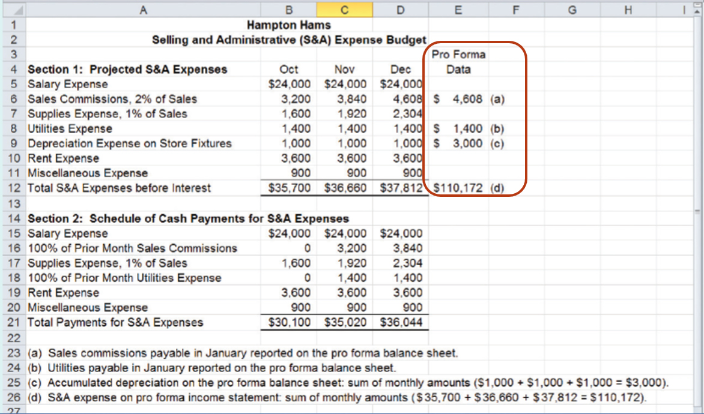
Exhibit 7.4: Selling and Administrative Expense Budget for Hampton Hams
Notes:
Here are the projected selling and administrative expenses for the quarter, as well as cash payments for these expenses.
The key to understanding the cash payments is to look at the month of October. The sales commissions and utilities are paid in the month following the incurrence of these expenses. We will need to return to the sales budget to calculate our sales commission and supplies expense. Depreciation expense does not require a payment of cash. Notice that overall, the cash paid for these expenses is less than the total amount of expenses recorded.
The Pro Forma Data column of the S&A expense budget displays four figures HH will report on the quarter-end budgeted financial statements.

Slide 22
Learning Objective 7-5
Prepare a cash budget.
Notes:
Learning objective 7-5 is to prepare a cash budget.

Slide 23
Information for Hampton Hams’ Cash Budget
H H plans to purchase, for cash, store fixtures with a cost of $130,000 in October.
H H borrows or repays principal and interest on the last day of each month.
Any money borrowed from the bank bears interest at an annual rate of 12 percent (1 percent per month).
The management at H H wants to maintain a cash balance of at least $10,000 at the end of every month.
Notes:
We are now ready to prepare the cash budget. Little is more important to business success than effective cash management. If a company experiences cash shortages, it will be unable to pay its debts and may be forced into bankruptcy. If excess cash accumulates, a business loses the opportunity to earn investment income or reduce interest costs by repaying debt.
We have learned that the company plans to acquire store fixtures at a cost of $130,000 in October. If it’s necessary to borrow money, the principal and interest are repaid on the last day of each month. Any money borrowed from the bank has a 12 percent annual interest rate, or 1 percent per month. Management has a policy of maintaining an ending cash balance of at least $10,000.

Slide 24
Exhibit 7.5: Schedule of Cash Receipts
Notes:
The cash budget is divided into three major sections: (1) a cash receipts section (shown here), (2) a cash payments section, and (3) a financing section.
There is no beginning cash balance because the new store opened in October. We can return to the cash receipts budget to find the $40,000 for October, the $168,000 for November, and the $201,600 for December.

Slide 25
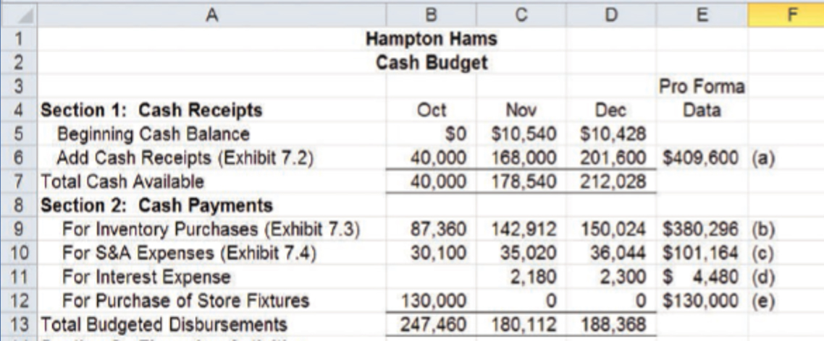
Exhibit 7.5: Schedule of Cash Receipts and Cash Payments
Notes:
The next section in our cash budget shows the projected cash payments. The payments for inventory purchases come from our cash payment for purchases on account budget. Our selling and administrative expenses come from the cash payments for selling and administrative expenses budget. The company borrowed money to purchase the store fixtures in October. As a result, interest was incurred in November and December. You can see in October that our cash payments substantially exceeded our cash receipts. It’s essential to borrow funds to maintain our $10,000 cash balance.

Slide 26
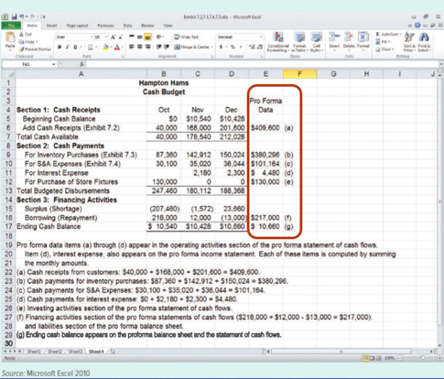
Cash Budget for Hampton Hams
Exhibit 7.5
Cash Budget
Notes:
Finally, the third section, financing activities, is very important to this company because you can see that HH has a shortage in October of $207,460. The company borrowed $218,000 to get its cash balance to $10,540.
Notice that the ending cash balance for October becomes the beginning cash balance for November. The company had a cash shortage in November, and it became necessary to borrow an additional $12,000. In December, the company had a cash surplus of $23,660. It was able to repay $13,000 of the money previously borrowed and maintain a cash balance of at least $10,000.
Figures in the Pro Forma Data column of the cash budget (Exhibit 7.5) are alphabetically referenced. The cash receipts from customers, item (a), and the cash payment items (b), (c), and (d) are reported in the operating activities section of the pro forma statement of cash flows (shown later in Exhibit 7.8). The interest expense, item (d), is also reported on the pro forma income statement (shown later in Exhibit 7.6). The figures are determined by summing the monthly amounts. The $130,000 purchase of store fixtures, item (e), is reported in the investing activities section of the pro forma statement of cash flows. The $217,000 net borrowings, item (f ), is reported in the financing activities section of the pro forma statement of cash flows (shown later in Exhibit 7.8) and also as a liability on the pro forma balance sheet (shown later in Exhibit 7.7). The $10,660 ending cash balance, item (g), is reported as the ending balance on the pro forma statement of cash flows and as an asset on the pro forma balance sheet.

Slide 27
Learning Objective 7-6
Prepare a pro forma income statement, balance sheet, and statement of cash flows.
Notes:
Learning objective 7-6 is to prepare a pro forma income statement, balance sheet, and statement of cash flows.

Slide 28
Pro Forma Income Statement
The pro forma income statement gives management an estimate of the expected profitability of H H.
If the project appears to be unprofitable, management can make the decision to abandon it.
Although managers remain responsible for data analysis and decision making, computer technology offers powerful tools to assist in those tasks.
Notes:
When the store prepares its pro forma income statement, management will get some feel for the expected profitability of that store. If the store does not appear to be profitable, management will probably abandon it.

Slide 29
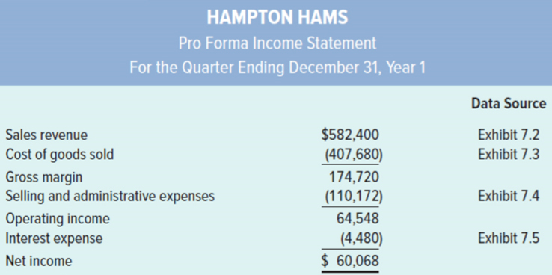
Pro Forma Income Statement for Hampton Hams
Exhibit 7.6
Notes:
We can see from the pro forma income statement that the store is projecting to produce net income of $60,068. We have also indicated the source of the numbers that appear on the pro forma income statement.

Slide 30
Pro Forma Balance Sheet
The new store has no contributed capital because its operations will be financed through debt (line of credit) and retained earnings.
The amount of retained earnings will be equal to the net income because there are no prior periods.
The fixtures purchased in October will be depreciated for a full three months.
Total accumulated depreciation will be $3,000.
Notes:
Owners have not provided the store with any working capital. Its operations were financed through a line of credit and its own earnings. The fixtures are being depreciated for three months of the year, and the total accumulated depreciation will be $3,000.

Slide 31
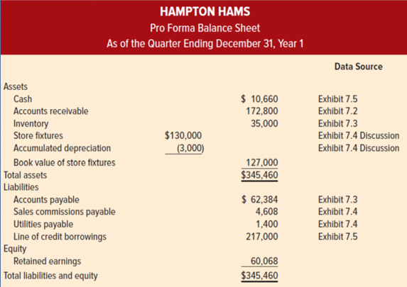
Pro Forma Balance Sheet for Hampton Hams
Exhibit 7.7
Notes:
Here is the pro forma balance sheet for the store. We’ve also indicated the source of the information that appears on the pro forma balance sheet. Notice that retained earnings is equal to our pro forma income because this is the first accounting period for the store.

Slide 32
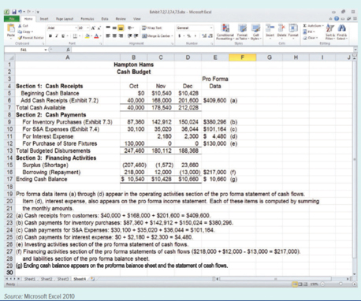
Cash Budget for Hampton Hams Revisited
Exhibit 7.5
Almost all the information needed to prepare the pro forma statement of cash flows can be found on the cash budget on the left.
Cash Budget
Notes:
You can see that the store had a cash outflow from operating activities as well as in investing activities. The major cash inflow came from the line of credit. Notice that the statement of cash flows reconciles to the ending cash balance of $10,660.

Slide 33
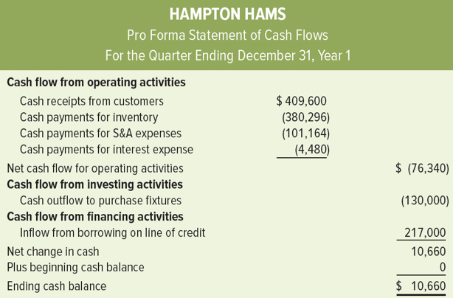
Pro Forma Statement of Cash Flows for Hampton Hams
Exhibit 7.8

Slide 34
End of Chapter 7

Slide 35
Accessibility Content: Text Alternatives for Images

Slide 36
Information Flows in the Master Budget - Text Alternative
The starting point of information in a master budget is the Sales budget. Information from the Sales budget flows to the Inventory purchases budget; information from the Inventory purchases budget flows to the S&A expense budget.
Information from the Sales budget also includes a schedule of Cash receipts.
Information from the Inventory purchases budget also includes a schedule of Cash payments for inventory.
Information from the S&A expense budget also includes a schedule of Cash payments for S&A expenses.
The schedules of cash receipts and cash payments form the basis for the Cash budget.
The Sales, Inventory purchases, S&A expense, and Cash budgets are all Operating budgets. These are used to prepare pro forma financial statements: the Income statement, Balance sheet, and Statement of cash flows.
Return to parent-slide containing images.

Slide 37
Sales Budget: Projected Sales Section - Text Alternative
A callout points to the $48,000 in the November column and reads: $40,000 times 120% = $48,000.
A second annotation points to the $144,000 in the November column and reads: $120,000 times 120% = $144,000.
A third annotation points to the $172,800 in the Pro Forma Data column and reads: Accounts receivable at December 31 are $172,800, the uncollected sales on account.
Return to parent-slide containing images.

Slide 38
Exhibit 7.3: Inventory Purchases and Schedule of Cash Payments - Text Alternative
A callout points to the $87,360 in the October column and reads: $145,600 times 60% = $87,360
A second annotation points to the $58,240 in the November column and reads: $145,600 times 40% = $58,240.
A third annotation points to the $172,800 in the Pro Forma Data column and reads: Accounts receivable at December 31 are $172,800, the uncollected sales on account.
Return to parent-slide containing images.

