Slide 1
Milestone 1 (1960-1969 economic period)
Jacklyn Borbon
Professor Bissessar
March 21st 2020

Slide 2
US Economic history (1960-1969)
In the 1960s, the US encountered a lengthy continuous economic growth period in history.
During that decade, housing as well as computer sector beat chemicals, automobiles, and electrically-powered commodities, which led during the 1950s.
Large businesses run the domestic economy within that period. In 1962, the 5 largest industrial companies constituted to over 12% of all manufacturing assets.
President Johnson had taken over a robust economy from president Kennedy. During his term, the growth from 1964-1965 produced annual dividends of 4 to 5 billion dollars in additional revenues for spending.
As the decade ended, the average income for Americans has rose by 50% . Median family earnings increased from $8,540 to $10,770 between 1963-1969.
Notes:
For the first two years of Johnson’s presidency the inflation rate was just under 2 percent. In 1965 inflation began to pick up slightly, but the GNP (gross national product) grew by $9 billion and unemployment stood at 1.4 percent.
By 1965 General Motors, standard old of New Jersey and ford had larger incomes than all the farms in the United States. America’s overseas investment increased to $49.2 billion in 1965 (Walsh, 2010).

Slide 3
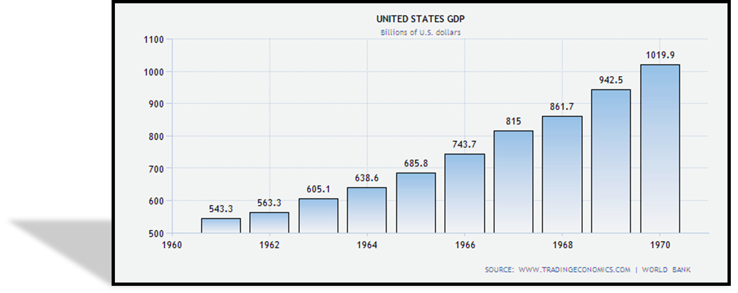
GDP (Gross Domestic Product
Notes:
The GDP (gross domestic product) measures of national income and output for a given country's economy. The gross domestic product (GDP) is equal to the total expenditures for all final goods and services produced within the country in a stipulated period of time.
Over 80 percent of the goods and services purchased by U.S. consumers each year are made in the United States; the rest are imported from other nations. In addition to spending by private households and businesses, government agencies at all levels (federal, state, and local) spend roughly an additional $1.5 trillion a year (Walsh, 2010).

Slide 4
INFLATION/UNEMPLOYMENT RATE
By the mid-1960s, inflation remained less than 2 percent, whereas unemployment started at about 7 percent and reduced to 3.7 percent in 1966.
The misery index was at the lowest in November, 1965, at 5.7 percent and unemployment and inflation at 4.1 percent and 1.6 percent respectively.
Johnson launched his ‘Great Society’ program which started increasing social programs and by 1969, misery index was almost at double at a little below 10 percent (December 1960: inflation = 6.2 percent, unemployment = 3.5 percent) (Manuel, 2015).
The mean inflation in that decade was an average 2.32 percent.
Notes:
In the 1960s, economist Arthur Okun created a simple system for measuring economic well-being called the ‘misery index’ which was simply the inflation rate plus the unemployment rate.
Interestingly, during this period, the misery index was one of the lowest on record dipping below 6% in late 1965.
As 1961 approached, the economy began to improve. The unemployment level at this time was 5.5% which was good. Wages and prices did of course interact with each other to cause inflation during this time period, but it was not a serious problem.

Slide 5
Yearly INFLATION (1960 - 1969)
Notes:
The GNP (Gross National Product) in 1960 was 1665.3 with a growth of 3.9 up from 3.5 in 1947.
The CPI (Consumer Price Index) also told about the economy. The CPI was 29.6 in 1960 which was a growth of 3.3 up from 2.2 growth in 1947 (Walsh, 2010). As you can see by these statistics the economy was on a track of growth.

Slide 6
Rate of UNEMPLOYMENT
Notes:
During the 1960s, hourly productivity grew relatively fast, at the same time as the share of employee compensation in total national income was rising.
As 1961 approached, the economy began to improve. The unemployment level at this time was 5.5% which was good (Manuel, 2015). Wages and prices did of course interact with each other to cause inflation during this time period, but it was not a serious problem.

Slide 7
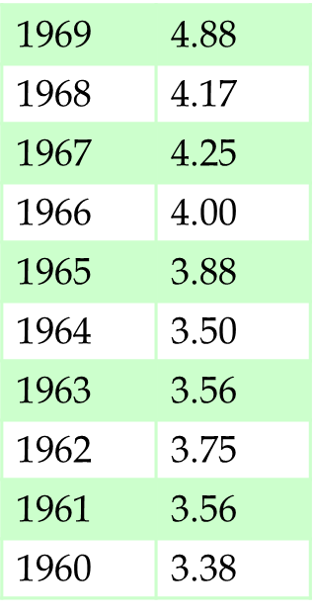
Interest Rate Fluctuations
August 1960 4.5
December 1965 5
March 1966 5.5
June 1966 5.75
August 1966 6
January 1967 5.75
March 1967 5.5
November 1967 6
April 1968 6.5
September 1968 6.25
December 1968 6.5
December 1968 6.75
January 1969 7
March 1969 7.5
June 1969 8.5
Rates of Saving Interest
Notes:
During the 1960s, the interest rate for savings help add to the ability for a family to save for the future (Walsh, 2010). In contrast to todays interest rate where it sees one percent.

Slide 8
References
Manuel, D. (2015) Historical Unemployment Rates in the United States retrieved from http://www.tradingeconomics.com/united-states/gdp
Walsh, K. (2010) The 1960s: A Decade of Promise and Heartbreak retrieved from http://www.usnews.com/news/articles/2010/03/09/the-1960s-a-decade-of-promise-and-heartbreak

