Slide 1
Role-Play Product and Buyer Information
Gartner
Product Information: Competitor Resources Tab
http://www.gartner.com/ncsc/

Slide 2
Role-Play Product Information
Gartner for Technology Leaders

Slide 3
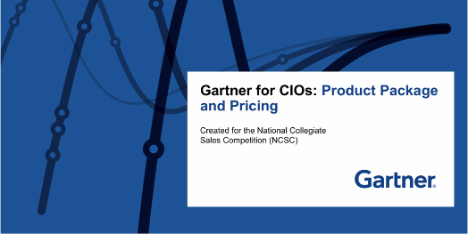
Product Info: Gartner
Product Information: Competitor Resources Tab
http://www.gartner.com/ncsc/
9-3
Notes:
Start 9/29

Slide 4
Product Info: Gartner
What Gartner does for End-User Clients
Our account managers build relationships with CIOs and their teams to understand their key challenges
Account managers connect them with the right Gartner analysts and insights
…so they can select and purchase the right technologies at the right price with less risk and more confidence in their decisions
9-4
Notes:
Start 9/29

Slide 5
Product Info: Gartner
Examples of WIFM and Gartner Facts and Capabilities
Overview:
We bring together Research insight, Benchmarking data, problem-solving methodologies and hands on experience to improve the return on your IT investment
Understanding: We know the issues you face:
80% of the Fortune 500 Use Gartner for their key technology initiatives
We deliver business value in over 1500 high-impact initiatives a year
Every year, we deliver over 5500 IT cost and performance benchmarks
Capabilities: the data, tools and capabilities to help:
Gartner solutions address the specific needs of each industry
All of our solutions are based on Gartner’s extensive Research
Every solution makes use of our performance benchmarking data
We emply seasoned consultants, with an average of 15 years experience
Experience: we help you deliver tangible results
Our clients spend 38% less than their peers for the same workload
Gartner Contract Optimization Services help our clients realize hundreds of millions of dollars of real and measured savings annually
Our consulting engagements help clients improve performance… and reduce risk
9-5
Notes:
Start 9/29

Slide 6
Gartner “Offerings”
Product Knowledge
Gartner http://www.gartner.com/ncsc/
Research
Cost Optimization
Executive Partner
135,000 research docs across 1,375 topics covering all aspects of IT
In-Depth vertical coverage in 9 industries
Targeted to specific IT role, key initiatives & purchasing decisions
World’s largest repository of IT spending & staffing metrics to baseline spending and adjust for optimized spend/staffing model.
Self-assessment tools to benchmark for world-class operating in under 1 hour
ITBudget Tool: online IT spending & staffing comparison tool
Vendor contract Review
Partner with expert in the “Office of the CIO” to develop personal & professional skills for the CIO and his/her team.
Receive specific customized advice on your challenges, opportunities and projects
Access to proprietary methodologies & interactive models applied to gain clear insight and actionable advice.

Slide 7
Gartner ExP Capabilities
“Deliverables - Benefits”
Research
Cost Optimization
Executive Partner
Tools to help select optimum technology vendors for variety of specific needs
Save thousands or millions of $ on purchasing decisions and operating budgets
Research Example:
  https://www.gartner.com/search/site/freecontent/simple
Access to ITBudget tool
Online IT spending & staffing comparison tool
Vendor contract review – 15-20% cost savings in 3 out of 4 contracts reviewed
Save up to 43% on per-unit costs – benchmarking against best-in-class enterprises
Access Executive with 15 – 20+ years of experience in CIO and IT executive roles
  Help define & develop customized strategies based upon CIO’s priorities & initiatives
Interact monthly
Executive partner will conduct 1 annual on site workshop to support IT strategy & execution
70+ Educational/Networking Events Annually
Benefits?
Benefits?
Benefits?

Slide 8

Example Executive Partner – David Hamilton Ulmer
Current Biography:
David is a Gartner Executive Partner. Previously, Mr. Ulmer's responsibilities included security, legacy modernization, organizational design, release management, capacity planning, business/technology integration, SOA, SDLC, maturity modeling and compliance.
Years of Experience
29 years in the IT industry
Professional Background
North Carolina Department of Transportation, Chief Information Officer, 2 years
Bank of America, Senor Technology Manager, 11 years
Synapse Technology, Senior Vice President, 3 years
Industry Awards/Accolades
Joint patent holder related to advanced mathematical modeling
used for predictive analysis of technology change
Education
B.A., Furman University, Greenville, SC
M.B.A., Emory School of Business, Atlanta, GA

Slide 9
Gartner Solution: Pricing
CIOs
Gartner Research
Cost Optimization Tools
Executive Partner
Direct
Report
Workgroup
Direct
Report
Workgroup
CIO Only: 3 Year Contract
Year 1: $50,000
Year 2: $51,500 (3% increase annually)
Year 3: $53,100 (3% increase)
renewal at end of 3 years – at Final Year Rate – 3 yr. Contract)
CIO
Leader
Direct
Reports
Gartner Research
Cost Optimization Tools
Executive Partner not included for Additional Licenses
Direct
Report
Workgroup
Each Additional Workgroup – License:
Year 1: $15,000
Year 2: $15,500
Year 3: $16,000

Slide 10
Role-Play Buyer Information
Technology Leaders

Slide 11
IT Specific Useful Statistics
IT Specific Stats
IT budget typically 3% of overall revenue
Typical revenue band for target market $200M - $500M annually.
Number of IT staff is typically between 20 – 60
Number of people in organization is typically 500 – 1000
IT Cost cutting can range from flat 0% to extreme 20%
Vendor contracts (i.e. Microsoft, Oracle) can range from $200k - $1M+ annually

Slide 12
8 Common CIO Prospects
Characteristics – Needs – WIFM direction
Tactical
Primarily focused on the technical
Strategy is low on priority list
Typically very time constrained
From the Business
Knows the company’s operations
Have held several CXO or VP roles
Don’t know what they don’t know
First -Time
Technical
Career path from IT staff to CIO
Often has a very technical background
May struggle w/business aspects of role
Turn-around
Hired from outside the organization
Set out to fix specific problem(s)
Benchmarks and peers are important
Seasoned
Have held several executive positions
Wealth of industry/market background
Looks to be intrigued
Consultant
Hired from consulting firm for specific purpose
Typically there to fix a problem
Strong problem identification, not implementation
CxO as CIO
IT reports to CxO…is IT decision maker
Typically concerned with risk and cost
IT is not their singular focus
Interim
Acting as CIO in a short term engagement
1 month – 3 years
Wants to avoid stagnation
26

Slide 13
CIO Types – Backgrounds - Insights
Tactical
First -Time
Technical
Seasoned
CxO as CIO
Challenges:
Often feels that their team lacks the right skills and enough time to be effective
May struggle articulating IT’s contribution to the business with non-IT stakeholders
Can be viewed as a utility by other executives
Challenges:
Struggles with the breadth and depth of leadership responsibilities outside of their area of expertise
Building a strong team is critical to their success
Strategic thinking can be foreign to them given their previous roles
Challenges:
Time is their most scarce and valuable asset
Empowering and developing their team is very important to them
Looks to improve relationships and communications with other business leaders
Challenges:
Lack of IT experience causes uncertainty in decision making
Needs to understand the ROI of all decisions
Cost cutting/containment are always top of mind
From the Business
Turn-around
Consultant
Interim
Challenges:
Lack of IT experience causes uncertainty in decision making
Unfamiliar with IT vendors and marketplace
May have blind spots and not recognize problem areas
Challenges:
Lacks business stakeholder relationships
May tend to be less strategic in their thinking
Cost cutting/containment are typically a priority
Challenges:
May not have high proficiency in leadership competencies
May lack operational management experience – not process oriented
Looks to improve relationships and communication with business leaders
Challenges:
Lacks confidence in decision making
May have limited decision making authority
May not have strong business relationships
28

Slide 14
Tech Initiative | Challenge / Need | Gartner Solution
E-Commerce: Traditional brick & mortar retailer creating online presence to better compete in crowded market | Struggling to determine how to create a digital commerce strategies that align to my business model and accelerate growth. Unsure what steps to take first to build out a success e-commerce strategy and roadmap. | Research Executive Partner
Mobile Strategy: Bank looking to digitize products via mobile app to better compete in crowded market | Not sure how to accelerate their mobile app development to delivery to meet the demands of the business. Struggling to select the right third party app developer that best understands the financial services market. | Research
IT Strategy: Transportation provider recently revamped business to deliver services via mobile app – now needs to restructure IT strategy and budget to reflect needs of digital business | Difficulty finding accurate data to understand their IT efficiencies specifically where their spending and staffing compares to their peers (i.e. similar industry, revenue, and geography) but does not have access to any comparative data. After determining where IT spending/staffing compares to peers, needs guidance on creating a digital transformation strategy and getting buy-in from the rest of the executive team. | Cost Optimization Tools
IT Leadership Transformation: Manufacturing company is looking to leverage Internet of Things (IoT) to drive efficiencies and increase profitability. | Lacking insight into the skills and capabilities needed to support a digital business strategy and IoT. Needs guidance and mentorship on how to attract talent and cultivate the next generation of IT leaders to support this transformation. | Research Executive Partner
Customer Experience: Insurance company is looking to leverage social tools to speed claim management while improving client satisfaction. | CIO is being mandated to improve customer satisfaction while reducing claim management process, however the CIO is struggling to gain support from CEO and board to make additional investments in social technology which will improve both metrics. | Executive Partner
Data & Analytics: A University has recently invested in smart infrastructure and is looking use the additional data captured to further improve efficiencies. | CIO is tasked with creating a program to analyze new data streams including Internet of Things (IoT) data, and even unstructured data to identify areas to improve efficiencies. Difficult to determine which area to invest in first and the initial steps to take in building out the program. | Research Executive Partner
Cost Reduction: Restaurant chain is looking to reduce costs to improve profitability in an increasingly crowded market. | CIO is new to the role and has not had experience in managing a full year business unit budget. CIO is unsure about where company is over-spending relative to peers. | Cost Optimization Tools
Cloud Computing: Law firm is seeking to reduce costs by moving IT infrastructure off premises and to the Cloud | CIO is evaluating 3 Cloud providers to help migrate IT infrastructure to the cloud. He is struggling in scoping out the project and determining which specific systems to move to the cloud vs keep on premises. Additionally he is struggling with selecting the right vendor and securing the best possible pricing from that vendor. | Research Cost Optimization Tools (contract reviews)
IT Org Structure: Fast growing pharma company is looking to make big investments in IT to help scale the growth. | Being in the midmarket, unsure of how to design to adjust for our rapid growth. Unable to determine what the key functions are needed to optimize organizational effectiveness. | Research Cost Optimization Tools
Corporate Objectives
Increase Revenues by “X”
Reduce Costs by “X”
Increase Efficiencies by “X”

Slide 15
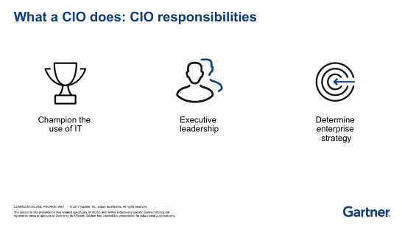
Buyer Info: Gartner
9-15
Notes:
Start 9/29

Slide 16
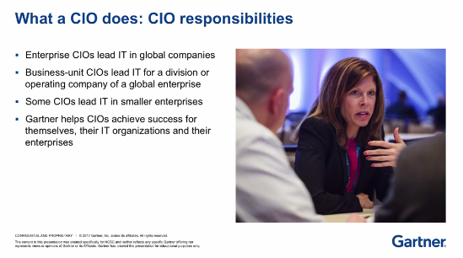
Buyer Info: Gartner
9-16
Notes:
Start 9/29

Slide 17
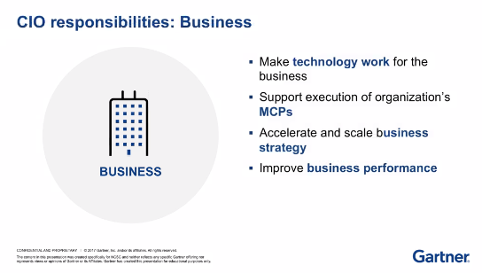
Buyer Info: Gartner
(Mission Critical Priorities)
9-17
Notes:
Start 9/29

Slide 18
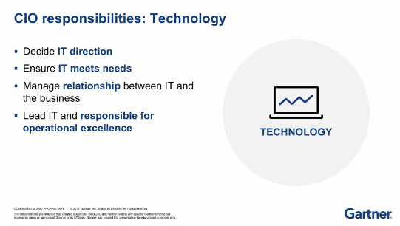
Buyer Info: Gartner
9-18
Notes:
Start 9/29

Slide 19
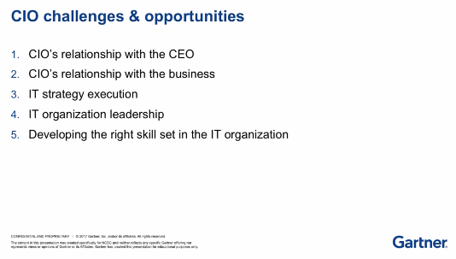
Buyer Info: Gartner
9-19
Notes:
Start 9/29

Slide 20
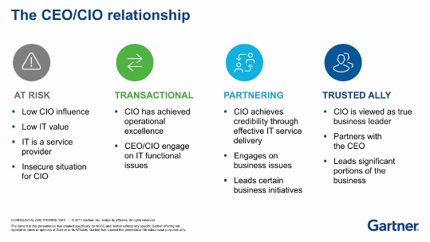
Buyer Info: Gartner
9-20
Notes:
Start 9/29

Slide 21
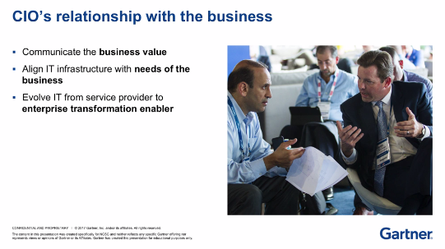
Buyer Info: Gartner
9-21
Notes:
Start 9/29

Slide 22
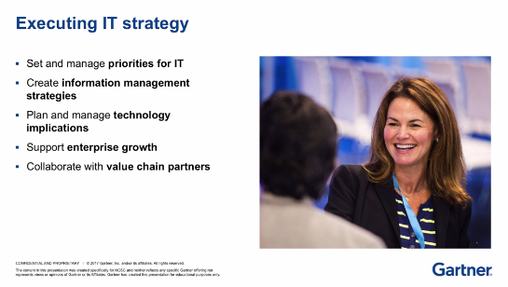
Buyer Info: Gartner
9-22
Notes:
Start 9/29

Slide 23
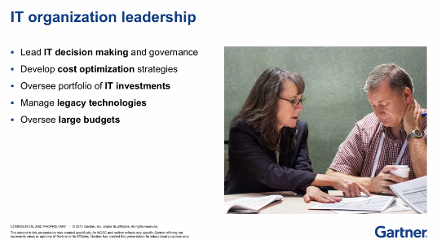
Buyer Info: Gartner
9-23
Notes:
Start 9/29

Slide 24
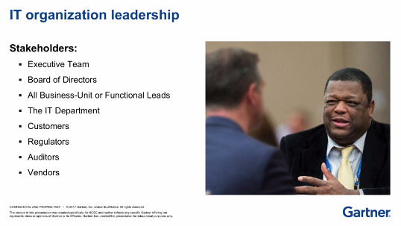
Buyer Info: Gartner
9-24
Notes:
Start 9/29

Slide 25
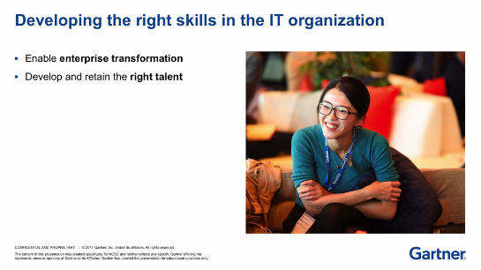
Buyer Info: Gartner
9-25
Notes:
Start 9/29

Slide 26
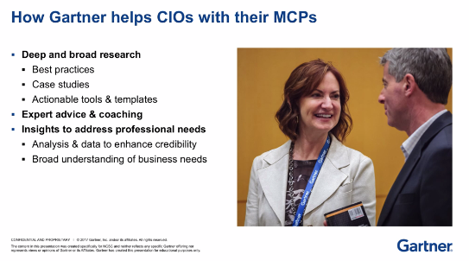
Buyer Info: Gartner
9-26
Notes:
Start 9/29

Slide 27
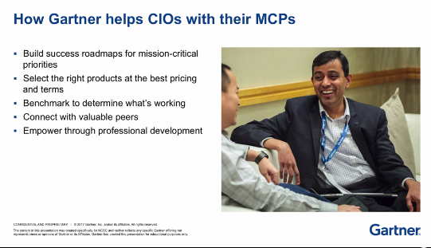
Buyer Info: Gartner – 5 Universal Needs
9-27

Slide 28

Common Objections | How to handle
“I can find research for free on the internet” | Gartner research is thoroughly vetted, unbiased and we and can help save you time finding the right research quicker
“Tech vendors are experts in their industry and have offered to give me free advice” | Gartner is unbiased while the vendors are attempting to sell you
“Need CFO or board approval to sign over x” | Establish strong mutual plan with commitment from all parties
“Timing isn’t right” | Need to tie back to initiative timelines and milestones that are urgent today, not in the future
“I don’t have time to take advantage of all these great resources” | Make sure to focus on the top priority and not a “nice to have”
“I need consensus from my direct reports to move forward” | Establish strong mutual plan with commitment from all parties
“This looks great but I can’t justify the spend if I can’t demonstrate hard dollar ROI” | Attempt to quantify any cost savings via ITBudget or contract review / also tie value back to Corporate Objective
“We don’t sign multiyear agreements” | Like most tech companies, 3 years is Gartner’s standard term. Gartner seeks to partner with clients for the long term, not just short projects
“Price is too much” | Quantify the value that will be delivered when Gartner helps accomplish X

