Slide 1
Diversity Recruitment

Slide 2
Overview
RECRUITMENT-
Refers to the organization’s desire and ability to attract individuals with a collective mix of similarities and differences.
These include not only race, religion, age, gender, ethnicity, military status, LGBT, but also differences in experience, values, and beliefs.
Do they provide internships and recruit from diverse universities?

Slide 3
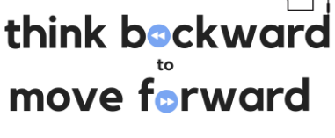

Slide 4
TOOLS-WHERE
Posting opportunities on a variety of sites with different applicant types
Use of social media and retargeting so potential candidates find YOU
Specific universities—STEM concentrations (MIT, Carnegie Mellon) , Howard University (African American), Barnard College (women)
Specific skills base- Veterans and Military (operations and teamwork)

Slide 5
TOOLS-HOW
Establish desired D&I metrics (Caesars 50% by 2025 example)
Use an inclusive recruiting team—are your interviewers as diverse as the people you wish to hire? Why would diverse people want to work for you?
Inclusive job descriptions
Consider the entire field before assuming “lead candidate”

Slide 6
TOOLS-WHEN
Proactive and pre-emptive recruiting practices
Referrals

