Slide 1
Risk Management & Insurance
Chapter 2
Insurance and Risk
Rev.1_Jan2020

Slide 2
Learning Objectives:
Explain the basic characteristics of insurance.
Explain the law of large numbers.
Describe the characteristics of an ideally insurable risk from the viewpoint of a private insurer.
Identify the major insurable and uninsurable risks in our society.
Describe the major types of insurance.
Explain the social benefits and social costs of insurance.

Slide 3
Definition or Insurance
Insurance: Is the pooling of fortuitous losses by transfer of such risks to insurers, who agree to indemnify insureds for such losses, to provide other pecuniary benefits on their occurrence, or to render services connected with the risk. [based on the Commission on Insurance Terminology of the American Risk and Insurance Association]
Basic Characteristics of Insurance
Based on the above definition an insurance plan includes the following characteristics:
Pooling of losses.
Payment of fortuitous losses.
Risk transfer.
Indemnification.

Slide 4
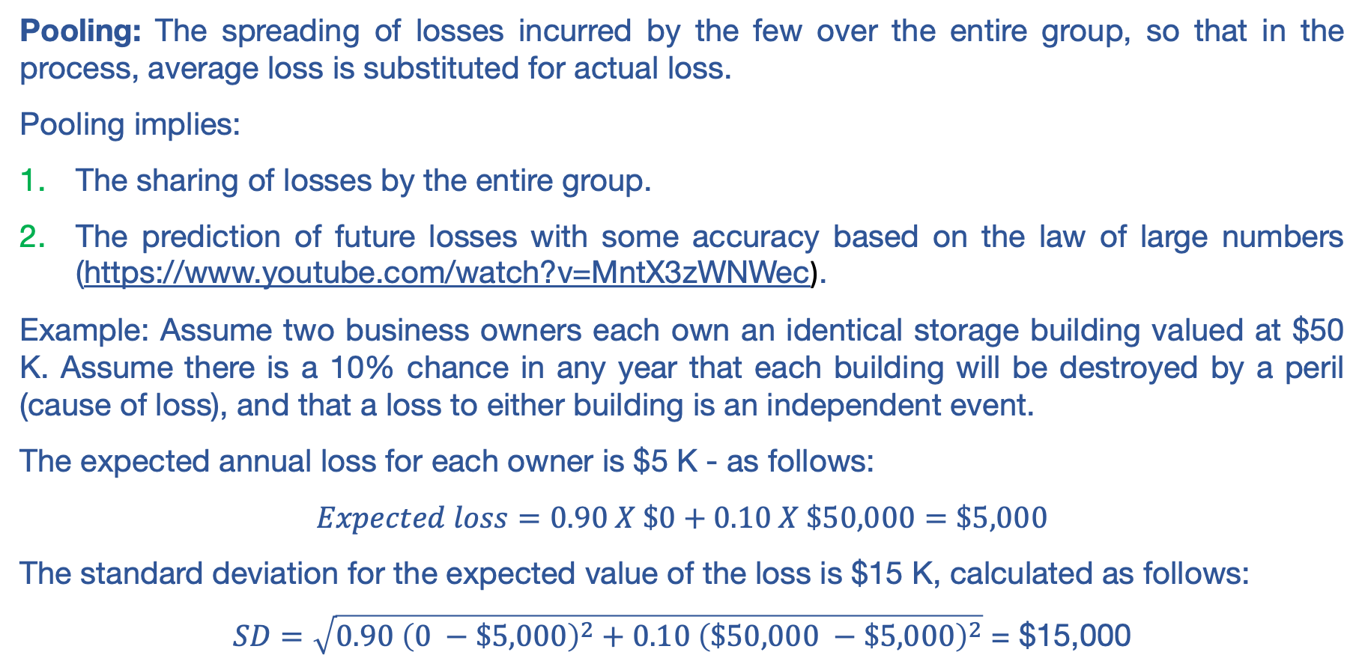
Basic Characteristics of Insurance [1 of 4]
Pooling of losses:
Pooling: The spreading of losses incurred by the few over the entire group, so that in the process, average loss is substituted for actual loss.
Pooling implies:
The sharing of losses by the entire group.
The prediction of future losses with some accuracy based on the law of large numbers (https://www.youtube.com/watch?v=MntX3zWNWec).
Example: Assume two business owners each own an identical storage building valued at $50 K. Assume there is a 10% chance in any year that each building will be destroyed by a peril (cause of loss), and that a loss to either building is an independent event.
The expected annual loss for each owner is $5 K - as follows:
$$Expected loss=0.90 X \$0+0.10 X \$50,000=\$5,000$$
The standard deviation for the expected value of the loss is $15 K, calculated as follows:
$SD=\sqrt{0.90 {\left(0 −\$5,000\right)}^{2}+0.10 {\left(\$50,000 −\$5,000\right)}^{2}}$ = $15,000

Slide 5
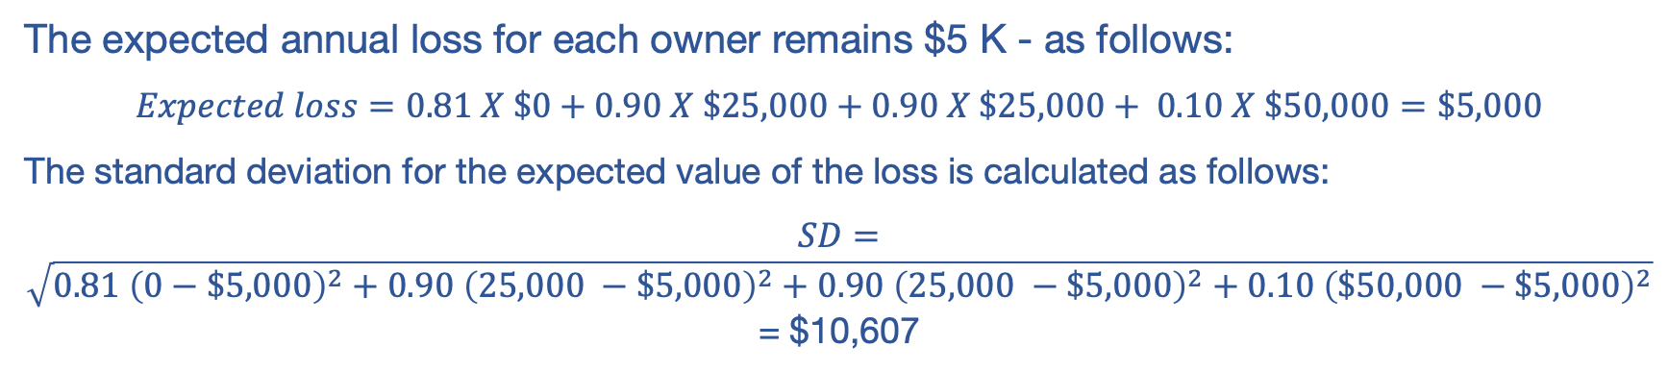
Basic Characteristics of Insurance [2 of 4]
Pooling of losses:
Suppose the two owners decide to pool (combine) their loss exposure, and each agrees to pay an equal share of any loss that might occur. This will give us four possible outcomes:
Possible Outcomes | Probability | Payment by Owners
Neither building is destroyed | 0.90 X 0.90 = 0.81 | $0 each
1st building is destroyed, 2nd building no loss | 0.10 X 0.90 = 0.09 | $25 K each
1st building no loss, 2nd building destroyed | 0.90 X 0.10 = 0.09 | $25 K each
Both buildings are destroyed | 0.10 X 0.10 = 0.01 | $50 K each
The expected annual loss for each owner remains $5 K - as follows:
$$Expected loss=0.81 X \$0+0.90 X \$25,000+0.90 X \$25,000+ 0.10 X \$50,000=\$5,000$$
The standard deviation for the expected value of the loss is calculated as follows:
$SD=\sqrt{0.81 {\left(0−\$5,000\right)}^{2}+0.90 {\left(25,000 −\$5,000\right)}^{2}+0.90 {\left(25,000 −\$5,000\right)}^{2}+0.10 {\left(\$50,000 −\$5,000\right)}^{2}}$ = $10,607

Slide 6
Basic Characteristics of Insurance [3 of 4]
Pooling of losses:
As the additional individuals are added to the pooling arrangement, the standard deviation continues to decline while the expected value of the loss remains unchanged. For example, with a pool of 100 insureds, the SD is $1,500; with a pool of 1,000 insureds, the SD is $474; and with a pool of 10,000, the SD is $150.
The law of large numbers states that the greater the number of exposures, the more closely will the actual results approach the probable results that are expected from an infinite number of exposures.

Slide 7
Basic Characteristics of Insurance [4 of 4]
Payment of Fortuitous Losses:
Fortuitous loss: A loss that is unforeseen and unexpected by the insured and occurs as a result of chance. Example: A person may slip on an icy sidewalk and break a leg.
Risk Transfer:
Risk transfer: It means that a pure risk is transferred from the insured to the insurer, who typically is in a stronger financial position to pay the loss than the insured. Examples: Death, disability, etc.
Indemnification:
Indemnification: It means that the insured is restored to his or her approximate financial position prior to the occurrence of the loss.

Slide 8
Characteristics of an Ideally Insurable Risk [1 of 4]
There are six characteristics of an insurable risk:
There must be a large number of exposure units.
The loss must be accidental and unintentional.
The loss must be determinable and measurable.
The loss should not be catastrophic.
The chance of loss must be calculable.
The premium must be economically feasible.

Slide 9
Characteristics of an Ideally Insurable Risk [2 of 4]
Large number of exposure units:
This is to enable the insurer to predict losses based on the law of large numbers. Loss data can be compiled over time, and losses for the group as a whole can be predicted with some accuracy. The loss costs can then be spread over all insureds in the underwriting class. [wood frame dwellings in a city]
Accidental and Unintentional Loss:
The loss should be accidental because the law of large numbers is based on the random occurrence of events. A deliberately caused loss is not a random event because the insured knows when the loss will occur. Also, moral hazard (dishonesty) is increased if the insured deliberately intends to cause a loss. Finally, it’s poor public policy to allow insureds to collect for intentional losses.
Determinable and Measurable Loss:
This means that the loss should be definite as to cause, time, place, and amount. Like life insurance. Think of sickness and disability, which are subjective in nature.

Slide 10
Characteristics of an Ideally Insurable Risk [3 of 4]
No Catastrophic Loss:
This means that a large proportion of exposure units should not incur losses at the same time. Otherwise, pooling breaks down and becomes unworkable. Examples are floods, hurricanes, terrorism, etc.
Several approaches are available for meeting the problem of catastrophic loss – as follows:
Reinsurance: An arrangement by which the primary insurer that initially writes the insurance transfers to another insurer (called the reinsurer) part or all of the potential losses associated with such insurance.
Dispersing the coverage over a large geographical area.
Using financial instruments, like catastrophic bonds.

Slide 11
Characteristics of an Ideally Insurable Risk [4 of 4]
Calculable Chance of Loss:
This means that the insurer must be able to calculate both the average frequency and the average severity of future losses with some accuracy.
Economically Feasible Premium:
This means that the insurer must be able to afford the premium, and the premiums paid must be substantially less than the face value, or amount, of the policy.

Slide 12
Important Insurance Concept
Adverse Selection:
This is the tendency of persons with a higher-than-average chance of loss to seek insurance at standard (average) rates, which, if not controlled by underwriting, results in higher-than-expected loss levels. Like someone with serious health issues who seeks life or health insurance at standard rates. This can be controlled by careful underwriting.
Underwriting: Refers to the process of selecting and classifying applicants for insurance.

Slide 13
Types of Insurance
Insurance can be private or government. Private insurance includes life, health, property and liability (AKA property and casualty) insurance. Government insurance includes social insurance programs and other plans.
Major social insurance programs in the U.S. include the following:
Old-Age, Survivor, and Disability Insurance (Social Security).
Medicare.
Unemployment insurance.
Workers compensation.
Compulsory temporary disability insurance.
Railroad Retirement Act.
Railroad Unemployment Insurance Act.

Slide 14
Benefits of Insurance to Society
This includes the following:
Indemnification for loss.
Reduction of worry and fear, like life insurance.
Source of investment funds.
Loss prevention: insurance companies are actively involved in loss-prevention programs like fire prevention, prevention of auto theft… etc.
Enhancement of credit.

Slide 15
Costs of Insurance to Society
This includes the following:
Cost of doing business.
Fraudulent claims, like faking an auto accident.
Inflated claims.

Slide 16
Thank You!

