Slide 1
Health Factors of Infants Exposed to Homelessness

Slide 2
Infants and Homelessness
Issue
Poverty and homelessness are linked to high rates of poor health
1/3 of US homeless made up of children under 18 years
There is a need to understand the link between homelessness and overall health, healthcare utilization, spending in early years
Notes:
One of the causes of poor health in the US is poverty and homelessness. About one-third of the US homeless are made up of children who are under the age of 18 years. There is a need to understand the link between homelessness and overall health, health utilization, and spending in early years.

Slide 3
Infants and Homelessness
Concepts in Study
Homeless children are affected by 3 major stresses: living in a shelter, poverty problems, and normal biological risks faced by all children
As such, homeless children have higher risk of developing depression, alcoholism and drug abuse, and suicide attempts in adulthood
Notes:
There are three major stresses that have been found to affect homeless children. They include living in a shelter, poverty problems, and normal biological risks faced by all children. As such, homeless children have a higher risk of developing depression, alcoholism and drug abuse behavior, and suicide attempts in adulthood.

Slide 4
Infants and Homelessness
Data and Methods
Two groups – homeless infants and control group (children born in low-income but are not homeless)
Claim-based diagnosis and procedures were used to identify subjects
Data used was from Massachusetts
Notes:
There are two groups of subjects that were used in the study. There is the homeless infants and a control group that is composed of children born in low-income families but are not homeless. To identify the subjects, the claim-based diagnosis and procedures on Medicaid were used. All the data was collected from Massachusetts.

Slide 5
Infants and Homelessness
Variables
Dependent – diagnosis for short gestation, fetal retardation, low birth weight, well-child visits, intensive care unit stays for infants, claim based expenditures
Independent – time (Clark et al., 2019)
Notes:
There are two main variables in the study. The independent variable is time. The dependent variables are diagnosis for short gestation, fetal growth retardation, low-birth weight, well-child visits, intensive care unit stays for infants, and the claim-based expenditures.

Slide 6
Infants and Homelessness
Key Findings
Most common illnesses are upper respiratory diseases, fever, allergies, nutritional, endocrine and metabolic deficiencies.
During 1st 2 years of life homeless infants are more likely to be admitted
Health condition differences became insignificant after 6 years
Notes:
The most common illnesses that were identified are upper respiratory diseases, fever, allergies, nutritional, endocrine and metabolic deficiencies. During the first 2 years of life, homeless infants were found to have higher chances of being admitted than the control group. However, after six years of age, tehre were no significant differences in health outcomes or trends between the two groups.

Slide 7
Infants and Homelessness
Limitations
The study lasts for up to 6 years, there is a need for long-term study to link poor health to bigger picture
Also, there is a need to study policy implications and their value to children, families and society in long-term
Notes:
Some of the limitations of the study is that it lasts for only 6 years. There is a need to follow the groups for a longer period to have better picture of overall health into adulthood. There is also a need to study the policies implemented and their effects on the value to children, families, and the society in the long-term.

Slide 8
Infants and Homelessness
Implications on Policy
Long term solution is dealing with poverty through policies dealing with affordable housing
Have health systems that screen and link pregnant and nursing mothers with unstable housing to rapid interventions to reduce health risks
Notes:
One of the long-term sustainable solutions is investing in affordable housing as a way of reducing poverty. There is also a need to have health systems that screen and link pregnant and nursing mothers who are found to have unstable housing to rapid interventions to reduce health risks.

Slide 9
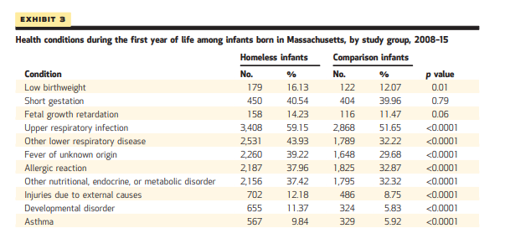
Infants and Homelessness
Table Discussion
a
Notes:
The table above shows the health conditions that were identified during the study and their corresponding prevalence in the control group. All the health conditions identified have a high prevalence rate in the homeless infants over the control group. The most common conditions were upper respiratory infections, lower respiratory diseases, fever, allergies, and nutritional, endocrine, and metabolic disorders in both groups. Low birth weights and fetal growth retardation had the least level of prevalence.

Slide 10
Infants and Homelessness
Key Finding and Management Implication
During 1st 2 years of life homeless infants are more likely to be admitted
Need to analyze management policies in shelters to offer mothers and infants extra care to promote better health outcome at younger age
Notes:
One of the key findings that have a management implication for shelter homes is the high rate of admission for homeless infants during the first 2 years of life. There is a need for the shelters to review and implement management policies that offer mothers and infants extra care for the purpose of promoting better health outcome for infants up to 2 years.

Slide 11
Infants and Homelessness
Conclusion
In conclusion, homelessness and poverty contribute to a larger degree to poor health outcomes of infants
Long terms policy aimed at affordable housing, a better chance of positive outcomes for better health, increased utilization of healthcare, and reduced healthcare spending for homeless
Notes:
In conclusion, homelessness and poverty are great contributors to poor health outcomes of infants. Long term policies aimed at affordable housing have a better chance of leading to more positive health outcomes, increased utilization of healthcare, and reduced healthcare spending for homeless families.

Slide 12
Infants and Homelessness
References
Clark, E. R., Weinreb, L., Flahive, M. J., Seifert, W. R. (2019). Infants Exposed To Homelessness: Health, Health Care Use, And Health Spending From Birth To Age Six. Health Affairs. 5: 721-728. doi: 10.1377/hlthaff.2019.00090

