Slide 1
PERT

Slide 2
Gantt

Slide 3
Template – Other Views
Unfreezing
Change
Refreezing

Slide 4
Element 4: Common Project Vocabulary
Make sure everyone knows what the following mean:
“End of year”
“Divestment” vs “sale”
“Acquisition” vs “purchase”
“Customer” vs “user”

Slide 5
Difficulties
IT projects are difficult to estimate and most fail to meet their schedules and budgets
Highly interactive, complex sets of tasks
Closely interrelated with each other (coupled)
Most projects cannot be made more efficient simply by adding labor
Some are actually slowed down (Brooks’ Law)

Slide 6
Systems Development Life Cycle
SDLC typically consists of typical phases such as:
Initiation of the project
The requirements definition phase
The functional design phase
The system is actually built
Verification phase
The “cut over:” The new system is put in operation
The maintenance and review phase
Different models have different numbers of phases

Slide 7
Limitations of SDLC
Traditional SDLC methodology for current IT projects are not always appropriate:
Sometimes costs are difficult to estimate
Sometimes uniqueness makes previous experience hard or impossible to find
Objectives may reflect a scope that is
Too broad (can’t solve it), or
Too narrow (not ambitious enough)
Might take too long when the business environment is very dynamic

Slide 8
Alternative Approaches – for speed
Iterative approaches enable evolutionary development

Slide 9
Other Approaches
Prototyping
Build a high-level version of the system very quickly and get feedback
Advantages:
User involvement early and throughout the development process
Disadvantages:
Documentation may be difficult to write
Users may not have a realistic scope of the system while making decisions
RAD (Rapid Application Development) prototyping + 4-step SDLC
Like prototyping, RAD uses iterative development tools to speed up development:
GUI, reusable code, code generation, databases, testing, debugging
Goal is much faster building of the system

Slide 10
Other Approaches (continued)
JAD (Joint Application Development) – IBM
Users are involved throughout the process
“Agile” approaches speed things up
XP (Extreme Programming), Scrum, etc.

Slide 11
Other Approaches (continued)
User-centered design
Focuses on usability but uses many of the tools of RAD, JAD, Agile, prototyping
Users participate and continuously evaluate usability
Usability.gov provides 209 guidelines
Technology is advancing so they are dated (e.g., touchscreen tablets are not included)
“How or why” for touch PC O/S not yet settled
Requires multidisciplinary approach: psychology, graphic art, Internet technologies, business needs, etc.

Slide 12
Other Approaches (continued)
Open source approach
Uses crowdsourcing
Code is available for all to see and improve
Linux: the basis for
Android
Some Garmin GPS
Some Sony TVs
OS/X is based on BSD
BSD and Linux come from Unix

Slide 13
Comparison of approaches
Methodology | Advantages | Disadvantages
SDLC | Structured approach Phase milestones and approvals Uses system approach Focuses on goals and trade-offs Emphasizes documentation Requires user sign-offs | Systems often fail to meet objectives Needed skills are often difficult to obtain Scope may be defined too broadly or too narrowly Very time consuming
Agile Development | Good for adapting to changing requirements Works well when user requirements change continuously Allows face-to-face communication and continuous inputs from users Speeds up development process Users like it | Hard to estimate system deliverables at start of project Under-emphasizes designing and documentation Easy to get project off-track if user goals are unclear
Prototyping | Improved user communications Users like it Speeds up development process Good for eliciting system requirements Provides a tangible model to serve as basis for production version | Often under-documented Not designed to be an operational version Often creates unrealistic expectations Difficult-to-manage development process Integration often difficult Design flaws more prevalent than in SDLC Often hard to maintain

Slide 14
What Makes a Project Risky?
Risk Framework
Complexity
Many parts? Impacts on rest of system? Global? Unfamiliar hardware/software/databases? Changing requirements?
Clarity
Hard to define the purpose, input, and output?
Size
Cost, staff, duration, team, departments affected, lines of code
They are geometric, not linear (additive):
Having all three of these would be much more than three times as bad as one of these.

Slide 15
Managing Risk from Complexity
Strategies to deal with complexity:
Leverage the Technical Skills of the Team such as having a leader or team members who have had significant experience
Rely on Consultants and Vendors – for additional expertise
Integrate Within the Organization such as
Having frequent team meetings
Extensive documentation
Regular technical status reviews

Slide 16
Managing Risk from Clarity
Strategies to deal with low clarity
Rely more heavily upon the users to define system requirements
Manage stakeholders by balancing the disparate goals
Sustain Project Commitment

Slide 17
Project Commitment – Important for project success
Determinant | Description | Examples | More likely for commitment if:
Project | Objective attributes of the project | Cost, benefits, expected difficulty, and duration | There is a large potential payoff.
Psychological | Factors managers use to convince themselves things are not so bad | Previous experience, personal responsibility for outcome, and biases. | There is a previous history of success.
Social | Elements of the various groups involved in the process | Rivalry, norms for consistency, and need for external validation | External stakeholders have been publicly led to believe the project will be successful.
Organizational | Structural attributes of the organization | Political support, and alignment with values and goals | There is strong political support from executive levels.
Cultural | Cultural attributes | Appreciation for teamwork or a focus on technical issues | There is a culture of teamwork.

Slide 18
Pulling the Plug
Often projects in trouble persist long after they should have been abandoned—Pull the plug!
Many projects are 99% complete for 50% of the project!
People can go to great lengths to sustain a doomed project when there are
Sunk costs
High penalties for failure
Emotional attachment to the project by powerful individuals

Slide 19
Four dimensions of success
Shenhar, Dvir and Levy’s (1998) four dimensions of success:
Resource constraints: does the project meet the time and budget criteria?
Impact on customers: how much benefit does the customer receive from the project?
Business success: how high and long are the profits produced by the project?
Prepare for the future: has the project enabled future success? Future impact?

Slide 20
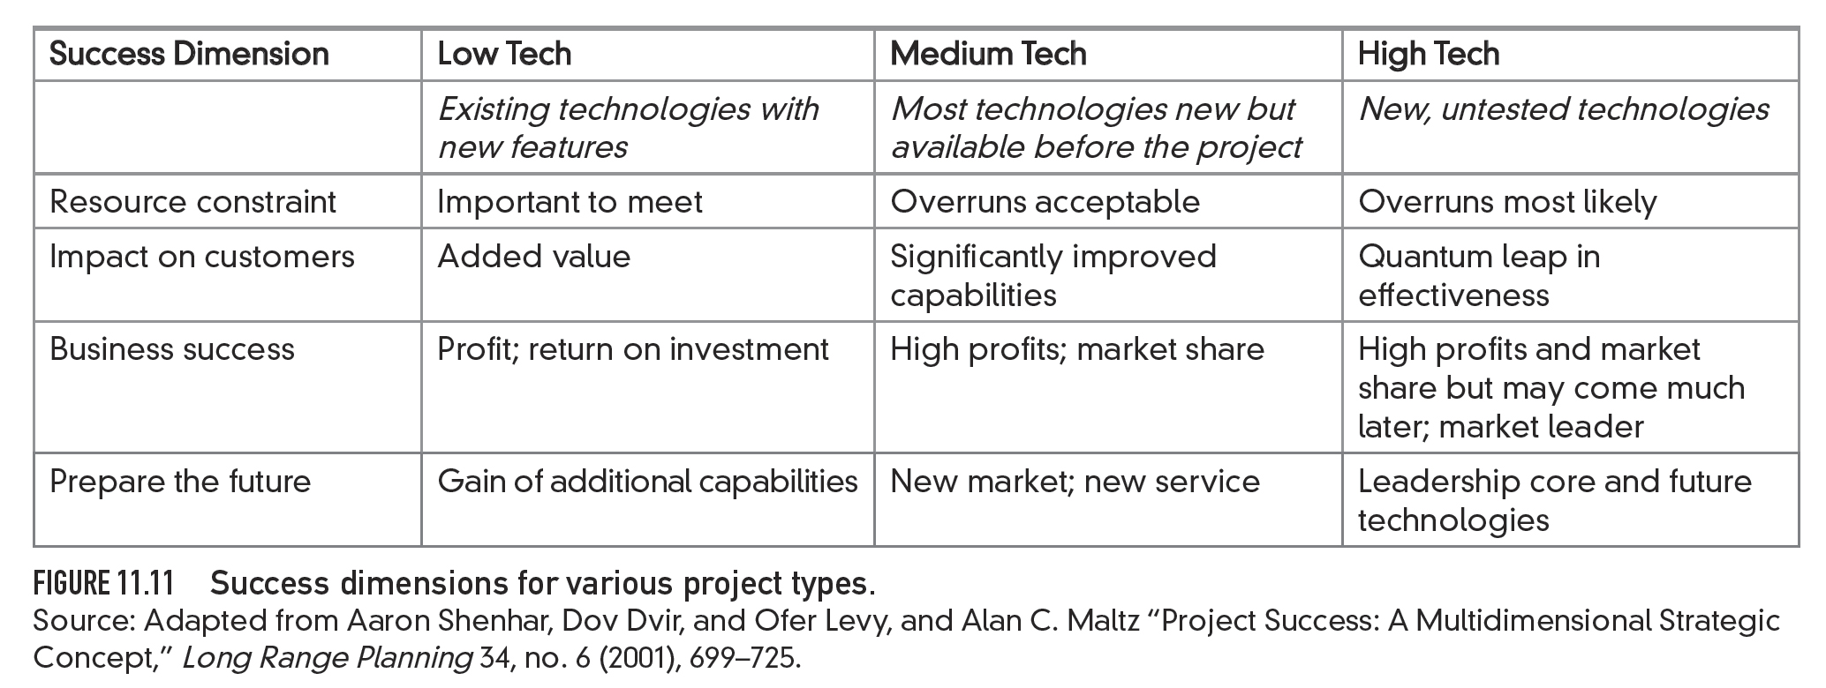
Figure 11.11 Success dimensions for various project types.

