Slide 1
ITS 835 enterprise risk management Chapter 9
Lessons from the Academy: ERM Implementation in the University Setting

Slide 2
introduction
Higher education environment
ERM in higher education
Adopting ERM in Colleges and Universities
The University of Washington case study
Summary

Slide 3
Higher education environment
Generally considered “different” from enterprises
Historically separate from targets of legislation
Often, success may lead to lack of risk management
Multiple high-visibility scandals have shed light on HE
Many HEIs have migrated to more corporate ERM
Different HE cultures demand different ERM solution

Slide 4
Erm in higher education
Recognition of institutional areas
Each encounters unique risks
Risks can include
Litigation settlements
Loss
Assets
Enrollment
Donors
Reputation damage

Slide 5
Adopting ERM in Colleges and Universities
Think tank of HE to discuss ERM in HE
2001
Pricewaterhouse Coopers
NationalAssocofCollegeandUnivBusOfficers (NAUCUBO)
Focus
Definition of risk
Risk drivers in HE
Implementation of risk management to assess, manage, monitor risk
Proactively engage the campus community

Slide 6
University of washington
Sentinel event
$35 million fine for Medicare and Medicaid overbilling
Push to implement ERM to improve compliance
UWis built on a decentralized governance model
Started with
Strategic Risk Initiative Review Committee (SRIRC)
Each initiative asked
Does this proposal add value?
What obstacles are apparent and how can they be addressed?
How can this proposal be improved?

Slide 7
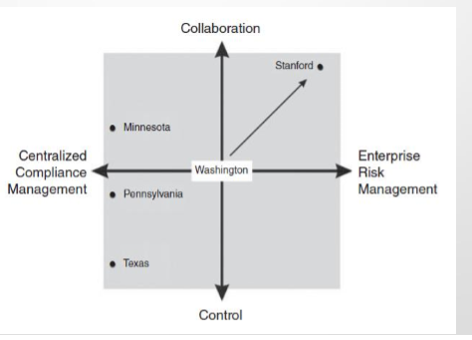
University of Washington (cont’d)
Committee recommendation
Create a Culture-Specific ERM
Examined other HEIs

Slide 8
UW Evolution of ERM

Slide 9
Uw erm structure

Slide 10
UW’s ERM Integrated Framework

Slide 11
Uw’s erm process

Slide 12
Uw’s risk assessment: likelihood and impact

Slide 13
summary
Outcomes are consistent with guidance offered by
National Association of College and University Attorneys (NACUA)
NACUA eight critical factors
Establish the right vision and realistic plan
Obtain senior leadershipbuy0inanddirection
Align with mission and strategic direction
Attack silos at the outset
Set objectives and performance indicators
Stay focused on results
Communicate vision and key outcomes
Develop a sustainable process versus a one-time project

