Slide 1
Literacy Development
Language Development
SLHS 204

Slide 2
Literacy
Literacy is: the use of visual modes of communication, specifically reading and writing
Literacy encompasses language – academic and cognitive processes, including
Thinking
Memory
Problem solving
Planning
Execution

Slide 3
Literacy
Reading and writing:
lack the give-and-take of conversation.
They are:
More permanent,
They lack the paralinguistic features (stress, intonation, fluency, etc) of speech.
They also have their own:
vocabulary
grammar
They are processed in a different manner.

Slide 4
Reading
Definition: reading is a language based task.
requires decontextualized language
Synthesis of a complex network of perceptual and cognitive acts
Word recognition
Decoding
Draw conclusions
Draw inferences from text
Decoding:

Slide 5
Phonological Awareness
Definition:
Phonemic Awareness:

Slide 6
Phonological Awareness
Phonological awareness also includes:
Syllabication
Phoneme identification
Alliteration
Rhyming
Segmentation
Blending

Slide 7
Comprehension
Definition:
Critical Literacy:

Slide 8
Comprehension
Dynamic Literacy:
Metacognition: knowledge about knowledge and about cognitive processes.
Self appraisal
Executive functioning

Slide 9
Theories of Reading Processing
Bottom Up: reading is the process of translating written elements into speech.
Bottom up processing emphasizes lower-level perceptual and phonemic processes and their influence on higher cognitive functioning.

Slide 10
Theories of Reading Processing
Top-Down: (problem solving) emphasizes the cognitive task of deriving meaning.
Higher cognitive functions such as concepts, inferences, and levels of meaning influence the processing of lower-order information

Slide 11
Theories of Reading Processing
Input: the most basic difference between oral and visual language is the input.

Slide 12
Reading Development
Like speech and language, reading in our culture is acquired through social interaction rather than formal instruction.
Reading is a highly social activity in which both parents and children participate.

Slide 13
Emerging Literacy
Definition:
Print Awareness:
Orientation components like: front to back, left to right, top to bottom
Attending to print on page
Recognizing some letters

Slide 14
Components of Reading
This is broken down different ways by different people
D(ecoding) X C(omprehension) = R(eading)
Another way to break the process into components is to talk about:
Word Identification
Listening Comprehension
Print Awareness or Print Processing and
Silent Reading Comprehension

Slide 15
Components of Reading
Word Identification
Listening Comprehension (also called Language Comprehension

Slide 16
Components of Reading
Print Processing (Print Awareness)
Understanding that we read a book
Front to back
Left to right
Top to bottom
Silent Reading Comprehension

Slide 17
Steps in the Process
The road to becoming literate has many stages

Slide 18
Steps in the Process
Emergent Reading and Writing
Pretend writing
Scribbling
Strings of letters and random marks
No systematic relations between letters and words
Also may be called: Pre-Phonetic or Pre-Literate

Slide 19
Steps in the Process
Letter Naming
Partial alphabetic
Sensitivity to phonological structure
Concept of word in print (print awareness)
Rely on letters of name to spell them (B = BEE)
Approach words one sound at a time
Leads to invented (unconventional) spelling (FYET for feet)
Initial and final consonants of words used (FT – foot)

Slide 20
Steps in the Process
Confusion regarding use of consonant (like C and K)
Incomplete use of digraphs (BAT for brat) – this is not unlike cluster reduction in spoken language

Slide 21
Steps in the Process
Alphabetic
phonics

Slide 22
Steps in the Process
Within Word Stage
Transitional reading/literacy stage
Use but often confuse vowel patterns

Slide 23
Steps in the Process
Main accomplishments
Common long vowel patterns
Complex consonants
Increasingly able to read complex texts fluently
Increase in number of sight words (DOLCH list)
Working towards mastering multisyllabic words

Slide 24
Steps in the Process
Orthographic

Slide 25
Steps in the Process
Advanced
Once children are at this phase, they are
Fluent readers
Good comprehension (written and oral language)
Use language for learning (Literate language – or – Academic language)

Slide 26
Steps in the Process
Mature Literacy

Slide 27
Emergent Readers
6 months to 6 years
Primary goal is exposure
May recognize some letters of the alphabet and some traffic signs (environmental print)

Slide 28
Developing Readers
Are now reading for meaning
Use their life experiences as context for what they read
Take interpretive risks
Make approximations about what words are or what words mean
Move beyond unfamiliar words to find lexical content they do recognize to help them figure out unfamiliar words
Reread and self-correct when the process of interpreting meaning has been interrupted or when the printed words do not seem to make sense

Slide 29
Developing Readers
Focus on:
Phonological awareness
Prediction
Decoding strategies
Sound-symbol relationships (phonics)

Slide 30
Independent Readers
Read on their own and when they are alone
Pay little or no attention to the details of printed words – because focus is on pulling meaning from the text
Higher level thinking (metalinguistics)
Compare and contrast what they have read from multiple sources

Slide 31
Independent Readers
Literal level – focus on word meaning and relationships between ideas conveyed in the paragraph
Inspectual level – scan content to determine main ideas
Analytic level – activate deep processing of information
Comparative level – use all levels to reflect on information

Slide 32
Process of Writing
Definition
Components
Text construction
Handwriting (penmanship)
Spelling
Executive Functioning
Memory

Slide 33
Writing Development
Emergent Literacy
Figure 6.6
Figure 6.7

Slide 35
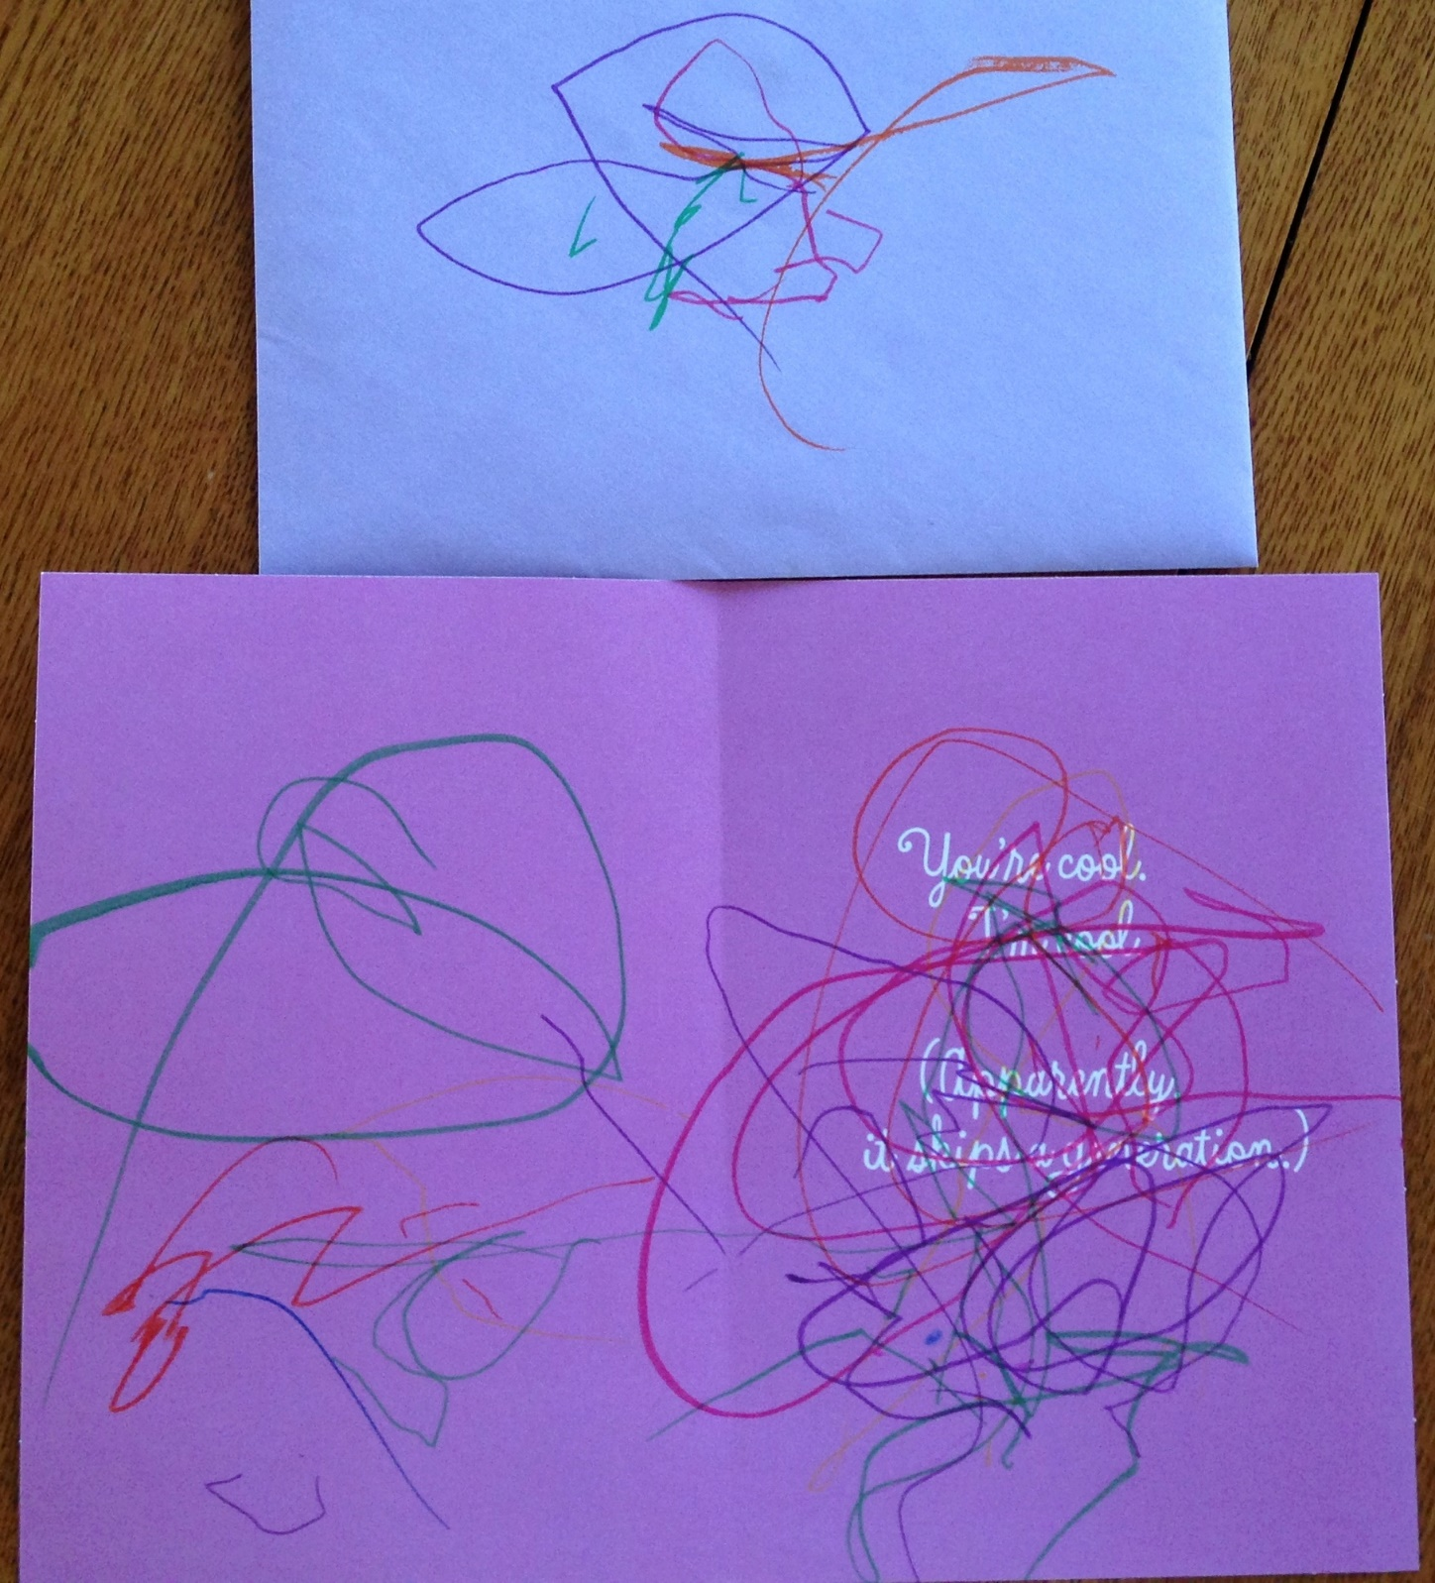

Slide 36
Writing Development
Functional Literacy
Write many alphabet letters
May struggle with letters that look the same
Less frequently occurring letters are also difficult
Switch between upper and lower case letters
Vowels are harder than consonants
Initial consonants first – final consonants later
Real word spelling is easier than nonsense word

Slide 37
Writing Development
Mature Literacy

Slide 38
Writing Development
Preparation Phase
Child copies letters from a model and practices letters and words
3-6 years

Slide 39
Writing Development
Consolidation Phase
Child writes strings of words using spoken vocabulary and grammar
7-10 years

Slide 40
Writing Development
Differentiation Phase
Writing is more sophisticated than the spoken grammar
10-11 years

Slide 41
Writing Development
Integration Phase
Child expresses mood, attitude, and personal style and creativity
Beyond 11 years
Child at this point is expected to:
Reread as a revision strategy
Revise for accuracy
Revise for coherence
Revise to provide additional details
Revise to eliminate redundancy
Revise to improve quality

Slide 42
Relationship to oral narratives

Slide 43
Writing Development
Relationship between spelling and writing

Slide 44
Spelling
Strategies
Memory
Spelling and reading experience
Phonological, semantic, and morphological knowledge
Orthographic knowledge
Mental grapheme representations
Analogy

Slide 45
Spelling
Preliterate
Phoneme-grapheme (graphophonemic awareness)
Invented spelling
Prephonemic spellings
Early phonemic spellings
Letter-name stage
Transitional stage
Conventional spelling

