Slide 1
BUS3-189: Strategic Management
Vision, Strategic Leadership
& Competitive Advantage
K. Thomas Chandy

Slide 2
Vision & Strategy
Vision
  Gives direction to strategy
Strategy
  A set of related actions that managers take
    To achieve their vision
    To increase their company’s performance
  Intelligence that directs the firm’s unique strengths towards market opportunities¹
  Things do not always work out as intended
    Vision provides the “compass”
      Helps keep the firm on track

Slide 3
Course Framework: Overview
Environment
Environment
Strategy
Vision
Results
Organization
Environment
Environment

Slide 4
Vision:
Gives direction to strategy
Vision is the compass
  But our route depends on the lay of the land
Strategy helps define our route to reach our vision
  Strategic leadership
    Creating competitive advantage through effective management of the strategy-making process.
  Strategy formulation
    Selecting strategies based on analysis of an organization’s external and internal environment.
  Strategy implementation
    Putting strategies into action.
    Organizing people and resources

Slide 5
What is Competitive Advantage?
Competitive Advantage
  When a company’s profitability is greater than the average profitability of firms in its industry.
Sustained Competitive Advantage
  When a company’s strategies enable it to maintain above-average profitability for a number of years.

Slide 6
What is Profitability?
Profitability is the return a company makes on the capital invested in the enterprise:
--Return on Invested Capital (ROIC)
    Net profit over the capital invested in the firm.
      Result of how efficiently the capital is used to satisfy customer needs.

Slide 7
What is Invested Capital?
Invested Capital = Equity +Debt
Equity = Risk capital
  Capital for which there is no guarantee that shareholders will:
    recoup their investment.
    earn a decent return

Slide 8
Shareholder Value
Shareholder value
  Returns that shareholders earn from buying shares in a company.
    Sources
      Capital appreciation in the value of a company’s shares
      Dividend payments
  Determined by company’s Performance
    Profitability (ROIC) and
    Profit growth
      The increase in net profit over time

Slide 9
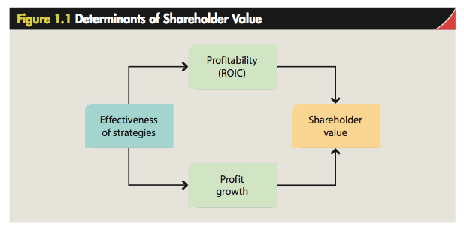
Strategy & Shareholder Value

Slide 10
What is a Business Model?
Conception of how strategies should work together as a whole to enable the company to achieve competitive advantage.
Deals with how a company:
  Selects, acquires, and keeps its customers.
  Defines and differentiates its product offerings.
  Creates value for its customers.
  Produces and delivers goods or services to the market.
  Organizes its resources and activities to increase productivity and quality, and lower costs.
  Achieves and sustains high profitability and growth.

Slide 11
Components of vision
(from “Building your Company’s Vision” by Collins & Porras)
Envisioned future
  Big Hairy Audacious Goal (BHAG)
    Challenging but Realistic
    Long-term
    (Hill, Schilling & Jones: Major goals)
  Vivid description
    (Hill, Schilling & Jones: Vision)
Core ideology
  Core purpose
    (Hill, Schilling & Jones: Mission)
  Core values
    A source of competitive advantage
    (Hill, Schilling & Jones: Values)

Slide 12
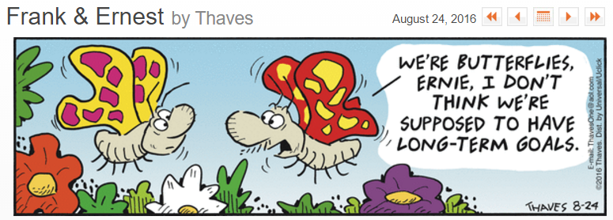
Vision is Long-Term

Slide 13
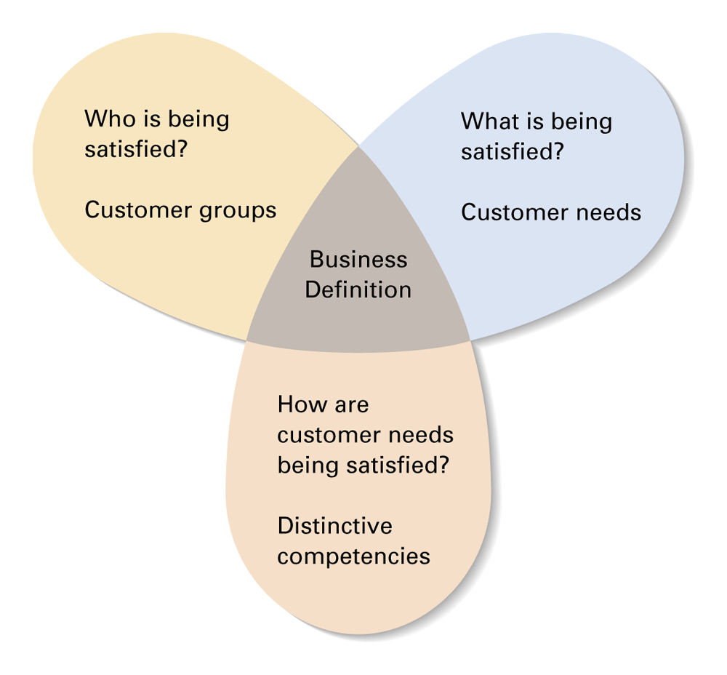
Abell’s Framework:
Defining the Core Purpose/Mission
Figure 1.5
Source: D. F. Abell, Defining the Business: The Starting Point of Strategic Planning (Englewood Cliffs, Prentice Hall, 1980), p. 7.

Slide 14
Abell’s framework:
Defining the Core Purpose/Mission
Three key questions
  Who is being satisfied?
    Customer groups
  What is being satisfied?
    Customer needs
  How are customer needs being satisfied?
    Distinctive competencies of the company
Drives
segmenting
decision

Slide 15
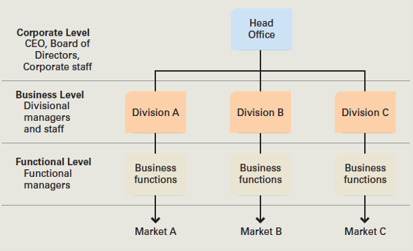
Levels of Strategic Management
Figure 1.3

Slide 16
Strategic Analysis
External Analysis
  Identifies Opportunities & Threats
  Mapping the business landscape
    Industry environment
    National environments
    Macroeconomic/Socioeconomic environment
Internal Analysis
  Identifies Firm’s Strengths & Weaknesses
    Resources
    Capabilities
    Competencies

Slide 17
Knowledge: Resource, Capability, Competency
Two types of knowledge
  Explicit Knowledge
    Formal & Systematic
    Can be documented
    Easily communicated and shared
  Tacit Knowledge
    “Know-how”
    Skill
    Expertise
    Highly personal
    Learned by doing
Capability
Competency

Slide 18
SWOT Analysis
Comparison of strengths, weaknesses, opportunities, and threats.
Purpose - Identify strategies to:
  exploit external opportunities.
  build on and protect company strengths.
  eradicate weaknesses and counter threats.
Goals - Affirm a company-specific business model.
  To align, fit, or match a company’s resources and capabilities to the demands of its environment.

Slide 19
Strategy Implementation:
Vision determines Shorter-term goals
Long-term objectives determines
  Intermediate-term goals
  Short-term goals
Goals should be “SMART”
  Specific
  Measurable
  Achievable
  Relevant
  Time-bound

Slide 20
Strategy Implementation:
Things don’t always work out as intended
Deliberate & Emergent strategies
  Deliberate (i.e. Planned) Strategies
    Some planned strategies may not be realized
  Emergent Strategies
    Bottom up process
    Unplanned shifts by top management
    Serendipity
The feedback loop – strategic planning is an ongoing process
  Managers must monitor strategy execution:
    Are strategic goals and objectives being achieved
    Is competitive advantage being created and sustained
  Managers must reevaluate
    For the next round of strategy formulation and implementation

Slide 21
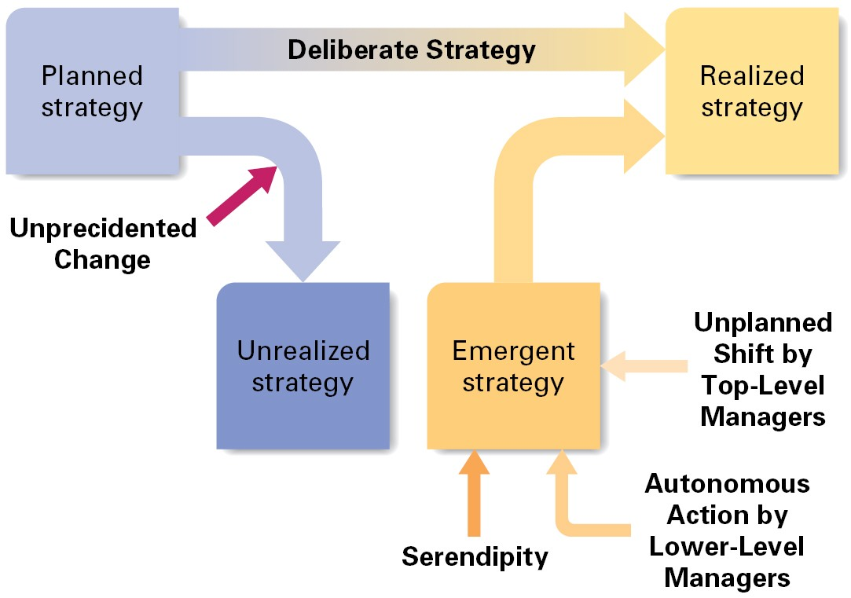
Strategy in an unpredictable world
Figure 1.6
Unpredicted
Change
Source: Adapted from H. Mintzberg and A. McGugh, Administrative Science Quarterly, Vol. 30. No. 2, June 1985.

Slide 22
Strategic Planning in Practice
Planning must address
  Current conditions
  Future conditions
    Scenario planning
      Examines several possible futures
Planning must involve
  Top management
  Operating management
    Decentralized planning

Slide 23
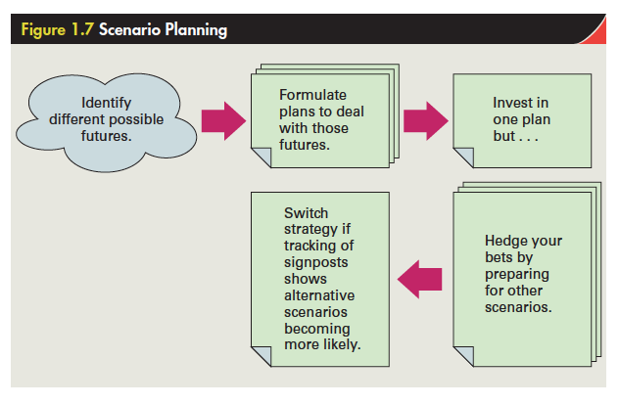
Scenario Planning

Slide 24
Scenario Planning
Formulating plans that are based on “what-if” scenarios about the future.
Encourages managers to:
  think outside the box and be more flexible.
  anticipate probable scenarios.

Slide 25
“Ivory tower” planning
Top managers formulate strategic plans without consulting with operational (functional) managers
Bad approach
Successful strategic planning encompasses managers at all levels of the corporation.

Slide 26
Strategic Decision Making
Cognitive biases can cause poor decisions
  Systematic errors in human decision making.
  Arise from the way people process information.
    Prior hypothesis bias
    Escalating commitment
    Reasoning by analogy
    Representativeness
    Illusion of control
    Availability error
Techniques for improving decision making
  Devil’s advocacy
  Dialectic inquiry
  Outside view

Slide 27
Strategic Leadership
Characteristics of good leadership
  Vision, Eloquence & Consistency
  Articulating the business model
  Commitment
  Being well-informed
  Willingness to delegate & empower
  Astute use of power
  Emotional intelligence
    Self awareness & Self regulation
    Motivation
    Empathy & Social skills
Communication
skills

