Slide 1
Incident Command System (ICS) Overview
Notes:
Purpose: The purpose of this course is to provide an orientation to the Incident Command System (ICS) for Executives and Senior Officials (including elected officials, city/county managers, agency administrators, etc.).
Time: 2 hours
Content Outline: This presentation includes the following major topics:
Part 1: What Is ICS?
Part 2: ICS Organization & Features
Part 3: Unified & Area Command
Part 4: Coordination & Incident Management Assessment
Part 5: NIMS Preparedness
Equipment:
Computer and projector
Extension cord and power strip (if needed)
Materials:
Copies of the Briefing Package - Recommend printing 2 slides per page in color. You can use the accompanying PDF file to ensure proper printing.
Handout: Resource Information and Checklists for Executives/Senior Officials (can be found at the end of this document)
Handout: Sample Delegation of Authority
Suggested handout: Local and State laws/policies relevant to incident management (if available)
Suggested handout: Local and State incident management roles and responsibilities (if available)
Suggested handout: Emergency Operations Center procedures
PowerPoint visuals (1 through 72)

Slide 2
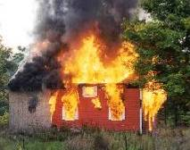
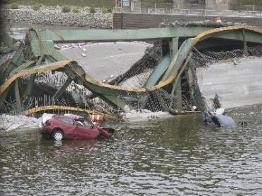
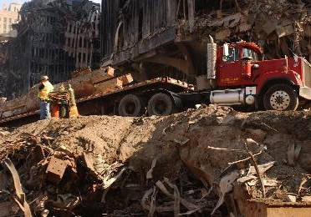
What Is an Incident?
An incident is . . .
  . . . an occurrence, caused by either human or natural phenomena, that requires response actions to prevent or minimize loss of life, or damage to property and/or the environment.
Notes:
Explain that an incident is an occurrence, caused by either human or natural phenomena, that requires response actions to prevent or minimize loss of life, or damage to property and/or the environment.
Present examples of recent incidents that have affected your jurisdiction.
Add the following points:
The vast majority of incidents are handled on a daily basis by a single jurisdiction at the local level. However, there are instances when incident management must involve multiple jurisdictions, functional agencies, and emergency responder disciplines.
Any incident can have a mix of political, economic, social, environmental, and cost implications with potentially serious long-term effects.
Large, complex incidents require effective and efficient coordination across this broad spectrum of organizations and activities. As the Executive or Senior Official, you need to be aware of how ICS and interagency (regional) multiagency coordination systems can work to ensure cooperative response efforts.

Slide 3
Incident Timeframes
How long will a complex incident last?
How long do we need to be self-sufficient?
How will you know that the incident is over?
Notes:
Note that Executives and Senior Officials must understand the timeframes associated with incident management so that they are prepared. During this 2-hour briefing, many minor, everyday incidents (e.g., structural fires, traffic accidents, medical emergencies, robberies, etc.) may occur and be resolved. However, complex incidents require much longer timeframes.
Facilitate a discussion on incident timeframes by asking the following discussion questions:
How long will a complex incident last?
If not mentioned by the participants, add the following key points:
The emergency period of a complex incident may be resolved in a matter of days or weeks. However, the long-term recovery needs and implications can be long lasting. For example:
Long-term mitigation projects are still underway for the Northridge earthquake.
Many 9/11 responders face potential health and psychological conditions for years to come. Even a small hazmat incident may cause long-lasting health effects in a small community.
The economic recovery from major incidents such as Hurricanes Andrew and Katrina can take a decade or more.
As an Executive/Senior Official, you must plan for the long-term recovery and not just the initial incident.
How long do we need to be self-sufficient?
If not mentioned by the participants, add the following key points:
Communities should plan to be self-sufficient for approximately 72 hours.
It is important for Executives/Senior Officials to ensure that resources (personnel, equipment, and supplies) are available for the initial incident period. During this time period, personnel will need to be relieved. Ensuring readiness may mean creating budgets for the acquisition and maintenance of essential resources.
Conducting training and exercises can help make sure that sufficient resources will be available.
How will you know that the incident is over?
If not mentioned by the participants, add the following key points:
The simple answer is that you may not know for sure.
For example, a worker safety issue may arise years later from exposure. Therefore, it is important to keep records in case long-term worker safety issues arise.

Slide 4

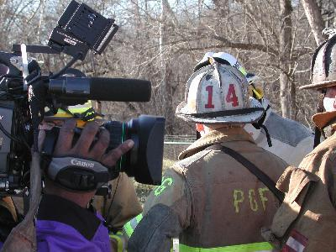
What Is ICS?
The Incident Command System:
  Is a standardized, on-scene, all-hazards incident management concept.
  Allows its users to adopt an integrated organizational structure to match the complexities and demands of
  single or multiple incidents
  without being hindered by
  jurisdictional boundaries.
Notes:
Elaborate on the points on the visual using the information below:
The Incident Command System, or ICS, is a standardized, on-scene, all-hazards incident management concept. ICS allows its users to adopt an integrated organizational structure to match the complexities and demands of single or multiple incidents without being hindered by jurisdictional boundaries.
ICS has considerable internal flexibility. It can grow or shrink to meet different needs. This flexibility makes it a very cost-effective and efficient management approach for both small and large situations.
Briefly cover the development of ICS.
ICS was developed in the 1970s following a series of catastrophic fires in California's urban/wildland interface. Property damage ran into the millions, and many people died or were injured. The personnel assigned to determine the causes of this disaster studied the case histories and discovered that response problems could rarely be attributed to lack of resources or failure of tactics.
Surprisingly, studies found that response problems were far more likely to result from inadequate management than from any other single reason. Weaknesses in incident management were often due to:
Lack of accountability, including unclear chains of command and supervision.
Poor communication due to both inefficient uses of available communications systems and conflicting codes and terminology.
Lack of an orderly, systematic planning process.
No common, flexible, predesigned management structure that enables commanders to delegate responsibilities and manage workloads efficiently.
No predefined methods to integrate interagency requirements into the management structure and planning process effectively.
Point out that a poorly managed incident response can be devastating to our economy and our health and safety.

Slide 5
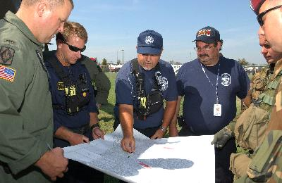
ICS Purposes
Using management best practices, ICS helps to ensure:
  The safety of responders and others.
  The achievement of tactical objectives.
  The efficient use of resources.
Notes:
Emphasize that by using management best practices, ICS helps to ensure:
The safety of responders and others.
The achievement of tactical objectives.
The efficient use of resources.
Review the following best practice or add an example from your jurisdiction: Southern California Firestorm 2003: Report for the Wildland Fire Lessons Learned Center reports that the use of Critical Incident Stress Debriefing (CISD) can help protect responder safety and welfare. A CISD team was ordered on day two of the incident. The team organized at a drop-in center. Twenty to 30 people per hour visited the CISD team members. On another incident, roughly 1,800 people took advantage of the availability of CISD staff to just release stress. Data from similar incidents indicate that CISD services are important for up to 2 years after significant traumatic stress situations.
What resources and plans do you have for ensuring the safety and welfare of your responders?

Slide 6
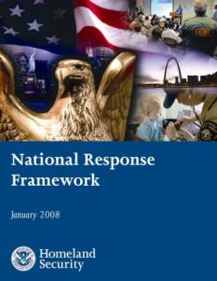
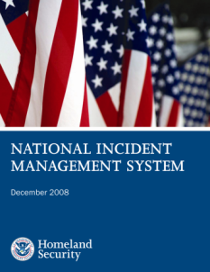
Legal Basis for ICS
HSPD-5
Management of Domestic Incidents
HSPD-8
National Preparedness
Mandates
Notes:
Transition to this topic by noting that you will now cover incident management mandates. Present the following points that form the legal basis for ICS:
Complex 21st century threats demand that all Americans share responsibility for homeland security. All levels of government, the private sector, and nongovernmental agencies must be prepared to prevent, protect against, respond to, and recover from a wide spectrum of major events that exceed the capabilities of any single entity. These hazards require a unified and coordinated national approach to planning and to domestic incident management.
To address this need, Homeland Security Presidential Directive 5: Management of Domestic Incidents (HSPD-5) and Homeland Security Presidential Directive 8: National Preparedness (HSPD-8) establish national initiatives that develop a common approach to preparedness and response.
The National Incident Management System (NIMS) and the National Response Framework (NRF) provide the process and structures for meeting these mandates. Together, these related efforts align Federal, State, local, tribal, private-sector, and nongovernmental preparedness, incident management, and emergency response plans into an effective and efficient national structure.

Slide 7
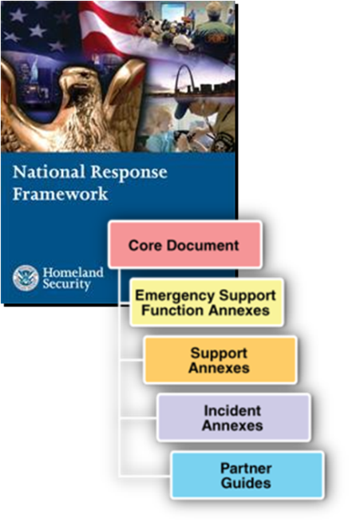
National Response Framework (NRF)
  Establishes a comprehensive, national, all-hazards approach to domestic incident response.
  Presents an overview of key response principles, roles, and structures that guide the national response.
  Includes the Core Document, Annexes, and Partner Guides.
  Replaces the National Response Plan.
Notes:
Explain that the National Response Framework (NRF):
Is a guide to how the Nation conducts all-hazards response.
Builds upon the NIMS coordinating structures to align key roles and responsibilities across the Nation, linking all levels of government, nongovernmental organizations, and the private sector.
The NRF is comprised of:
The Core Document, which describes the doctrine that guides our national response, roles and responsibilities, response actions, response organizations, and planning requirements to achieve an effective national response to any incident that occurs.
• Emergency Support Function Annexes that identify Federal resources and capabilities that are most frequently needed in a national response (e.g., Transportation, Firefighting, Mass Care).
• Support Annexes that describe essential supporting aspects that are common to all incidents (e.g., Financial Management, Volunteer and Donations Management, Private-Sector Coordination).
• Incident Annexes that address the unique aspects of how we respond to seven broad categories or types of incidents (e.g., Biological, Nuclear/Radiological, Cyber, Mass Evacuation).
• Partner Guides that provide ready references describing key roles and actions for local, tribal, State, Federal, and private-sector response partners.

Slide 8
NRF Emphasizes Partnerships
Federal Government Last Resort!
State Government Provides Support
Local Government First Response!
Individuals and Households
Private
Sector
Nongovernmental Organizations
Notes:
Ask the participants: Why it is important that incidents be managed at the lowest level possible? If not mentioned by participants, add the following key points:
Local responders have the most knowledge about the needs of their communities.
Tactical incident command decisions are best made at the incident scene.
Summarize the discussion and review the roles of different levels of Government in response.
Local and Tribal Governments. The responsibility for responding to incidents, both natural and manmade, begins at the local level.
States and Territorial Governments. States and territorial governments have responsibility for the public health and welfare of the people in their jurisdiction. During response, States play a key role coordinating resources and capabilities from across the State and obtaining resources and capabilities from other States.
Federal Government. When an incident occurs that exceeds or is anticipated to exceed State, tribal, or local resources, the Federal Government may provide resources and capabilities to support the State response.
Note that effective response also requires partnerships with:
Individuals and Households. Individuals and households can contribute by reducing hazards in and around their homes, preparing an emergency supply kit and household emergency plan, and monitoring emergency communications carefully.
Private Sector. The private sector plays a key role before, during, and after an incident. First, they must provide for the welfare and protection of their employees in the workplace. Many private-sector organizations are responsible for operating and maintaining portions of the Nation’s critical infrastructure.
Nongovernmental Organizations (NGOs). NGOs play important roles before, during, and after an incident. For example, NGOs provide sheltering, emergency food supplies, counseling services, and other vital support services to support response and promote the recovery of disaster victims. These groups often provide specialized services that help individuals with special needs, including those with disabilities.

Slide 9

National Incident Management System
  What? . . . NIMS provides a consistent nationwide template . . .
  Who? . . . to enable Federal, State, tribal, and local governments, the private sector, and nongovernmental organizations to work together . . .
  How? . . . to prepare for, prevent, respond to, recover from, and mitigate the effects of incidents regardless of cause, size, location, or complexity . . .
  Why? . . . in order to reduce the loss of life and property, and harm to the environment.
Notes:
Transition to this visual by explaining that the National Response Framework provides the broad response doctrine, while the National Incident Management System includes greater detail on the processes used to manage a response.
Explain that NIMS:
Defines what needs to be done to prepare for, prevent, protect against, respond to, and recover from a major event, how it needs to be done, and how well it needs to be done.
Provides a systematic approach for all levels of government, the private sector, and nongovernmental organizations to work seamlessly together.
Applies to all incidents regardless of cause, size, location, or complexity.
Emphasize the following points:
NIMS integrates existing best practices into a consistent, nationwide approach to domestic incident management.
NIMS is applicable at all jurisdictional levels and across functional disciplines in an all-hazards context.
Note that the National Response Framework reinforces that incidents should be managed using NIMS principles and structures.

Slide 10
NIMS: What It Is/What It’s Not
NIMS is . . .
  A flexible framework of:
    Doctrine
    Concepts
    Principles
    Terminology
    Organizational processes
  Applicable to all hazards and jurisdictions
NIMS is not . . .
  An operational incident management plan
  A resource allocation plan
  A terrorism/WMD-specific plan
  Designed to address international events
Notes:
Refer the participant to items on the visual stating “What NIMS Is” and “What NIMS Is Not.”
Read aloud the following situations (or other examples that would be relevant to the audience). Tell the participants to indicate if they are consistent or inconsistent with NIMS:
Local officials are using the Incident Command System (ICS) to plan for the upcoming Fourth of July celebration.
[ X ] Consistent With NIMS [ ] Not Consistent With NIMS
NIMS encourages the use of ICS for both planned events and incidents.
A jurisdiction/agency follows NIMS only when incidents are complex enough to involve
other jurisdictions.
[ ] Consistent With NIMS [X] Not Consistent With NIMS
NIMS applies to all hazards independent of size or complexity.
An agency is replacing its operational plan for responding to incidents with the guidance provided in NIMS.
[ ] Consistent With NIMS [ X] Not Consistent With NIMS
NIMS provides overall response principles and structures but does not provide specific plans.
An organization is reorganizing and using NIMS/ICS titles for day-to-day routine activities.
[ ] Consistent With NIMS [X ] Not Consistent With NIMS
NIMS is designed to manage incidents rather than day-to-day business operations.

Slide 11
NIMS Components
Preparedness
Communications and
Information Management
Incident Command System
Resource Management
Command and Management
Multiagency Coordination Systems
Ongoing Management and Maintenance
Public Information
Notes:
ICS is only one facet of NIMS. Following is a synopsis of each major component of NIMS:
Preparedness. Effective incident management and incident response activities begin with a host of preparedness activities conducted on an ongoing basis, in advance of any potential incident. Preparedness involves an integrated combination of planning, procedures and protocols, training and exercises, personnel qualification and certification, and equipment certification.
Communications and Information Management. Emergency management and incident response activities rely on communications and information systems that provide a common operating picture to all command and coordination sites. NIMS describes the requirements necessary for a standardized framework for communications and emphasizes the need for a common operating picture. NIMS is based on the concepts of interoperability, reliability, scalability, portability, and the resiliency and redundancy of communications and information systems.
Resource Management. Resources (such as personnel, equipment, and/or supplies) are needed to support critical incident objectives. The flow of resources must be fluid and adaptable to the requirements of the incident. NIMS defines standardized mechanisms and establishes the resource management process to: identify requirements for, order and acquire, mobilize, track and report, recover and demobilize, reimburse for, and inventory resources.
Command and Management. The Command and Management component within NIMS is designed to enable effective and efficient incident management and coordination by providing flexible, standardized incident management structures. The structure is based on three key organizational constructs: the Incident Command System, Multiagency Coordination Systems, and Public Information.
Ongoing Management and Maintenance. DHS/FEMA manages the development and maintenance of NIMS. This includes developing NIMS programs and processes as well as keeping the NIMS document current.

Slide 12
NIMS & Institutionalizing ICS
Governmental officials must:
  Adopt the ICS through executive order, proclamation, or legislation as the agency’s/jurisdiction’s official incident response system.
  Direct that incident managers and response organizations train, exercise, and use the ICS.
  Integrate ICS into functional and system-wide emergency operations policies, plans, and procedures.
  Conduct ICS training for responders, supervisors, and command-level officers.
  Conduct coordinating ICS-oriented exercises that involve responders from multiple disciplines and jurisdictions.
Notes:
Summarize the additional information about the NIMS requirement regarding “Institutionalizing the Use of ICS”:
According to the FEMA National Integration Center, "institutionalizing the use of ICS" means that government officials, incident managers, and emergency response organizations at all jurisdictional levels must adopt the Incident Command System. Actions to institutionalize the use of ICS take place at two levels: policy and organizational/operational.
At the policy level, institutionalizing the ICS means government officials (i.e., agency administrators, governors, mayors, county and city managers, tribal leaders, and others) must:
Adopt the ICS through executive order, proclamation, or legislation as the agency’s/jurisdiction's official incident response system; and
Direct that incident managers and response organizations in their jurisdictions train, exercise, and use the ICS in their response operations.
At the organizational/operational level, evidence that incident managers and emergency response organizations are institutionalizing the ICS would include the following:
ICS is being integrated into functional and system-wide emergency operations policies, plans, and procedures.
ICS training is planned or underway for responders, supervisors, and command-level officers.
Responders at all levels are participating in and/or coordinating ICS-oriented exercises that involve responders from multiple disciplines and jurisdictions.
Additional information about NIMS can be found online at www.fema.gov/nims.

Slide 13
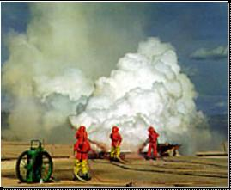
Other ICS Mandates
  Hazardous Materials Incidents
    Superfund Amendments and
    Reauthorization Act (SARA) – 1986
    Occupational Safety and Health Administration (OSHA) Rule 29 CFR 1910.120
  State and Local Regulations
Notes:
Explain that in addition to the NIMS mandate, the following laws require the use of ICS:
The Superfund Amendments and Reauthorization Act (SARA) of 1986 established Federal regulations for handling hazardous materials. SARA directed the Occupational Safety and Health Administration (OSHA) to establish rules for operations at hazardous materials incidents.
OSHA Rule 29 CFR 1910.120, effective March 6, 1990, requires all organizations that handle hazardous materials to use ICS. The regulation states: “The Incident Command System shall be established by those employers for the incidents that will be under their control and shall interface with other organizations or agencies who may respond to such an incident.”
Note that the Environmental Protection Agency (EPA) requires States to use ICS at hazardous materials incidents.
IMPORTANT INSTRUCTOR NOTE: Add any State, tribal, local, or agency regulations governing the use of ICS.

Slide 14
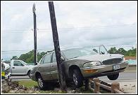
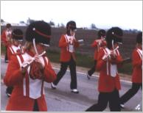
Examples of Incidents Managed Using ICS
  Fire, both structural and wildland
  Natural disasters, such as tornadoes, floods, ice storms, or earthquakes
  Human and animal disease outbreaks
  Search and rescue missions
  Hazardous materials incidents
  Criminal acts and crime scene investigations
  Terrorist incidents, including the use of weapons of mass destruction
  National Special Security Events, such as Presidential visits or the Super Bowl
  Other planned events, such as parades or demonstrations
Notes:
Refer to the following examples of the types of incidents that have been managed using ICS:
Fire, both structural and wildland
Natural disasters, such as tornadoes, floods, ice storms, or earthquakes
Human and animal disease outbreaks
Search and rescue missions
Hazardous materials incidents
Criminal acts and crime scene investigations
Terrorist incidents, including the use of weapons of mass destruction
National Special Security Events, such as Presidential visits or the Super Bowl
Other planned events, such as parades or demonstrations
Review the following best practice or add an example from your jurisdiction/agency:
The greater Boston area conducts special events as “planned disasters” by employing ICS and integrating portions of the region’s disaster plans into the event’s operations plans. This approach improves coordination during event planning and operations, strengthens relationships between the many agencies and organizations involved in disaster operations, and facilitates the enhancement of regional disaster plans. The Boston area uses ICS to conduct its three regularly occurring events (First Night festivities, the Boston Marathon, and Fourth of July celebrations) and one to two special events (e.g., Super Bowl rallies and Sail Boston) as “planned disasters.” Many of these events can attract crowds of one million or more participants and spectators, providing an optimal environment to test and improve disaster plans.

Slide 15
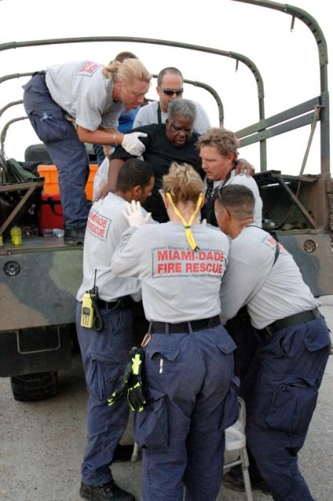
ICS Benefits
  Meets the needs of incidents of any kind or size.
  Allows personnel from a variety of agencies to meld rapidly into a common management structure.
  Provides logistical and administrative support to operational staff.
  Is cost effective by avoiding duplication of efforts.
Notes:
Explain that ICS is designed to be interdisciplinary and organizationally flexible.
Point out that ICS:
Meets the needs of incidents of any kind or size.
Allows personnel from a variety of agencies to meld rapidly into a common management structure.
Provides logistical and administrative support to operational staff.
Is cost effective by avoiding duplication of efforts.
Ask the participants if they can add any benefits to those listed on the visual. Add a personal experience that illustrates the benefits of using ICS.
Summarize by noting that any incident can have a mix of political, economic, social, environmental, and cost implications with potentially serious long-term effects. ICS, as a management system, helps to mitigate the risks by providing accurate information, strict accountability, and planning for any incident.
Emphasize that it is critical that Executives and Senior Officials support ICS planning, preparedness, and training activities.
February 2009
Page 15

Slide 16
ICS Organization
& Features
Notes:
Use this visual to transition to the next section of the presentation, which covers the ICS organization and features. Explain that this part of the briefing will discuss the relationship between the ICS organizational structure and the role of the Executive/Senior Official.

Slide 17
ICS Organization
Differs from the day-to-day, administrative organizational structures and positions.
  Unique ICS position titles and organizational structures are designed to avoid confusion during response.
  Rank may change during deployment. A “chief” may not hold that title when deployed under an ICS structure.
Notes:
Explain that the ICS organization differs from the day-to-day, administrative organizational structures and positions.
Unique ICS position title and organizational structures are used. There is no correlation with the administrative structure of any other agency or jurisdiction. This organization’s uniqueness helps to avoid confusion over different position titles and organizational structures.
Rank may change. Someone who serves as a chief every day may not hold that title when deployed under an ICS structure. ICS positions depend on a combination of training and experience.

Slide 18
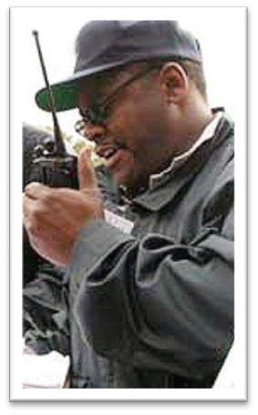
Common Terminology
ICS requires the use of common terminology. Common terminology helps to define:
  Organizational functions.
  Incident facilities.
  Resource descriptions.
  Position titles.
This is Unit 1, we have a
10-37,
Code 2.
Notes:
Present the following key points:
It is important to use plain English during an incident response because often there is more than one agency involved in an incident.
Ambiguous codes and acronyms have proven to be major obstacles in communications. Often agencies have a variety of codes and acronyms that they use routinely during normal operations. Not every “10” code is the same nor does every acronym have the same meaning. When codes and acronyms are used on an incident, confusion is often the result.
NIMS requires that all responders use “plain English,” referred to as “clear text.”
Explain that ICS establishes common terminology that allows diverse incident management and support entities to work together across a wide variety of incident management functions and hazard scenarios. This common terminology covers the following:
Organizational Functions. Major functions and functional units with domestic incident management responsibilities are named and defined. Terminology for the organizational elements involved is standard and consistent.
Incident Facilities. Common terminology is used to designate the facilities in the vicinity of the incident area that will be used in the course of incident management activities.
Resource Descriptions. Major resources—including personnel, facilities, and major equipment and supply items—used to support incident management activities are given common names and are "typed" with respect to their capabilities, to help avoid confusion and to enhance interoperability.
Position Titles. At each level within the ICS organization, individuals with primary responsibility have distinct titles. Titles provide a common standard for all users, and also make it easier to fill ICS positions with qualified personnel. ICS titles often do not correspond to the titles used on a daily basis.

Slide 19
Chain of Command
  Chain of command is an orderly line of authority within the ranks of the incident management organization.
  Unity of command means that every individual has a designated supervisor to whom he or she reports at the scene of the incident.
Authority
Notes:
Explain that within the ICS organization, chain of command and unity of command are maintained. Review the following definitions:
Chain of command refers to the orderly line of authority within the ranks of the incident management organization.
Unity of command means that every individual has a designated supervisor to whom he or she reports at the scene of the incident.
These principles clarify reporting relationships and eliminate the confusion caused by multiple, conflicting directives. Incident managers at all levels must be able to control the actions of all personnel under their supervision.
Emphasize that chain of command must be followed at the incident site and by those not deployed to the incident. After being deployed and receiving an incident assignment, personnel may be assigned by someone who is not their day-to-day supervisor. In this situation, the responders must take direction from their on-scene ICS supervisors only. In addition, someone who is a day-to-day supervisor may not be assigned or qualified to serve as an on-scene supervisor.
Ask the participants: What can Executives and Senior Officials do to ensure that chain of command is maintained? If not mentioned by the participants, add the following key points:
Ensure that only qualified supervisors are assigned.
Follow the chain of command by working through the Incident Commander rather than calling personnel within the ranks.

Slide 20
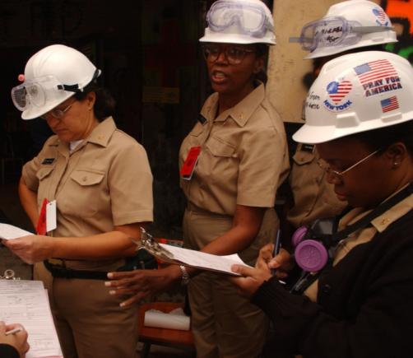
Incident Commander
Upon arriving at an incident, the higher ranking person will either assume command, maintain command as is, or transfer command to a third party.
The most qualified person at the scene is designated as the Incident Commander.
Notes:
Emphasize that all incident responses begin by establishing command. Explain that upon arriving at an incident, the higher ranking person will either assume command, maintain command as is, or transfer command to a third party. Point out that in some situations, a lower ranking person may be the Incident Commander if he or she is the most qualified person.
Ask the participants the following question: Why is it critical to establish command from the beginning of incident operations? If not mentioned by the participants, add the following key points:
Lack of command becomes a safety hazard for responders.
Size-up and decisionmaking are impossible without a command structure.
It is difficult to expand a disorganized organization if the incident escalates.
Tell the participants that the process of moving responsibility for incident command from one Incident Commander to another is called transfer of command. Explain that a transfer of command occurs when:
A more qualified person assumes command.
The incident situation changes over time, resulting in a legal requirement to change command.
There is normal turnover of personnel on extended incidents.
The incident response is concluded and responsibility is transferred to the responsible agency.
Explain that transfer of command must include a transfer of command briefing – which may be oral, written, or a combination of both.

Slide 21

Incident Commander’s Role
The Incident Commander:
  Provides overall leadership for incident response.
  Takes policy direction from the Executive/Senior Official.
  Delegates authority to others.
  Ensures incident safety.
  Provides information to internal and external stakeholders.
  Establishes and maintains liaison with other
  agencies participating in the incident.
  Establishes incident objectives.
  Directs the development of the Incident Action Plan.
Notes:
Explain that the Incident Commander:
Provides the overall leadership for incident response. The Incident Commander is in charge of overall management of the incident and must be fully qualified to manage the incident.
Takes policy direction from the Executive/Senior Official.
Delegates authority to others to manage the ICS organization.
Ensures the safety of incident responders and the public.
Provides information to internal and external stakeholders.
Establishes and maintains liaison with other agencies participating in the incident.
Establishes incident objectives.
Directs the development of the Incident Action Plan.
Note that the Incident Command will size up the incident and assess resource needs. If the incident is complex and/or long term, more staff may be needed. In addition, a Deputy Incident Commander may be assigned. Note that if a Deputy is assigned, he or she must be fully qualified to assume the Incident Commander’s position.

Slide 22

Executives’/Senior Officials’ Role & Responsibilities
Executives/Senior Officials:
  Provide policy guidance on priorities and objectives based
  on situational needs and the Emergency Plan.
  Oversee resource coordination
  and support to the on-scene command from the Emergency Operations Center (EOC) or through dispatch.
Incident Commander
Notes:
Present the following key points:
The Executive/Senior Official (elected official, city/county manager, agency administrator, etc.) is responsible for the incident. In most jurisdictions, responsibility for the protection of the citizens rests with the chief elected official. Along with this responsibility, by virtue of their office, these people have the authority to make decisions, commit resources, obligate funds, and command the resources necessary to protect the population, stop the spread of damage, and protect the environment.
Having the responsibility does not mean that the Executive/Senior Official assumes a command role over the on-scene incident operation. Rather, the Executive/Senior Official:
Provides policy guidance on priorities and objectives based on situational needs and the Emergency Plan.
Oversees resource coordination and support to the on-scene command from the Emergency Operations Center or through dispatch.
Typically, the Executive/Senior Official is not at the scene of the incident, but must have the ability to communicate and meet with the Incident Commander as necessary.
Ask the participants to identify reasons why an Executive’s/Senior Official’s presence at the incident scene may be detrimental. If not mentioned by the participants, add the following key points:
A visit from leadership personnel could draw more media and bystanders into a hazardous area.
Response resources may be diverted away from critical tactical operations to attend to a visiting Executive/Senior Official.
The presence of the Executive/Senior Official could cause confusion about the chain of command (who’s in charge of on-scene operations).
Acknowledge that visits to the scene by an Executive/Senior Official may be beneficial to the operation. Tell the participants that those visits must be coordinated with the Incident Commander and not jeopardize the response efforts.

Slide 23
Command vs. Coordination
What is the difference between command and coordination?
Notes:
Ask the participants: What is the difference between command and coordination? If possible, record the participants’ responses on chart paper.

Slide 24
NIMS: Command
Command: The act of directing, ordering, or controlling by virtue of explicit statutory, regulatory, or delegated authority.
Who has the explicit authority for the management of all incident operations?
Notes:
Compare the participants’ response to the following definition:
Command: The act of directing, ordering, or controlling by virtue of explicit statutory, regulatory, or delegated authority. In NIMS, responsibility for this process is delegated to the on-scene Incident Commander by the Executive/Senior Official. Examples of command activities include:
Determining incident objectives.
Establishing operational periods.
Assigning and supervising field resources.

Slide 25
NIMS: Coordination
Multiagency coordination is a process that allows all levels of government and all disciplines to work together more efficiently and effectively.
Notes:
Compare the participants’ response to the following definition:
Coordinate: To advance systematically an analysis and exchange of information among principals who have or may have a need to know certain information to carry out specific incident management responsibilities. Coordination includes the activities that ensure that the ICS organization(s) receive the resources and support they need when they need them. Coordination takes place in a number of entities and at all levels of government. Examples of coordination activities include:
Adjusting agency budgets, policies, and work priorities to make funds and resources available.
Facilitating interagency decisionmaking.
Coordinating interagency public information.
Dispatching additional resources.

Slide 26
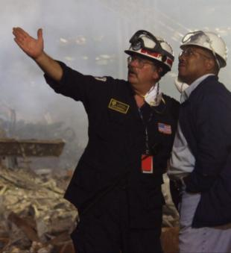
Executives/Senior Officials Delegate Command Authority
Executives/Senior Officials delegate authority to the designated Incident Commander for on-scene operations.
The Incident Commander has direct tactical and operational responsibility for conducting incident management activities.
Notes:
Explain that Executives/Senior Officials delegate authority to the designated Incident Commander for on-scene operations. The Incident Commander is accountable to the Executive/Senior Official but has the complete authority to direct the operation.
Emphasize that direct tactical and operational responsibility for conducting incident management activities rests with the Incident Commander, while the Executive/Senior Official plays a vital coordination role.
Facilitate a discussion of the importance of keeping command and coordination roles clear by asking the following discussion question: Why is it important to keep the command role solely with the Incident Command?
Acknowledge the participants’ input and add any personal experiences that illustrate the teaching points.

Slide 27
Delegation of Authority
Delegation of authority may be in writing (established in advance) or verbal, and include:
  Legal authorities and restrictions.
  Financial authorities and restrictions.
  Reporting requirements.
  Demographic issues.
  Political implications.
  Agency or jurisdictional priorities.
  Plan for public information management.
  Process for communications.
  Plan for ongoing incident evaluation.
Delegation
of
Authority
Notes:
Present the following key points:
An Incident Commander's scope of authority is derived:
From existing laws and agency policies and procedures, and/or
Through a delegation of authority from the agency administrator or elected official.
A delegation of authority:
Grants authority to carry out specific functions.
Is issued by the chief elected official, chief executive officer, or agency administrator in writing or verbally.
Allows the Incident Commander to assume command.
Does NOT relieve the granting authority of the ultimate responsibility for the incident.
Whether it is granted in writing or verbally, the authorities granted remain with the Incident Commander until such time as the incident is terminated, or a relief shift Incident Commander is appointed, or the Incident Commander is relieved of his or her duties for just cause.
Explain that a delegation of authority may not be required if the Incident Commander is acting within his or her existing authorities or under a preestablished delegation in the Emergency Plan. Present the following examples:
Example 1: An emergency manager may already have the authority to deploy response resources to a small flash flood.
Example 2: A fire chief probably has the authority (as part of the job description) to serve as an Incident Commander at a structure fire.
Refer to the visual and review the elements that should be included in a delegation of authority. Note that the delegation should also specify when the authority ends and conditions for demobilization (e.g., the teams will not be released until the following conditions have been met). Tell the participants that a sample delegation of authority can be found at the end of this briefing package.

Slide 28
Summary: Incident Management Roles
Incident Commander’s
Role
The Incident Commander:
Manages the incident at
the scene.
Keeps the EOC informed
on all important matters
pertaining to the incident.
Agency Executives’/Senior Officials’ Role
These officials provide the following to the Incident Commander:
Policy
Mission
Strategic direction
Authority
To maintain unity of command and safety of responders, the chain of command must NOT be bypassed.
Notes:
Use the visual to summarize the different roles assumed by the Executive/Senior Official and Incident Commander. Add the following key points:
The Executive’s/Senior Official’s task is to ensure that you are informed and that your Incident Commander is functioning in a responsible manner. You set policy, establish the mission to be accomplished, shape the overall direction, and give the trained responders the authority to accomplish the incident objectives.
The Incident Commander is the primary person in charge at the incident. In addition to managing the incident scene, he or she is trained to keep you informed and up to date on all important matters pertaining to the incident.
Present the following example or add one from your jurisdiction: The Washington area sniper case was one of the most infamous crimes in recent law enforcement history, instilling fear in thousands of people. According to the after-action report, communication was clearly the most compelling concern in the sniper case. Investigations of this kind succeed or fail based on executives’ ability to effectively manage and communicate information in a timely manner. Incident Commanders must balance the incident needs with the obligations of local executives to be responsive to their citizens. In the words of one police chief, “You cannot expect leaders to stop leading.”
The final responsibility for the resolution of the incident remains with the chief elected official, chief executive officer, or agency administrator. It is imperative then that the chief elected official, chief executive officer, or agency administrator remain an active participant, supporter, supervisor, and evaluator of the Incident Commander.
Summarize the discussion by noting that the ICS hierarchy of command must be maintained. After you have clearly articulated the policy you wish followed and delegated certain authorities, the Incident Commander who reports to you will have the necessary authority and guidance to manage the incident.

Slide 29
Command Staff
The Incident Commander may designate a Command Staff who:
  Provide information, liaison, and safety services for the entire organization.
  Report directly to the Incident Commander.
Incident
Commander
Public Information
Officer
Liaison
Officer
Command
Staff
Safety
Officer
Notes:
Present the following key points:
The Command Staff is assigned to carry out staff functions needed to support the Incident Commander. These functions include interagency liaison, incident safety, and public information.
Incident Command comprises the Incident Commander and Command Staff. Command Staff positions are established to assign responsibility for key activities not specifically identified in the General Staff functional elements.
The Command Staff includes the following positions:
Public Information Officer
Advises the Incident Commander on information dissemination and media relations.
Obtains information from and provides information to the Planning Section.
Obtains information from and provides information to the community and media.
Liaison Officer
Assists the Incident Commander by serving as a point of contact for agency representatives who are helping to support the operation.
Provides briefings to and answers questions from supporting agencies.
Safety Officer
Advises the Incident Commander on issues regarding incident safety.
Works with the Operations Section to ensure the safety of field personnel.
Ask the participants to identify types of incidents where it would be critical to assign a Safety Officer.
The Command Staff may include additional positions as required and assigned by the Incident Commander.

Slide 30
General Staff
As the incident expands in complexity, the Incident Commander may add General Staff Sections to maintain span of control.
Incident
Commander
Public Information
Officer
Liaison
Officer
Command Staff
Safety
Officer
General
Staff
Operations
Section
Planning
Section
Logistics
Section
Finance/Admin
Section
Notes:
Present the following key points:
The General Staff represents and is responsible for the functional aspects of the Incident Command structure.
The General Staff typically consists of the Operations, Planning, Logistics, and Finance/Administration Sections.
As the number of operational responders (tactical resources) increases, the need for support resources (e.g., food, communications equipment, or supplies) increases.
General guidelines related to General Staff positions include the following:
Only one person will be designated to lead each General Staff position.
General Staff positions may be filled by qualified persons from any agency or jurisdiction.
Members of the General Staff report directly to the Incident Commander. If a General Staff position is not activated, the Incident Commander will have responsibility for that functional activity.
Deputy positions may be established for each of the General Staff Section Chiefs and Operations Section Branch Directors. Deputies are individuals fully qualified to fill the primary position. Deputies can be designated from other jurisdictions or agencies, as appropriate. This strategy allows for greater interagency coordination.
General Staff members may exchange information with any person within the organization. Direction takes place through the chain of command. This is an important concept in ICS.
General Staff positions should not be combined. For example, to establish a "Planning and Logistics Section," it is better to initially create the two separate functions, and if necessary for a short time place one person in charge of both. That way, the transfer of responsibility can be made easier.
Refer the participants to the handout, found at the end of the briefing package, that includes a description of all the Command and General Staff positions.

Slide 31
Incident Management Team
Incident
Commander
Public Information
Officer
Incident Management Team = Command and General Staff Members
Liaison
Officer
Safety
Officer
Operations
Section
Planning
Section
Logistics
Section
Finance/Admin
Section
Incident Management Team
Notes:
Present the following key points:
An Incident Management Team (IMT) is an incident command organization made up of the Command and General Staff members and other appropriate personnel in an ICS organization.
The level of training and experience of the IMT members, coupled with the identified formal response requirements and responsibilities of the IMT, are factors in determining the “type,” or level, of IMT.
IMTs may be designated prior to an incident in order to train and exercise together to become qualified to response to different types of incidents.
Provide examples of IMTs from within the participants’ agency or jurisdiction.

Slide 32
Who Does What?
Finance/Admin: Monitors costs related to the incident. Provides overall fiscal guidance.
Command: Overall responsibility for the incident. Sets objectives.
Incident
Commander
Operations
Section
Planning
Section
Logistics
Section
Finance/Admin
Section
Operations: Develops the tactical organization and directs all resources to carry out the Incident Action Plan.
Planning: Develops the Incident Action Plan to accomplish the objectives.
Logistics: Provides resources and all other services needed to support the incident.
Notes:
Present the following key points:
The Incident Commander is responsible for establishing incident objectives.
The Operations Section Chief is responsible for managing all tactical operations at an incident. The Incident Action Plan provides the necessary guidance. The need to expand the Operations Section is generally dictated by the number of tactical resources involved and is influenced by span of control considerations.
The Planning Section Chief is responsible for providing planning services for the incident. Under the direction of the Planning Section Chief, the Planning Section collects situation and resources status information, evaluates it, and processes the information for use in developing action plans. Dissemination of information can be in the form of the Incident Action Plan, in formal briefings, or through map and status board displays.
The Logistics Section Chief provides all incident support needs with the exception of logistics support to air operations.
The Finance/Administration Section Chief is responsible for managing all financial aspects of an incident. Not all incidents will require a Finance/Administration Section. Only when the involved agencies have a specific need for finance services will the Section be activated.

Slide 33
Modular Organization (1 of 2)
  Develops in a top-down,
  modular fashion.
  Is based on the size and
  complexity of the incident.
  Is based on the hazard environment created by the incident.
Notes:
Present the following key points:
The ICS organization adheres to a “form follows function” philosophy. The size of the current organization and that of the next operational period are determined through the incident planning process.
An ICS organization is a modular organization, which means that it:
Develops in a top-down, modular fashion.
Is based on the size and complexity of the incident.
Is based on the hazard environment created by the incident.
Emphasize that the ICS organization is expanded and contracted to maintain an optimal span of control. With an ICS organization, span of control for any supervisor:
Is between 3 and 7 subordinates.
Optimally does not exceed 5 subordinates.
Ask the participants what factors might affect the span of control at an incident. If not mentioned, explain that safety is the single most important factor. More hazardous incidents require the smallest span of control to mitigate against risks.

Slide 34
Modular Organization (2 of 2)
  Incident objectives determine the organizational size.
  Only functions/positions that are necessary will be filled.
  Each element must have a person in charge.
Notes:
Explain that employing a modular organization means that:
Incident objectives determine the organizational size.
Only functions/positions that are necessary will be filled.
Each element must have a person in charge.
Optional: Distribute examples of organizational charts from recent incidents that demonstrate how the ICS organization adjusts to fit the requirements of the incident.

Slide 35
Example: Expanding Incident (1 of 3)
Scenario: On a chilly autumn day, a parent calls 911 to report a missing
7-year-old child in a wooded area adjacent to a coastal area.
Incident
Commander
Public Information
Officer
Safety
Officer
Liaison
Officer
EMS
Group
Search
Group
Investigation
Group
Initially, the Incident Commander manages the General Staff resources.
Notes:
Tell the participants to review the scenario described on the visual.
Scenario
At 4:30 p.m. on a chilly autumn day, a parent calls 911 to report a missing 7-year-old child. The child was outside playing and may have wandered off into a vast wooded area adjacent to a coastal area.
The initial ICS organization includes:
Safety Officer to ensure the well-being of all responders and volunteers.
Liaison Officer to coordinate the different response groups.
Public Information Officer to handle the increasing numbers of media arriving at the scene.
The Incident Command is managing the following tactical resources: Emergency Medical Services Group, Search Group, and Investigation Group. The Search Group and Investigation Group each have a Supervisor who reports to the Incident Commander.
Instructor Note: Use the next series of visuals to demonstrate how the ICS organizational structure expands and contracts through the life-cycle of an incident. If time permits, ask the participants to identify the Executive’s/Senior Official’s priorities and actions.

Slide 36
Example: Expanding Incident (2 of 3)
Scenario: As additional resource personnel arrive, the Incident Commander assigns an Operations Section Chief to maintain span of control.
Incident
Commander
Public Information
Officer
Safety
Officer
Liaison
Officer
Operations
Section
Staging
Area
As the incident expands, an Operations Section Chief is assigned.
EMS
Group
Search
Group
Investigation
Group
Canine
Strike Team
Volunteer
Searchers
Notes:
Explain that as resources continue to expand, the Incident Commander assigns an Operations Section Chief to manage the tactical operations and resources.
The initial Operations Section includes a Staging Area where available resources wait for assignments. Three Groups have been established: the EMS Group, Search Group, and Investigation Group. Within the Search Group, resources are being organized into teams.
If the incident expands more, then the Operations Section Chief may add:
Divisions, which are used to divide an incident geographically.
Branches, which are used when the number of Divisions or Groups exceeds the span of control, and which can be either geographical or functional.

Slide 37
Example: Expanding Incident (3 of 3)
Scenario: With hundreds of responders and volunteers arriving, there is a need for on-scene support of the planning and logistics functions.
The Incident Commander adds a Planning Section Chief and Logistics Section Chief.
Incident
Commander
Public Information
Officer
Safety
Officer
Liaison
Officer
Operations
Section
Planning
Section
Logistics
Section
Remember . . . Not all Sections need to be activated!
Notes:
Tell the participants to review the next part of the scenario. After the first hour, the Incident Commander establishes the following additional Sections to support the operation:
Planning Section to develop the Incident Action Plan and track the status of resources on the scene.
Logistics Section to provide resources and all other services needed to support the incident. The Logistics Section will order needed resources, set up communications systems, and establish feeding areas for searchers.
Note that in this incident the Finance and Administration functions were not needed. Sections are only established if needed.
Explain that although there are no hard-and-fast rules, it is important to remember that:
Only functions/positions that are necessary are filled.
Each activated element must have a person in charge.
An effective span of control must be maintained.

Slide 38

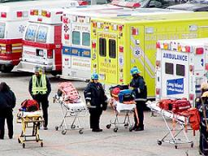
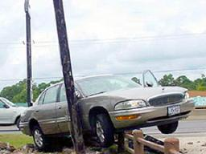
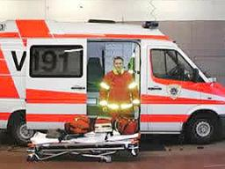
Incident Complexity and Resource Needs
Incident Complexity
Resource Needs
ICS Structure
Complexity
Notes:
Refer the participants to the visual. Note that as demonstrated in the lost child scenario, as complexity increases, resources must increase, requiring an organization with additional levels of supervision.

Slide 39
Complexity Analysis Factors
In your agency or jurisdiction, what factors may affect the complexity of an incident?
Notes:
Ask the participants to identify the factors that may affect the complexity of an incident. If not mentioned, add any of the following relevant factors:
Impacts to life, property, and the economy
Community and responder safety
Potential hazardous materials
Weather and other environmental influences
Likelihood of cascading events (events that trigger other events)
Potential crime scene (including terrorism)
Political sensitivity, external influences, and media relations
Area involved, jurisdictional boundaries
Availability of resources

Slide 40
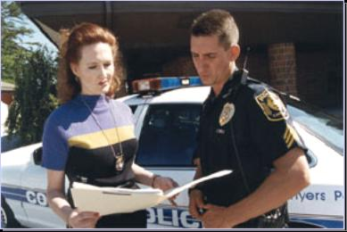
Management by Objectives
  ICS is managed by objectives.
  Objectives are communicated throughout the entire ICS organization.
Notes:
Tell the group that management by objectives is another key ICS feature. Emphasize these key points:
ICS is managed by objectives.
Objectives are communicated throughout the entire ICS organization.
Tell participants that the steps for establishing incident objectives include:
Step 1: Understand agency policy and direction.
Step 2: Assess incident situation.
Step 3: Establish incident objectives.
Step 4: Select appropriate strategy or strategies to achieve objectives.
Step 5: Perform tactical direction.
Step 6: Provide necessary followup.

Slide 41
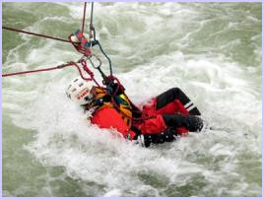
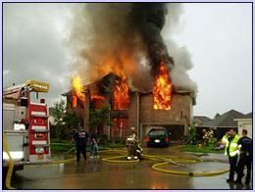
Overall Priorities
Initial decisions and
objectives are established
based on the following
priorities:
#1: Life Safety
#2: Incident Stabilization
#3: Property/Environmental
Conservation
Notes:
Explain that the Incident Commander develops incident objectives—the statement of what is to be accomplished on the incident. Not all incident objectives have the same importance.
Incident objectives can be prioritized using the following simple “LIP” mnemonic:
Life Safety: Objectives that deal with immediate threats to the safety of the public and responders are the first priority.
Incident Stabilization: Objectives that contain the incident to keep it from expanding and objectives that control the incident to eliminate or mitigate the cause are the second priority.
Property/Environmental Conservation: Objectives that deal with issues of protecting public and private property and the environment are the third priority.
Explain that incident objectives are not necessarily completed in sequence determined by priority. It may be necessary to complete an objective related to incident stabilization before a life safety objective can be completed. Using the LIP mnemonic helps prioritize incident objectives. This device can also be used to prioritize multiple incidents, with those incidents with significant life safety issues being given a higher priority than those with lesser or no life safety issues.
Ask the participants for examples of each type of priority. Present examples based on your experience.

Slide 42
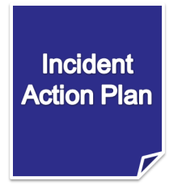
Reliance on an Incident Action Plan
The Incident Commander creates an Incident Action Plan (IAP) that:
  Specifies the incident objectives.
  States the activities to be completed.
  Covers a specified timeframe, called
  an operational period.
  May be oral or written—except
  for hazardous materials incidents,
  which require a written IAP.
  Takes into account legal and policy
  considerations and direction.
Notes:
Present the following key points:
Every incident, large or small, requires some form of an Incident Action Plan (IAP). For most incidents that are small, the IAP is developed by the Incident Commander and verbally passed on to subordinates and assigned resources.
The operational period is the period of time scheduled for completion of a given set of actions called for in the IAP. The length of the period is determined by the Incident Commander and may be as short as 1 hour or as long as 24 hours, or even multiple days.
As incidents grow in size or complexity and/or as other agencies and resources are added, it is important to document vital information pertaining to the plan of action for the incident.
On large incidents, preparation of a written IAP is accomplished within the Planning Section. The Incident Commander establishes the objectives and strategy, based on needs of the incident and policy and guidance from the Executive/Senior Official.
The Incident Commander will hold a planning meeting involving, at a minimum, the General and Command Staffs. The planning meeting is key to developing an effective Incident Action Plan.
Note that an IAP covers an operational period and includes:
What must be done.
Who is responsible.
How information will be communicated.
What should be done if someone is injured.

Slide 43
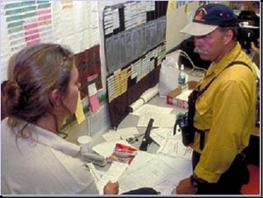
Resource Management
Resource management includes processes for:
  Categorizing resources.
  Ordering resources.
  Dispatching resources.
  Tracking resources.
  Recovering resources.
It also includes processes for reimbursement for resources, as appropriate.
Notes:
Explain that in ICS, resources are defined as personnel, teams, equipment, supplies, and facilities. Explain that ICS identifies resources as tactical or support resources. Provide the following definitions:
Tactical Resources: Personnel and major items of equipment used in the operation.
Support Resources: All other resources required to support the incident (e.g., food, communications equipment, supplies).
Present the following key points:
Resources at an incident must be managed effectively. Maintaining an accurate and up-to-date picture of resource utilization is a critical component of incident management.
Resource management includes processes for:
Categorizing resources.
Ordering resources.
Dispatching resources.
Tracking resources. Resources are tracked as follows:
Assigned - Currently working on an assignment under the direction of a supervisor
Available - Ready for immediate assignment and has been issued all required equipment
Out of Service - Not available or ready to be assigned (e.g., maintenance issues, rest periods)
Recovering resources.
Point out that resource management also includes processes for reimbursement for resources, as appropriate.

Slide 44
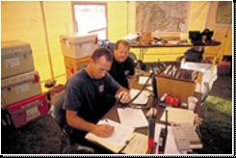
Integrated Communications
Incident communications are facilitated through:
  The development and use of a common communications plan.
  The interoperability of communication equipment, procedures, and systems.
Before an incident, it is critical to
develop an integrated voice and data communications system (equipment, systems, and protocols).
Notes:
Explain to the group that another important feature of ICS is the use of integrated communications.
Summarize the following key points:
Effective emergency management and incident response activities rely upon flexible communications and information systems that provide a common operating picture to emergency management/response personnel and their affiliated organizations.
Establishing and maintaining a common operating picture and ensuring accessibility and interoperability are the principal goals of the Communications and Information Management component of NIMS.
Properly planned, established, and utilized communications enable the dissemination of information among and between command and support elements and, as appropriate, cooperating agencies and organizations.
Explain that incident communications are facilitated through the development and use of common communications plans and interoperable communications equipment, processes, standards, and architectures. This integrated approach links the operational and support units of the various organizations involved during an incident, which is necessary to maintain communications connectivity and situational awareness. Planning for communications and information management must address the incident-related policies and equipment, systems, standards, and training necessary to achieve integrated communications.

Slide 45
Interoperability Saves Lives
Jan. 13, 1982: 70 people lost their lives when Air Florida Flight 90 crashed in Washington, DC. Police, fire, and EMS crews responded quickly but couldn't coordinate their efforts because they couldn't talk to each other by radio.
Sept. 11, 2001: When American Airlines Flight 77 crashed into the Pentagon, 900 users from 50 different agencies were able to communicate with one another. Response agencies had learned an invaluable lesson from the Air Florida tragedy.
Interoperability makes sense. It's a cost-saver,
a resource-saver, and a lifesaver.
Notes:
Review the following incidents in order to point out the importance of interoperability:
January 13, 1982: Air Florida Flight 90 crashed into the 14th Street Bridge in Washington, DC, during a snowstorm. More than 70 people lost their lives. Police, fire, and EMS crews responded quickly to the scene but discovered that they couldn't coordinate their efforts because they couldn't talk to each other by radio.
September 11, 2001: When American Airlines Flight 77 crashed into the Pentagon, 900 users from 50 different agencies were able to communicate with one another. Response agencies had learned an invaluable lesson from the Air Florida tragedy. Washington-area agencies had instituted a formal Incident Command System for large emergencies before the attack, so the chain of command was clear.
The Public Safety Wireless Network Program, a joint effort sponsored by the U.S. Departments of Justice and the Treasury, issued a report titled, “Answering the Call: Communications Lessons Learned from the Pentagon Attack.” The report noted that:
“During the initial response, the majority of local public safety responders experienced no difficulty in establishing interoperable communications on the scene. This was because of the high level of regional coordination and agreements previously established. However, as the number of State and Federal agencies (secondary responders) increased at the site, interoperability presented new challenges. No means of direct interoperability was immediately available to these secondary response agencies.”

Slide 46
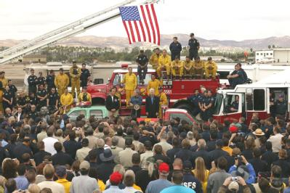
Mobilization
At any incident:
  The situation must be assessed and the response planned.
  Managing resources safely and effectively is the most important consideration.
  Personnel and equipment
  should not be dispatched
  unless requested by the
  on-scene Incident Command.
Notes:
Point out that another key feature of ICS is the importance of managing resources to adjust to changing conditions.
Emphasize that at any incident:
The situation must be assessed and the response planned.
Managing resources safely and effectively is the most important consideration.
Personnel and equipment should not be dispatched unless requested by the on-scene Incident Command.
Ask the participants the following discussion question: What’s the issue with having personnel arrive at an incident without being requested or dispatched? If not mentioned by the participants, add the following points:
Uncontrolled and uncoordinated arrival of resources at emergencies causes significant accountability issues.
Self-dispatched or freelancing resources cause safety risks to responders, civilians, and others who are operating within the parameters of the Incident Action Plan.
Chaos at the scene occurs, creating additional risks.
Emergency access routes can be blocked, preventing trained responders from gaining access to the site or not allowing critically injured personnel to be transported from the scene.
In the World Trade Center 9/11 response, many private and volunteer ambulance units self-dispatched, undermining command and control at the scene and clogging the streets so that other responders assigned to the WTC had difficulty getting through.
The bottom line is that when resources show up that have not been requested, the management of the incident can be compromised.

Slide 47
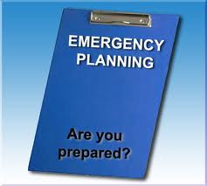
The Next Section
The next Section will deal with planning

