Slide 1
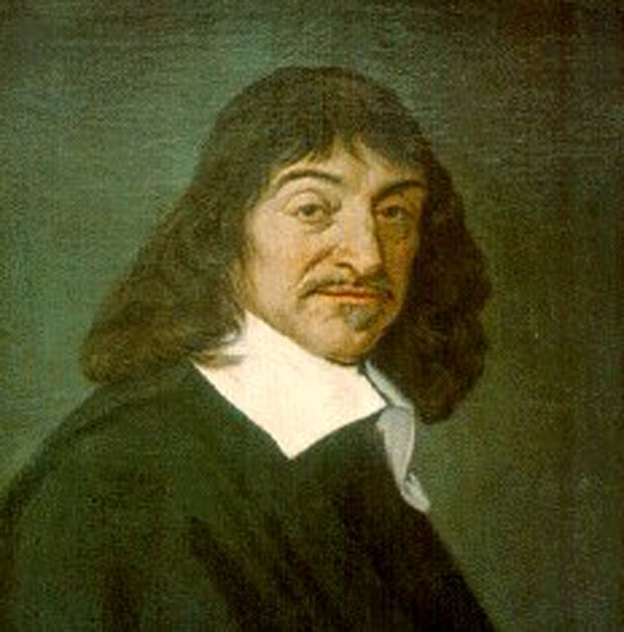
Rene Descartes
1596-1650
Father of Modern Philosophy
Meditations on First Philosophy

Slide 2
DUALISM
Metaphysically, the view that reality consists ultimately of two fundamentally different entities.

Slide 3
Cartesian Dualism
Material Body
Extended substance in space
Immaterial Mind
Unextended substance that thinks

Slide 4
Descartes Two Universal Substances
Physical
Mind (Mental/Soul)

Slide 5
“I think; therefore, I am.”
“This ‘I’—that is, the soul, by which I am what I am, is entirely distinct from the body; and would not fail to be what it is even if the body did not exist.”

Slide 6
“I think; therefore, I am.”
He equated the soul with the thinking mind. It is the continuity of the thinking mind or soul that makes a person endure as the same person over time.

Slide 7
So…
Essential property of body is that it is “extended.” (Geometric qualities: size, shape, etc.)
Essential property of mind is that it thinks.

Slide 8
Isn’t Dualism Obvious?
Most people accept dualism as the answer to the mind-body problem.

Slide 9
Arguments for Dualism
Don’t the major world religions posit a non-material soul that survives the physical demise of the body?

Slide 10
Christianity: Matthew 10:28
“Do not be afraid of those who kill the body but cannot kill the soul.”

Slide 11
Arguments for Dualism
With our mind we feel hope, fear, love, hate, disgust, shame, pride, and amusement (consciousness).
For our bodies, we diet, lift weight, and adorn them with jewelry and make-up.

Slide 12
Arguments for Dualism
When our bodies weaken, don’t our minds still stay strong?
E.g., Stephen Hawking (Amyotrophic Lateral Sclerosis)

Slide 13
Arguments for Dualism
And can’t the mind deteriorate while the body remains vigorous?
E.g., Alzheimer’s

Slide 14
Arguments for Dualism
Don’t these differences imply that the mind and body are distinct entities?

Slide 15
Modern Western Viewpoint
We as humans consist of two entities. Our physical selves and our mind/souls/consciousness.
We are composed of material and immaterial ‘stuff.’
And these two interact…..

Slide 16
THE MIND-BODY PROBLEM

Slide 17
Interactionism
1. You hit your thumb with a hammer. Physical event
2. Which Causes Pain. Mental event
3. You Scream! Physical event

Slide 18
Problem
How can something material affect anything that immaterial?
Or Vice-Versa…
How can anything immaterial affect anything that is material?

Slide 19
Example
“Most people regard with suspicion a claim that a nonphysical mind has moved some dice or a table. They should regard with equal suspicion a claim that a nonphysical mind has moved an arm or a toe.”

Slide 20
Problems of Dualism
(1) How can something like the mind reach into the physical world and affect it? If it did so, then the mind would somehow have to introduce new energy and force into the physical world.

Slide 21
Problems of Dualism
(2) Dualism cannot account for why mental functioning is substandard when the physical brain is damaged.

Slide 22
Problems of Dualism
For if it is the non-physical soul that thinks, why can’t it think just as well in a damaged brain as in an undamaged brain?
After all, the soul is supposed to be able to think without any brain at all.

Slide 23
Problems of Dualism
Dualism cannot account for why mental functioning develops *ontogenetically right along with the physical development of the brain and nervous system.
*based on morphological characteristics

Slide 24
Problems of Dualism
There are degrees of mental development, and they appear to correlate with degrees of physical brain development.
Fetuses, babies, toddlers, adults

Slide 25
Problems of Dualism
Dualism cannot explain why mental capacities apparently developed *phylogenetically in tandem with brain development.
*Evolutionary history of an organism. Based on natural evolutionary relationships.

Slide 26
Problems of Dualism
That is, dualism cannot account for why the best-thinking souls have always inhabited the most highly evolved brains.
Neanderthals, homo erectus, homo sapiens sapiens

Slide 27
Problems of Dualism
(5) Dualism cannot account for why we can sometimes change our mental functioning by altering our brain chemistry.
E.g., Prozac or Zoloft alleviates depression by inhibiting the brain’s reuptake of the neurotransmitter serotonin.
(End)

