Slide 1
Spirituality and Work Module 9: Respectful Pluralism
RELS 2330.1
Instructor: David Sable
david.sable@smu.ca

Slide 2
Objectives
Review dangers and problems associated with the idea of spirituality in the workplace
Introduce a framework for respectful pluralism
Explore how such ideals could really work

Slide 3
Dangers of Introducing Spiritual Values
Intentionally using spirituality as propaganda for the company (intentional deception)
Unintentionally using spirituality as propaganda for the company (self-deception, leaders genuinely believe they are doing the right thing and cannot see negative consequences).
Notes:
Sometimes leaders misuse spiritual values intentionally – they may only want to change public perception of their organization. Or they may justify giving false hopes to employees just to improve productivity and never follow through on their promises. Such leaders may have only a superficial understanding of what spirituality can mean or they may have selfish motives. Many examples have been revealed in the news media over the past 20 years. Enron, the Texas-based power company; Worldcom, the telecommunications company; and BP, the petroleum company, come to mind because there were criminal arrests and public humiliation connected with their actions. Yet in each case their mission statements and annual reports expressed goals and principles that could have fit with our consensus definition of spirituality in the workplace. It appears the leaders in these companies were using intentional deception.
However, sometimes the leaders actually begin with good intentions, but for various reasons their intentions go awry. Self-deception is probably the most common problem for leaders who really believe they are doing something beneficial, but have not looked carefully at the consequences for all the stakeholders or the public in general. Currently, it appears Facebook may be an example of this.
Tyson Foods, a major meat-packing company based in the U.S., is an example of a company that has promoted itself as a place where spirituality in the workplace is part of their mission. Tyson even received industry awards for their efforts. However, for several years the company was also reported in the news media for safety and human rights violations and cruelty to animals (Driscoll & Bell, 2010). It may be a case where the leaders promoted themselves as supporting spirituality in the workplace and perhaps unknowingly were causing harm to people and unnecessary suffering to animals.

Slide 4
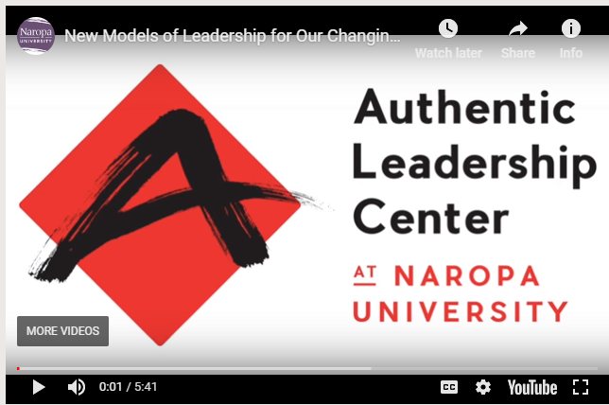
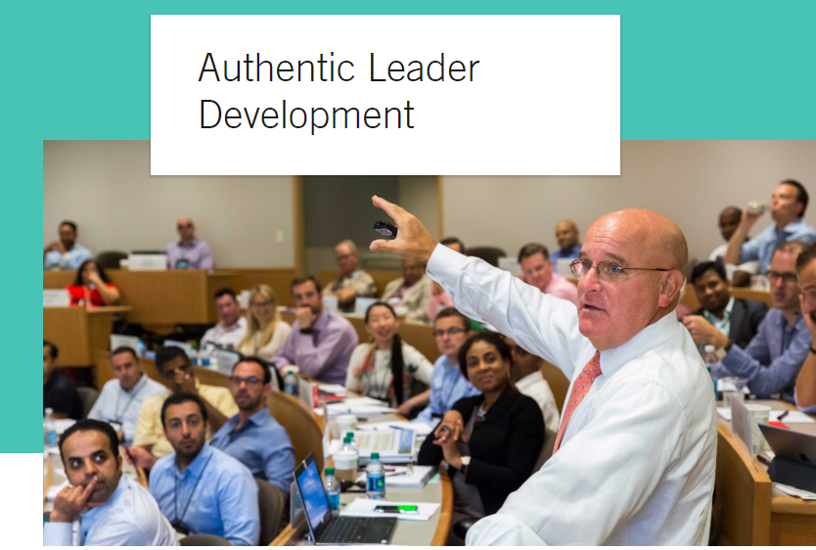
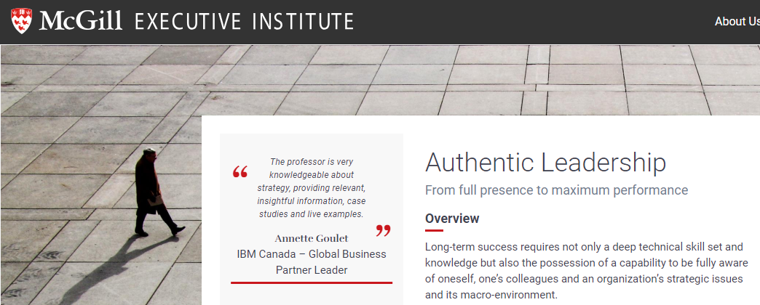
Review: Authentic Leadership
Notes:
As discussed previously, the challenge for leaders is to be authentic. One way to describe authentic leadership is being able to:
earn the trust of others involved with the project or task without deception;
Reflect on their own motivations and the consequences of their actions;
encourage creativity, communication, and responsibility amongst everyone involved with the task or problem;
see the situation clearly from multiple points of view, beyond just short-term views; and
“think outside the box” - "We can't solve problems by using the same kind of thinking we used when we created them." -- Albert Einstein
Use the presentation mode in PowerPoint and then click on the graphic links above to learn about programs on Authentic Leadership at Harvard and Naropa universities in the U.S. and McGillUniversity here in Canada. These programs are ways to explore how managers, leaders, and consultants are preparing to become authentic leaders, leaders who respect their workers, understand long-term consequences, and recognize that authentic leadership requires on-going self-evaluation and openness to creative thinking.

Slide 5
The Challenges of Diversity in the Workplace
The increasing diversity of the work force in terms of cultural backgrounds, religions, attitudes towards work, etc.
Different definitions of spirituality and spirituality in the workplace can make core spiritual values unclear.
Notes:
Even with training in how to be an authentic leader there will be many difficult challenges, in part because the international workforce has so much diversity. An example of a policy that works against diversity was adopted by the Riverview Community Bank in the U.S. (Review the article from Module 8 on our Brightspace web site, by Russel Shorto, “Faith at Work” [NY Times Sunday Magazine October 31, 2004]. This article shows how an employer legally evades issues of pluralism in the workplace (multiple ethnic, social, and religious groups working together) by only hiring people with the same beliefs. This kind of hiring practice is still common in many organizations around the world, not just in the United States. But there are policy frameworks that can help authentic leaders address the challenges of diversity and gain significant benefits. There is substantial evidence that diversity amongst decision-makers consistently improves outcomes compared to homogenous decision-makers (Surowiecki, (2005), The Wisdom of Crowds).

Slide 6
A Framework for Respectful Pluralism
What can reasonable people agree on?
all persons possess human dignity
all persons deserve equal respect
relations with employees and employers should be without deception or coercion
fair wages and fair working conditions are considered from a wide view of health and well-being (mental and physical)
All persons have freedom to express their spiritual identity at work
Reference: The Pluralism Project at Harvard University http://pluralism.org/about/our-work/mission/
Notes:
Douglas Hicks, a Harvard researcher, led a major study on pluralism in the workplace. Pluralism is another way to talk about diversity. His book, Religion and the Workplace (2003) had an important impact on major corporations and institutions because it provided realistic policy guidelines. The reading assignment for this module is taken from that book. It offers a basic common ground that includes principles common to religious and spiritual values. We can recognize the similarity to what we have studied earlier from the Catholic teaching in the Compendium on the Social Doctrine of the Church. But these principles are not limited to the beliefs of any particular religion. The principles on this slide can be considered universal from many spiritual, social and cultural perspectives.
The web site on the slide supplements and updates the assigned reading.
http://pluralism.org/about/our-work/mission/

Slide 7
Respectful Pluralism – Presumption of Inclusion
The presumption of inclusion: to the greatest extent, organizations should allow employees to express their spirituality “subject to the limiting norms of
non-coercion,
non-degradation,
non-establishment,
in consideration of the reasonable instrumental demands of the for-profit enterprise.”
Hicks, 173
Notes:
Douglas Hicks (in the reading reference for this week) added three simple, clear principles to the concept of respectful pluralism:
Non-coercion: no one should use their position or proximity to power to impose their values on others or to subject them to unwanted invitations in ways that might violate their co-workers human dignity.
Non-degradation: no speech or symbols that show disrespect for other individuals or groups can be permitted.
Non-establishment: no organization should endorse one particular spiritual or religious worldview over another even if that worldview is considered “generic.”
Notice that the last statement in the slide acknowledges the need for the enterprise to make a profit. Thus, for example, giving employees time off from productive work tasks for personal reflection may necessarily be limited by the employer.
Hicks was practical and realistic. He understood that inclusivity and expression of spirituality should not interfere with reasonable demands of getting work done. Yet Hicks also recognized that allowing workers some time to themselves could benefit the employer as well as the individual.

