Slide 1
D-Day: Allied Invasion

Slide 2
D-Day Overview
Attack began on June 6th, 1944
Allies invaded France
Allies include U.S., Canada, Great Britain, Free French fighters
Established a beachhead as a part of Operation Overlord
Air assault, parachute landings, and an amphibious attack on the beaches in France

Slide 3
Why did the Allies strike back?
Germany had invaded France
Planned to take over all of Europe
Allied forces had been able to slow down the expansion of German troops
This was a good time to go on the offensive
D-Day (Operation Overlord) was their chance to strike back and retake France

Slide 4
Leading up to D-Day
Allied troops performed multiple practice runs of the invasion
Exercise Tiger was a practice invasion on April 28th, 1944
749 U.S. soldiers were killed from a surprise attack of German torpedo boats
The real invasion date had to be during a full moon and spring tide
Days leading up to June 6th experienced awful weather
German forces assumed the Allies would wait until conditions were more favorable
President Eisenhower decided on June 6th, although the forecast was still unsure

Slide 5
Operation Fortitude
Deception tactic used by Allies to fool Germany into thinking the attack was coming at a different location
Divided into two sub plans → North and South
Created fake field armies that threatened Norway (Fortitude North) and Pas de Calais (Fortitude South)
This plan successfully diverted Axis attention on Normandy, leaving those beaches more vulnerable to be attacked by the real Allied forces

Slide 6
June 6th Invasion
The night before June 6th, Allied paratroopers dropped into France behind the German forces on the beachfront
Thousands of dummy paratroopers were dropped to help protect the actual soldiers and attract attention
Set up position, seized roads and bridges, prepared for Allied troops to invade beaches and move inland
Amphibious Allied forces faced enemy fire from Germans who were in an advantageous position

Slide 7
U.S. Forces on French Beaches
Soldiers battled through 5 foot waves, rough seas, thrashing wind to get to the beach from the boats
Allied Air forces played a huge role in allowing amphibious forces to reach land by suppressing German forces
"The sea was very rough, and everybody got seasick and we were soaking wet, cold and miserable. It was June, but it felt like November, December. We were under fire all the way. When we got 200,300 yards from shore, we started taking artillery and mortars, and then as we got closer in the small arms opened up. And they cut us down pretty good. Some of the men couldn't swim, and we were carrying 60 pounds of equipment or weapons. It was a tough deal," said Staff Sergeant John Robert Slaughter, Company D, 116th Infantry, 29th Division, according to a journal called American History.

Slide 8
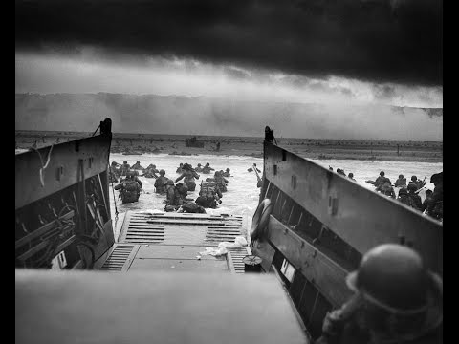
Notes:
https://www.youtube.com/watch?v=Abk0mhu4a-g play till 2:26

Slide 9
Beginning of the end
This attack by Allied forces began to drive the enemy out of France which weakened German power in Europe
By the end of D-Day, over 150,000 troops had landed in Normandy
Once they established position, they pushed inland which allowed more Allied troops to land on those beaches
By June 17th, over half a million Allied troops had arrived and all that support led to the Allies pushing the Germans out of France
Losing France really hurt Axis power
Less than a year later (May 7th, 1945), Germany surrendered unconditionally

Slide 10
Citations
https://www.dday.org/june-6-1944/
https://www.history.com/topics/world-war-ii/d-day
https://www.army.mil/d-day/
https://www.nationalww2museum.org/war/articles/d-day-allies-invade-europe
https://www.historyonthenet.com/d-day

