Slide 1
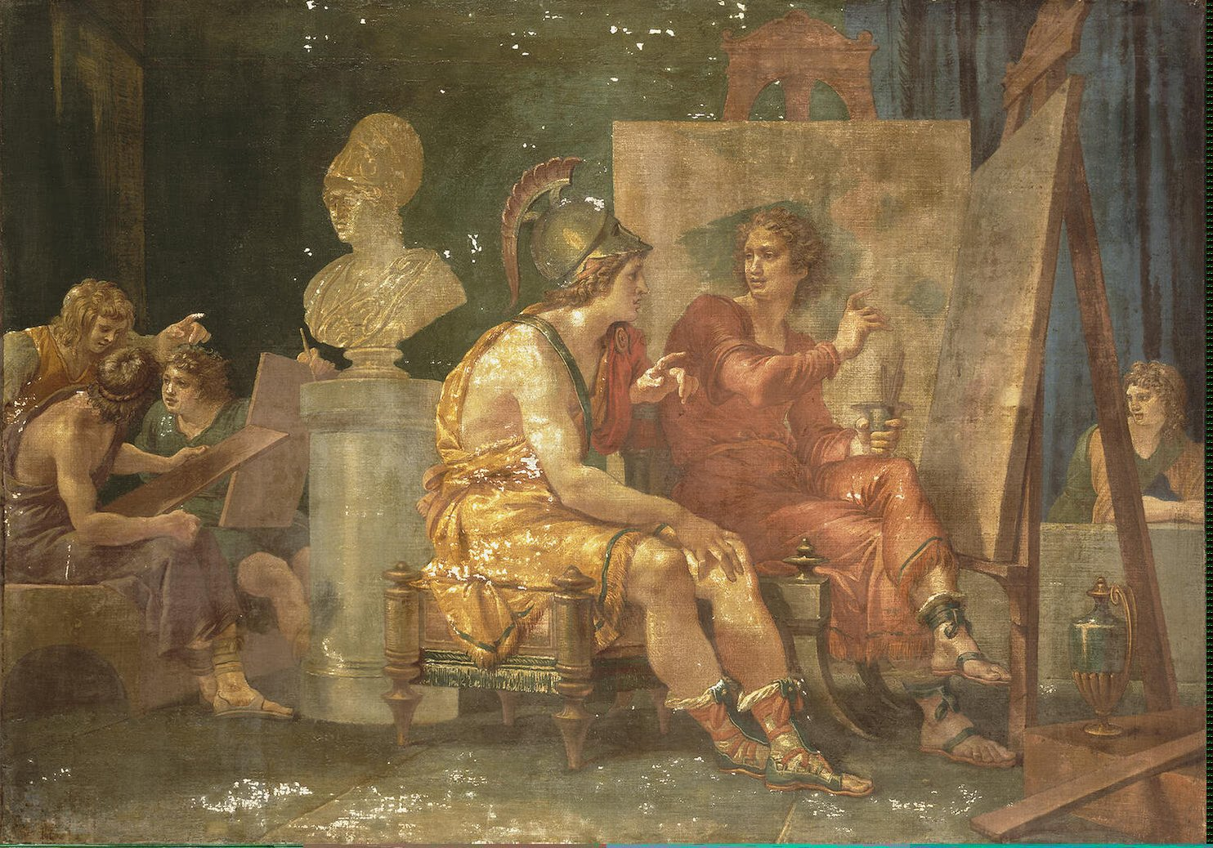
The Hellenistic World
Notes:
Cades_Giuseppe-ZZZ-Alexander_the_Great_in_the_Workshop_of_Apelles

Slide 2
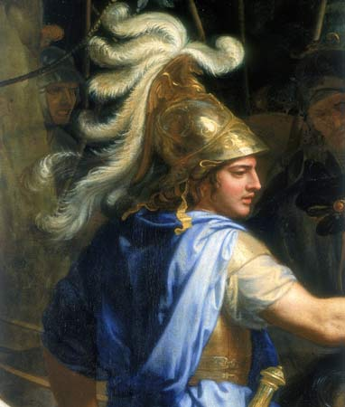
The Rise of Macedonia
Philip II (359 – 336 B.C.)
336BC assassination of Philip
Alexander (r. 336 - 323 B.C.)

Slide 3
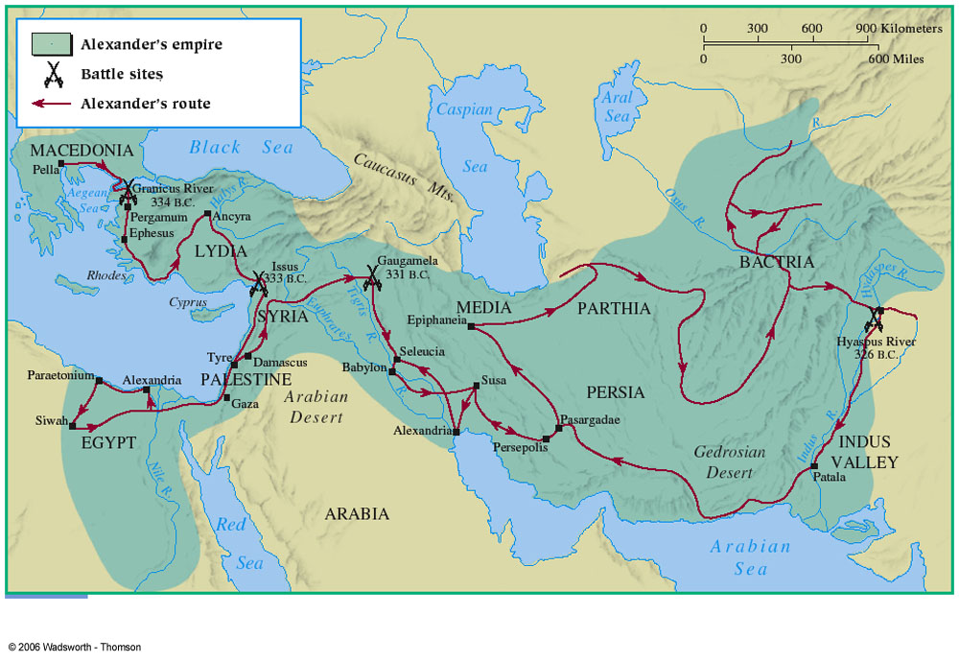

Slide 4
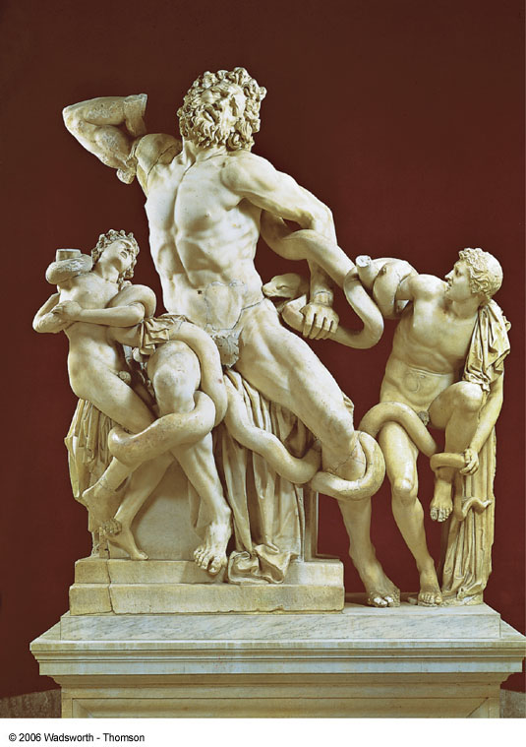
Hellenistic Age
Hellenistic Age (323-30BC)
Ends when Egypt fell to Rome

Slide 5
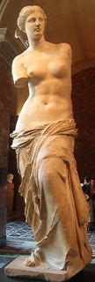
Characteristics of the Hellenistic Age
Heritage of classical Greece
Kingdoms and empires
(no longer city-states)
Cosmopolitism and Universalism

Slide 6
Three Hellenistic Kingdoms:
Macedonia (including Greek Peninsula)
Ptolemaic Egypt
Seleucid Empire

Slide 7
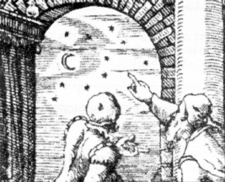
The Golden Age of Greek Science during Hellenistic Period:
A hybrid of Hellenic natural philosophy and the state-supported science of the East

Slide 8
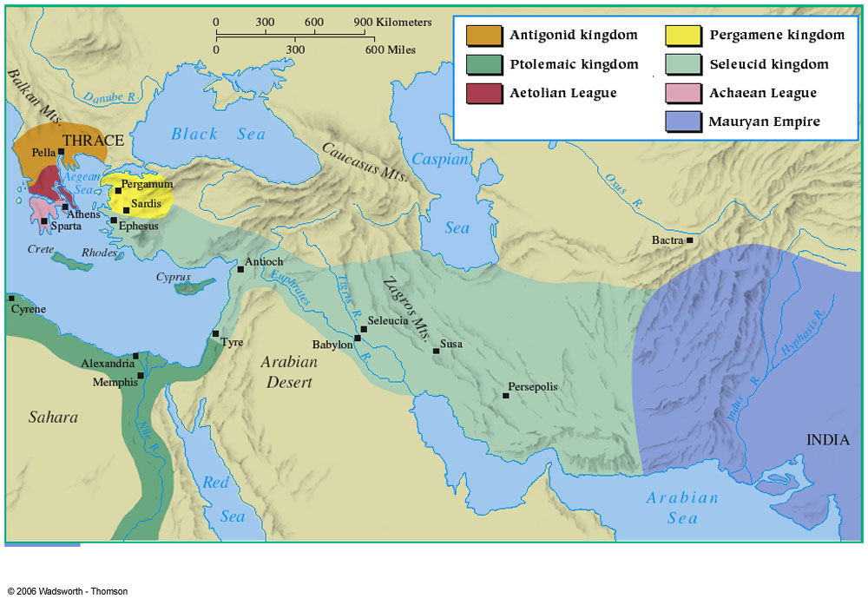

Slide 9
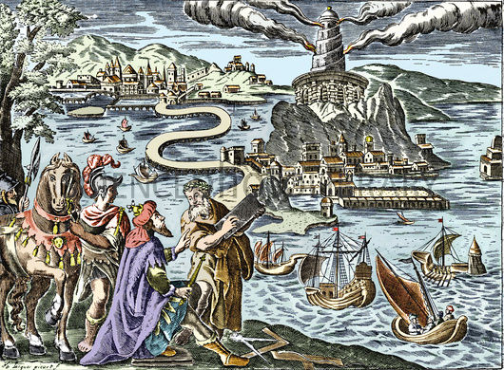
Ptolemaic Egypt:
Lighthouse at Alexandria
The Museum of Alexandria

Slide 10

Alexandria
most populous city of Mediterranean (~300,000)
Alexandrian Museum and Library
Greek and Egyptian
Cross-cultural
fertilization

Slide 11
Famous Scholars who studied at or were associated with the Museum:
Aristarchus (310–230 BCE): Heliocentric cosmos
Euclid (fl. 300 BCE): Geometry
Eratosthenes (fl. 225 BCE): circumference of Earth
Archimedes (287 – 212 BCE): Archimedean screw and Antikythera Mechanism
Hero (fl. 60 BCE): steam-driven toys
Galen (129 – c. 200 CE): medicine
Ptolemy (Second century CE): astronomy and geography

Slide 12
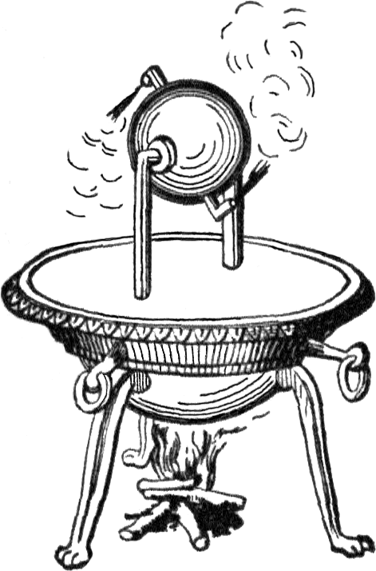
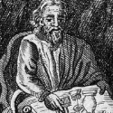
Hero of Alexandria
Hero’s steam engine

Slide 13
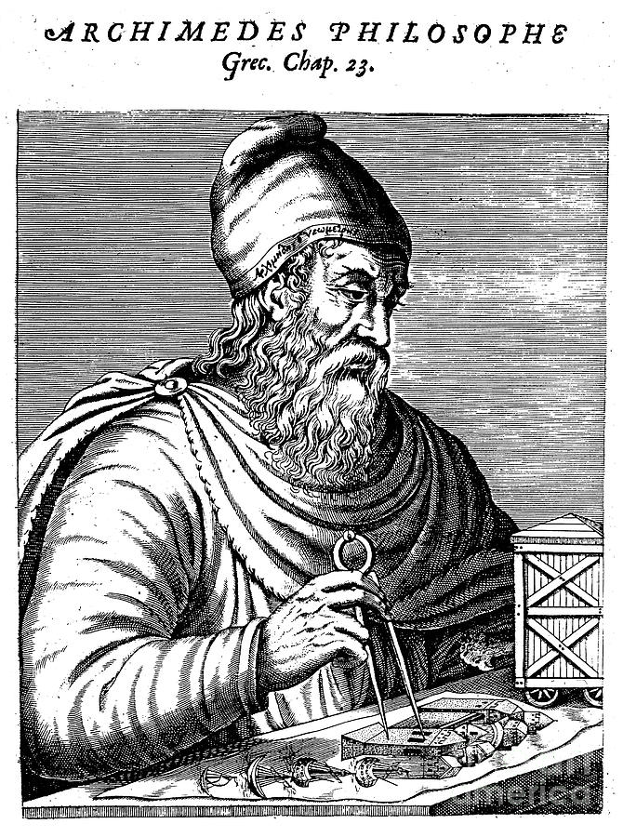
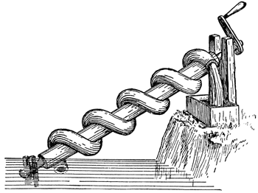
Archimedes (287 – 212 BCE)
Watch: Archimedean screw

Slide 14
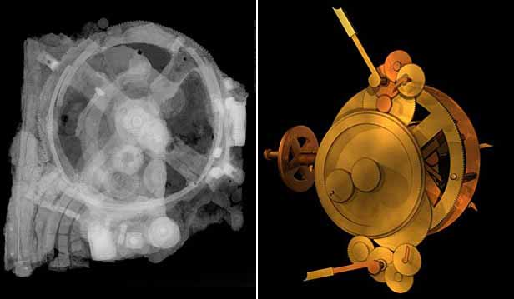
Greek Computer (Antikythera mechanism)
Watch Nova Documentary (see link on BB) and answer given questions on outline.

Slide 15
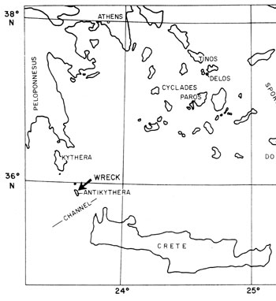
The island where the Antikythera mechanism was found.

Slide 16
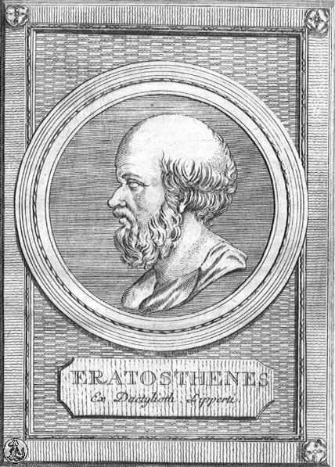
Eratosthenes (c. 275-194BC)
Alexandrian geographer
Divided planet into climatic zones
oceans are joined
Fairly accurate measure of earth’s circumference
24,675 miles
24,860 (actual)

Slide 17
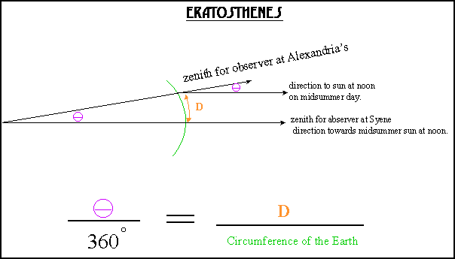
From: http://www.phys-astro.sonoma.edu/observatory/eratosthenes/

Slide 18
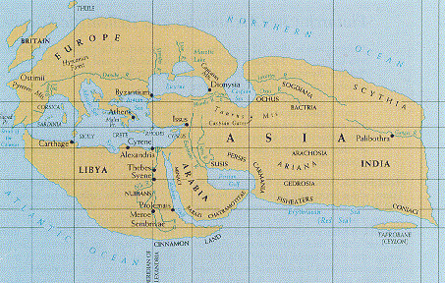
Map of World (Eratosthenes)

Slide 19
Why did ancient science decline in late antiquity?
Some claim that it declined because of a clear need for it.
Some claim that the rise of certain religious cults weakened its authority because they were anti-intellectual (Isis, Demeter, Mithraism, and Christianity).

