Slide 1
Evidence for the Proposed Study
Proposed Study: HIV/AIDS in gay/bisexual and men having sex with men

Slide 2
Theories Cited
Some of theories that have been cited in this studies include
Halve of the homosexuals find their sex partners through their mobile phones hence intervention can be provided through the mobile phones
Motivational messages delivered through the phone can encourage more gays to embrace HIV testing.
Electronic gaming is an acceptable means of delivering HIV prevention interventions to the target population between the age of 12-16 years

Slide 3
Common Theme
The common theme that can be gotten from these theories is the impact technology in offering HIV intervention among gay/homosexual

Slide 4
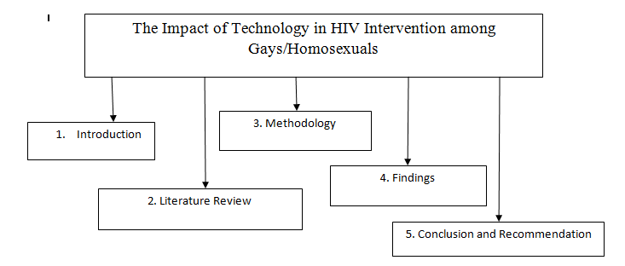
Conceptual Map

