Slide 1
The Era of Reconstruction
Chapter 15

Slide 2

Civil War Timeline
April 1861-April 1865
Andrew Johnson becomes President after Lincoln’s assassination
4-14-65

Slide 3
Two major issues
Subject of national debate
Issue #1
Issue #2

Slide 4
The South under Johnson’s Plan
States had to:
revoke secession ordinances
abolish slavery
ratify the 13th amendment
take an oath of allegiance to be granted amnesty

Slide 5
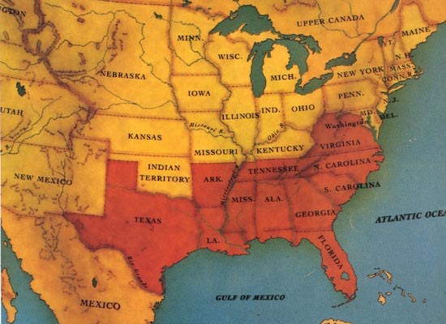
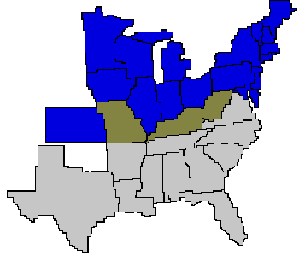
Southern states quickly enter the Union

Slide 6
New Congress December 1865
Many Southern representatives are the old leadership
Example Alexander Stephens elected as senator from Georgia

Slide 7
Life in South under Johnson’s Plan
Black Codes 1865 and early 1866
called virtual slavery by critics
Sharecropping and tenancy
by end of 1865 most confiscated land returned to original owners
20 % of blacks owned land but most sharecroppers

Slide 8
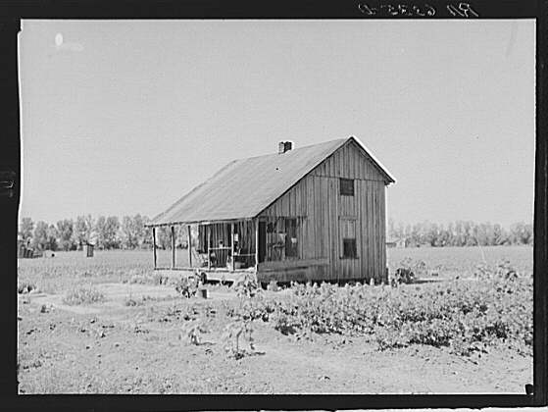
Why did Sharecropping grow?

Slide 9
Congressional reaction
Widened the scope of the Freedmen’s Bureau
Passed Civil Rights Act making ex slaves citizens
Johnson vetoed both but Congress overrode him

Slide 10
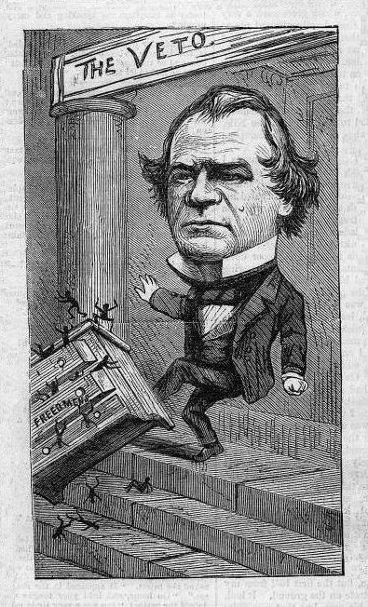
Johnson & veto of Freedmen’s Bureau Nast cartoon

Slide 11
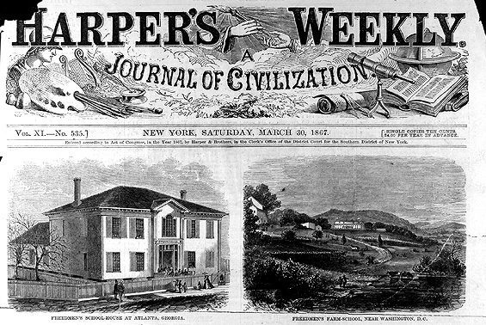
Freedmen’s Bureau
Freedmen’s Bureau schoolhouse Atlanta, Freedmen’s Bureau Farm Washington D.C.

Slide 12
Congress takes over 1867
Proposed 14th and 15th amendments
States had to ratify for readmission

Slide 13
14th and 15th amendments

Slide 14
South Redeemed
By 1876 old Democratic elite regained control
Why?
Intimidation to deny voting
KKK
Harassment of white sympathizers
Southern blacks lose support of Northern politicians

